Slide 1
Geog 375
Final Project
Spring 2011
Peter Mallen

Slide 2
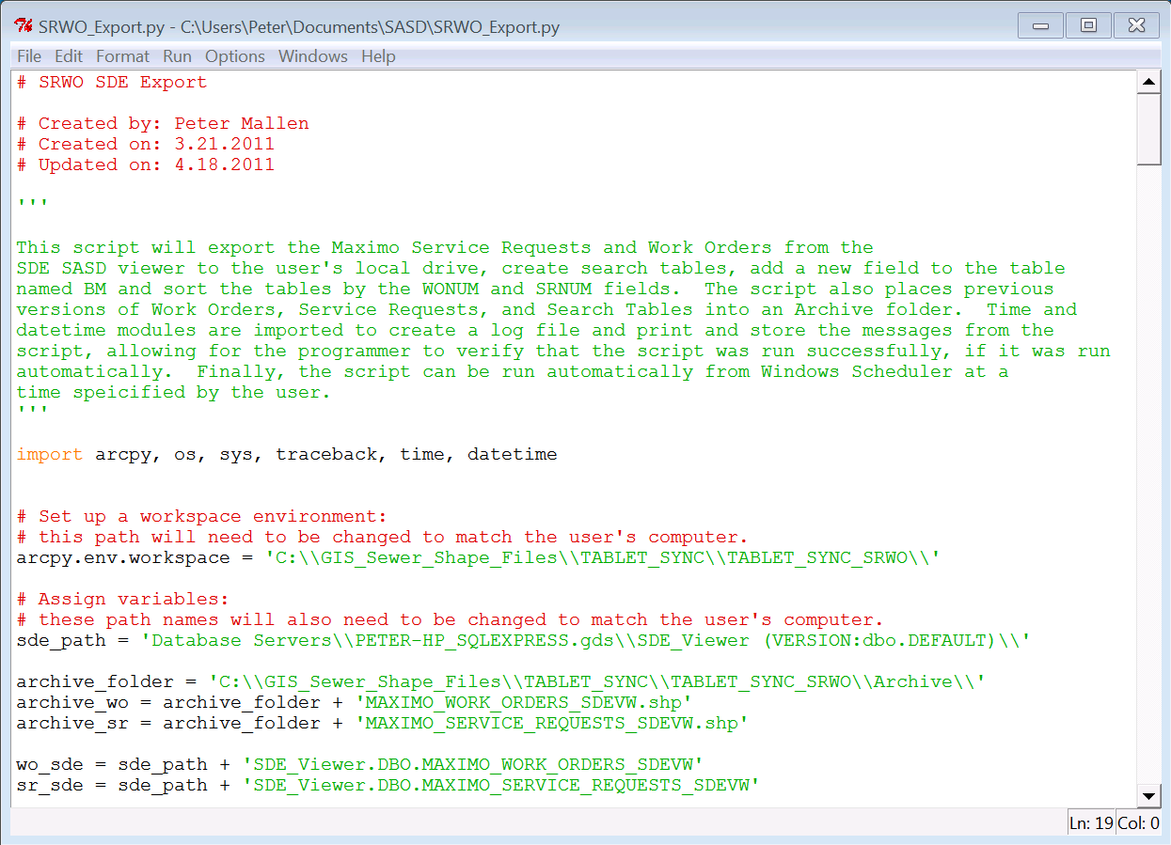
Outline of Script
Summary of Script
Title and Author Info
Import Modules
Setup Workspace Environment and Assign Data Path Variables

Slide 3
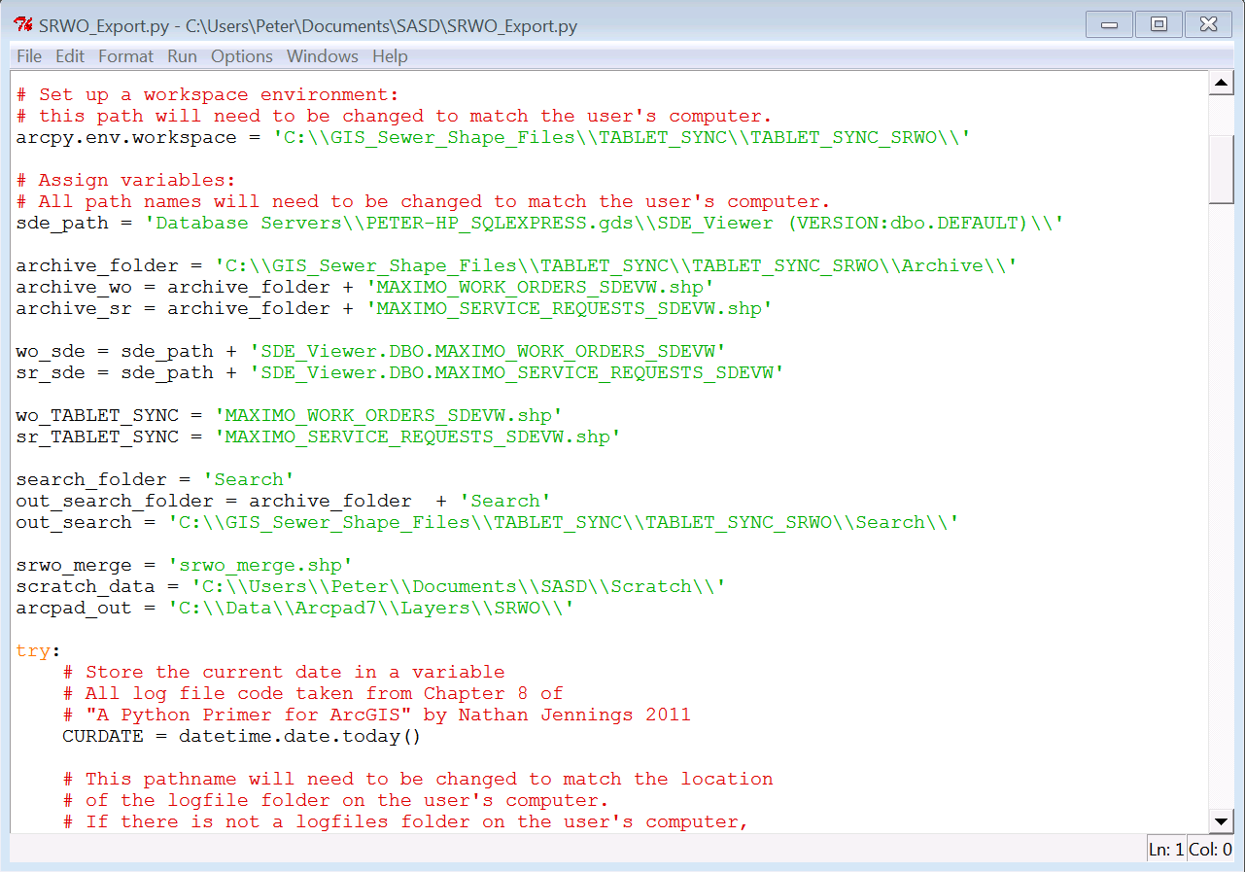
Setup Workspace Environment and Assign Data Path Variables

Slide 4
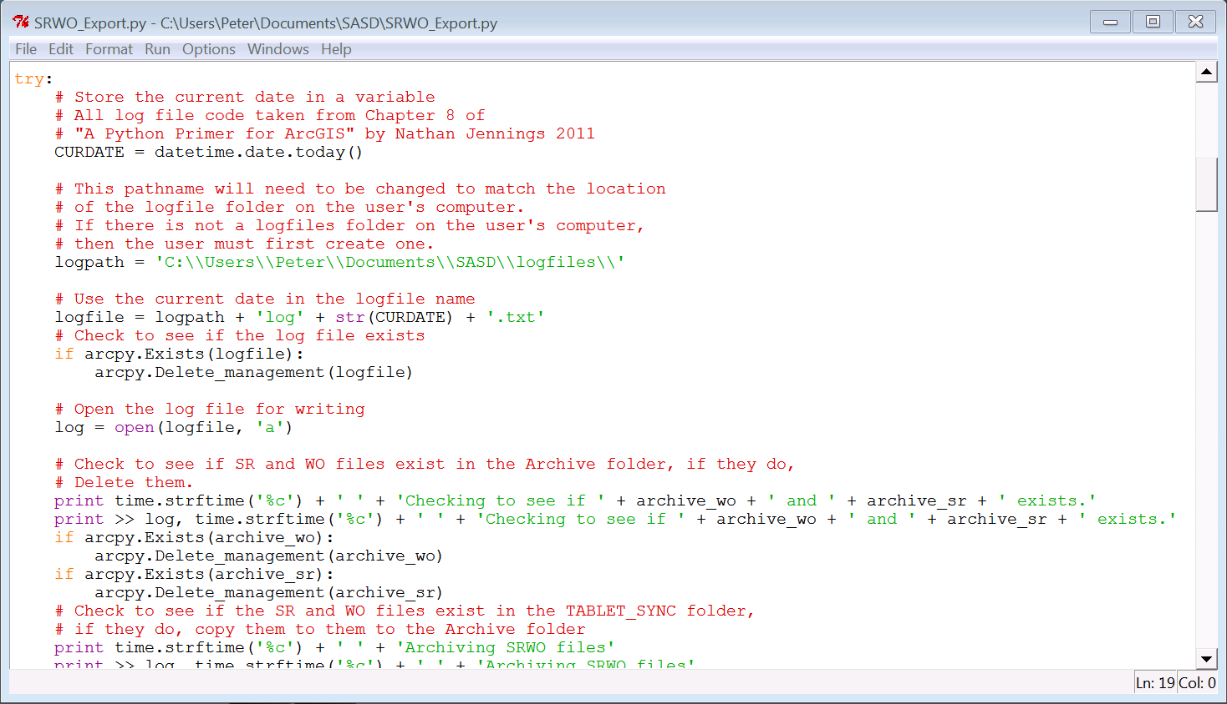
Add Error Handling Function
and Variable for the Current Date and Time
Assign a Variable to the Log File Location.
Assign a Variable to Hold the Name for the Log File.
Check for an Existing Log File of the Same Name, Delete It, and Open the Log File for Writing.

Slide 5
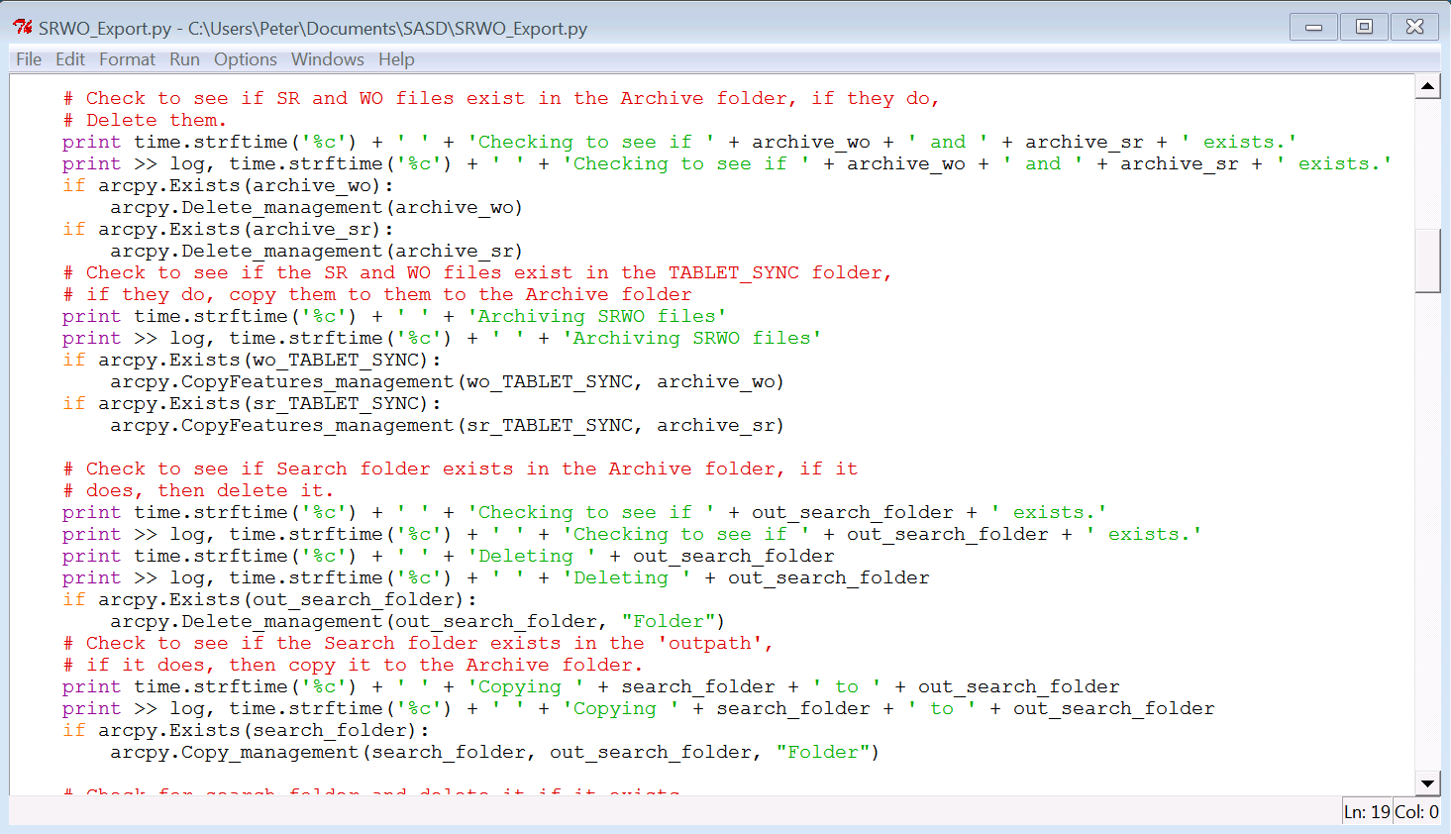
Check for Existing Service Request and Work Order Shapefiles in Archive Folder, Delete Them & Copy Current Shapefiles to Archive Folder
Check for Existing Search Folder in Archive Folder, Delete it
Check for Existing Search Folder in Workspace and Copy to Archive Folder

Slide 6
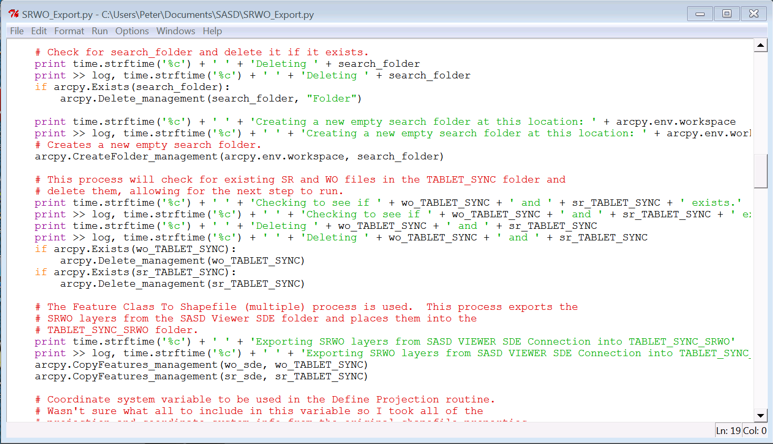
Check for Existing Search Folder in Workspace, Delete it, and Create a New Empty One
Check for Existing SR and WO Files in the Workspace and Delete Them
Copy SR and WO Feature Classes from the SDE Connection to the Workspace

Slide 7
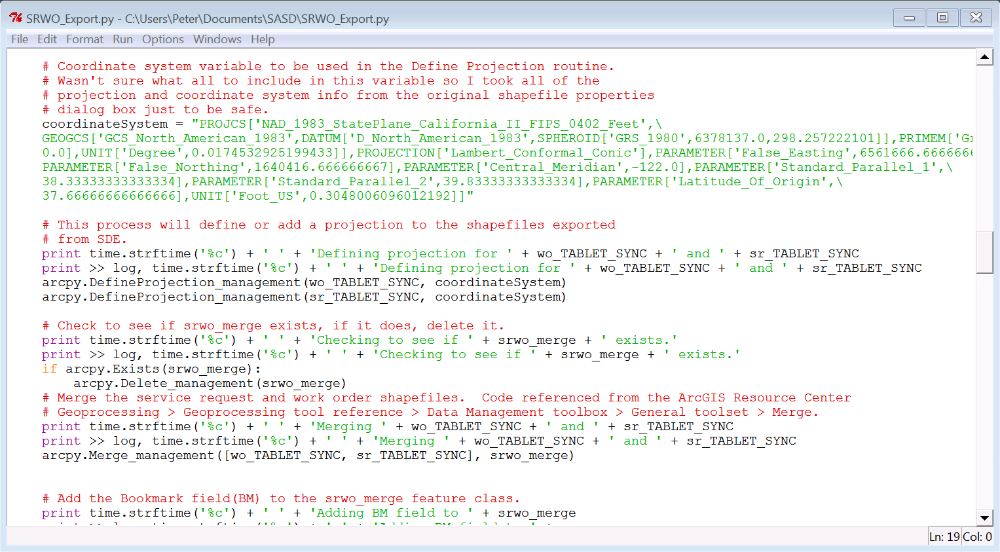
Assign a Variable to Hold the Correct Coordinate System
Define the Projection of the Shapefiles Exported from SDE
Check to See if the srwo_merge File Exists, if it Does, Delete it, and Merge the SR and WO Shapefiles

Slide 8
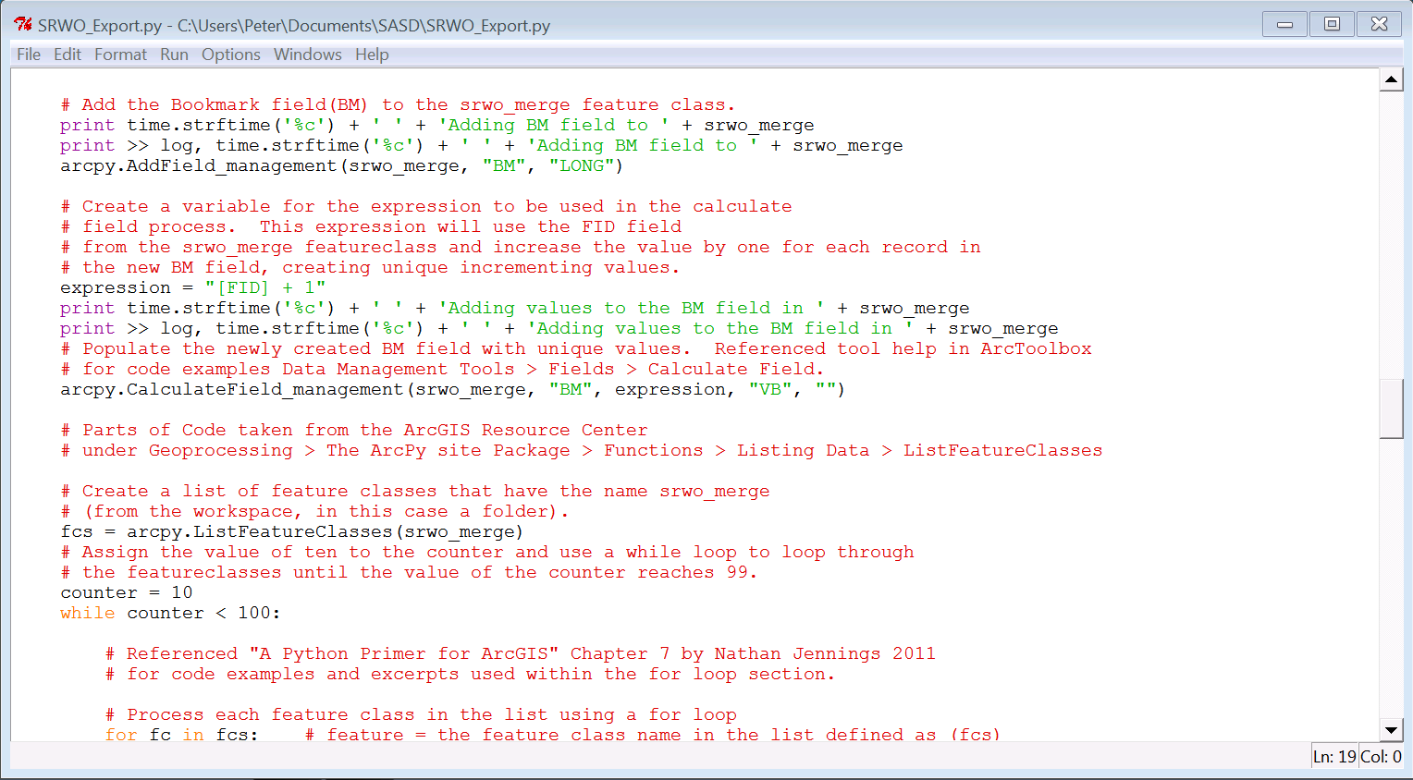
Use AddField Function to Add the BM Field.
Create a Variable to Hold the Calculate Field Expression and Add the CalculateField Function.
Create a List of Feature Classes

Slide 9
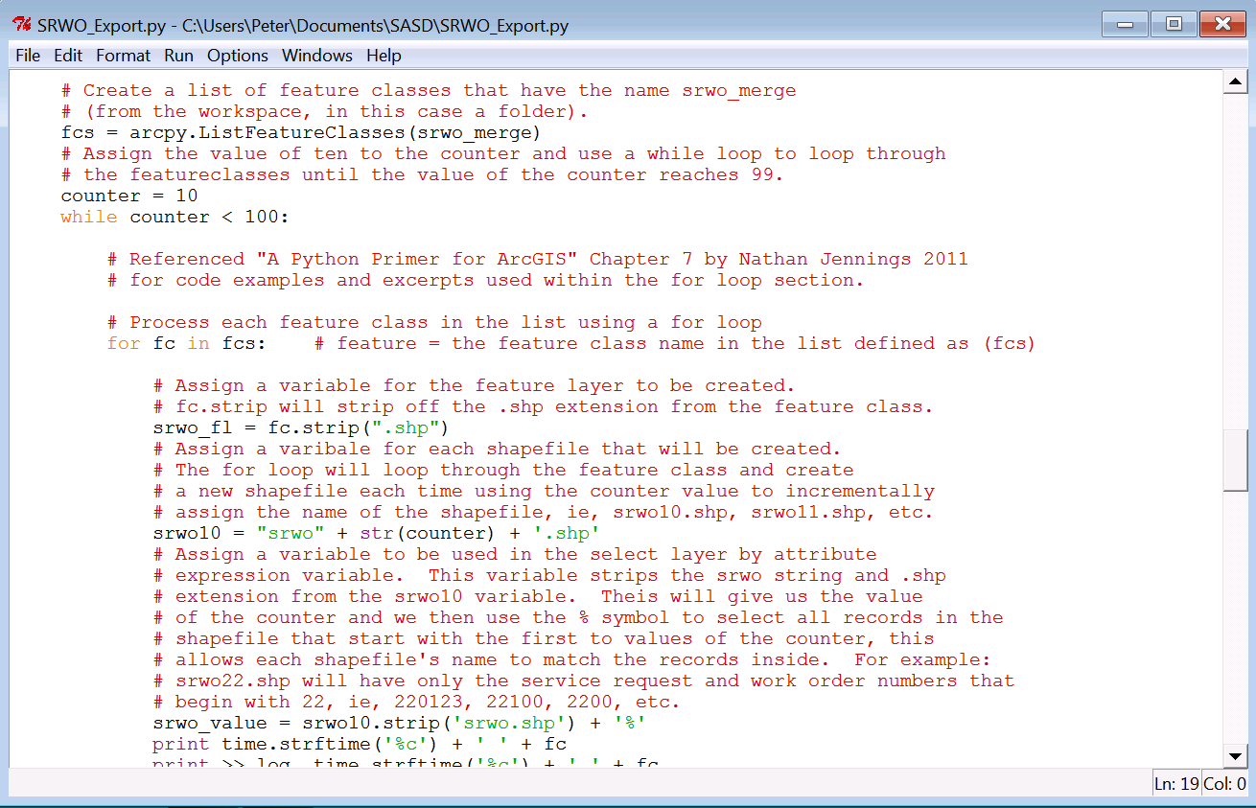
Assign a Value to the Counter and Use a While Loop to Loop Through the Feature Classes Using Counter
Use a For Loop to Process the Features in the Features List.
Assign a Variable for the Feature Layer and Assign the Variable for Each Shapefile that will be Created.

Slide 10
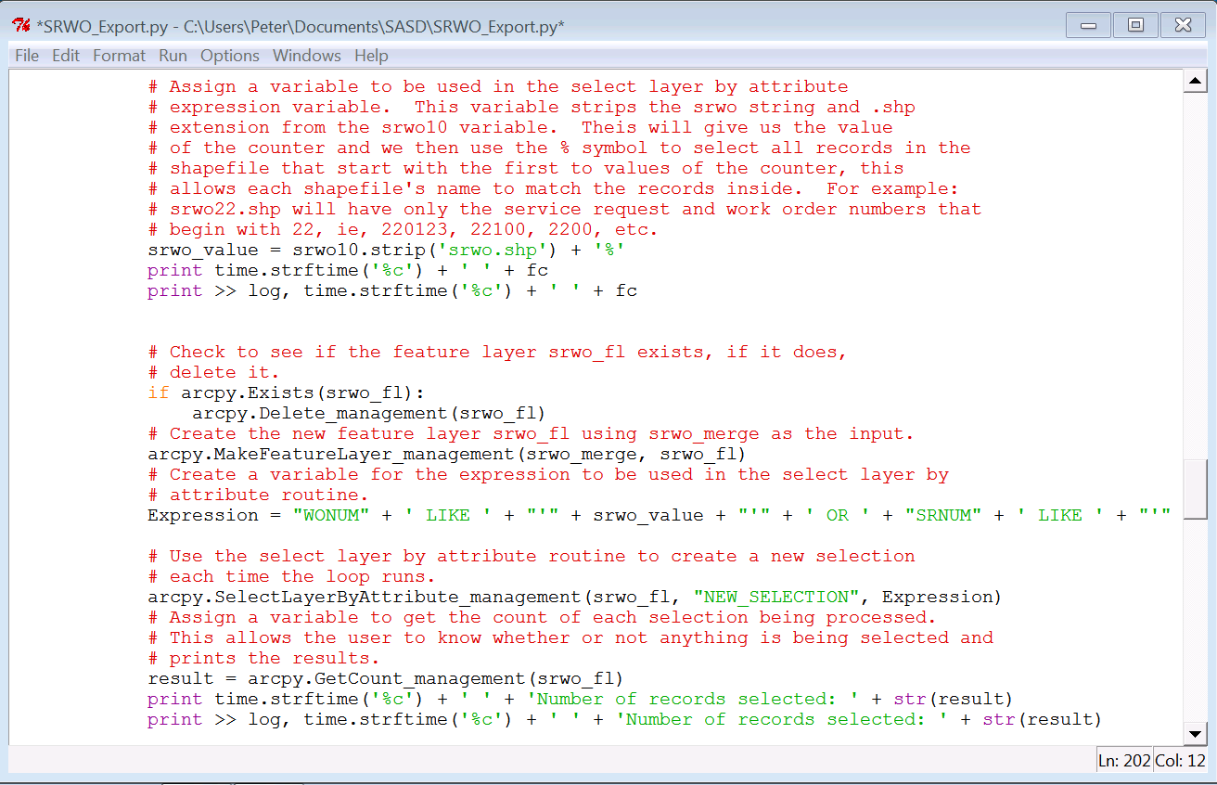
Variable to be Used in the SelectLayerByAttribute Routine
Check to See if Feature Layer Exists and Make a New Feature Layer
Variable for SelectLayerByAttribute Function
SelectLayerByAttribute Function
Variable for the GetCount Function

Slide 11
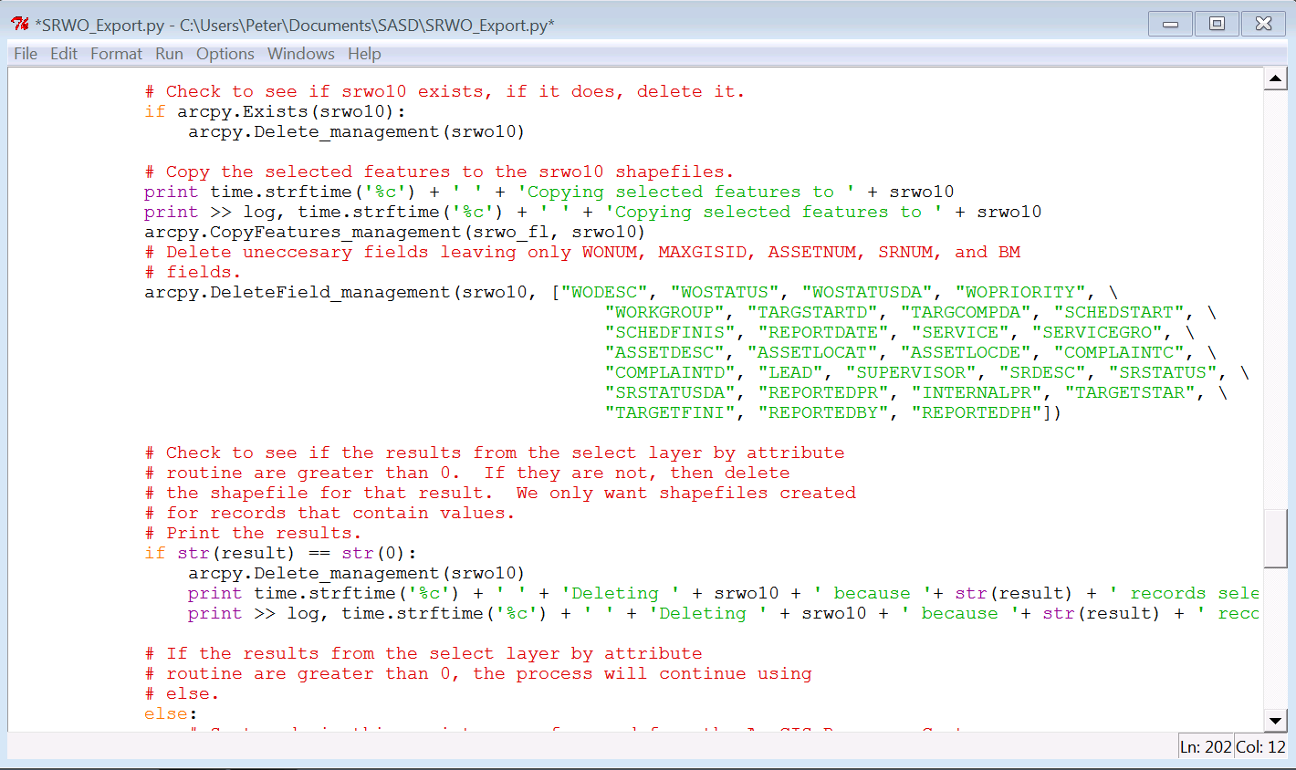
Check to See if the File Exists and Delete it.
Copy Selected Features to New Shapefiles and Delete Unnecessary Fields.
Check to See if Results are Greater Than 0, if They Aren’t, Then Delete the Shapefile.

Slide 12
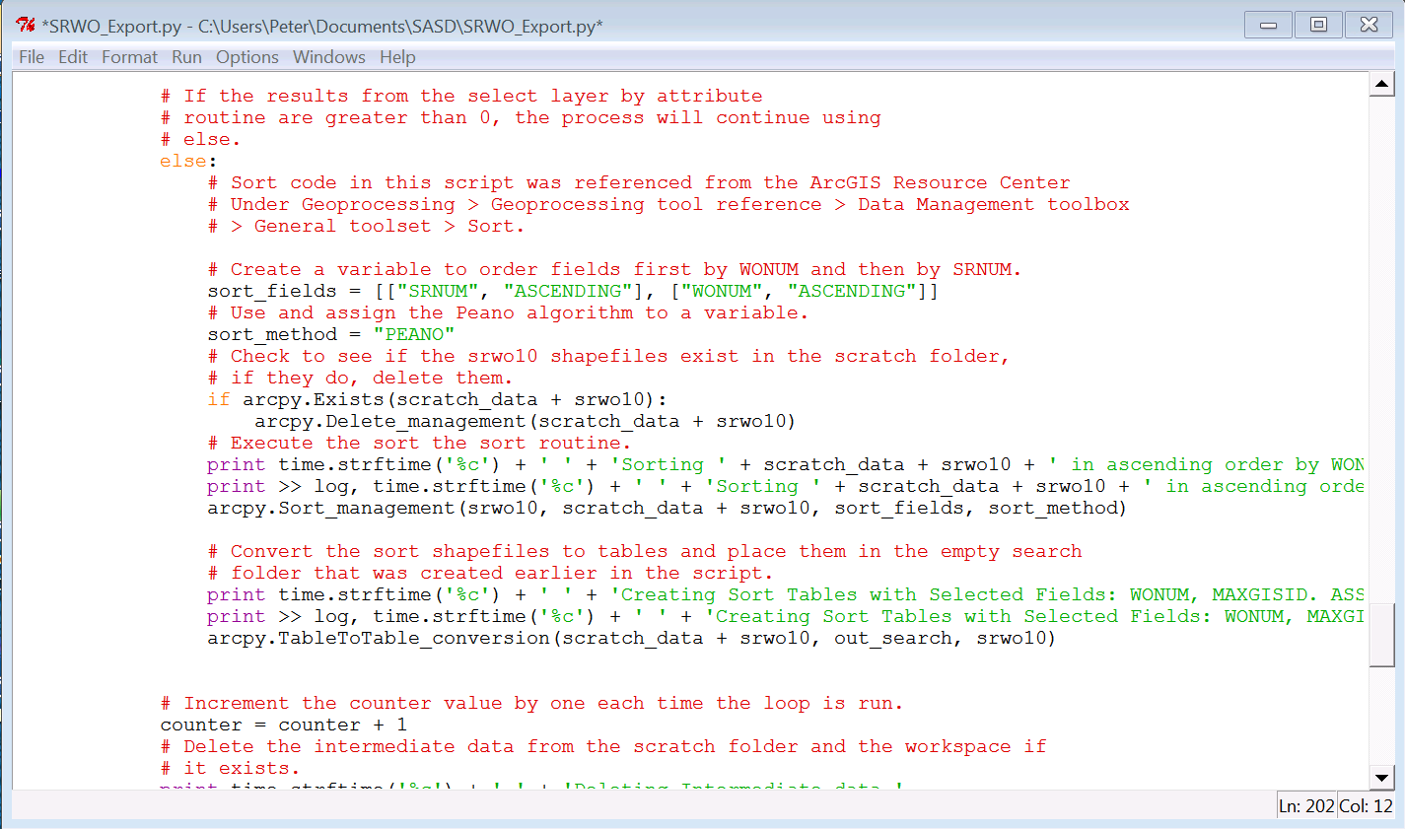
Else is Used if the Results are Greater Than 0.
Sort Variables are Assigned and the Sort Function is Used
TableToTable Function is Used to Create Non-Spatial Tables

Slide 13
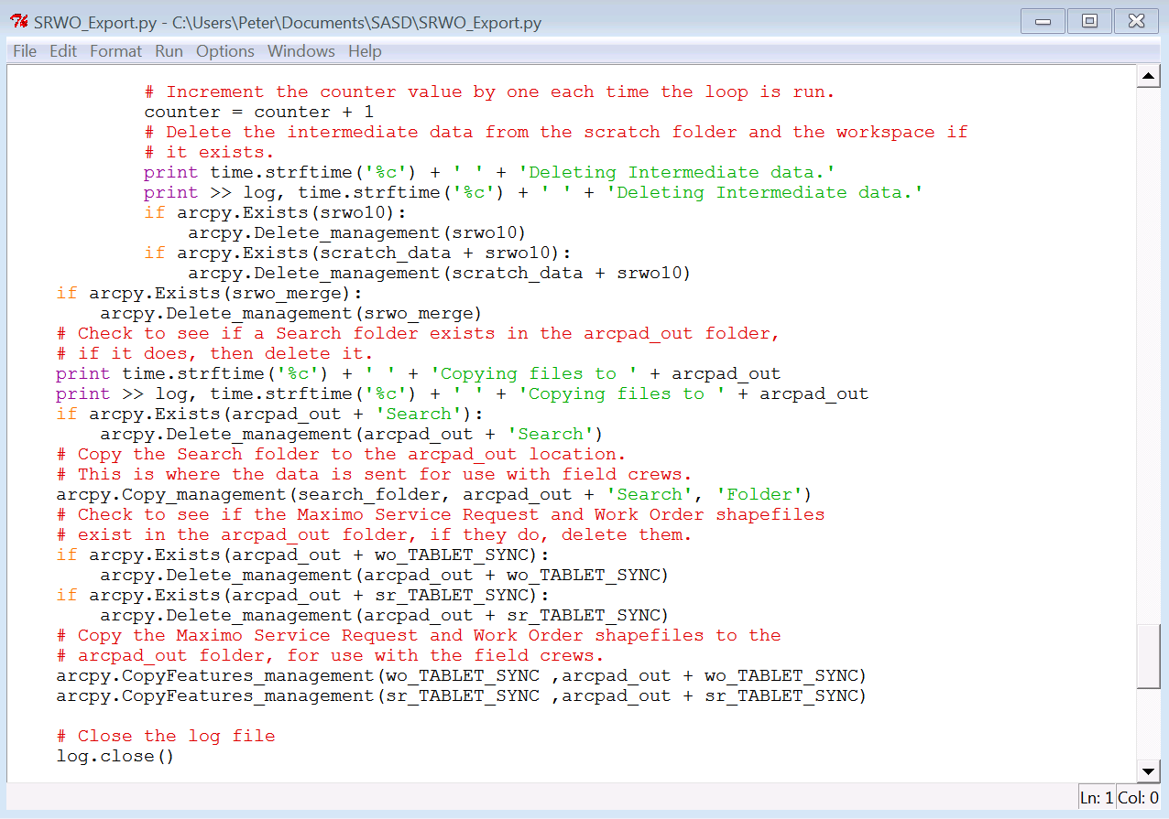
Counter Variable is Incremented by 1
Check for Intermediate Data and Delete
Check for Search Folder in ArcPad Folder, Delete it and Copy Updated One
Check for SR and WO Shapefiles in ArcPad Folder, Delete Them and Copy Updated Files

Slide 14
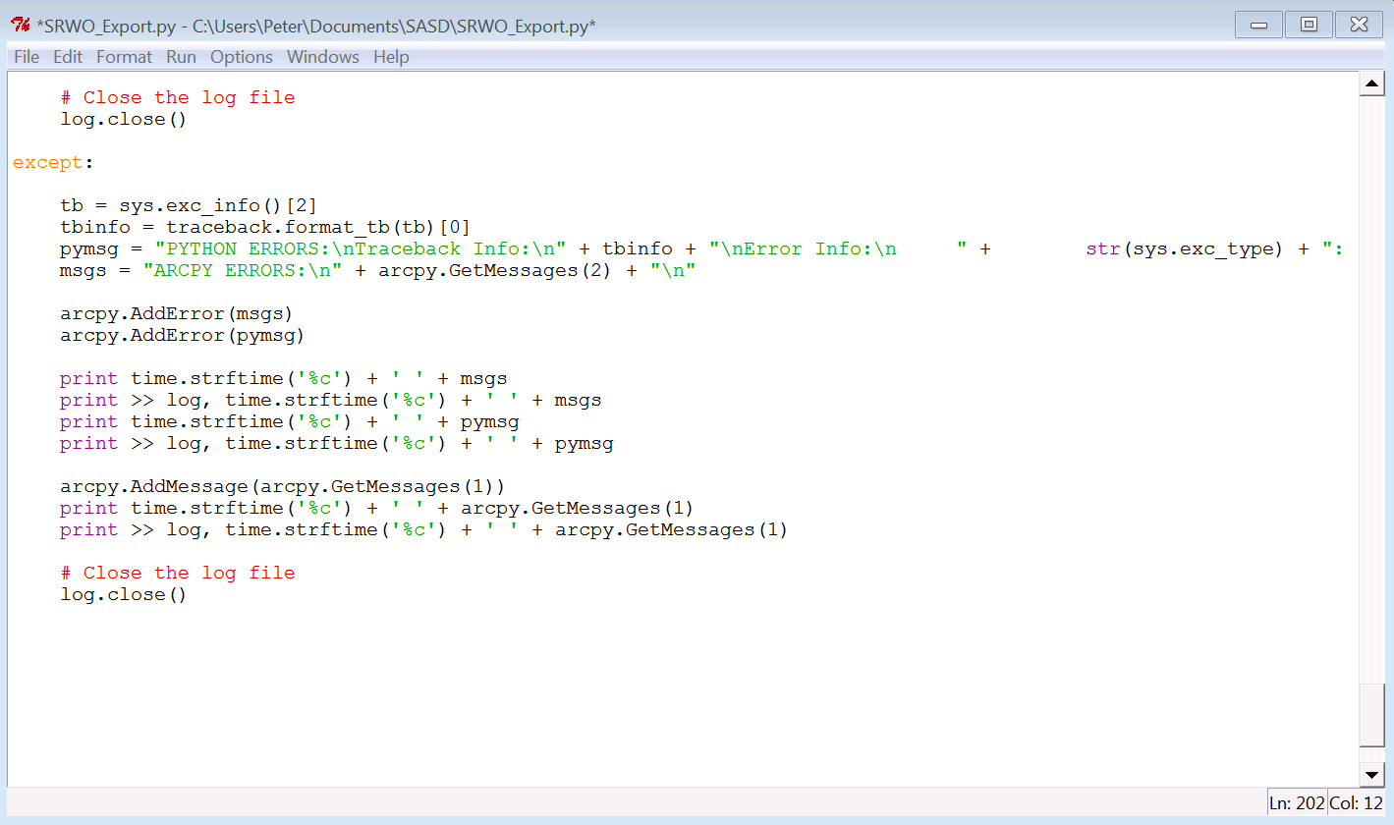
Close the Log File
Add the Except Block and Code for Error Handling
Log File Must Be Closed In Except Block Also

Slide 15
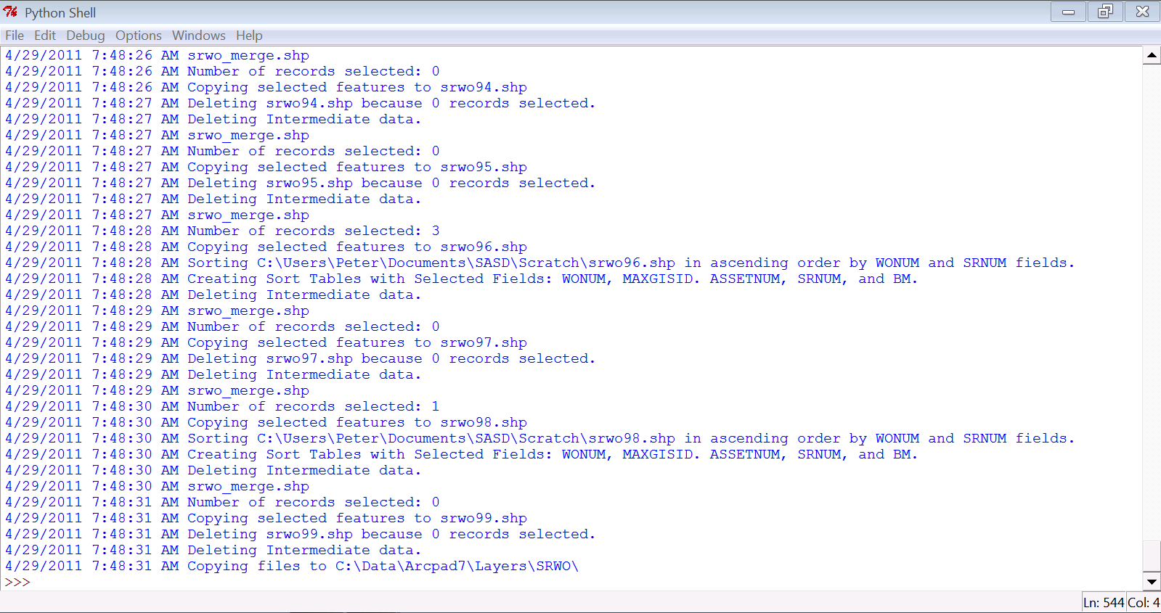
Python Shell Results

Slide 16
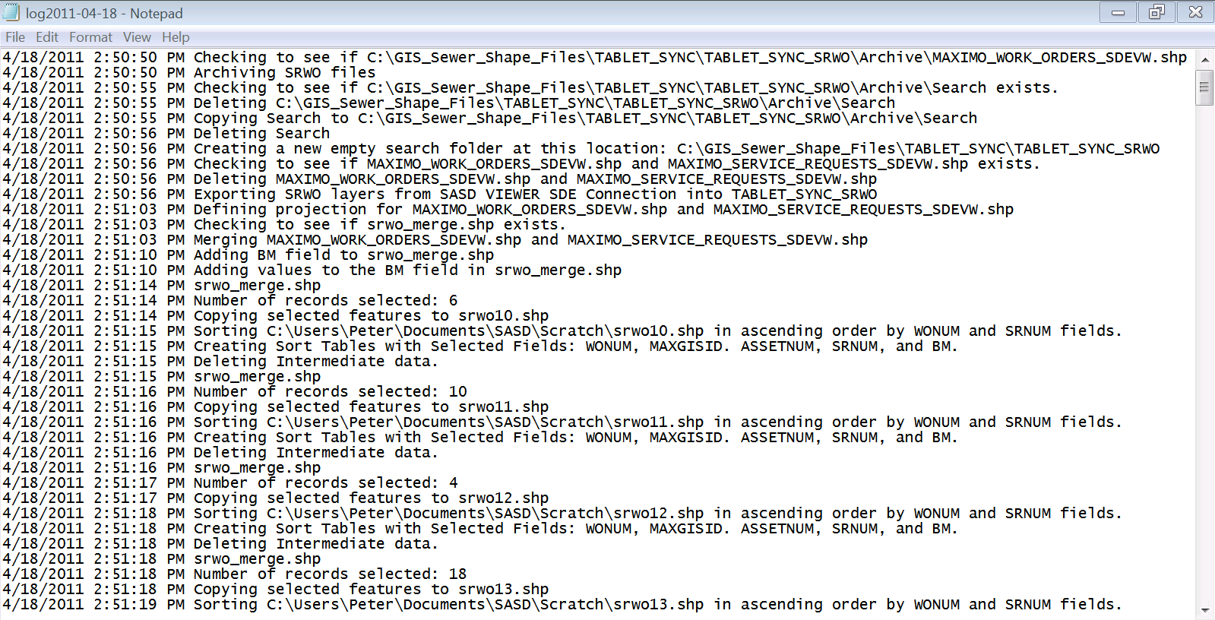
Log File Results

Slide 17
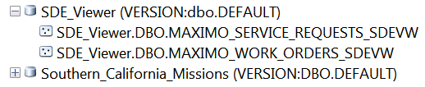
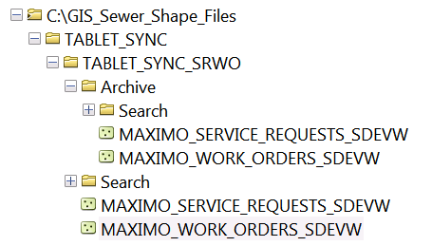
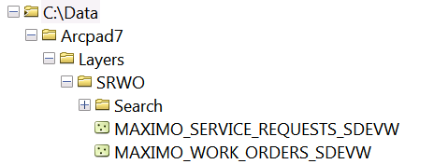
Data Before and After
Data Origin (SDE)
Updated Data (Local Directory)
Updated Data (Directory for ArcPad)
* Actual Working Files Will be Stored on a Separate Network Drive

Slide 18
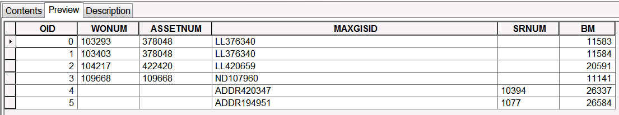
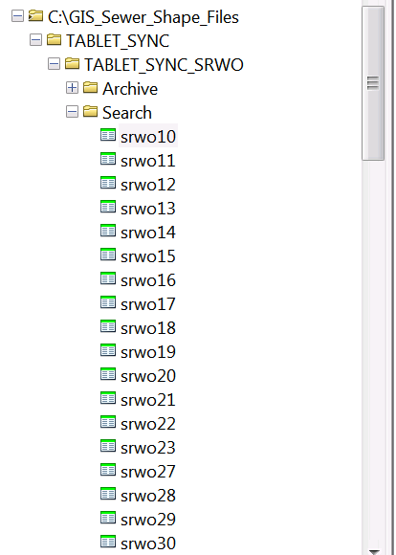
Sorted Search Tables
A Sorted Search Table is Created for Each Selection Containing Values

Slide 19
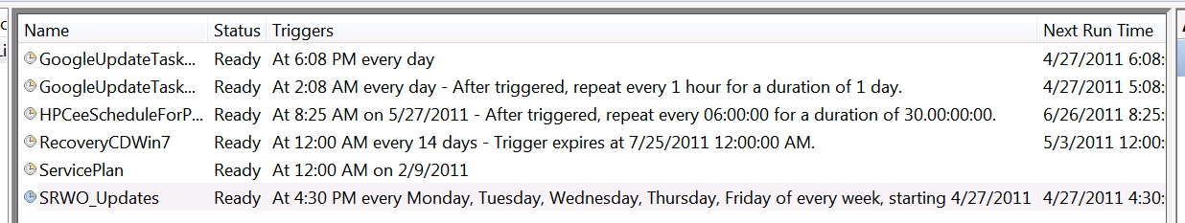
Using Windows Scheduler
The Script is Scheduled to Run Monday – Friday and is Shown in the Task Scheduler Active Tasks Window

