Slide 1
Updating Environmental Sampling Data for Routine Reporting Deliverables Using Python Scripting
Virginia Lenvik
Geography 375
Spring 2013

Slide 2
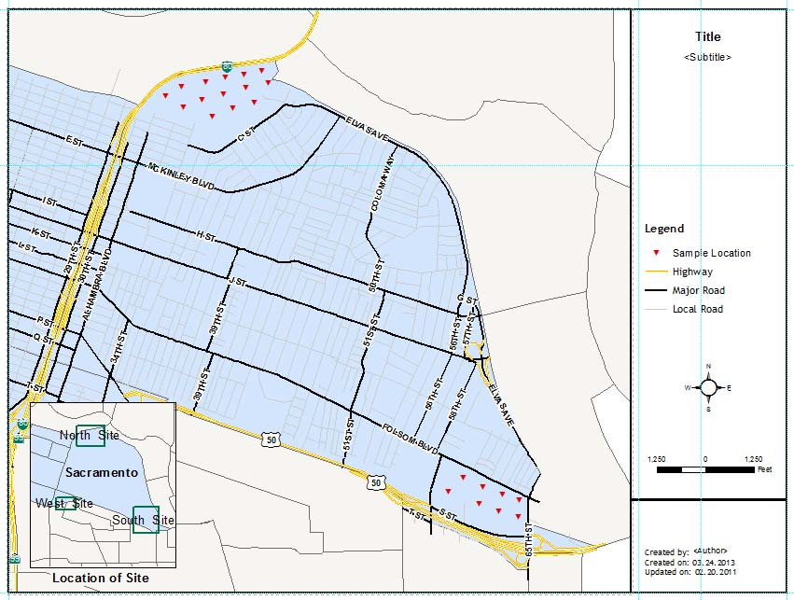
Three sites are sampled for contamination based on a scheduled plan
Final deliverable is a PDF map with most recent sampling results posted
ArcMap Template
Final Map in PDF format

Slide 3
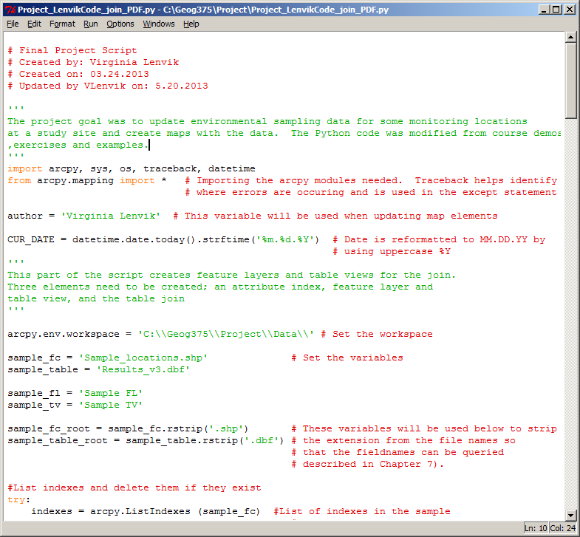
Beginning the Script
The purpose of the script is documented and some metadata is recorded
The arcpy modules are imported
Traceback helps identify where errors are occurring and is used in the except statement
Variables are set for updating the map elements
Workspace is set
Variables are set for creating the join and search cursor
Documentation within the script is very important

Slide 4
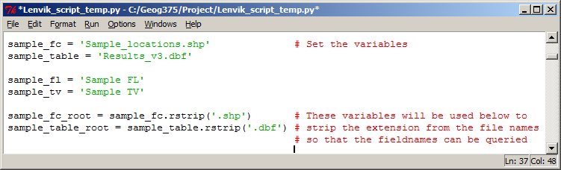
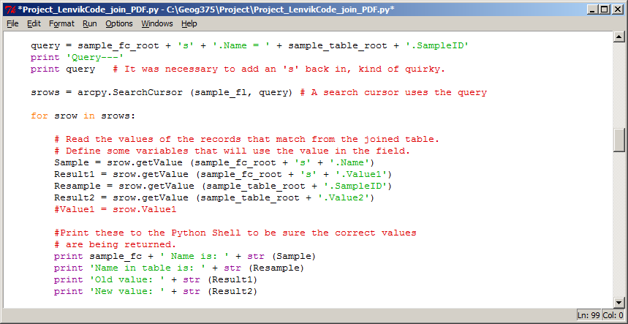
An interesting problem occurred with rstrip. The last character in one file name had to be added back in with code (see the ‘s’ below) Printing the query helped find the problem: Sample_location.Name = Results_v3.SampleID

Slide 5
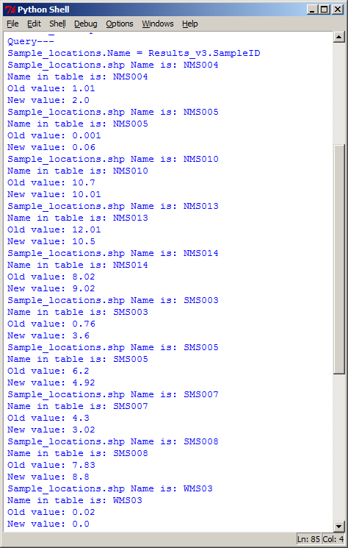
Two files are joined and a search cursor finds the matching records
It is useful to print the result of the search to the Python shell to be sure the correct data has been retrieved and that it is complete
At this point the update should occur
The next step uses the mapping module functions to complete the deliverables

Slide 6
A map template contains placeholders for the title and date etc. which are modified when the script is run

Slide 7
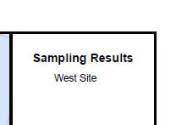
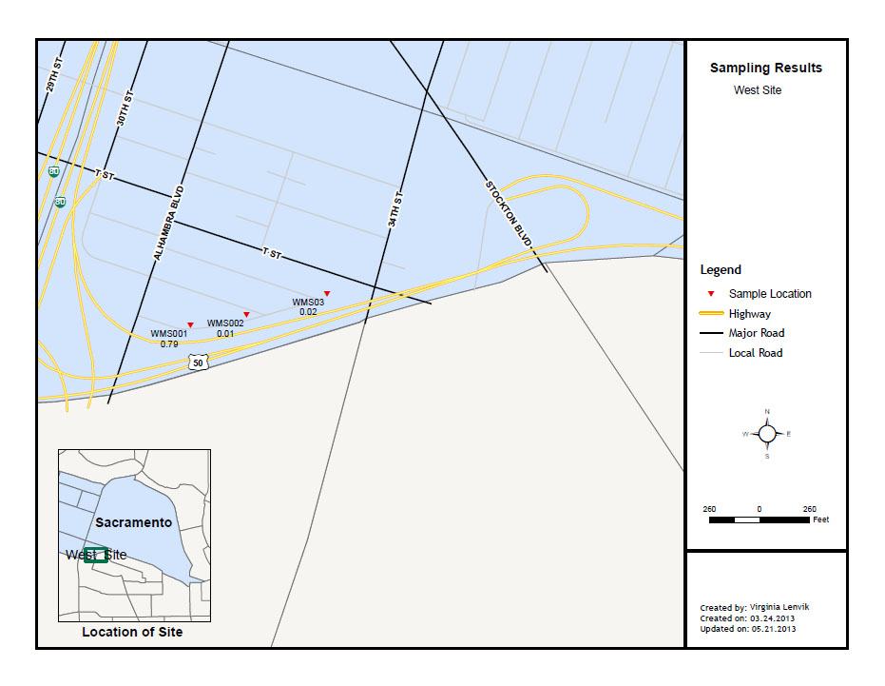
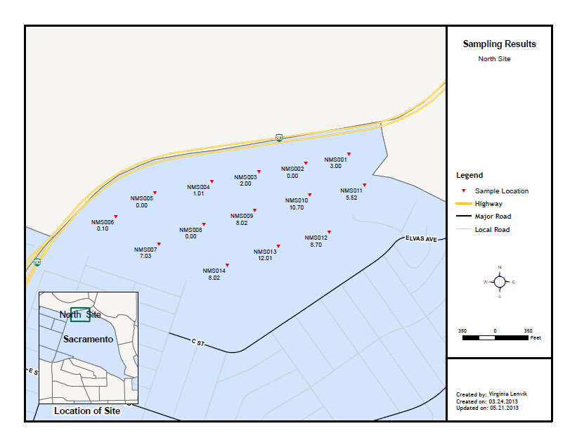
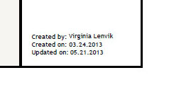
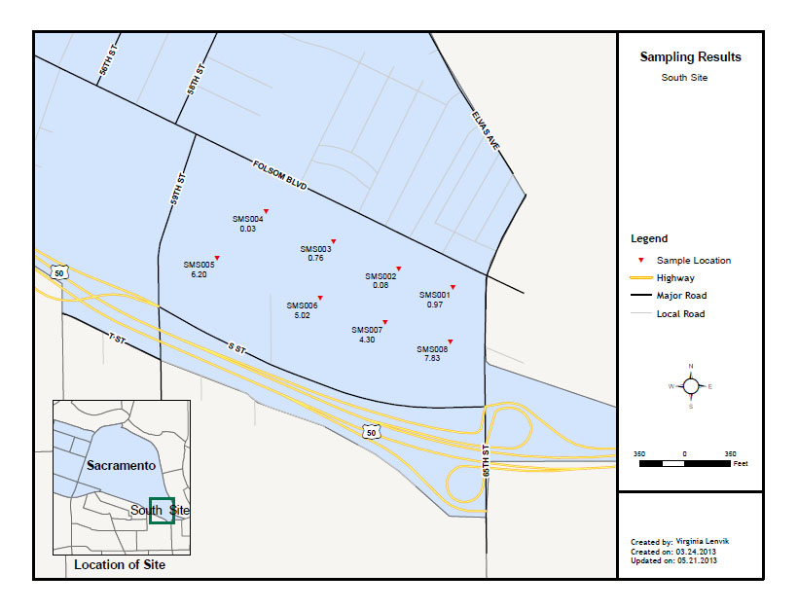
Map elements and dataframe extents
are modified by the script
Final PDFs are named and exported

