Slide 1
Geography 376 Project
Clip & Convert to ASCII Program
Kelly Knapp
Spring 2010

Slide 2
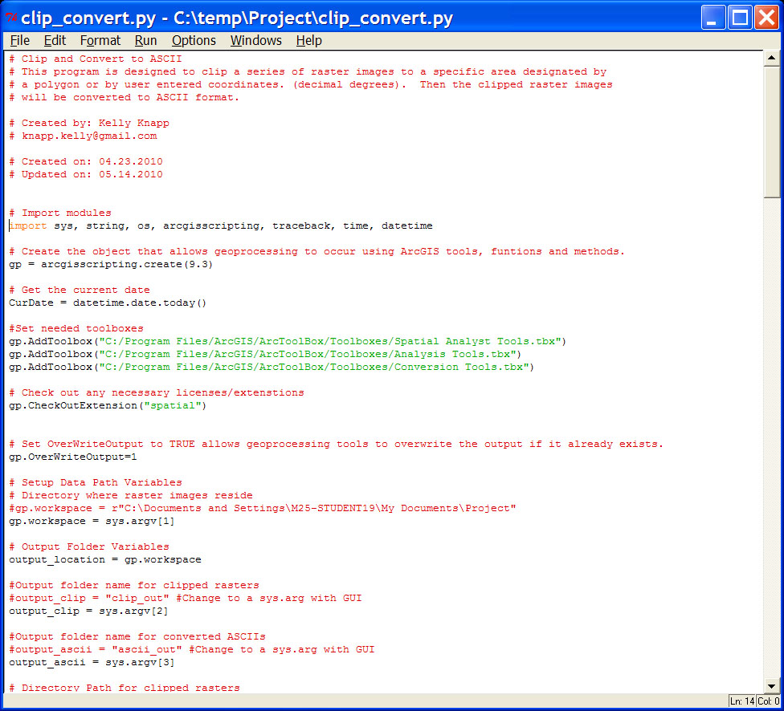
Basic parts of script
Comments
Import Modules
Load Toolboxes
Check out SpatialAnalyst
Setup of Data Path
Variables

Slide 3
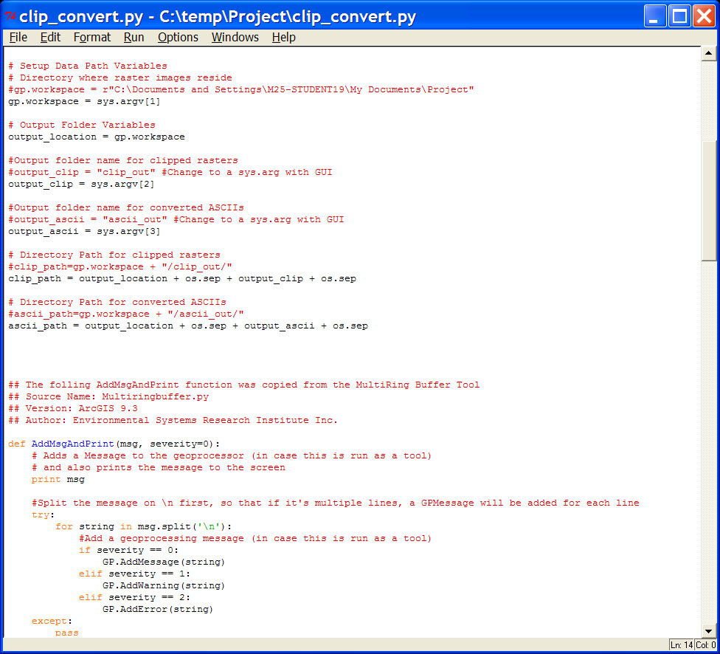
Setup of Data Path Variables
Output Folder variables (Clip & ASCII files saved here)
Function for Error Handling

Slide 4
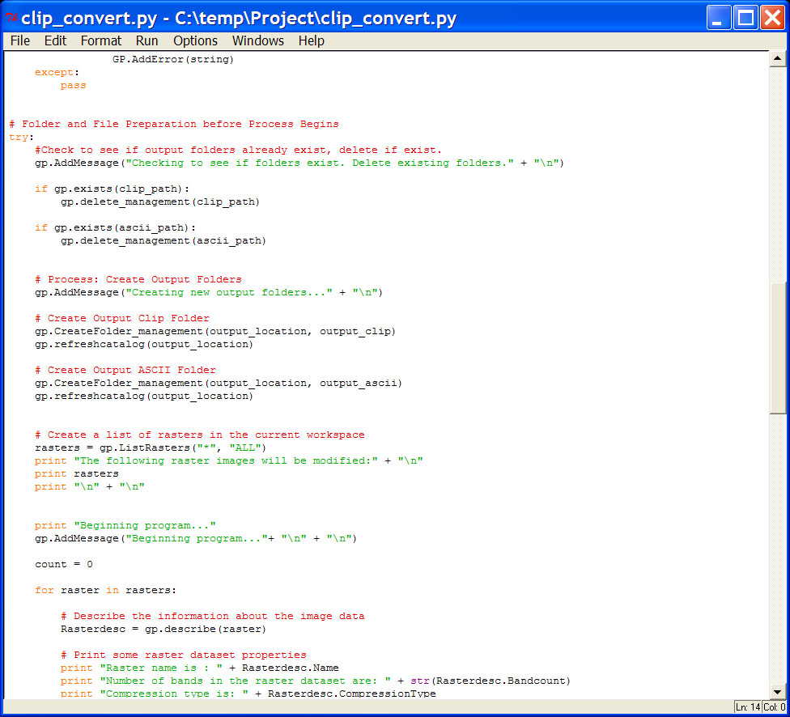
Check for existing folders
Delete & Create new folders
Create List of Rasters

Slide 5
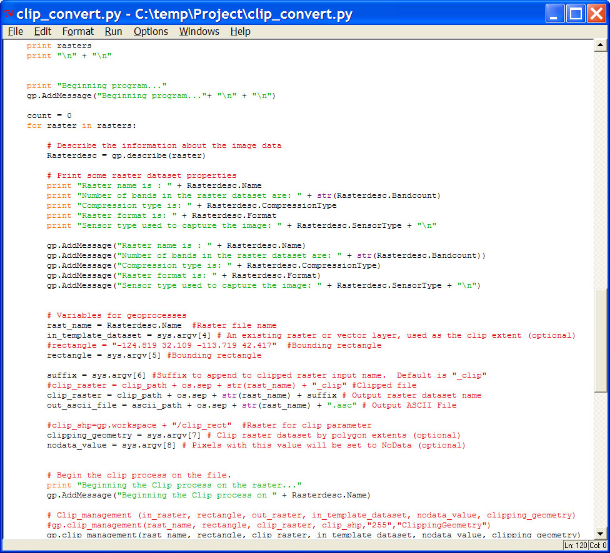
Description attributes displayed on screen for user
Variables for Clip & ASCII process

Slide 6
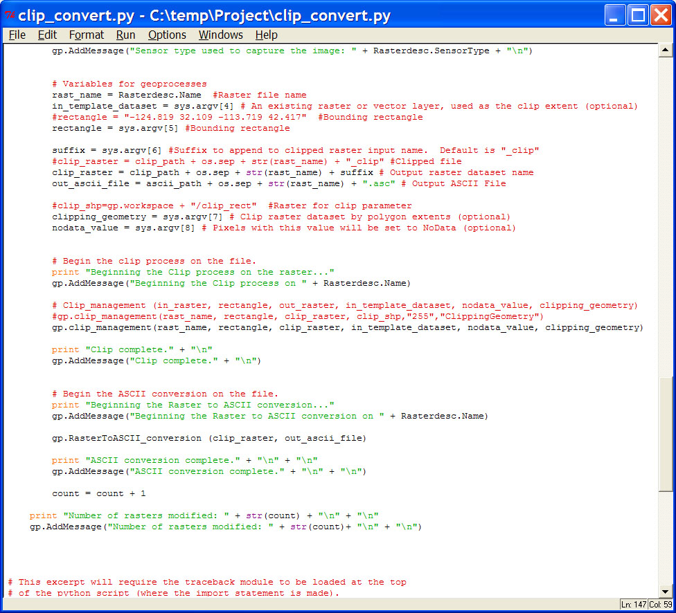
Variables for Clip & ASCII process
Clip & ASCII conversion
# of rasters modified

Slide 7
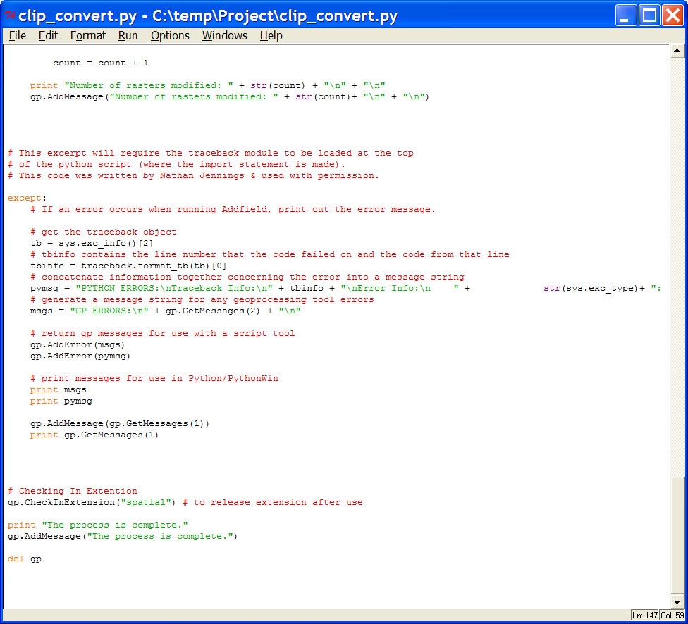
Except block for error handling
Check in Spatial Analyst extension
Delete gp

Slide 8
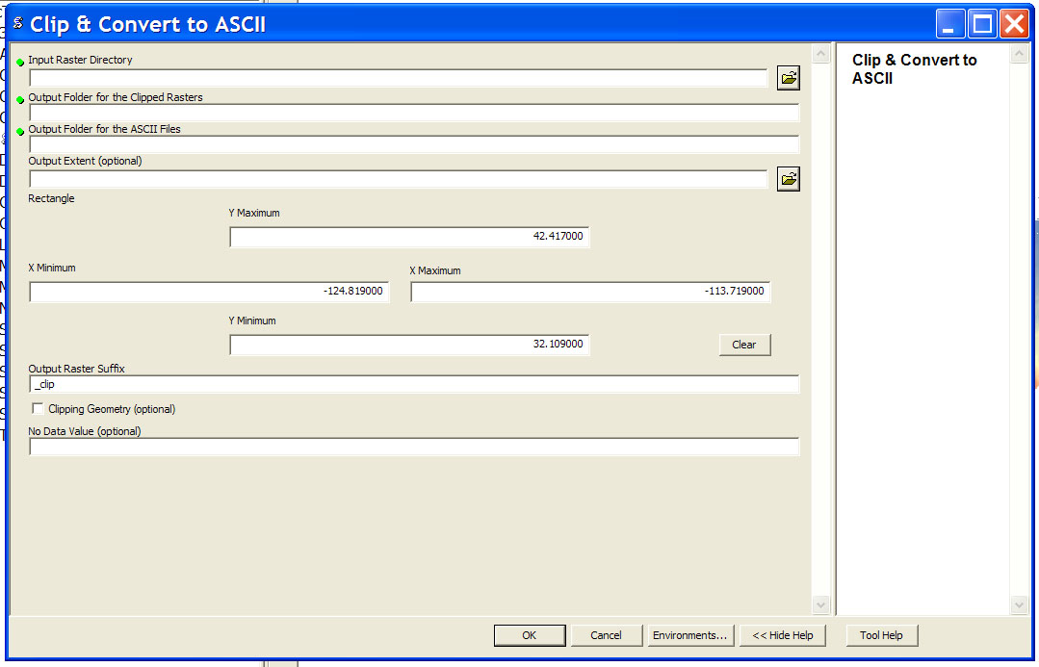
Custom Tool GUI

Slide 9
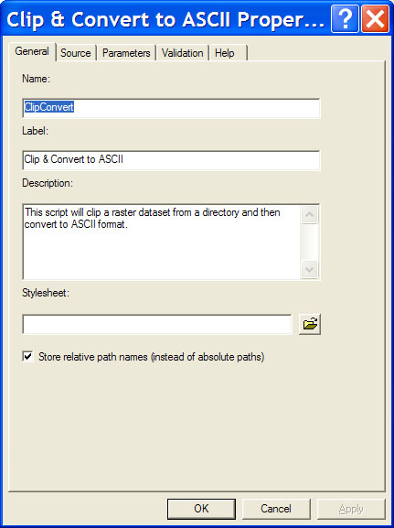
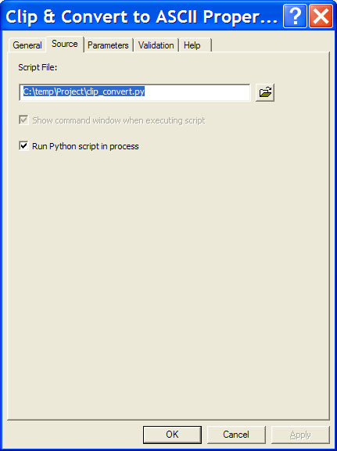
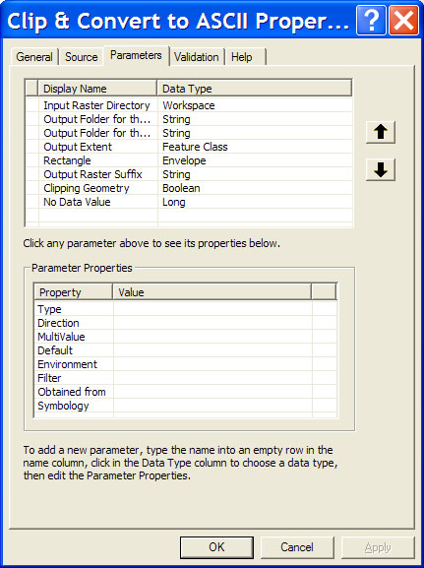
Tool Parameters

Slide 10
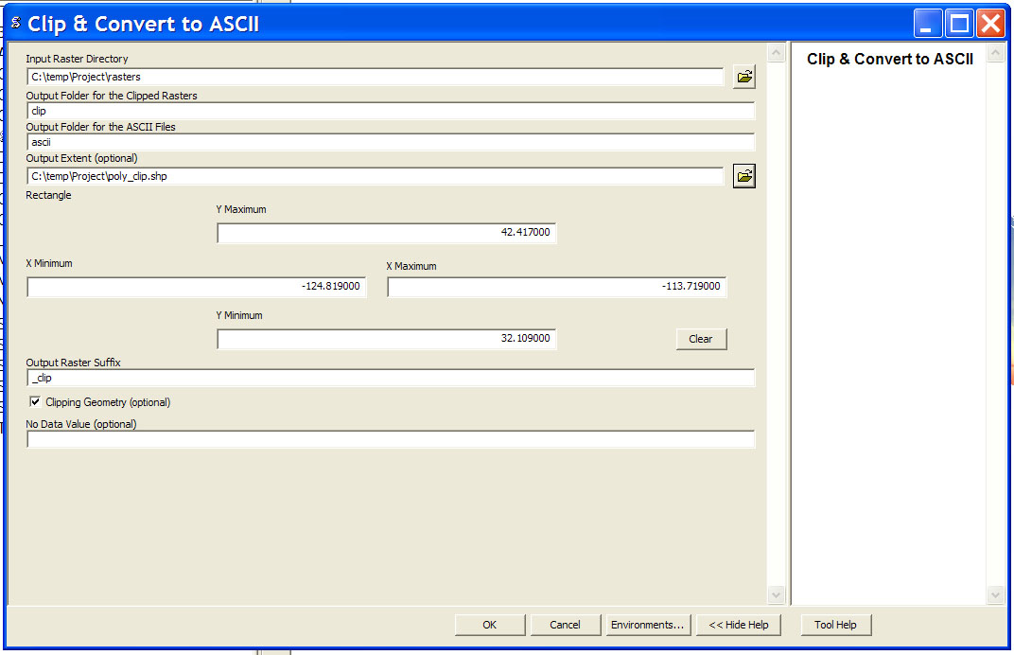
Custom Tool GUI
Example of User Inputs

Slide 11
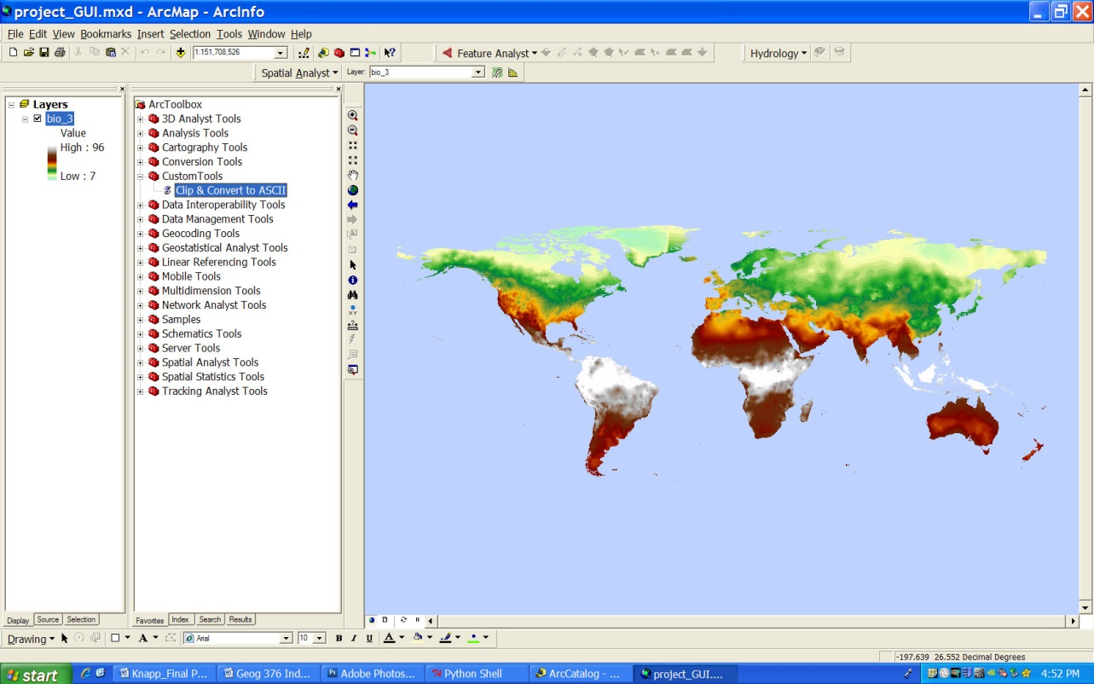
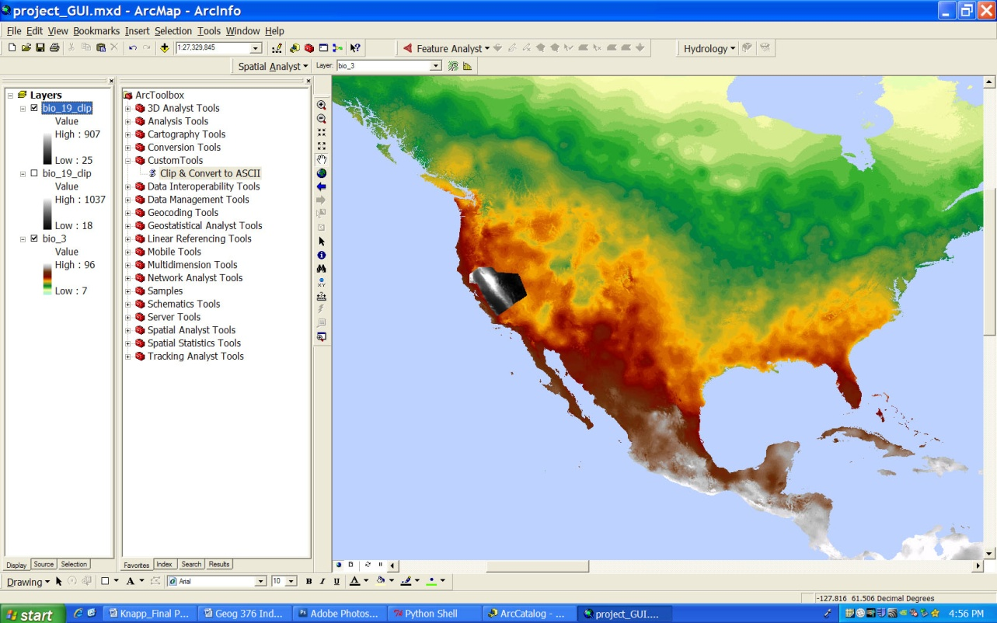
Original GRID file
Clipped raster using
Polygon Features
for extents

Slide 12
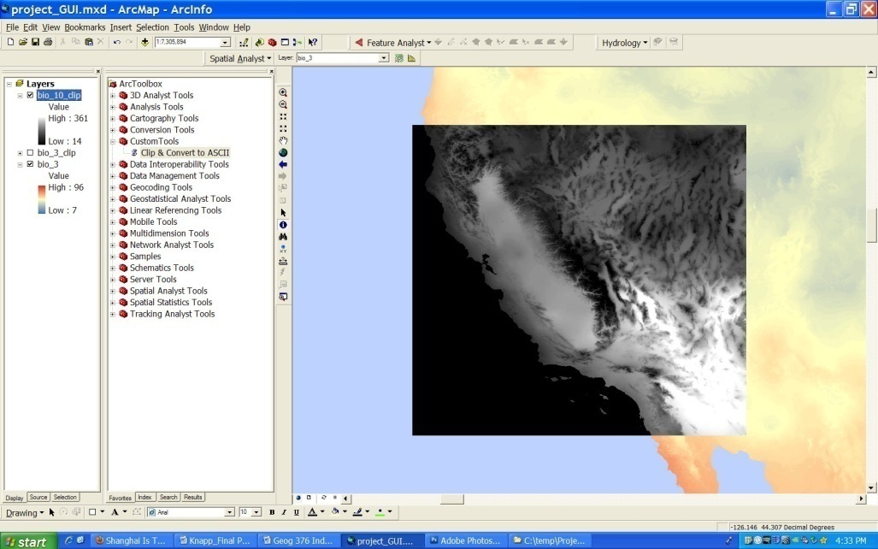
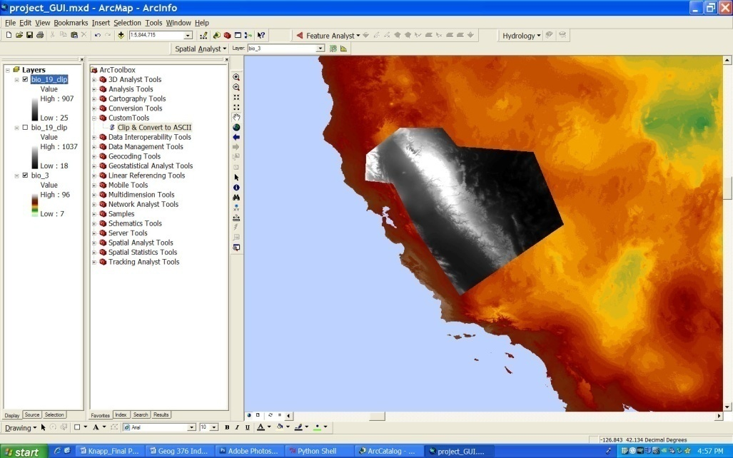
Clipped raster with User
Defined Latitude & Longitude
Coordinates
Clipped raster using
Polygon Features
for extents

Slide 13
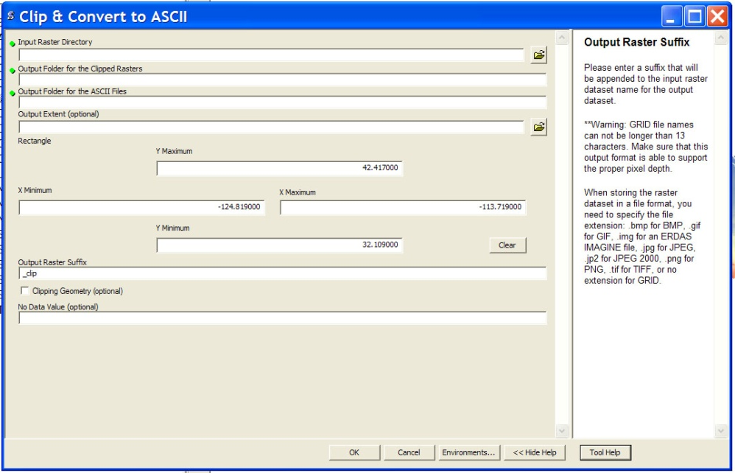
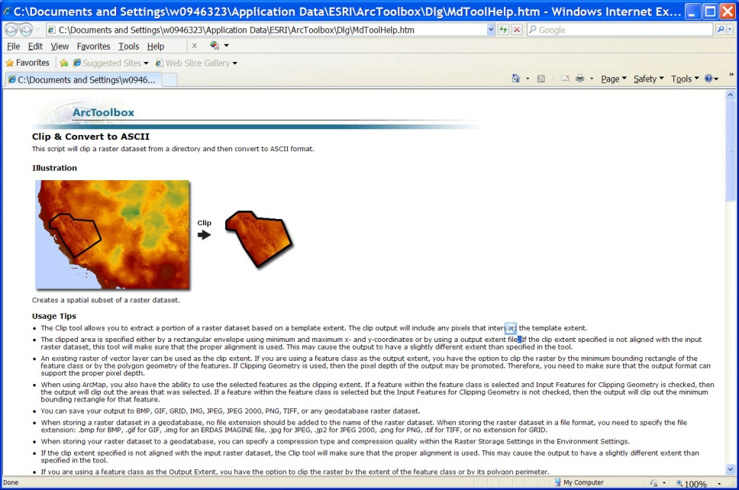
Tool Help
HTML Exported Help File

Slide 14
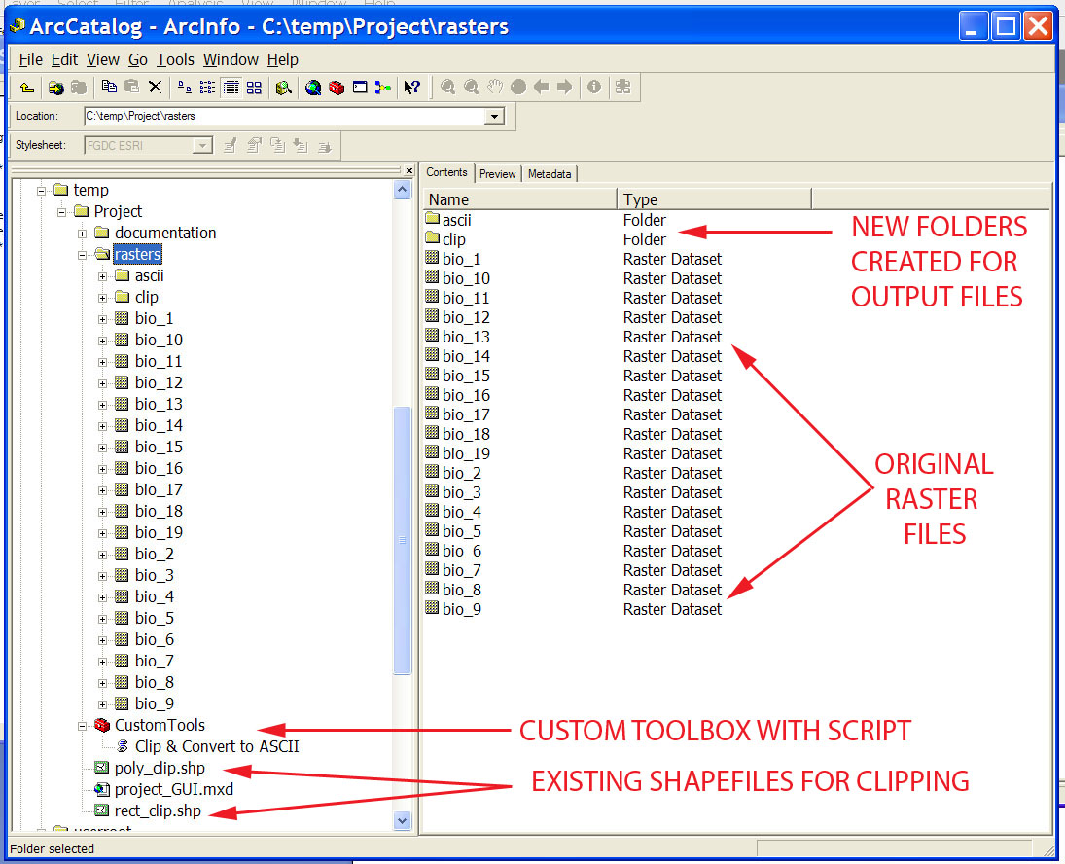

Slide 15
