Slide 1
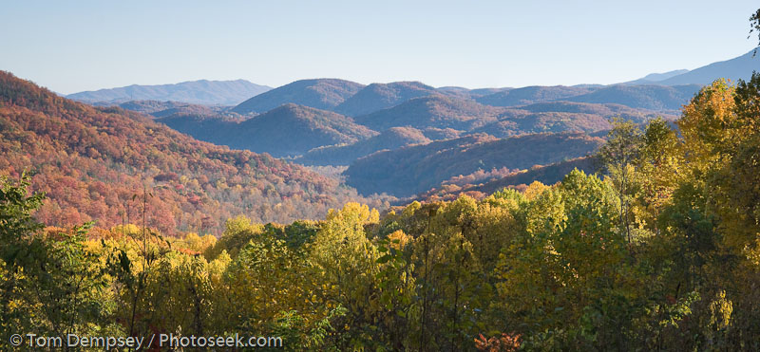
To find a suitable land to develop a dream vacation home
GEO376 Final Python Project Helen Peng May 2010

Slide 2
Brief Description
The Python script is to create vacation-home footprints in the suitable land where can see rivers and access by roads.
It is divided into two parts: one is to find suitable lands, the other is to create footprints polygons in the suitable land.
Original Data needed:
DEM data
River shapefile
Major road shapefile
Boundary Polygon
GEO376 Final Python Project Helen Peng May 2010

Slide 3
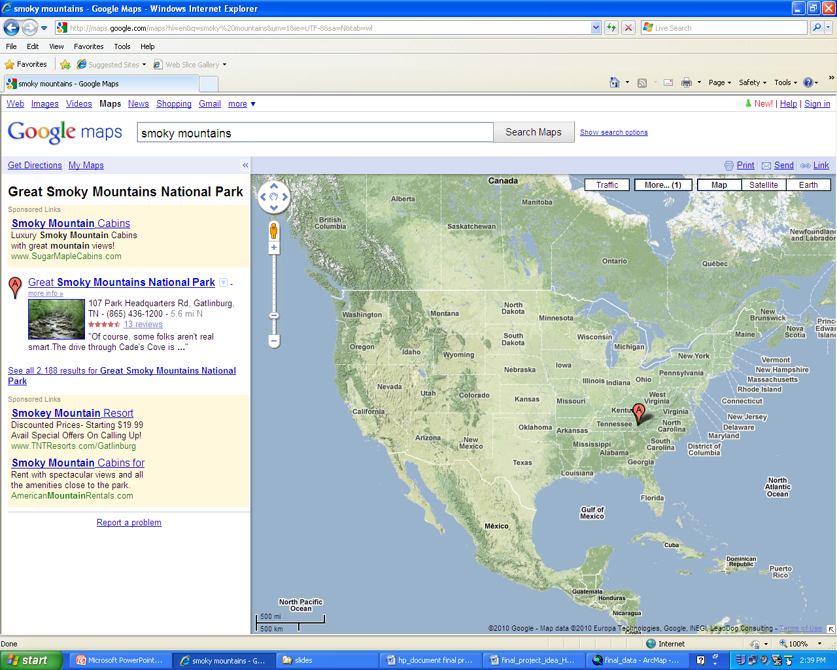
Project Site—Great Smokey Mountains at Tennessee

Slide 4
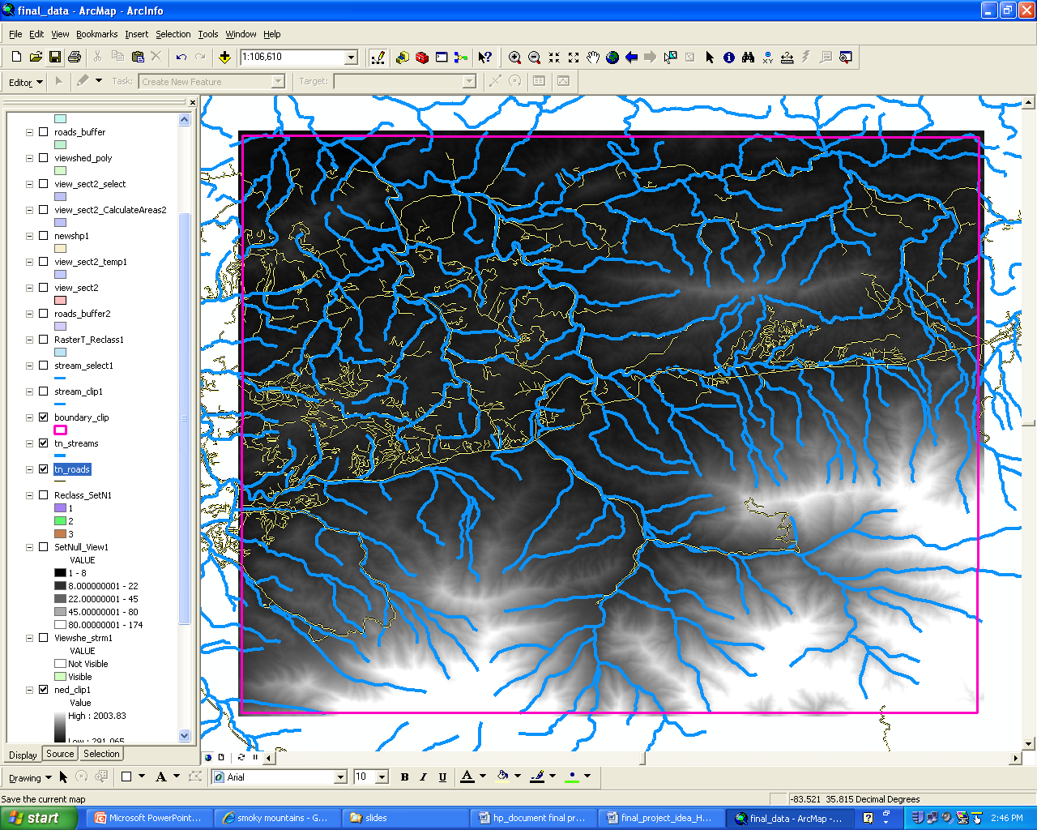
Original Data collection
Original Data :
DEM data
River shapefile
Major roads
Boundary Polygon

Slide 5
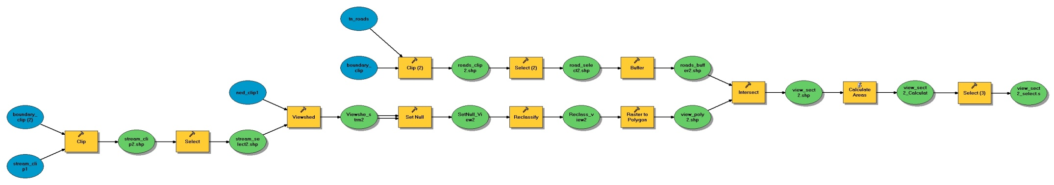
Part 1: Created by Model Builder
In the first part, it defines three functions.
One function is to select proper roads and buffer roads with a certain distance.
The second function is to run viewshed analysis for a stream data and convert raster data to polygons.
The third function is to intersect road buffer and viewshed polygons, then select polygons with larger areas by calculating areas

Slide 6
Part 1.1 Define function to buffer roads
# Define function to clip and select proper roads, then buffer roads with a certain distance
def RoadBuffer(boundary_clip, tn_roads, roads_buffer, rds_select_querry, buffer_distance):
# Process: Clip
gp.Clip_analysis(tn_roads, boundary_clip, roads_shp, "")
# Process: Select
gp.Select_analysis(roads_shp, road_select, rds_select_querry)
# Process: Buffer
gp.Buffer_analysis(road_select, roads_buffer, buffer_distance, "FULL", "ROUND", "NONE", "")
print "Finished road buffer“
try:
# Call RoadBuffer function to buffer selected roads
rds_select_querry = "FCC = 'A20' OR FCC = 'A30' OR NAME ='GREAT SMOKY MTNS %'"
buffer_distance = "150 Meters"
RoadBuffer(boundary_clip, tn_roads, roads_buffer, rds_select_querry, buffer_distance)

Slide 7
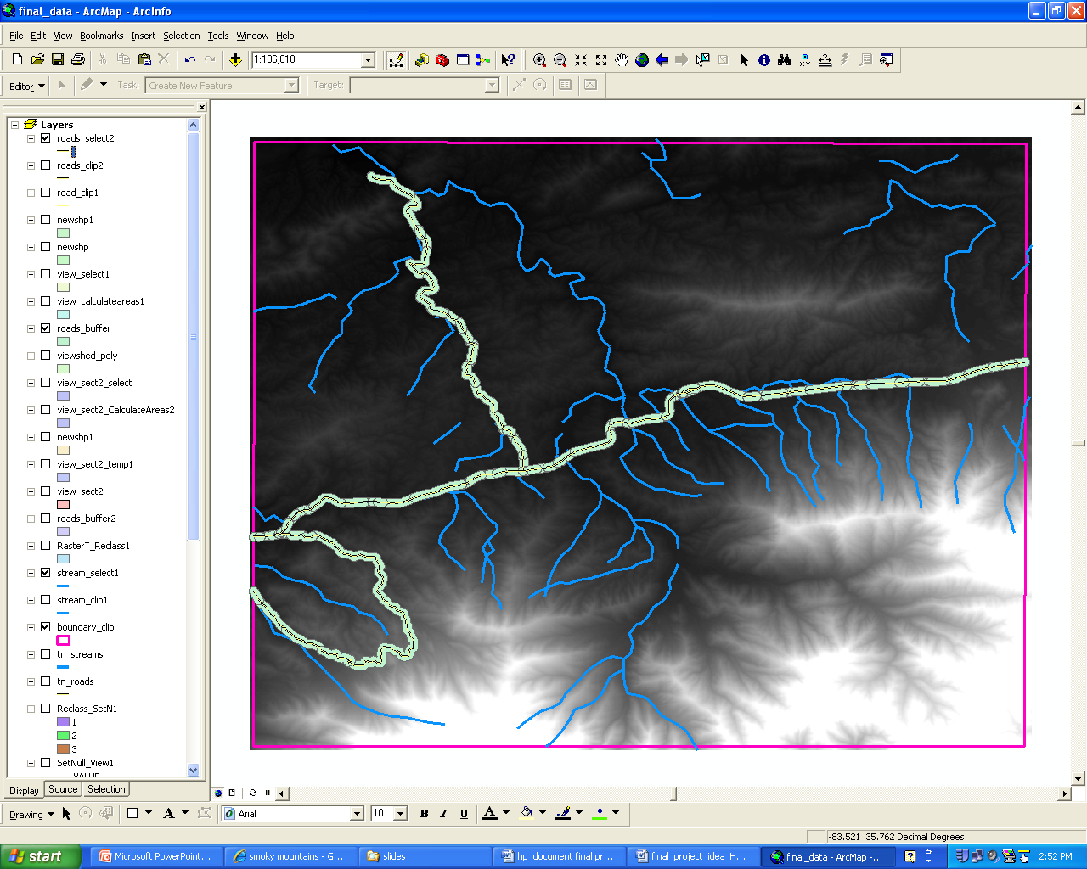
Road Buffer
def RoadBuffer:
Clip
Select
Select qurry = major roads
Buffer
buffer_distance = "150 Meters"

Slide 8
Part 1.2 Define function to run viewshed Analysis
# Define function to run viewshed analysis for a stream data and convert raster data to polygons
def StreamViwshed(boundary_clip, tn_streams, dem1, strm_select_querry, viewshed_poly):
# Process: Clip...
gp.Clip_analysis(tn_streams, boundary_clip, streams_clip, "")
# Process: Select...
gp.Select_analysis(streams_clip, streams_select, strm_select_querry)
# Process: Viewshed...
gp.Viewshed_sa(dem1, streams_select, viewshed_strm, "1", "FLAT_EARTH", "")
# Process: Set Null...
gp.SetNull_sa(viewshed_strm, viewshed_strm, setnull_view, "VALUE =0")
# Process: Reclassify...
gp.Reclassify_sa(setnull_view, "VALUE", "1 180 1", reclass_view, "DATA")
# Process: Raster to Polygon...
gp.RasterToPolygon_conversion(reclass_view, viewshed_poly, "SIMPLIFY", "VALUE")
try:
strm_select_querry = "\"STREETNAME\" LIKE '% Creek' OR \"STREETNAME\" = 'Little Pigeon River'"
StreamViwshed(boundary_clip, tn_streams, dem1, strm_select_querry, viewshed_poly)

Slide 9
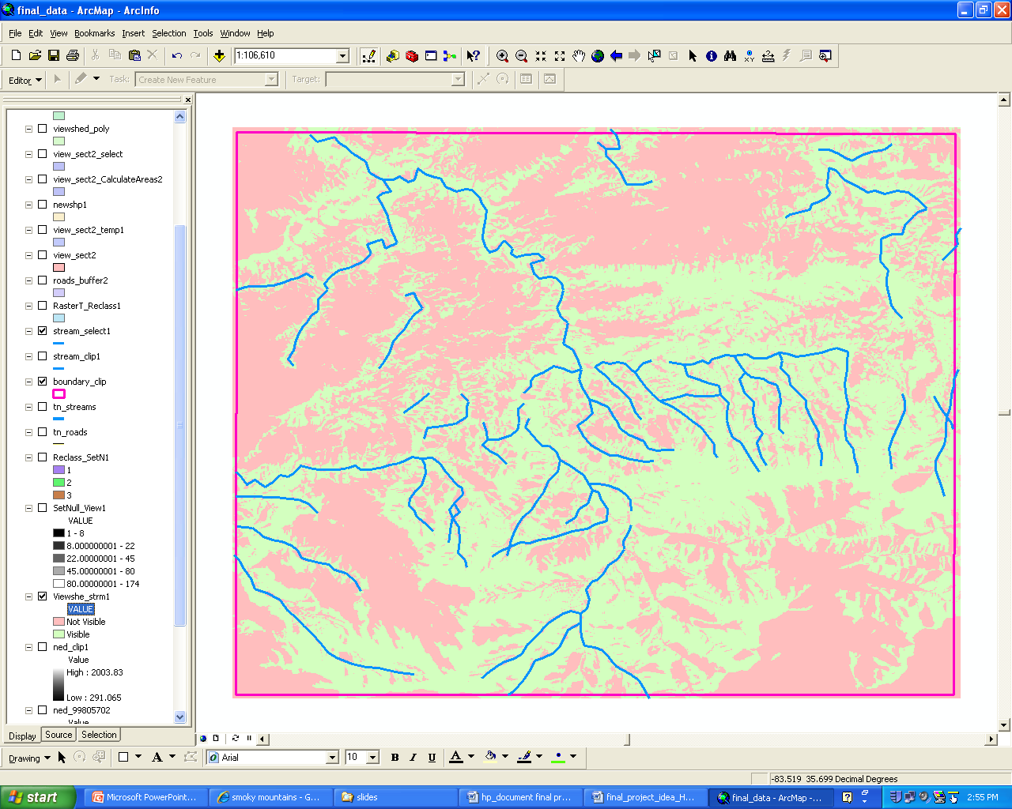
Viewshed Analysis
The visible data represents in green.
Not-visible data represents in red.

Slide 10
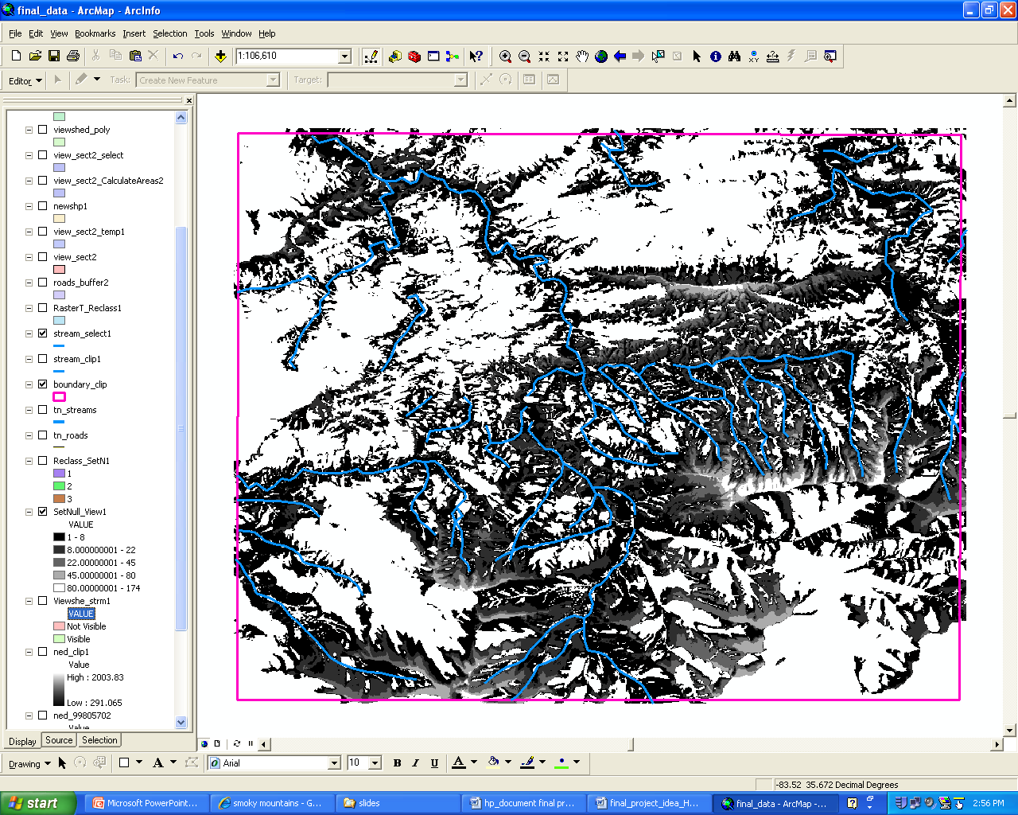
Set Null
The value of visible data is more than 0 and not-visible data is equal to 0.
By running a SetNull tool, the step eliminated not-visible data.

Slide 11
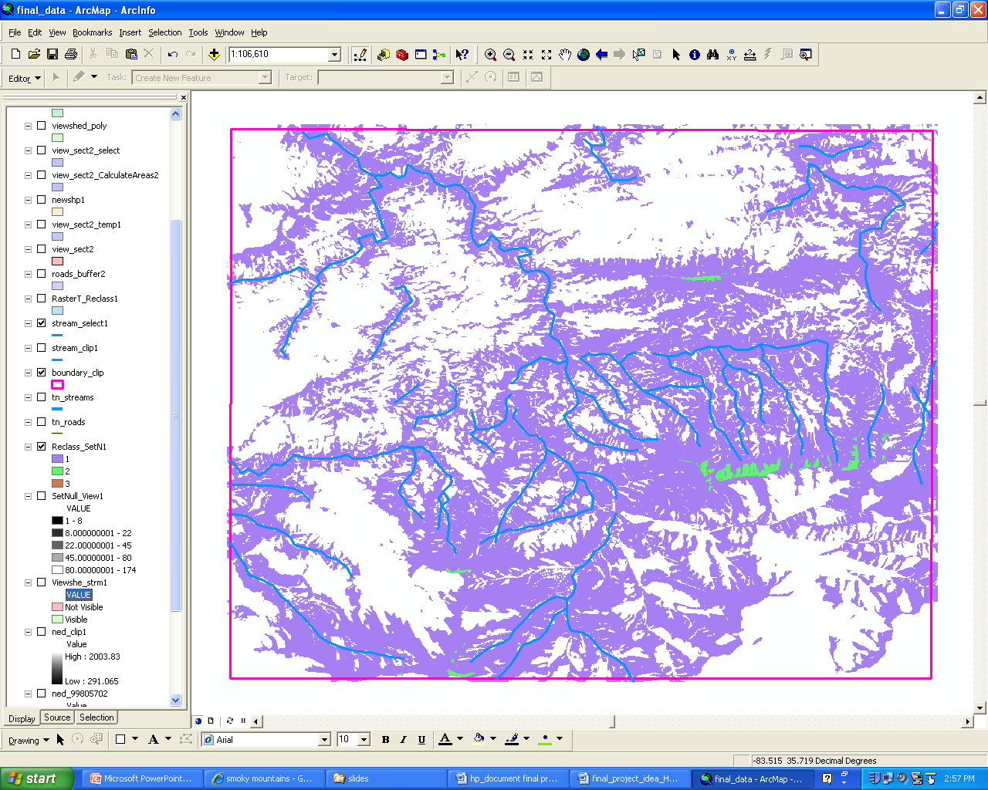
Reclassify Analysis

Slide 12
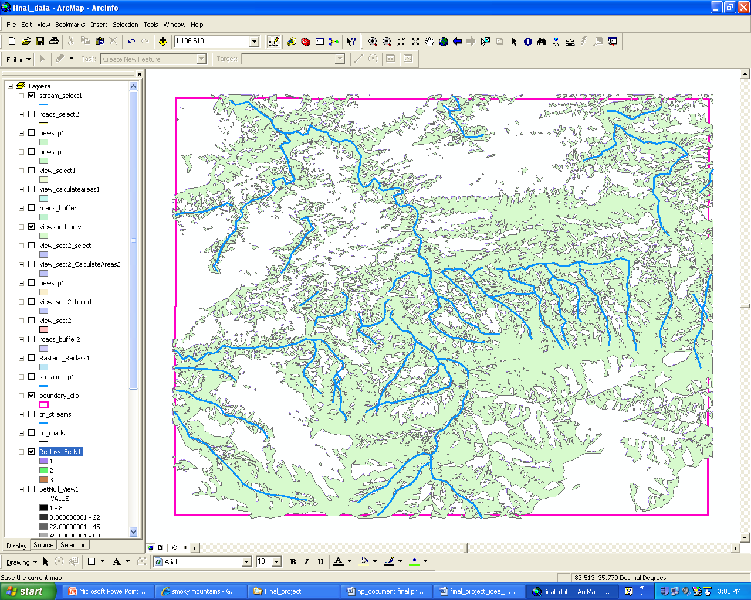
Convert to Polygon

Slide 13
Part 1.3 Define function to intersect
# Define function to intersect road buffer and viewshed polygon, then select polygons with larger areas by calculating areas
def IntersectCalSel (roads_buffer, viewshed_poly, area_querry, inputShp)
# Process: Intersect...
gp.Intersect_analysis(roads_buffer + ';' + viewshed_poly, view_intersect, "ALL", "", "INPUT")
print "intersect finished"
# Process: Calculate Areas
gp.CalculateAreas_stats(view_intersect, view_calculateareas)
print "calculate area"
# Process: Select polygons with larger area
gp.Select_analysis(view_calculateareas, inputShp, area_querry)
print "select suitable land“
try:
# Call function of IntersectCalSel for roads_buffer, viewshed_poly
area_querry = "\"F_AREA\" >= 7.43E-06"
IntersectCalSel (roads_buffer, viewshed_poly, area_querry, inputShp)

Slide 14
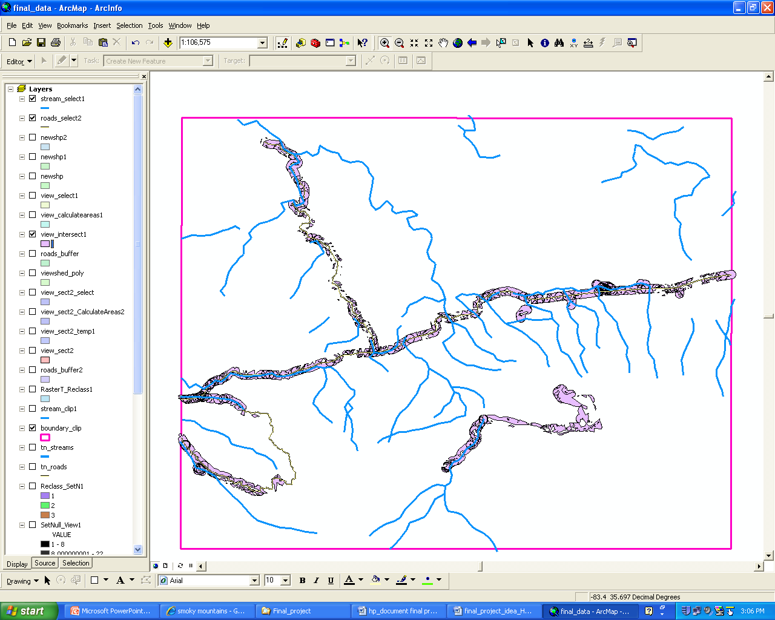
Intersect with Road and Viewshed polygon

Slide 15
Part 2 Create Footprints Polygons
In the second part, it reads centroids from the suitable land polygon shapefile, and create footprints polygons from centroids.
One is to read geometry features from the suitable land polygon, the other one is to create new footprint polygons.
# Create search cursor
cur = gp.SearchCursor(inputShp)
row = cur.Next()
# Describe the new feature class
desc = gp.Describe(outputShp)
shpFld = desc.ShapeFieldName
# Create Array, Point, and Cursor objects
pnt = gp.CreateObject("Point")
curr = gp.InsertCursor(outputShp)
a = 1

Slide 16
Part 2 Create Footprints Polygons
While loop is used to get each feature and an array is used to create a footprint.
while row:
# read a centroid from a polygon provided
feat = row.shape
centroid = feat.centroid
print "The midpoint/centroid is: "+ centroid
#split string, get x,y values
ctr = centroid.split(' ')
x = float(ctr[0])
y = float(ctr[1])
print a, x, y
#create array and draw the square from centroids, write x, y to excel/textfile
array = gp.CreateObject("Array")
pnt.x = x - 0.001
pnt.y = y - 0.001
array.Add(pnt)
txtFile.write(str(a) + "," + str(x) + "," + str(y)+ "\n")
….
  a = a + 1
row = cur.Next()

Slide 17
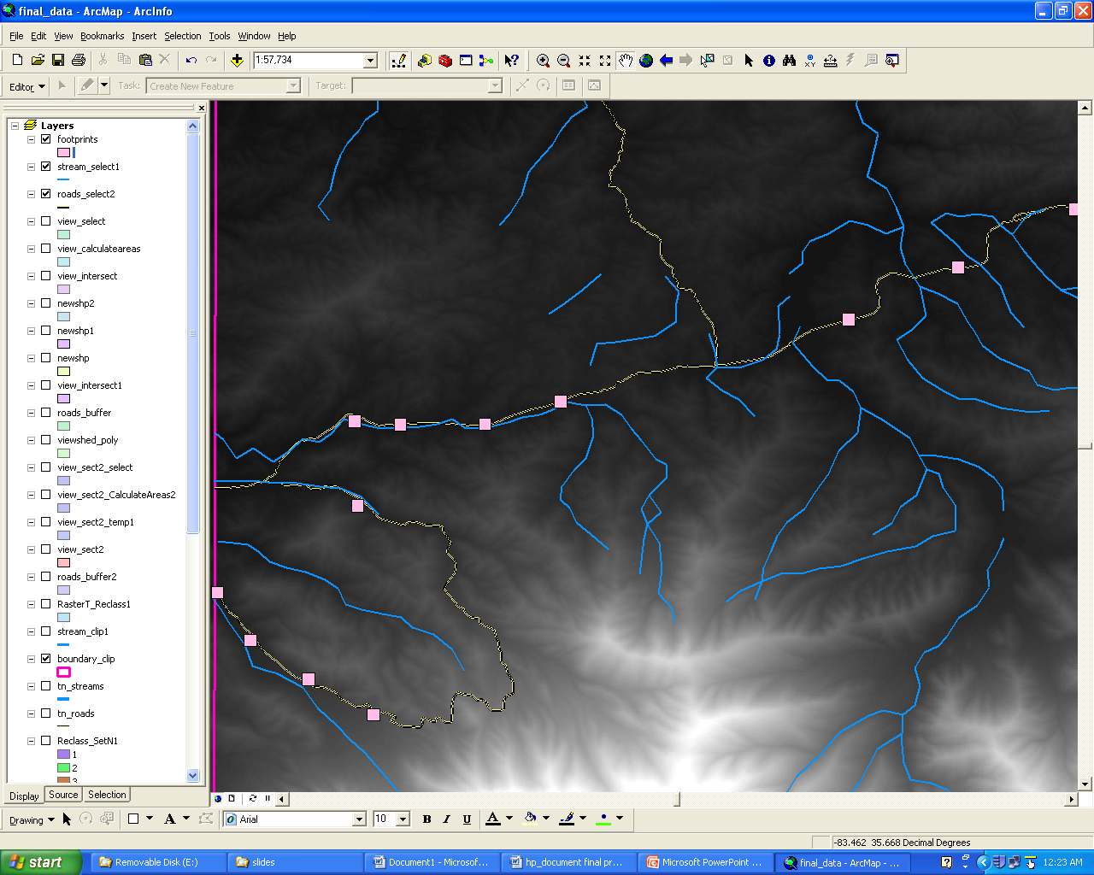
Create Footprint Polygons (with DEM)

Slide 18
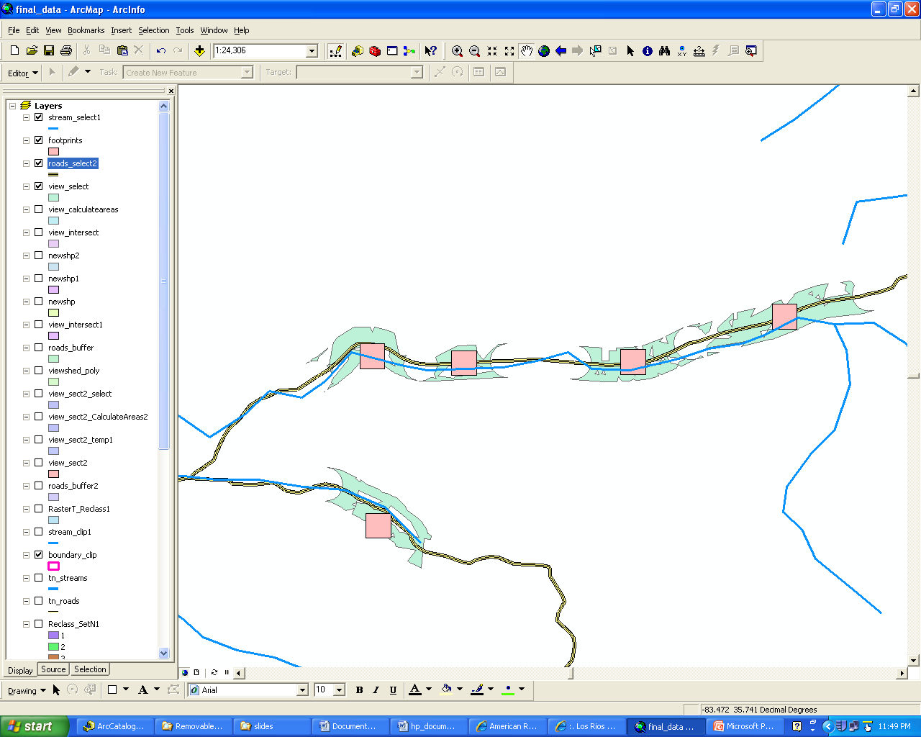
Create Footprint Polygons (Zoom In)

