Slide 1
Final Project
Geog 375
Daniel Hewitt

Slide 2
Project Summary
This script was designed to extract, at regular intervals, the newest records from a Police record management system, geocode and insert them into a production GIS police incident layer. Developing this script automates a process that without Python would be too time consuming to be practical. Python is especially useful in that the script is ran at regular intervals, in this case hourly, and then only processes those records from the last hour and inserts them into the production feature class. There were some challenges that were encountered in developing the script at all phases. These challenges included using time as a query variable, geocoding the raw data and creating the batch and task scheduler jobs.

Slide 3
Project Steps
Select new records in the police SQL database from the last hour, this would be based on current time compared to a time stamp field in the table.
The script then geocodes the selected records using a geocoder in our SDE database.
Next, a spatial join is preformed to update a Reporting District field.
An append would be used to then write the geocoded records to the production GIS layer.
A log file is written to for auditing and troubleshooting should any issues arise and to provide a list of records that did not meet the geocoding standards.
Lastly, the script is ran as a batch process and scheduled task that is to be ran at an hourly interval.

Slide 4
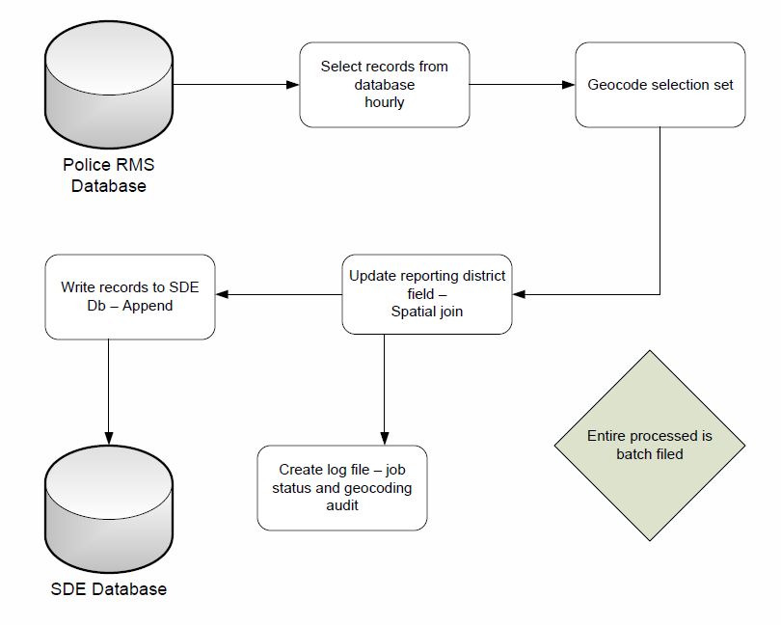
Workflow

Slide 5
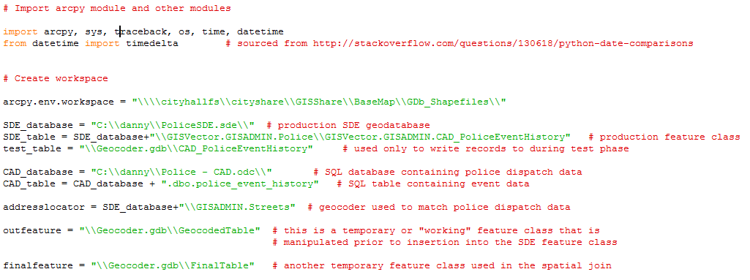
Import modules & set variables
All necessary Python modules are imported
Variables are created providing a path to all necessary input and output data locations

Slide 6
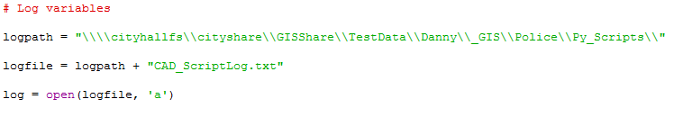
Create log variables
Log is written to at various phases of the script
All print functions are mirrored in both Python Shell and in the log

Slide 7
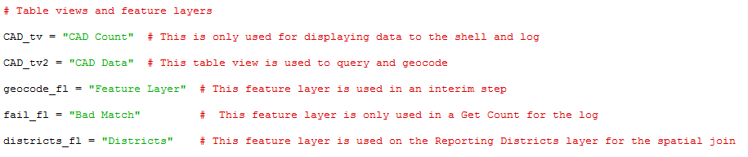
Create table views & feature layers
Table views and feature layers that are referenced are defined in this section of the script

Slide 8
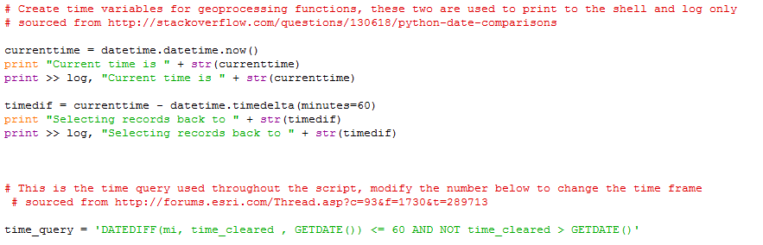
Set time variables & query
The time variables and query are established
The first section is just for verification and printing to the log and Shell, the second section is the query

Slide 9
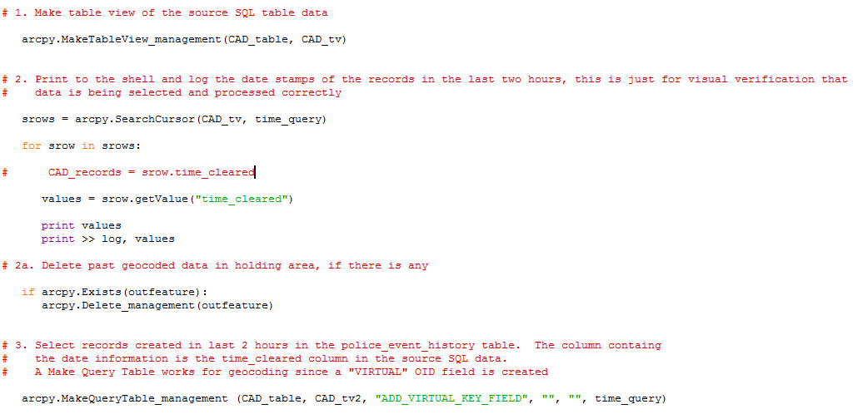
Select records using time variable
A search cursor is run to write values to the Shell and log, then the selection set is made

Slide 10
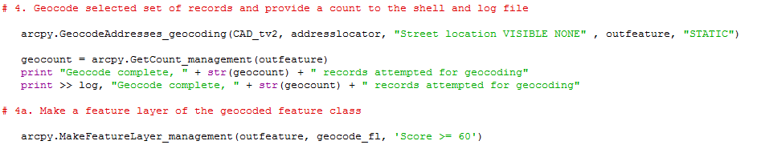
Geocode records
Geocode process is ran creating an interim feature class
Job status information is printed and recorded in log

Slide 11
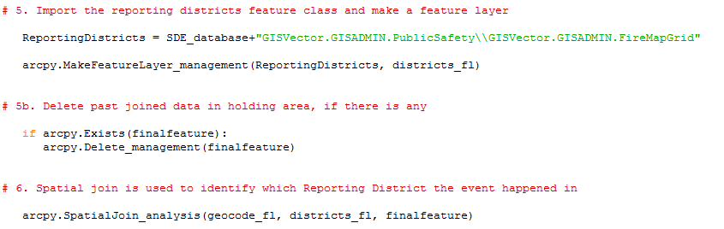
Spatial Join
Spatial join is preformed in order to populate the Reporting Districts attribute field

Slide 12
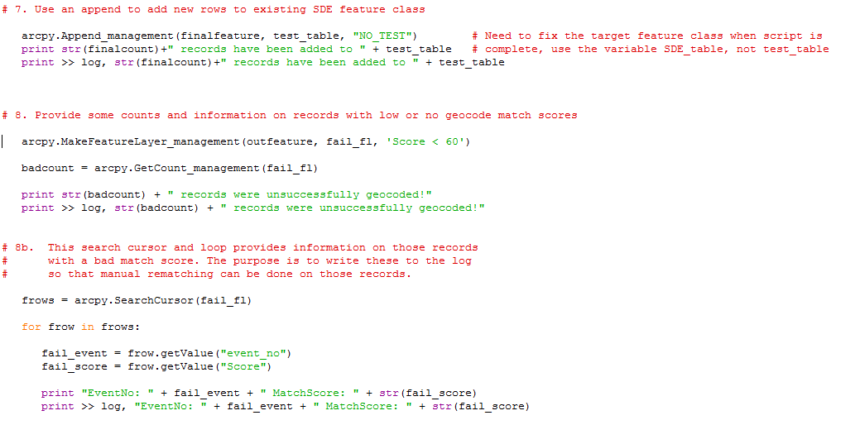
Append & Summary
Append is preformed and a final summary is sent to the log and Shell

Slide 13
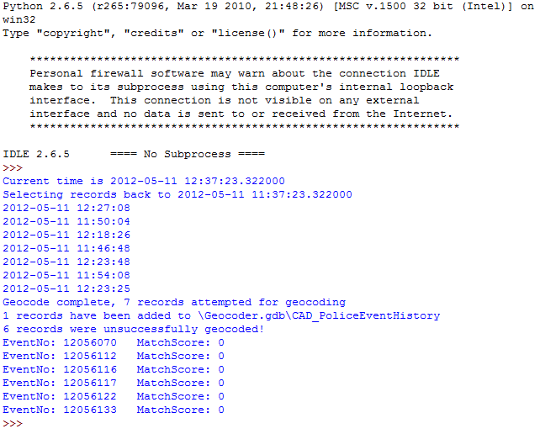
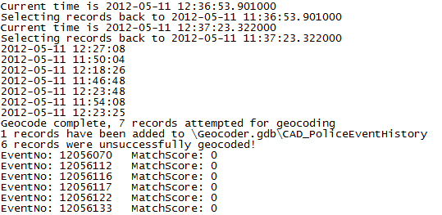
Log & Shell Print Output
Shell
Log

Slide 14
Batch & Schedule
Batch file is created that executes the Python script
Scheduled job is ran using Windows Task scheduler that executes batch file.

