Slide 1
Automated Cartography
Python scripting project
GEOG 375 Intro to GIS Programming with Python
Nathan Jennings, Professor
American River College
Spring 2011
by Michael Hertneck
hertnem@imail.losrios.edu

Slide 2
Contents
Comments section
Create an ArcMap mxd file 3
Intro ArcMap Toolbox 4, 5
Intro ArcMap Help 5
Intro ArcMap Model Builder 6
Intro ArcMap python code samples 7
SciTE: Editor of choice 8
Project section
About the script 9
Running the script 10, 11
See error log sample 12
Documenting code 13
Geoprocessing 14, 15, 16
Problems and resolutions 17
Map examples
Map #1. City data format 18
Map #2. City data with error example 19
Map #3. Bing aerial format 20
Map #4. Bing hybrid format 21
Map #5. Bing road format 22
Reference materials
Recommended text:
Lutz, Mark. Learning Python: Powerful Object-Oriented Programming, Sebastopol: O’Reilly Press, 2009. Print
ISBN:978-0-596-15806-4
Python language website: http://www.python.org/doc/
Active-State website: http://code.activestate.com/recipes/langs/python/tags/meta:min_python_2/

Slide 3
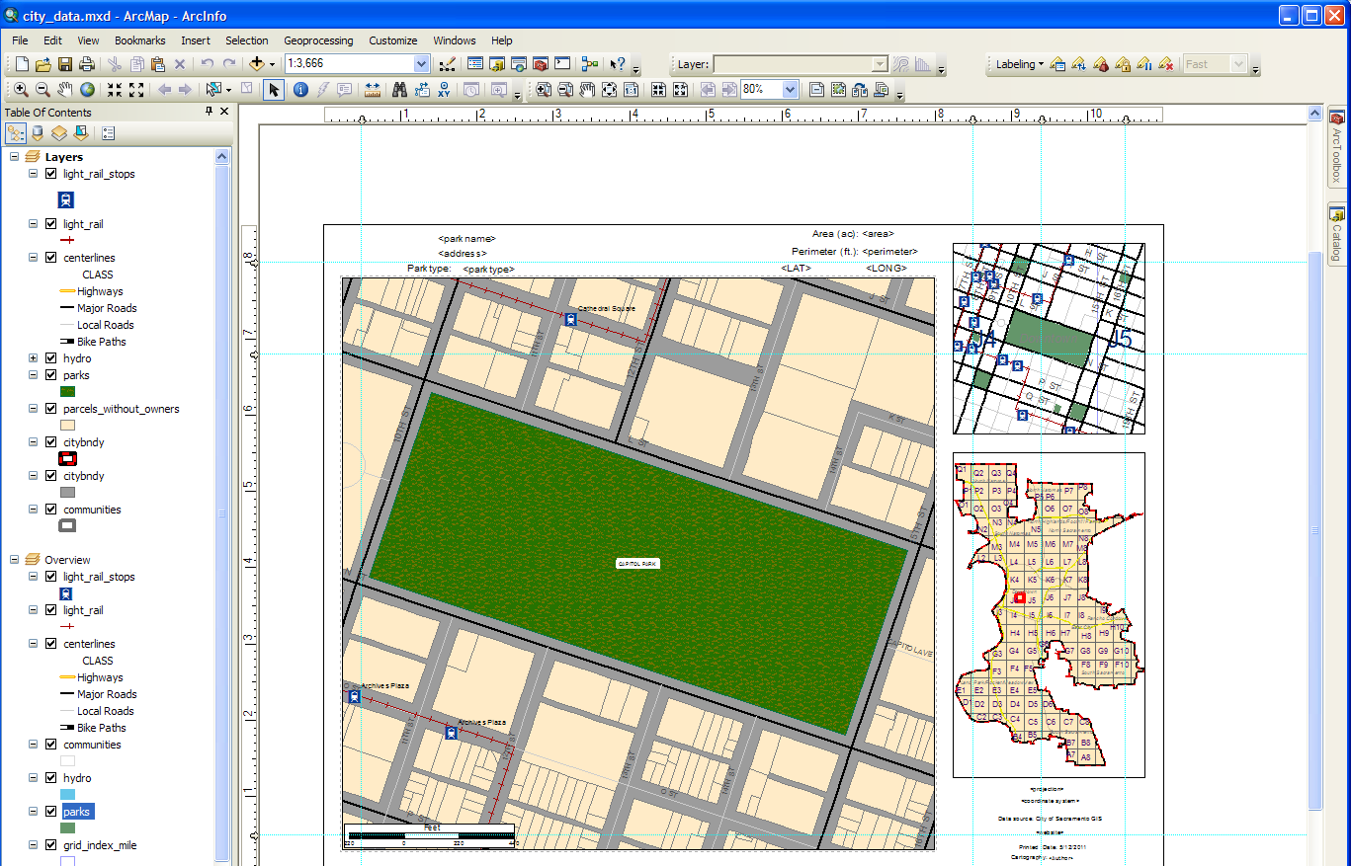
Creating a set of maps can be a tedious, time consuming process.
Automated scripting can simplify your work and save time, money and resources. The procedure for this requires a few basic skills in GIS and Python scripting. I’ll begin with a few slides that provide a brief explanation of available tools I used to get started on my scripting project, then a few comments about what I learned working with python. I’ll then continue with an explanation about my project.
With an .mxd configured to reuse for all of the maps, a uniformly designed map set is possible with a fairly simple script that will do much time-consuming, tedious work for you. Scripting is not overly difficult. ArcGIS ‘s mapping module presents the functionality necessary to accomplish this task. With a basic knowledge of the Python language, you have the necessary programming skills to do this in ArcMap 10.0.
Contents
Creating a map layout
mxd file in ArcMap will get you started.
Add data layers as needed.
Configure layers, label, etc.
This is your map set template.
You can create as many templates like this as you need.
The reason is that the Element Name field of elements like text, date, time, title, author, etc. will be captured by the script to locate where to insert data programmatically. Here I have my city format map, with locator and scaled views. Another map set could be made from the locator map layout (lower right).

Slide 4
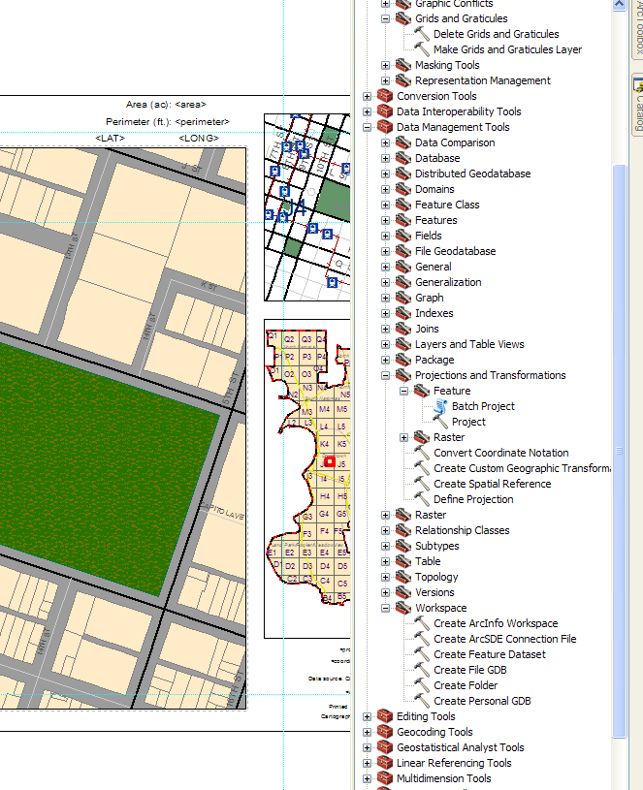
Contents
ArcMap has a geoprocessing toolbox, called ArcToolbox, that contains a great number of functions you can use.
There you will also find help on each tool and sample python code you can use in your projects.
Within ArcMap 10.0, you have access to the mapping module through the use of the ArcToolbox.
Here is where you locate the geoprocessing functions necessary to use to accomplish specific tasks. A detailed explanation on the tool’s usage, help and sample code are always available in the Desktop help or online.
Here’s the create file geodatabase function. My project requires a file geodatabase. The basic script I used to create it is included here, in the example code.

Slide 5
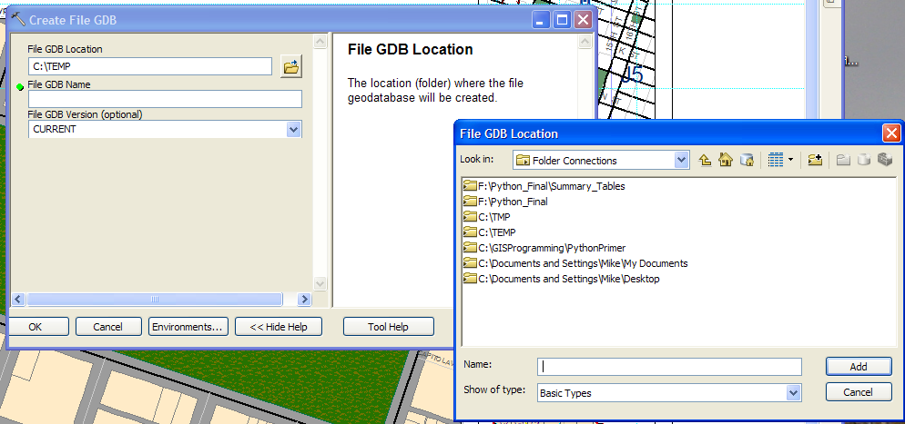
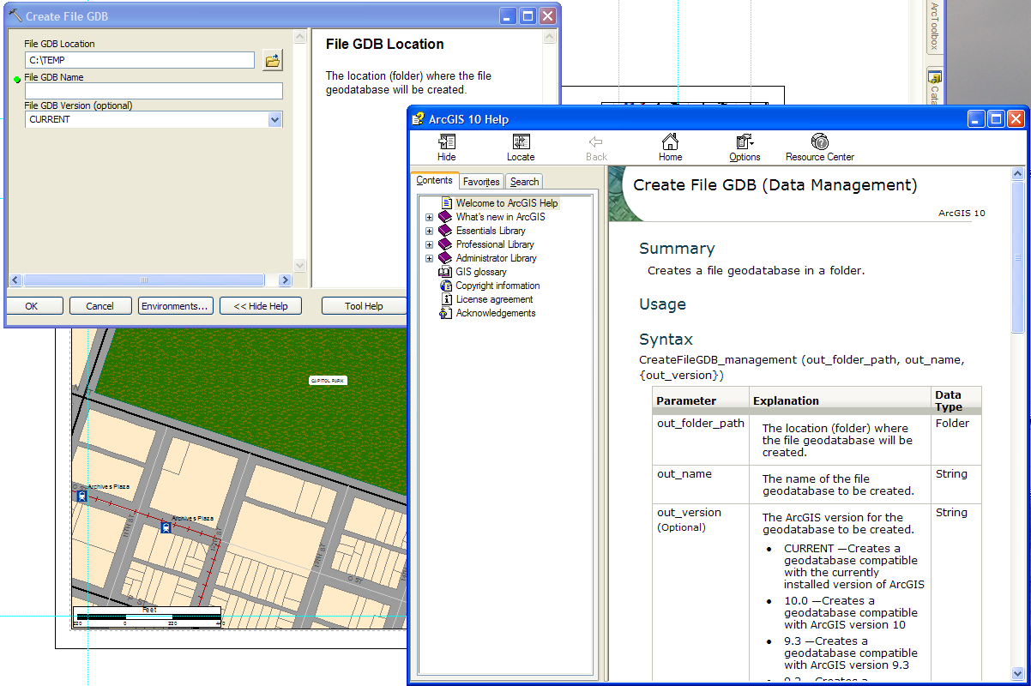
Contents
For example, you can use a tool (geoprocessing function) to create a file geodatabase.
Many tools are as simple to use as this.
Populate the dialog boxes with the required
information and click ‘OK’. This tool requires a
path to the location you want to use, a name
for the file geodatabase and (optionally) the version
of ArcMap you want to be compatible with.
Example code is here at the page bottom
Help for ArcMap scripting
If you have difficulty getting the function to work as anticipated, click on the ‘Tool Help’. Information is available in the help system. More information can be obtained online from many sources, including ESRI @
http://help.arcgis.com/en/arcgisdesktop/10.0/help/index.html. Try the Professional Library.
Help is right here

Slide 6
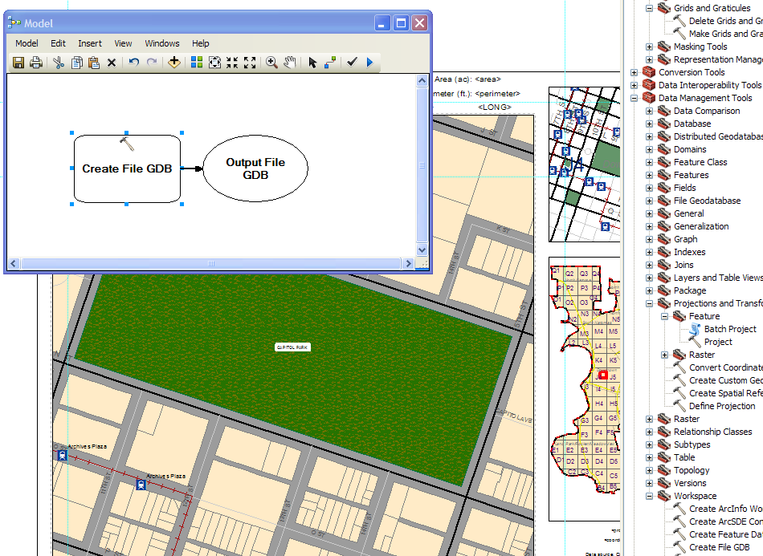
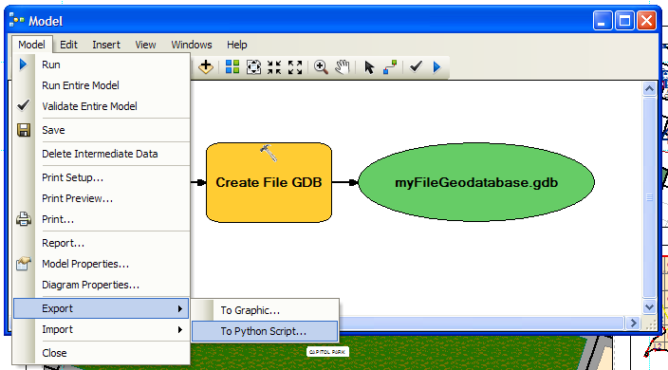
Contents
ArcMap has a Model Builder to help you develop your script.
Many geoprocessing tasks can be implemented using the Model Builder. Open a Model Builder window and drag a tool from the ArcToolbox into the window and release the mouse. You are ready to start using the function to do its task. Double-click on the geoprocessing task (generally the rectangular element with the small hammer icon) and fill in the required information.
The tasks you have designed using the modeling tool can be executed, and then SAVED to a Python language script for you. ArcMap writes the code.
You can design, test, debug and generate much of your script using this single tool. You can limit tasks - that uncomplicates things a bit. This feature allows for rapid development of your script in easy to handle pieces. With the code running this way, you might say, the model builder helps to debug. The code is limited, very focused, and the errors are handed to you. I generally used this method throughout the semester to try out geoprocessing functions I am unfamiliar with and to create my project a piece at a time.

Slide 7
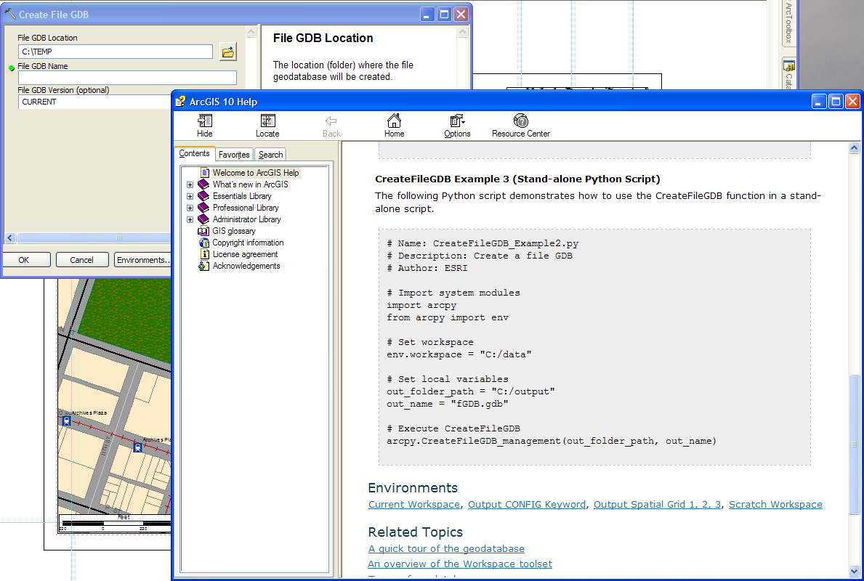
Contents
You can find example code in many of the tool help pages to get you
experimenting with geoprocessing code quickly.
You can cut and paste this code directly into a text editor. You will likely need to change some of the values to suit your system. For instance, change the paths to point to the location you want your geodatabase to reside in.

Slide 8
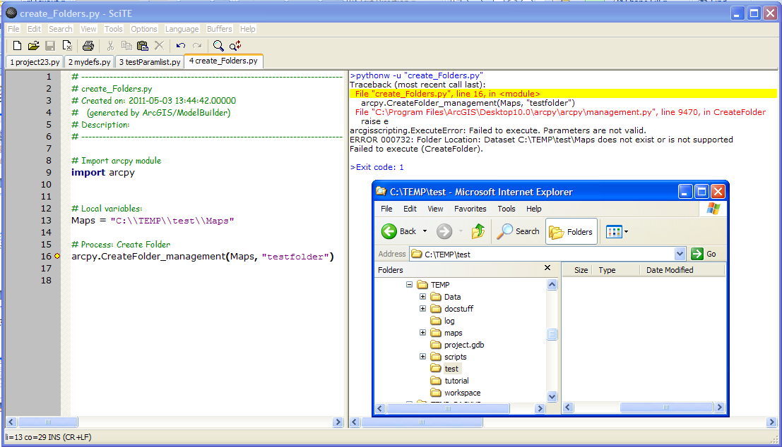
Contents
With the Python language script created by the Model Builder, or one of your own,
you can begin modifying the code using IDLE, or an editor of your choosing.
You can use Python’s IDLE editor which works really well, or select an editor you prefer to run Python code. I like SciTE. http://www.scintilla.org/SciTEDownload.html.
I think SciTE is worth using for the feature as shown below. Syntax checking is another great help. It helps me to troubleshoot my mistakes (and there are a lot of those!). Select Tools, then Run.
This example script attempts to use geoprocessing functions to create a folder in a folder that doesn’t exist. The script is attempting to make a folder named ‘testfolder’ in a folder named ‘Maps’. The problem is that the folder ‘Maps’ doesn’t exist. Note the error message in the right pane of the editor. The yellow highlighted line (I clicked it) is explaining the error and the corresponding line of code where the error occurs, represented with the yellow dot in the line numbered margin of the left pane. By clicking on the error in the right pane, you can locate the error (or nearly). This is showing the details of the traceback.
By naming the error that is thrown, (ExecuteError), the editor helps you. Now you can write an exception to catch it - further simplifying and time saving.

Slide 9
Contents
About the project script.
This is a simple script. The project data (shapefiles) come from Sacramento City and County GIS download sites. Every part of this project will be familiar to a GIS student; it’s similar to assignment 9.
The script first performs a few steps prompting for user input (two variable values used to select how to make the maps) using a simple menu. The user is prompted to keep or create a new geodatabase.
The script creates a set of maps based on user criteria: ‘Parktype’ (a field in the shapefile), and the format that the user selects.
Of the parktypes, the GIS department has created 8 values. The user selects one from the menu.
The available formats are: based on city and county shapefiles, and Bing Maps as base layers that come in aerial, hybrid and road layouts. A separate .mxd (4) is provided, one for each format. Again, the user makes a menu selection for this choice.
After the menu prompts are satisfied, the script runs in a loop, making a pass on each row of data in the shapefile. On each pass it performs the same tasks, over and over, until it reads the last row of data from the shapefile and creates the last map in .pdf format. As the script executes, it is writing .pdf files as output into the designated folder. The user can view these .pdf maps as soon as they are written out, to determine if the user wants to stop the script or allow it to continue.
There are many hundreds of data rows (one for each park) and the script takes quite a while to complete. The script never attempts to create all of the possible maps available according to the row count in the shapefile. The script only allows map creation for a particular parktype per run. I wanted to break out the maps into logical groupings based on format and parktype.
The script then writes out parameters and comments to the log file and terminates.

Slide 10
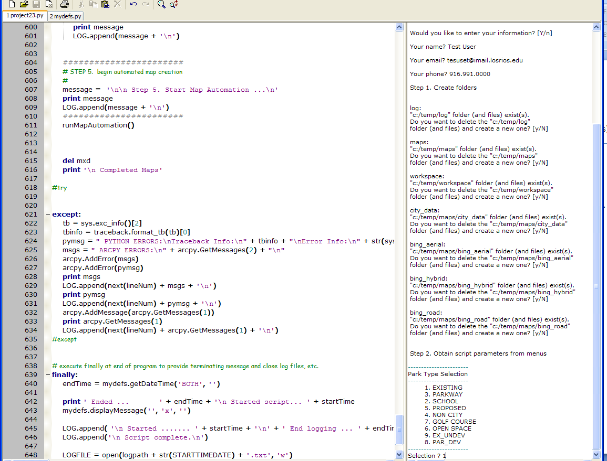
Contents
Running the script in SciTE, you see the following menu choices.
Notice there are uppercase default selections – just press ENTER.
Can you see the problem?

Slide 11
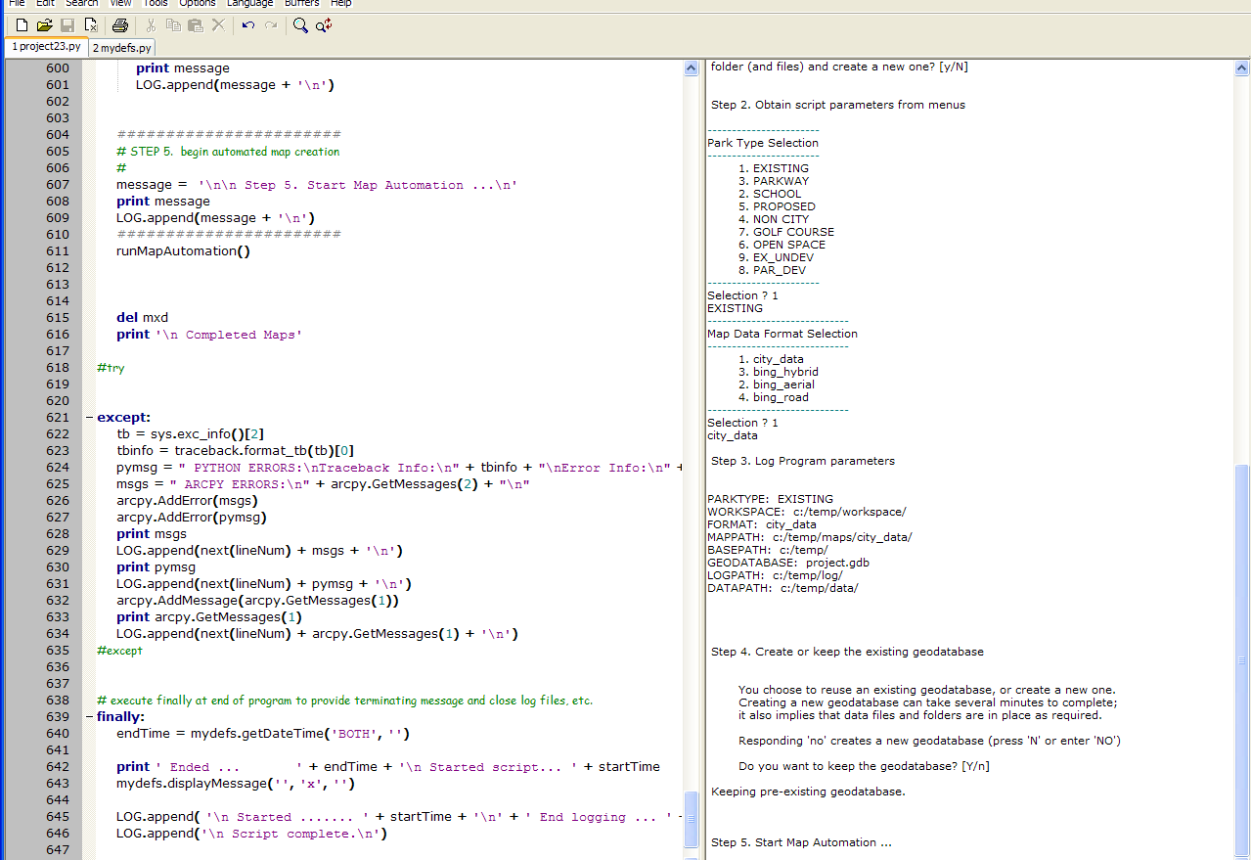
Contents
Running the script in SciTE(cont.)
Here you can see the problem with my menus. Python doesn’t enforce dictionary sorting as you may like it to. This could lead to input errors – not the users fault, but mine.
And again here.
Here you choose to keep or create a geodatabase

Slide 12
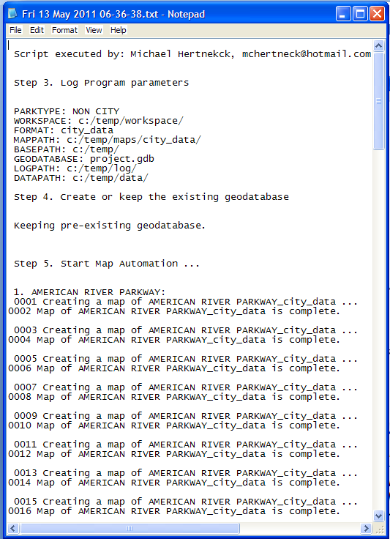
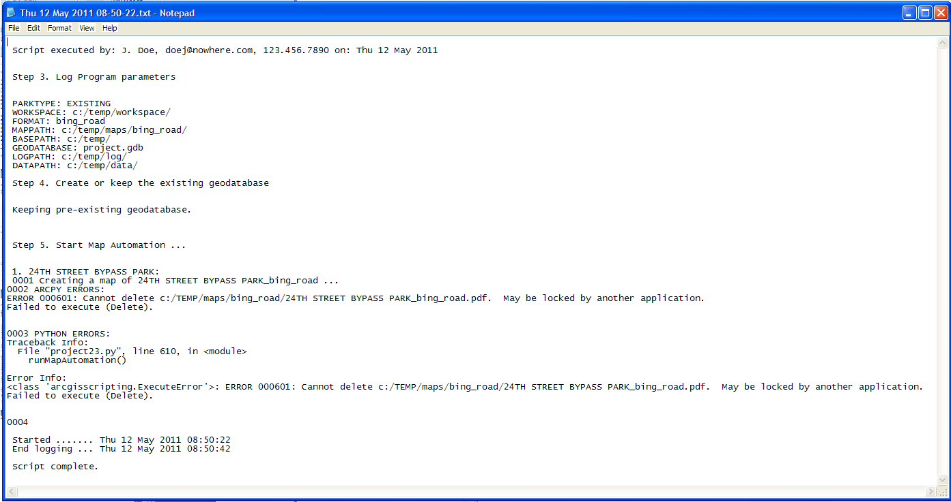
Contents
Error logging. Capture useful information about the script as its running for
debugging and troubleshooting purposes.
Log file without errors
Log file with errors
I should have added more information, i.e. who to contact if there is a problem. Would be a good idea to capture to a database. Python has a built-in sort of database discussed briefly on p.236 of the text called pickle ; a module for storing dictionary objects. It seems like it would be worth getting familiarized with this. Also an email notification of completion would be useful to the user as the script takes a good while to complete, or an error message so you could restart and not lose the time you thought the script was running. The script runs for a long while and encourages you to walk away. Implementing the email notification was proving difficult for me and I dropped the idea for this project.

Slide 13
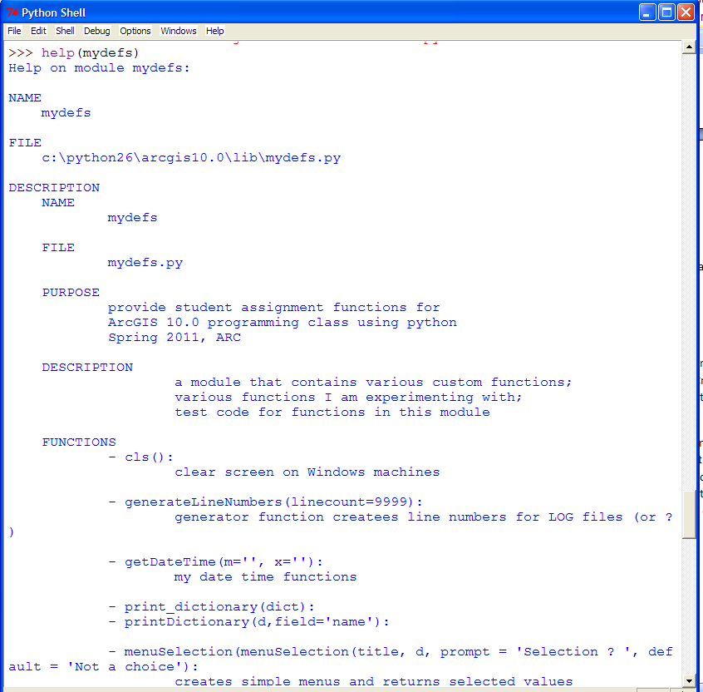
Contents
Documenting code is very useful to the user.
Well written code will provide the user with the required information to properly run the
script with a minimum of difficulty. Also assists others who will reuse your code in the future. Imagine ArcMap without documentation or code samples!
This code used in my script is documented according to the style explained by the text author in Chapter 15: The Documentation Interlude.

Slide 14
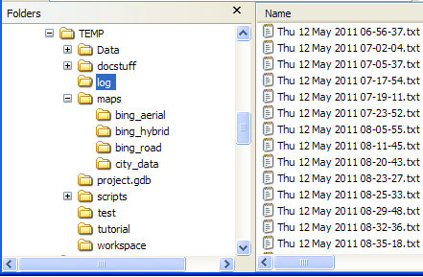
Contents
Geoprocessing in the script.
Many functions were used in this script.
FeatureToPoint(), Delete(), CreateFileGDB(), FeatureClassToGeodatabase(), Clip(), Rename(), GridIndexFeatures(), Exists(), CreateFolder(), ListDataFrames(), ListLayers(), SearchCursor(), Project(), CopyFeatures(), DeleteField(), GetExtent(), ListLayoutElements(), ExportToPDF(),
MapDocument().
Many of these functions were introduced this semester. They required little experimentation, and were able to be cut-and-pasted into my script and modified as required from the examples and assignments. Other functions I’ve not used before were generally used in the manner I explained in the Comments Section: I used the Model Builder, and a bit of trial and error, then exported the script and tweaked it manually in the editor to pass variables and such to get it working, often times in a function to modularize the code a bit to add a little structure to the script.
I will provide a brief explanation of a geoprocessing function in my script.
Here’s an example of a code created using the Model Builder (I’ve modified it a bit). It
creates folders for my project files:
FOLDERS = ['log','maps', 'workspace‘, ‘test’]
MXDfolders = ['city_data', 'bing_aerial', 'bing_hybrid', 'bing_road']
def createFolders(basepath, l, mes=''):
if arcpy.Exists(basepath):
for x in l:
print '\n ' + x + ':‘
if arcpy.Exists(basepath + x):
print ' "' + basepath + x +'" folder (and files) exist(s).'
if mydefs.query_yes_no(' Do you want to delete the "' + basepath + x + '"\n folder (and files) and create a new one?', default='no'):
arcpy.management.Delete(basepath + x)
arcpy.management.CreateFolder(basepath, x)
print '\n Created "' + basepath + x + '" folder.\n'
else:
arcpy.management.CreateFolder(basepath, x)
# createFolders()
Ex.:
createFolders(basepath, FOLDERS)
createFolders(mappath, MXDfolders)
After creating the code using a model and exporting it, it was simple to edit for my
purpose. Placing it into a function makes the code available to use over and over, without reinserting the lines of code each time and producing a monster of a code file. This function creates the required folders for all of my files from a list[] passed through the second parameter, l.

Slide 15
Contents
Geoprocessing in the script(cont.)
Simple data structures.
MXDfolders = ['city_data', 'bing_aerial', 'bing_hybrid', 'bing_road'] # python list – contains folder names per name
FOLDERS = ['log','maps', 'workspace'] # python list[] – contains the path names and folder names
layerNames = ['centerlines', 'parks', 'parcels_without_owners', 'neigh_hd', 'communities', 'light_rail', 'light_rail_stops', 'hydro'] # also the names of the shapefiles
FORMATS = {'1':'city_data', '2':'bing_aerial', '3':'bing_hybrid', '4':'bing_road'} # python dictionary{} used in menu
PARKTYPES = {'1':'EXISTING','2':'SCHOOL','3':'PARKWAY','4':'NON CITY','5':'PROPOSED','6':'OPEN SPACE','7':'GOLF COURSE','8':'PAR_DEV','9':'EX_UNDEV'} # parks.shp row.ParkType values
createFolders(basepath, FOLDERS) # Here you can see how the folders are created from the list[] data.
createFolders(mappath, MXDfolders) # The menus use the same list[] data.
The idea in creating lists and dictionaries was to structure the code to make it easier to pass hardcoded values around to the functions.
I thought it would simplify the code and make it more maintainable.
I was partly successful, but better coding technique will be required to improve this script.
Modular code is useful.
Model Builder can help modularize code. You can work with a simple model until you get it right. You can then export the file into
Python script. This can be placed into it’s own module (.py file) and imported. Once you know it is working, it is a simple matter to
import the module. Here’s a trick I learned from the author of the text and also online. Here’s how to test your module before importing. Setup your .py file similar to this. You write calls to the function, testing parameters and such. You can place dummy data
Into the .py to accomplish this.
def func():
‘’’do stuff’’’
def main():
‘’’ all kinds of code here’’’
func()
# end main()
If __name__ == ‘__main__’:
main()
‘’’ test code here ‘’’
func()
This allows you to test your function in an independent manner, isolated from the remainder of your script. This makes it simpler to debug and troubleshoot. It is useful to test in this manner.

Slide 16
Contents
Geoprocessing in the script(cont.)
####################################
# STEP 4. choice to create geodatabase from scratch
#
message = '\n\n Step 4. Create or keep the existing geodatabase\n‘
print message
LOG.append(message + '\n')
####################################
prompt = ''‘
You choose to reuse an existing geodatabase, or create a new one.
Creating a new geodatabase can take several minutes to complete;
it also implies that data files and folders are in place as required.\n
Responding 'no' creates a new geodatabase (press 'N' or enter 'NO')\n
Do you want to keep the geodatabase?''‘
if not mydefs.query_yes_no(prompt):
buildGeodatabase()
else:
message = '\n Keeping pre-existing geodatabase.\n‘
print message
LOG.append(message + '\n')
This code calls the build geodatabase function.
The actual function code is a lot more detailed than this, but this example demonstrates why you want to modularize your code to make it simpler to use. Isn’t it simpler to call ‘buildGeodatabase()’
than to copy and paste nearly 100 lines of code (with comments, print statements, etc.)? Place reusable code in a module, something like myGeoprocessing.py., and include an import statement to read it. Keeping your code modularized makes it easier to maintain. All the edits need occur only once, in one place.
def buildGeodatabase():
arcpy.management.Delete(basepath + geodatabase)
arcpy.management.CreateFileGDB(basepath, geodatabase, "CURRENT")
arcpy.conversion.FeatureClassToGeodatabase(clippingdatafile, basepath + geodatabase)
# begin populating geodatabase with processed shapefiles
for filename in layerNames:
arcpy.analysis.Clip(datapath + filename + '.shp', clippingdatafile, datapath + 'Clipped_' + filename + '.shp')
arcpy.conversion.FeatureClassToGeodatabase(datapath + 'Clipped_' + filename + '.shp', basepath + geodatabase)
data_type = "Feature Class“
arcpy.management.Rename(basepath + geodatabase+ '/' + 'Clipped_' + filename, basepath + geodatabase + '/' + filename, data_type)
if arcpy.Exists(datapath + 'Clipped_' + filename + '.shp'):
arcpy.management.Delete(datapath + 'Clipped_' + filename + '.shp')
# for
# additional geoprocessing
grid_index_mile = geodatabasepath + 'grid_index_mile‘
arcpy.cartography.GridIndexFeatures(grid_index_mile, geodatabasepath + "citybndy",
"INTERSECTFEATURE", "NO_USEPAGEUNIT", "", "1 Miles", "1 Miles", "6687129.00021085 1921798.0605931", "18", "11", "1", "LABELFROMORIGIN")
createCentroidMark(geodatabasepath + 'parks', geodatabasepath + 'park_centers')
createCentroidFeatureClass()
# buildGeodatabase()
buildGeodatabase()
with comments removed.

Slide 17
Contents
Problems and Resolutions.
Centroid calc, menus, scalebar, numbers and punctuation ( ‘ , / ) characters in names.
It may seem a bit strange, but I had difficulty with the records in the parks.shp, where the PARKNAME column data has numeric, or punctuation characters in it, the park’s name. I was able to fix the problem with the / (forward slash) character. It occurs when the name of the park is attempting to be concatenated into the name of the map file. Windows doesn’t allow this character in a file name. I masked this character by replacing it with a blank space, using string.replace(parkname, ‘/’, ‘ ‘).
The number and apostrophe problem was not resolvable. I don’t see how to fix it. You can see the problem in the Map#2, slide 18.
There is no park feature displayed (indicated as a green polygon). The Bing maps don’t have this problem, of course. A side effect of this is that the next map in the queue, in a manner of speaking, often seems to have similar issues.
Menus presented a challenge. To create the simple menus I have required a bit more code than anticipated. I noticed that after I had the script working, there was redundant code. I set to work to minimize duplicate code. Our instructor emphasized pseudocoding early on. Bench checking code before writing it can save time and effort. The problem I have is that I pass a dictionary to the menu function. Python won’t enforce a sort on a dictionary. No guarantee that it will sort the way you want. I was too far in before I caught this bugm after much reading and experimenting. I live with it for now, but it needs to be fixed to prevent user selection errors.
I wanted to provide a center mark in each polygon, labeled in degrees decimal. I though it would be useful to highlight and copy the coordinates and drop them into Google maps URL, for instance, and navigate to the same position – a sort of checks and balances, as well as useful information. This was difficult because the source data files have this data – in State Plane system, in units of feet. I experimented with the CalculateCentroid() from ESRI. Worked ok. But not what I wanted. I tried Calculate Geometry. It works too, but not as I wanted. In the end, I took my source data file, parks.shp, dropped the State Plane system and projected to NAD 83. I then recreated my geodatabase using this altered file. This was the simplest solution. I left the functions in the script that I used to create my workaround shapefiles. These functions still execute when the geodatabase is created and the feature classes are there in the geodatabase, unused.
The scale bar doesn’t size up perfectly as I could wish. It looks a bit sloppy, but I can live with it for now.
Bug: this is a time waster. The main loop, runMapAutomation(), appears to run twice. I haven’t been able to figure out what’s happening.

Slide 18
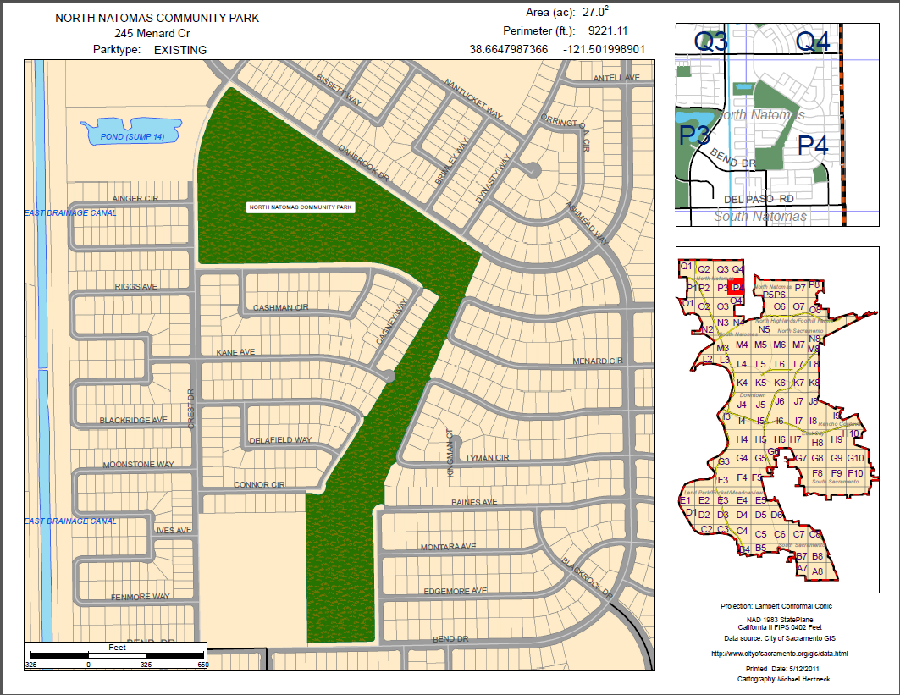
Contents
Example using city data. This is my standard map.

Slide 19
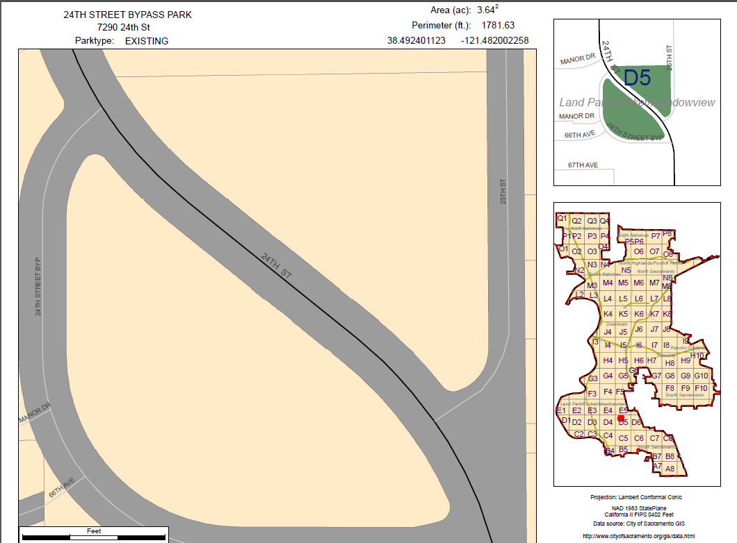
This is my standard map displaying in an error mode.
Contents
A bug exists in my script. No green area park polygon feature appears. In the Park.shp, features with numbers, apostrophes in the PARKNAME field, produced this intermittent error. Unable to explain this. The polygon appears in the upper right scaled view.

Slide 20
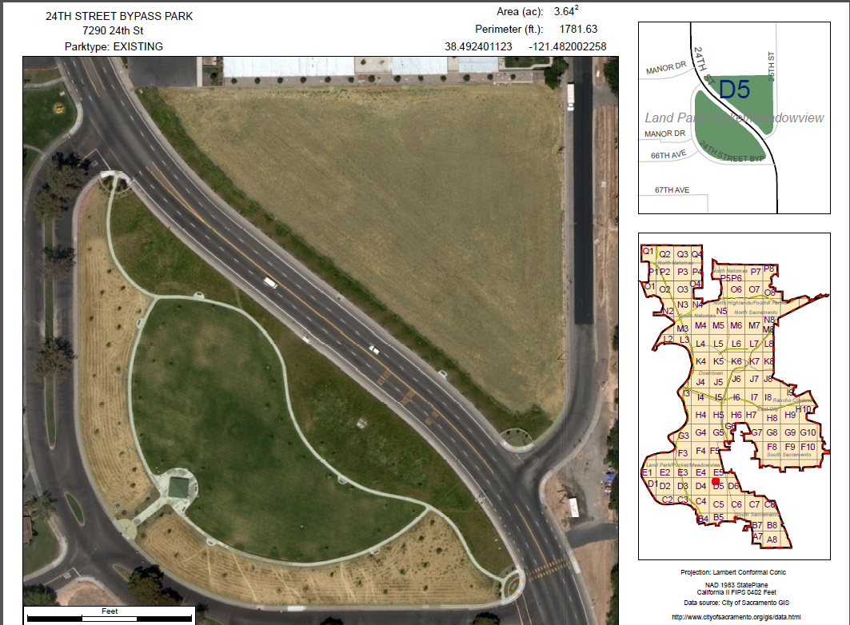
Contents
Bing aerial formatted map

Slide 21
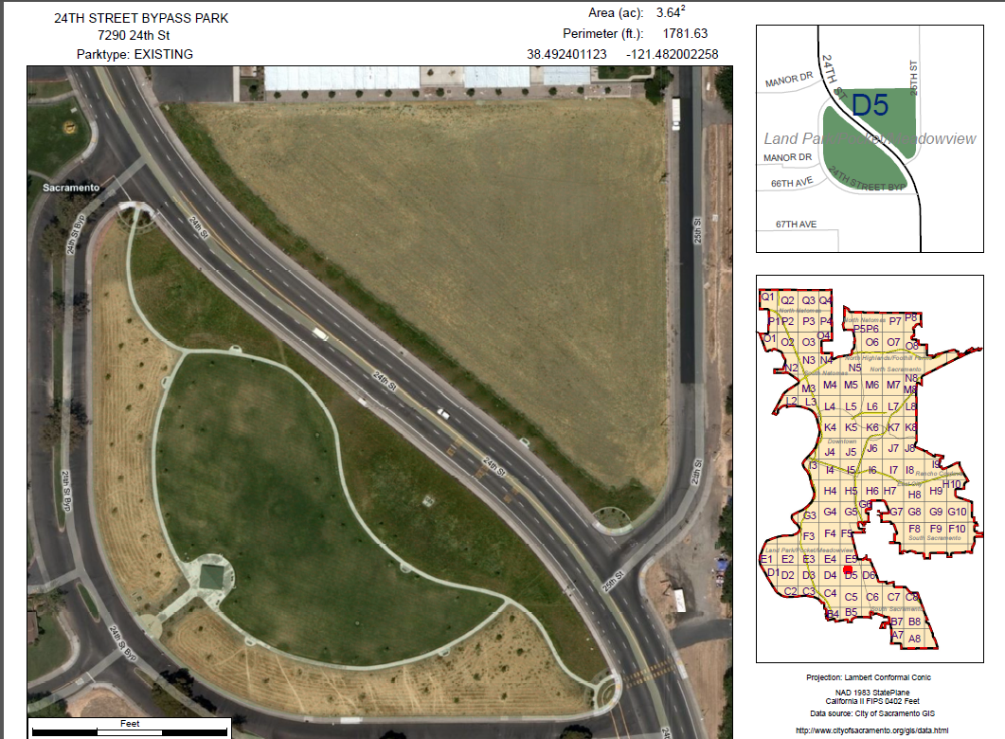
Contents
Bing hybrid formatted map.

Slide 22
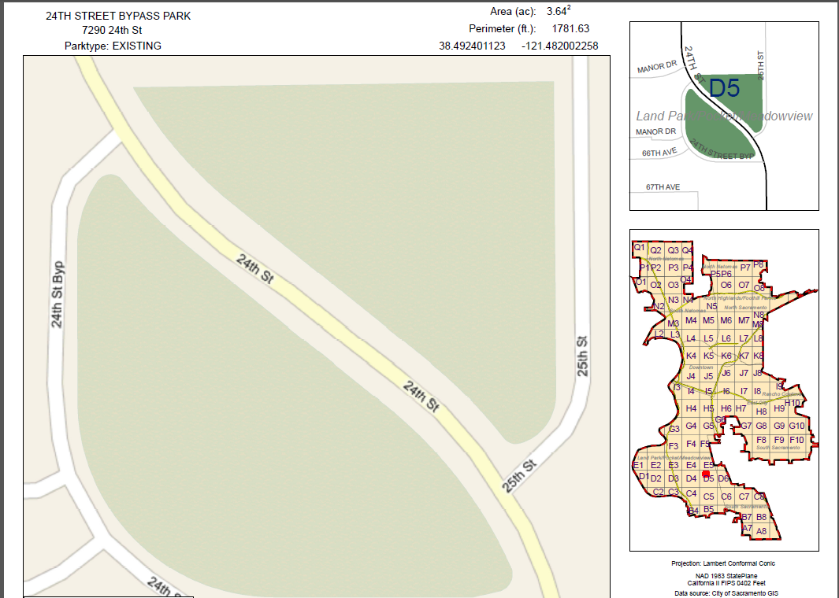
Contents
Bing road formatted map

