Slide 1
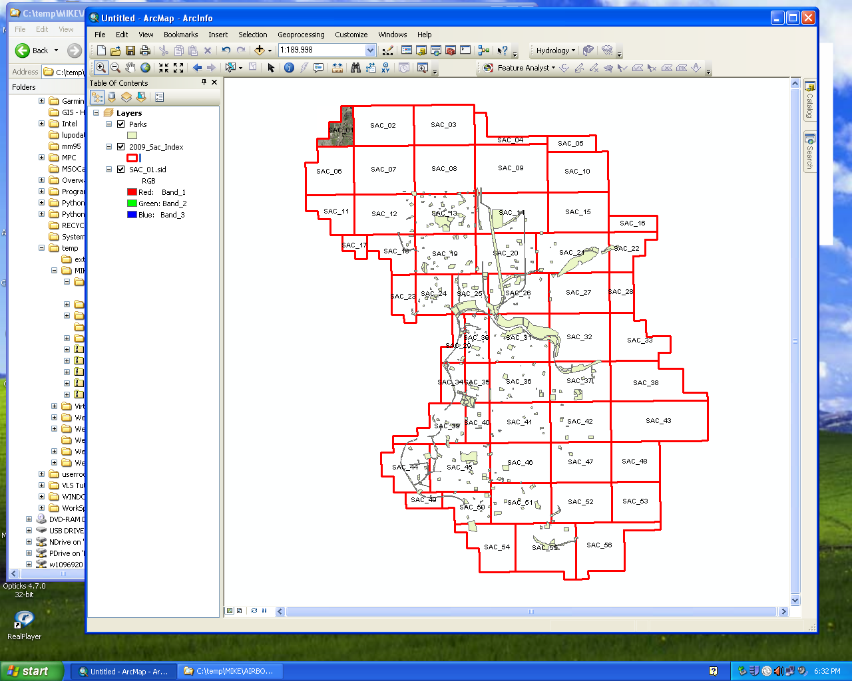
Experimenting with Feature Analyst 5.0
ArcGIS 10.0
Feature Analyst 5.0
GeoExpress
Airborne imagery:
  City of Sacramento
  0.5 foot resolution
  3 bands
  MrSid format
  created 2009
  grid index of images
  metadata

Slide 2
Project preparation
Preview software product
Read tutorials
Review previous student assignments
Test tutorials, experiment
Attempt to duplicate other student results
Try new workflows

Slide 3
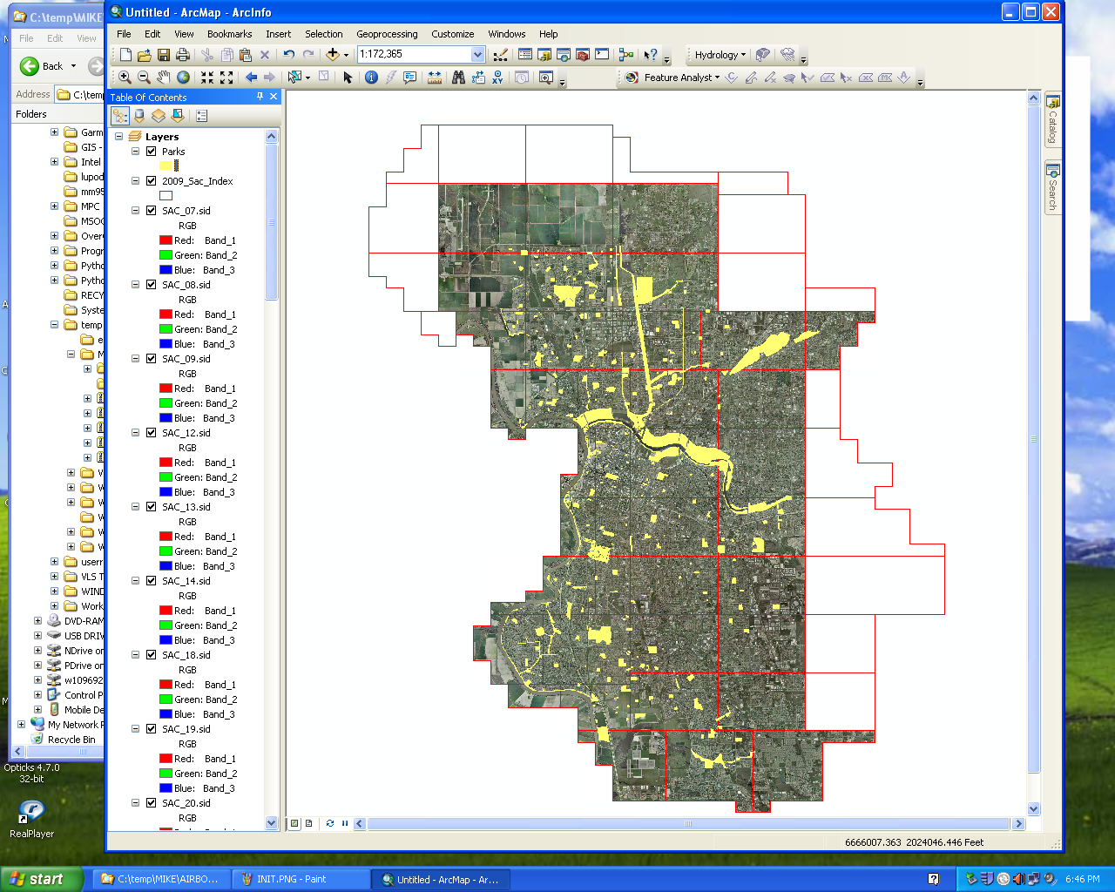
Preview image data
Concentration on urban areas
Supervised learning tool
Single class
Features extracted:
Tennis and basketball courts
Swimming pools
Lakes
Sidewalks

Slide 4
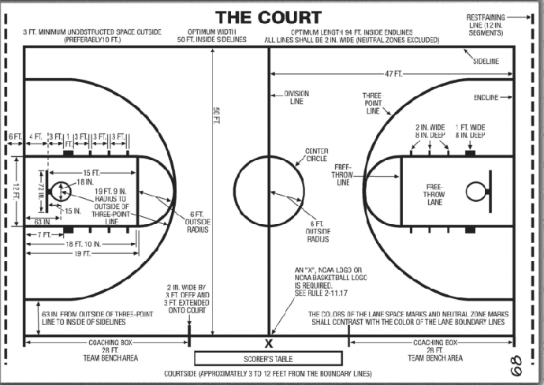
Would additional data be useful?

Slide 5
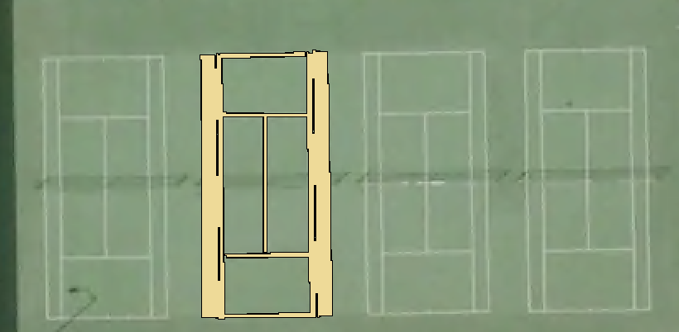
Create a polygon training feature

Slide 6
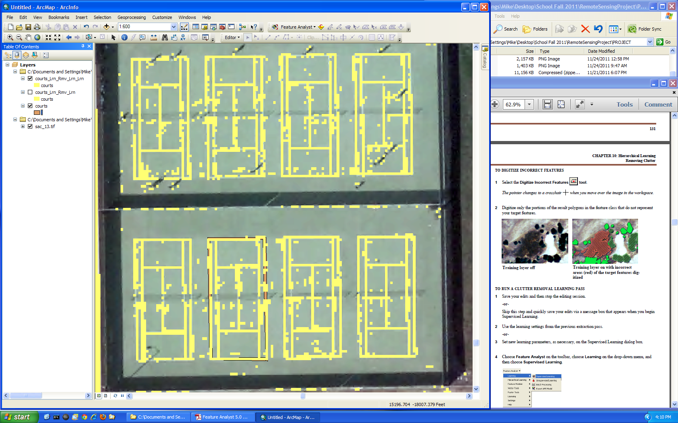
Results of supervised learning

Slide 7
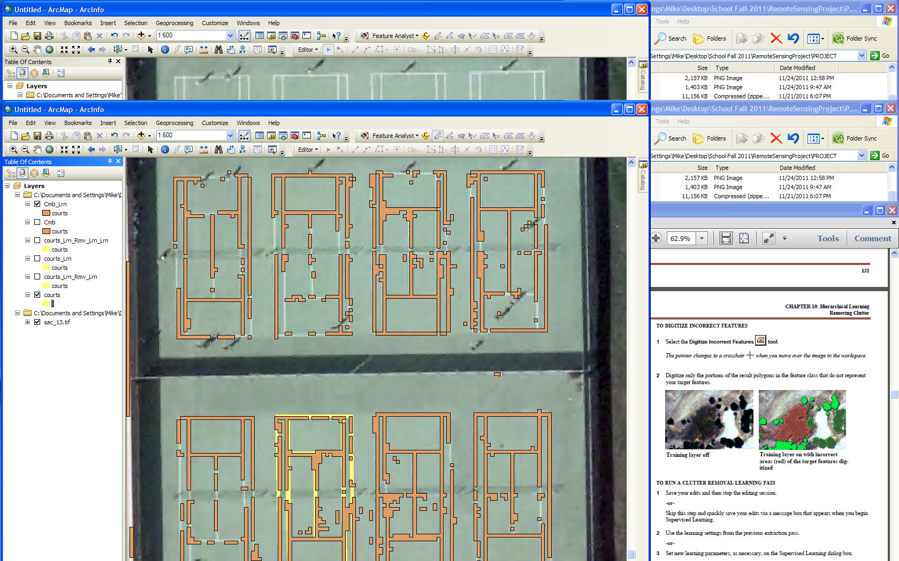
Need to continue digitizing feature

Slide 8
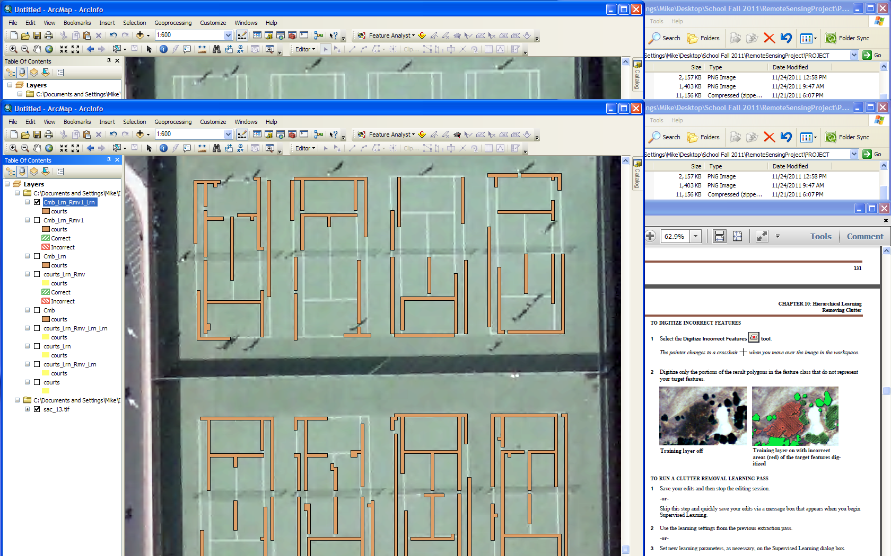
Tennis courts are coming together

Slide 9
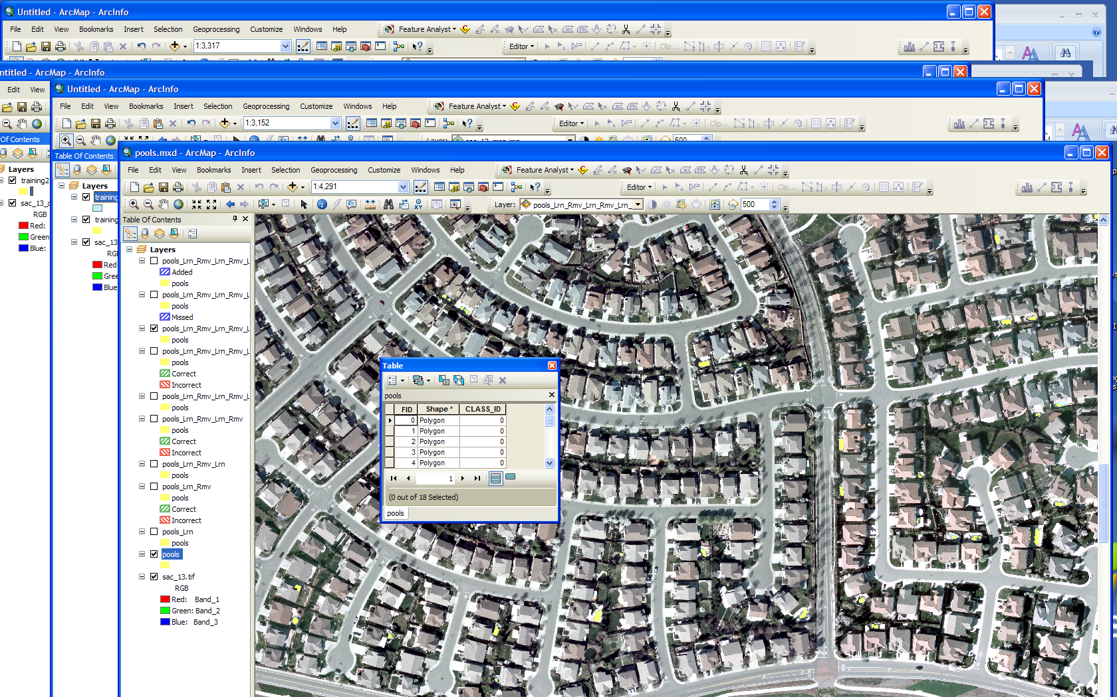
Can I extract swimming pools?

Slide 10
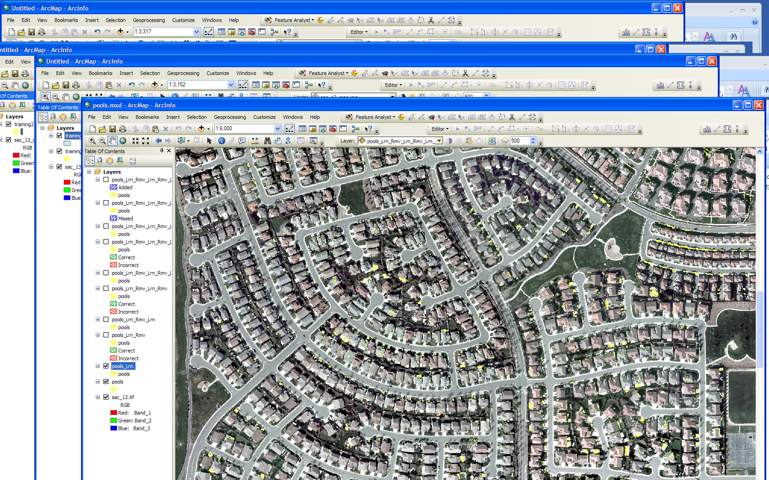
First pass reveals many polygons

Slide 11
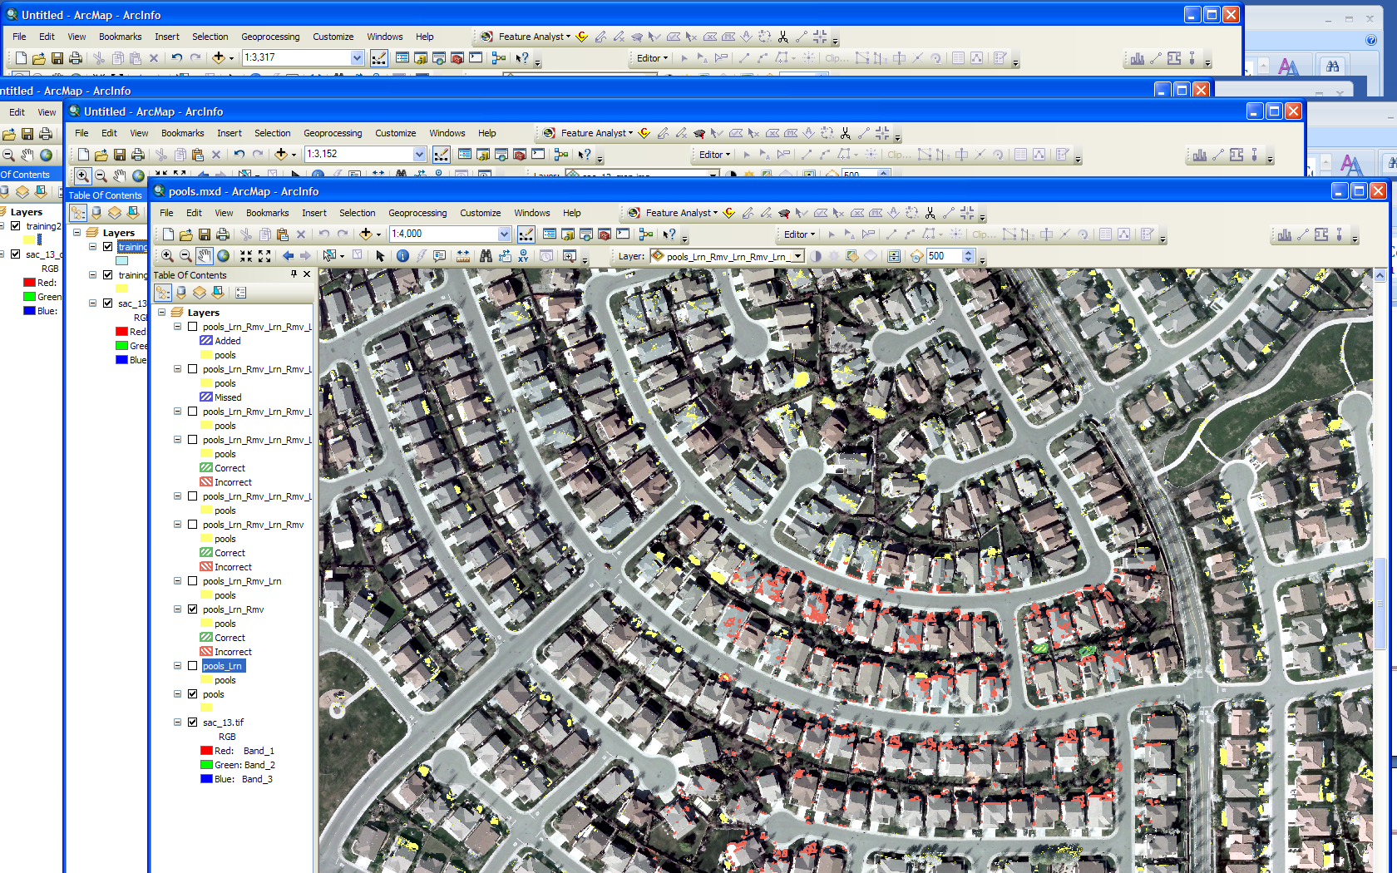
Remove false positives

Slide 12
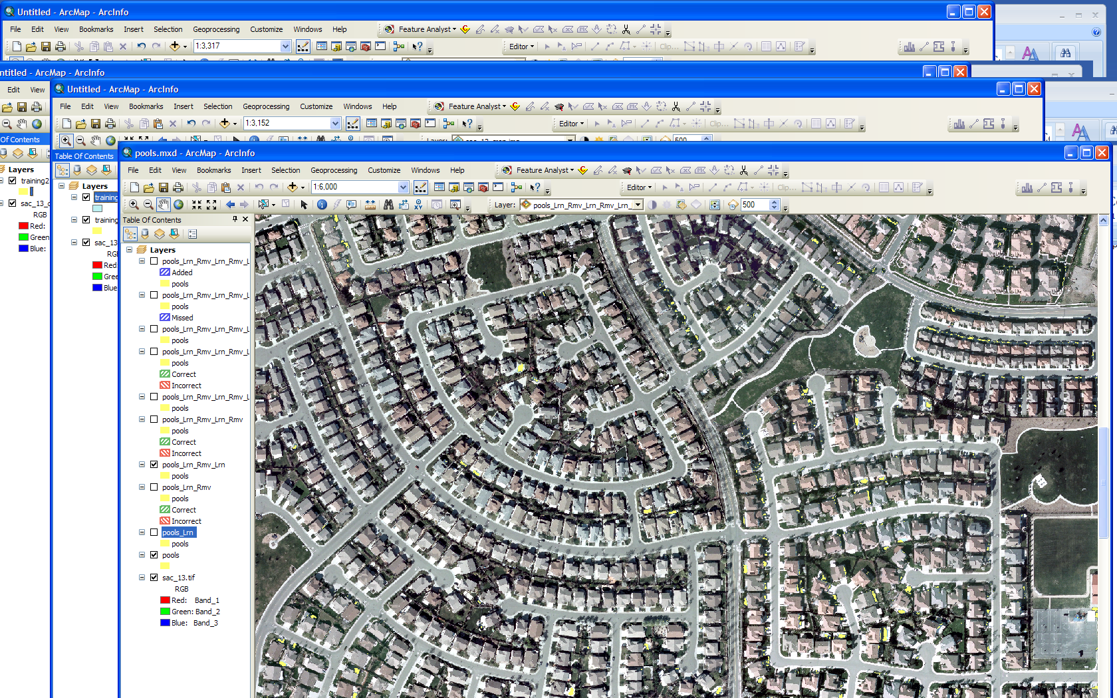
Improved results

Slide 13
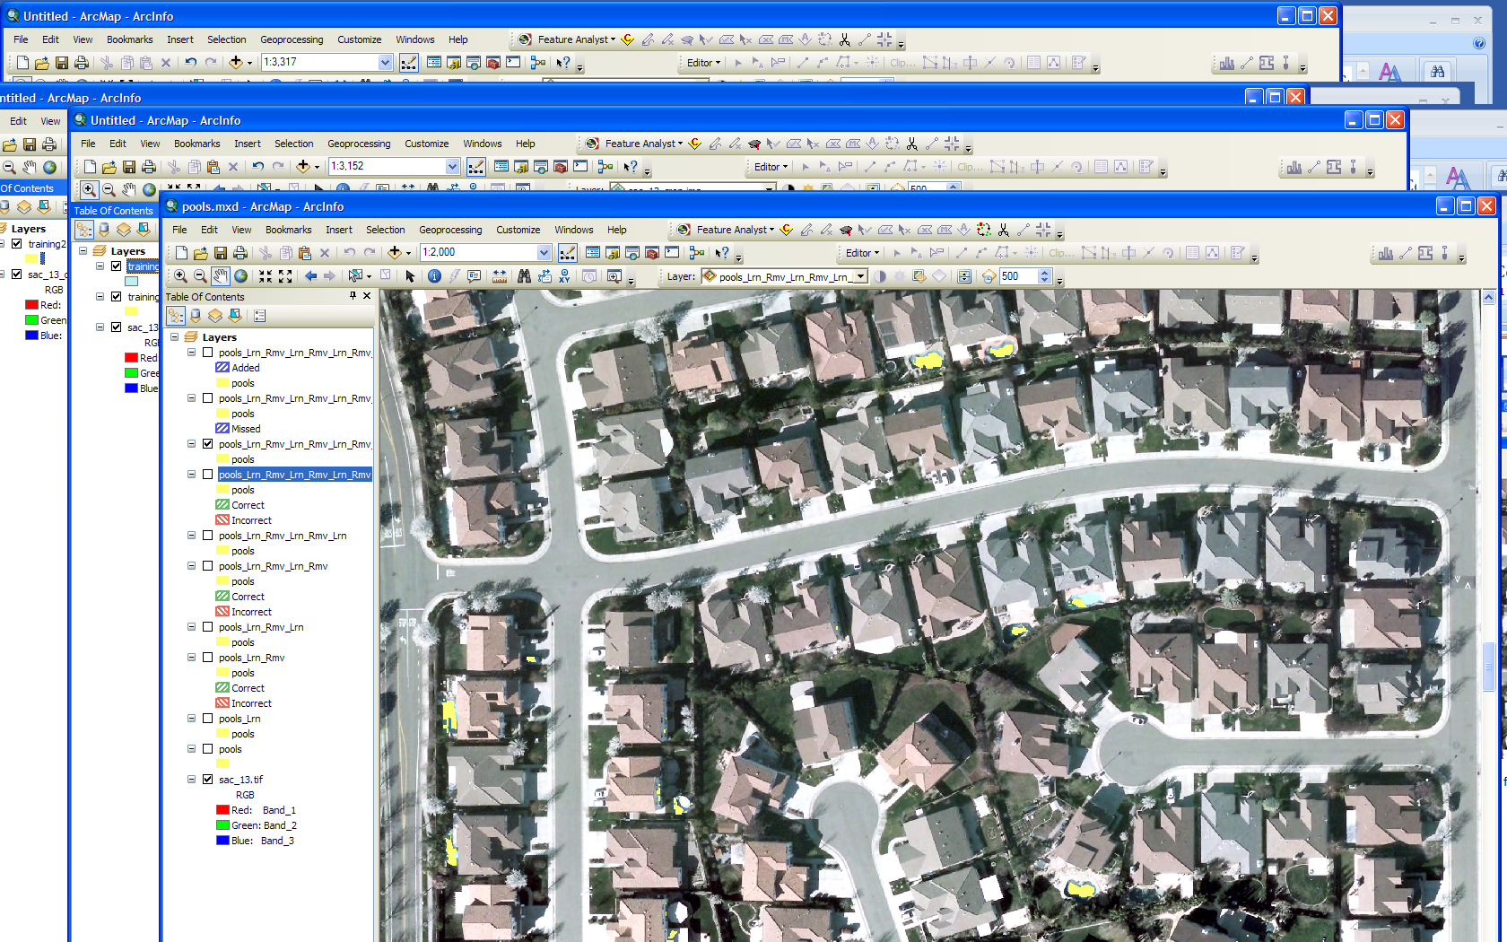
Extraction contains artifacts

Slide 14
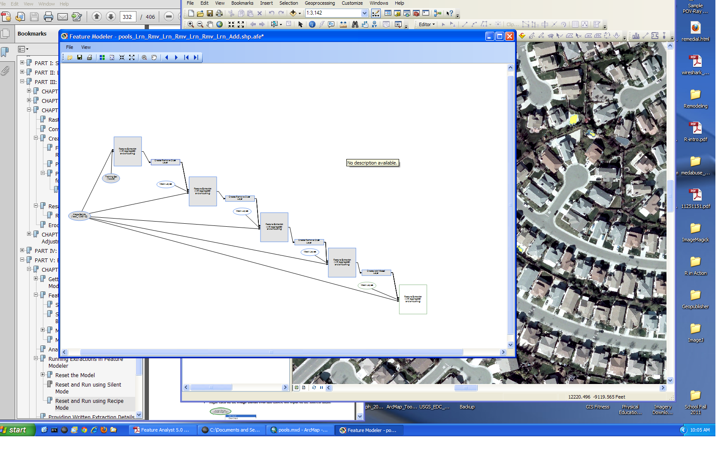
Complete .AFE model

Slide 15
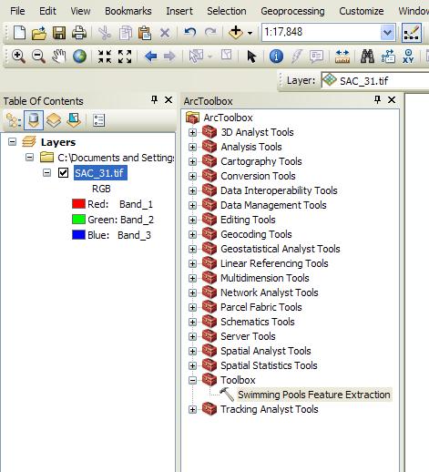
Model added to toolbox

Slide 16
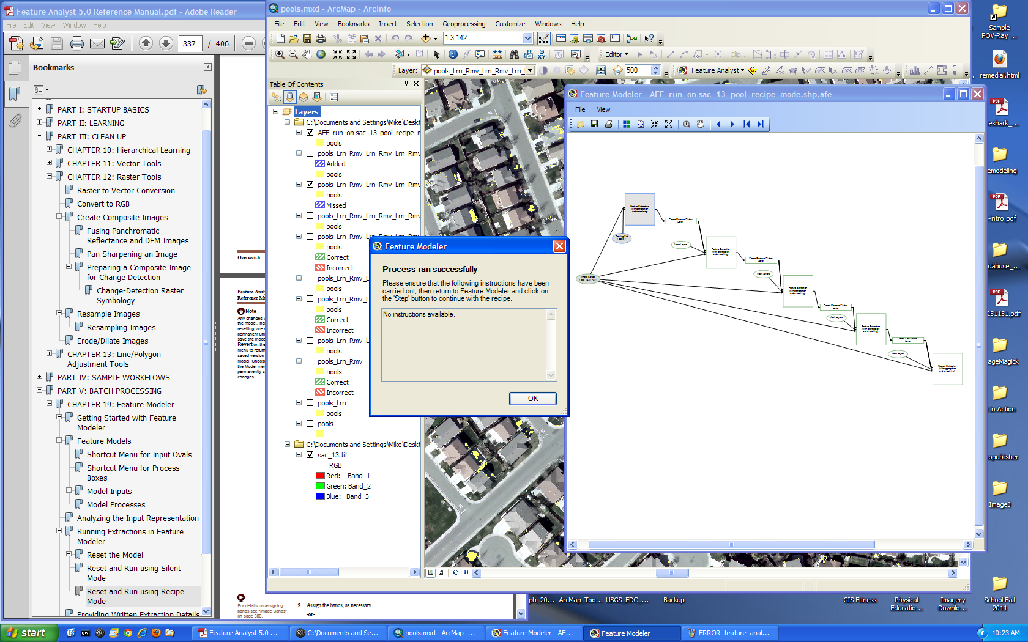
Checking model script

Slide 17
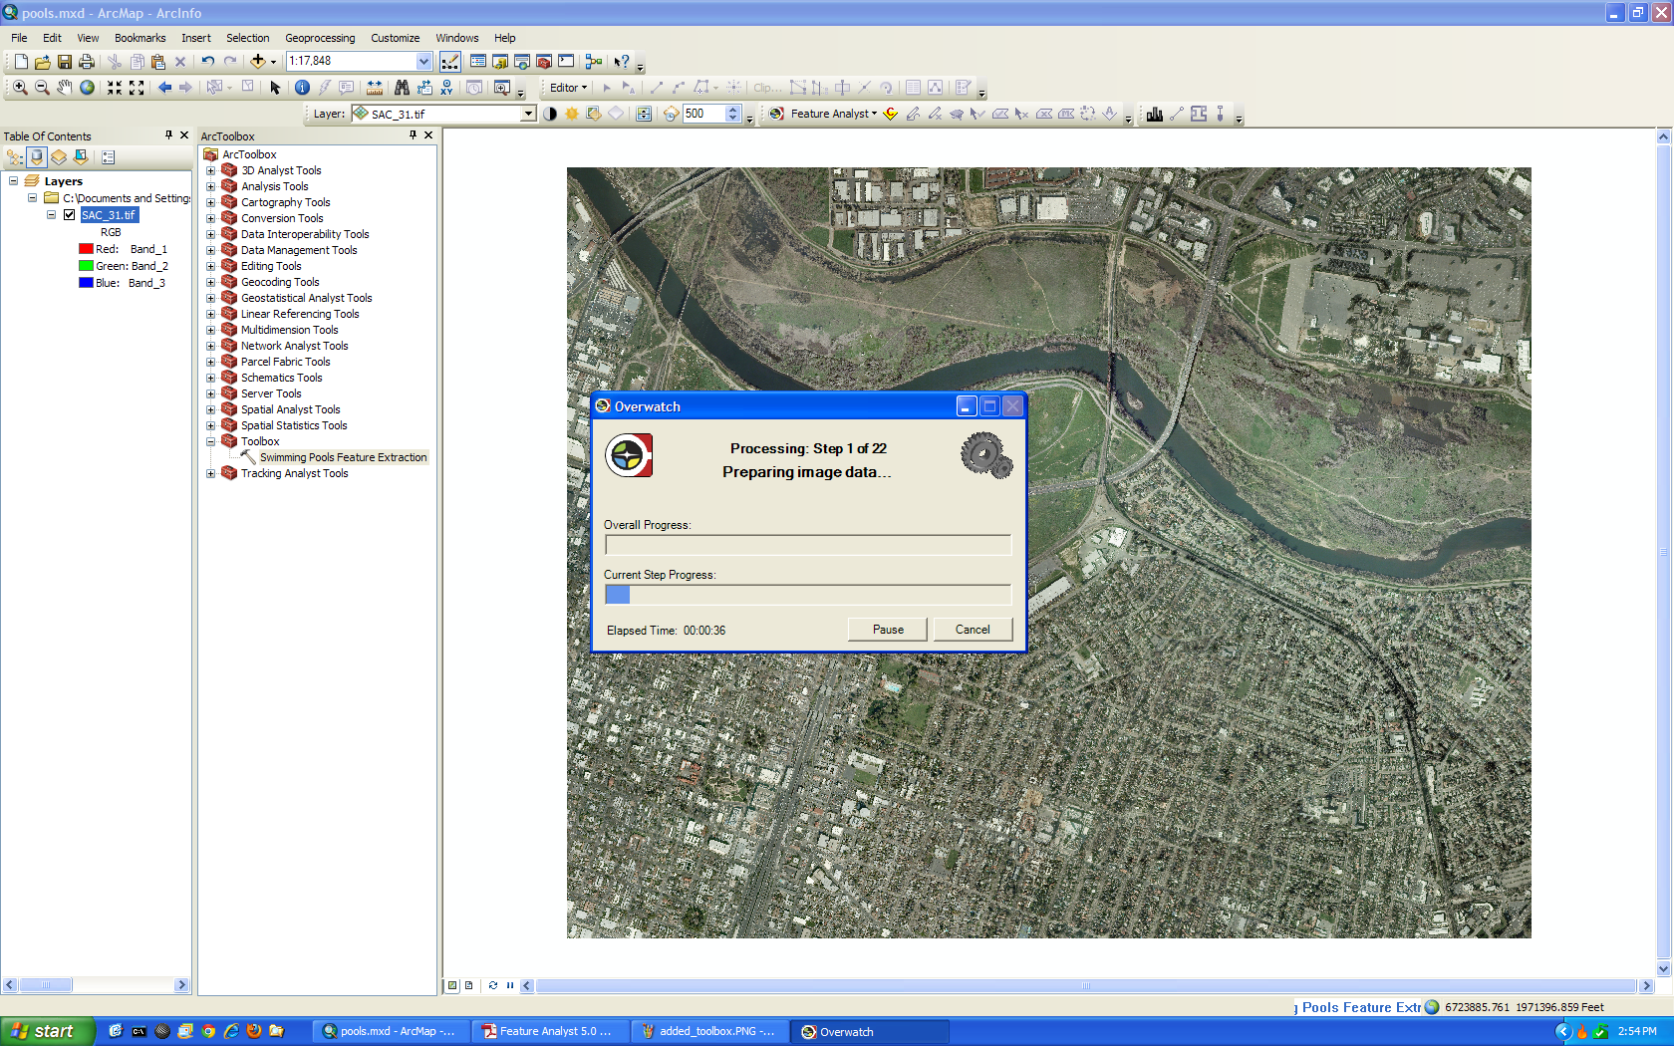
Running .AFE script. Results were not as good as hoped.

Slide 18
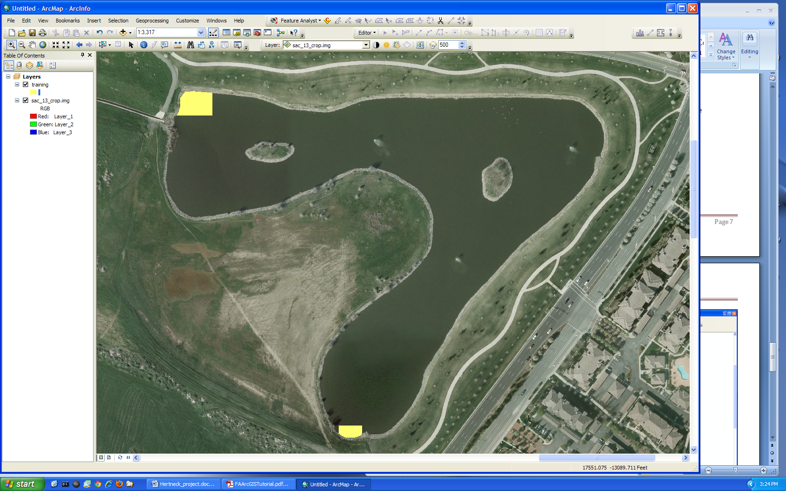
Lake Feature Extraction
Training sites

Slide 19
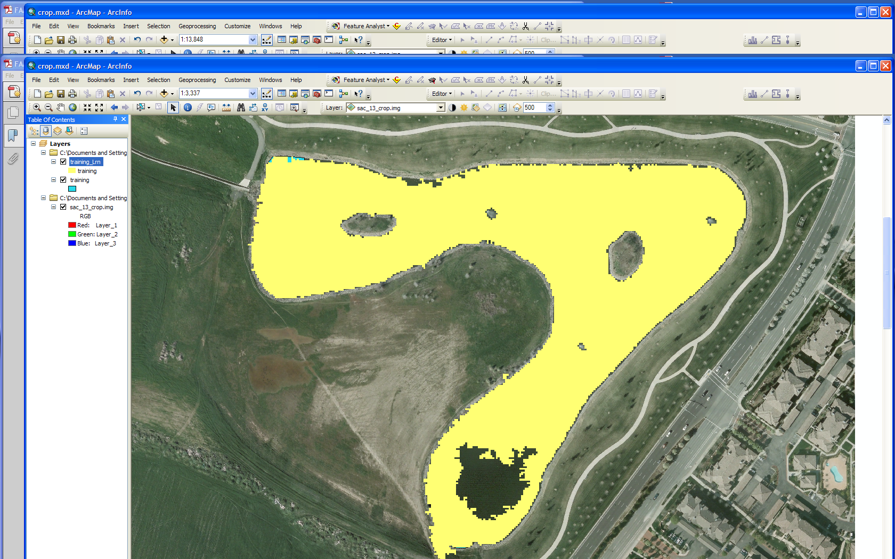
Lake training sites were not well selected

Slide 20
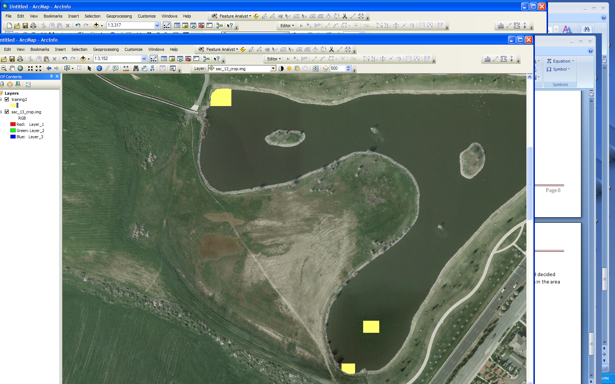
Add another training polygon

Slide 21
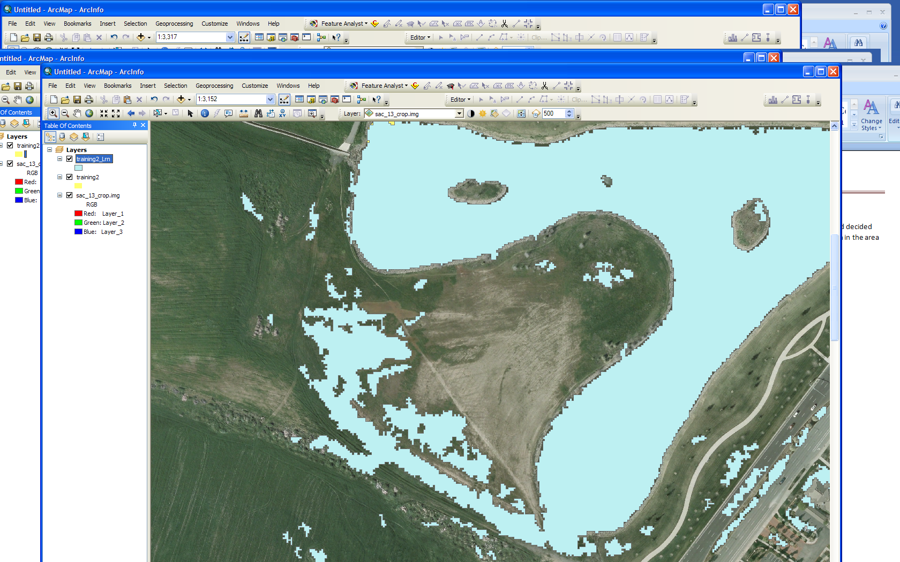
Hole disappears but many false positives. Is there another way to extract the feature?

Slide 22
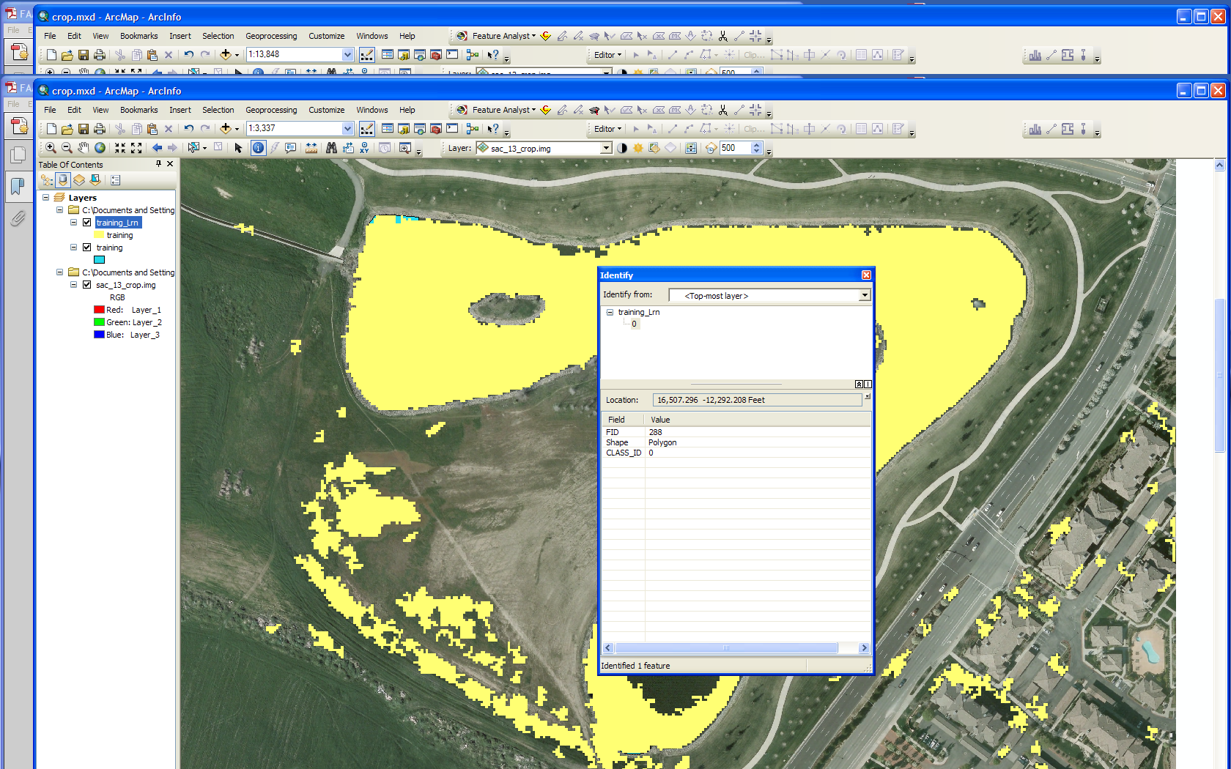
Try another approach

Slide 23
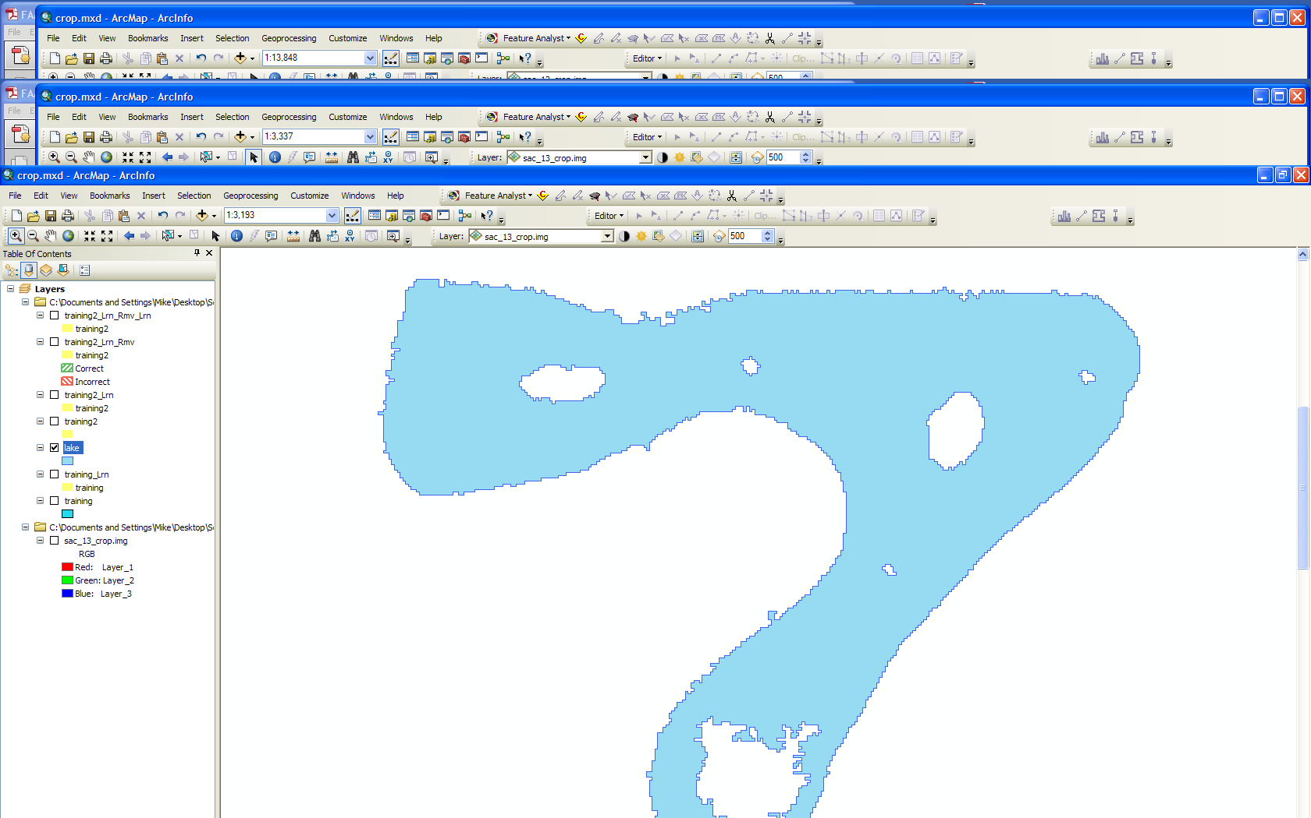
Export feature class

Slide 24
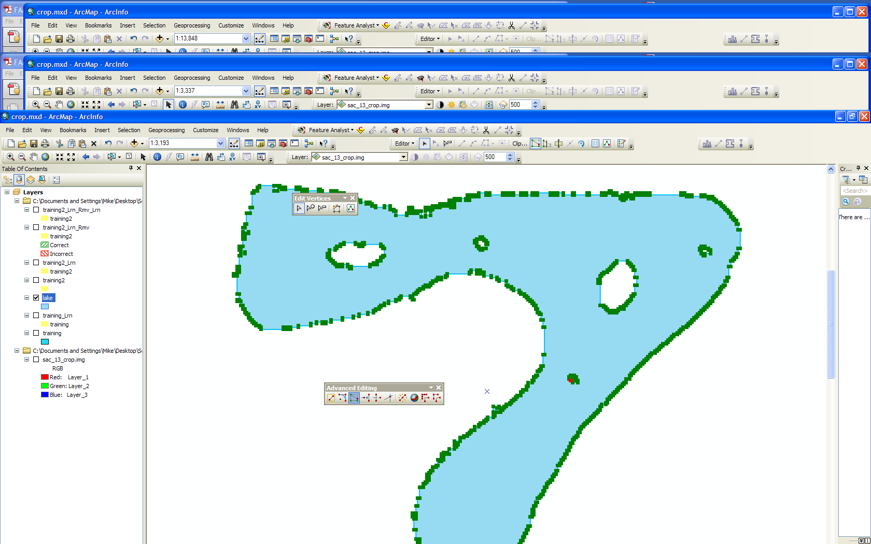
Edited out vertices to fill hole

Slide 25
Conclusion
Feature Analyst is a great product
Works to extract feature classes
Creates model scripts (.AFE) for reuse
Difficult to master – serious learning curve
Easy to work with and get results
Tutorials are helpful

Slide 26
References:
Feature Analyst Tutorials for versions 4.2 and 5.0
http://proceedings.esri.com/library/userconf/proc02/pap0924/p0924.htm
http://www.featureanalyst.com/feature_analyst/publications/success/AFE-Ecog-FA.pdf
http://www.vls-inc.com/feature_analyst/publications/reviews/obrien_asprs.pdf
http://www.jenningsplanet.com/fileadmin/uploads/nj/StudentProjects/Geog342_Spring2010/JSmith_presentation.pdf
http://www.jenningsplanet.com/fileadmin/uploads/nj/StudentProjects/Geog342_Spring2010/JSmith_paper.pdf

