Slide 1
A Brief Interlude Into Opticks version 4.9.1
by Bryan Goodrich
Geography 342 – Remote Sensing – Fall 2012
with Nate Jennings

Slide 2
1. Data Importing
2. Image Properties
3. Image Clipping
4. Image Composition
5. Histograms
6. Band Math
7. Image Classification
8. Opticks Wizards
9. Python Scripting
TOPICS

Slide 3
1. Data Importing

Slide 4
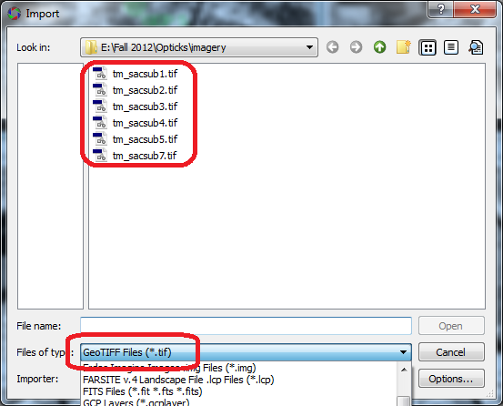
TIFF IMPORTING

Slide 5
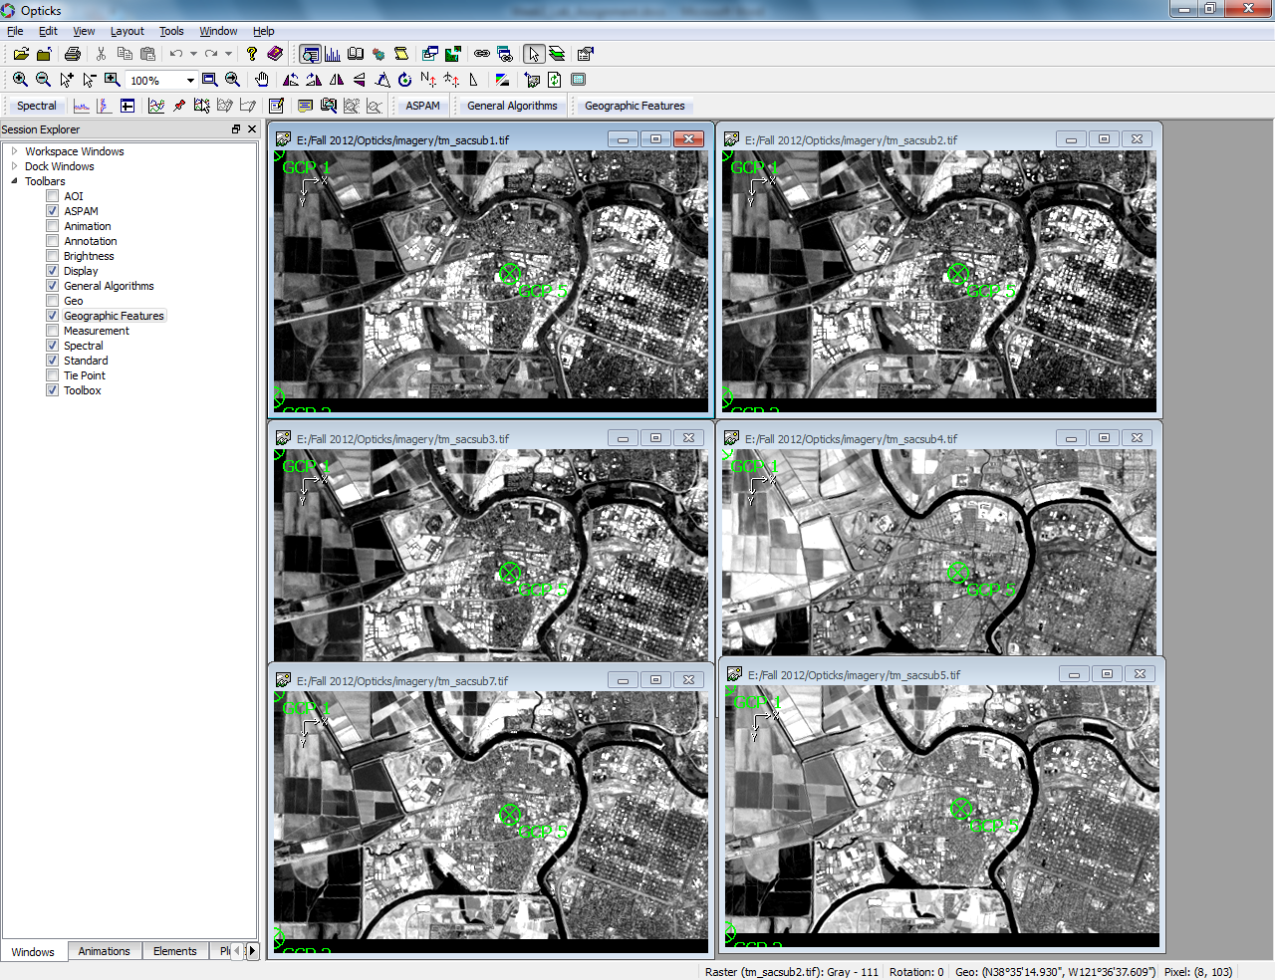

Slide 6
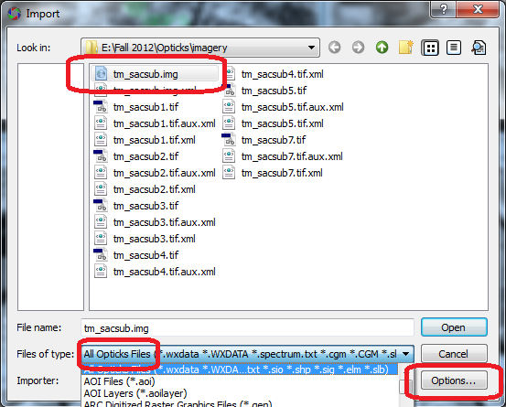
IMG IMPORTING

Slide 7
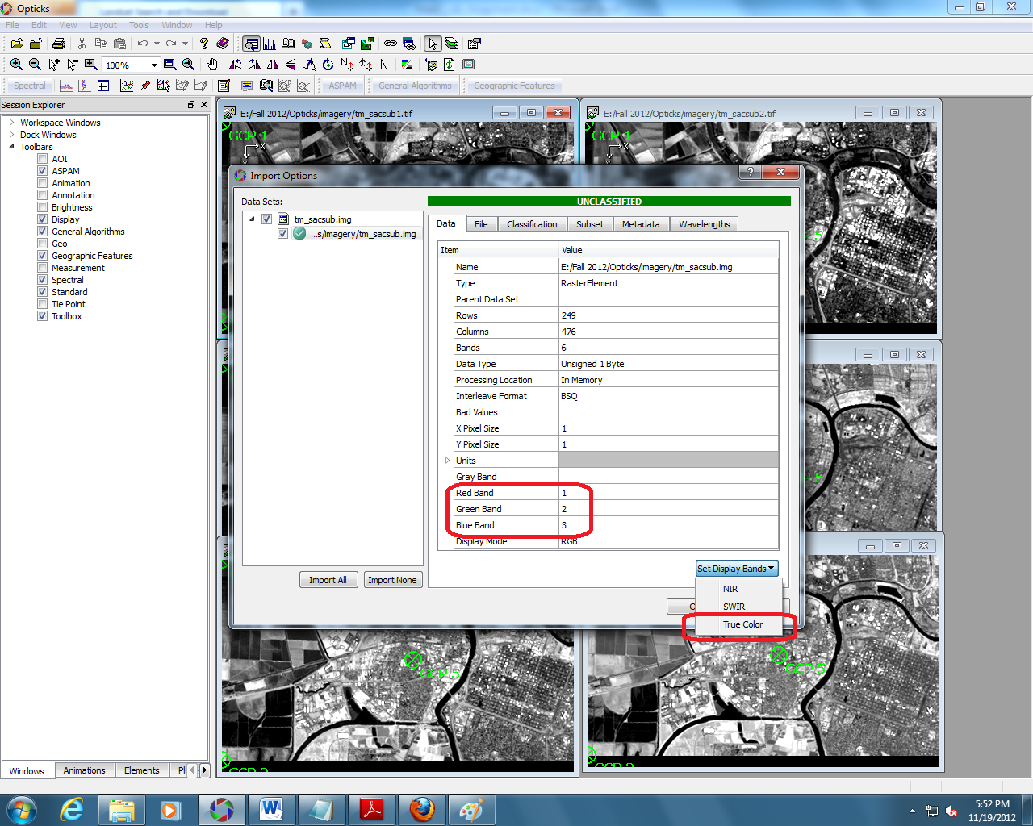

Slide 8
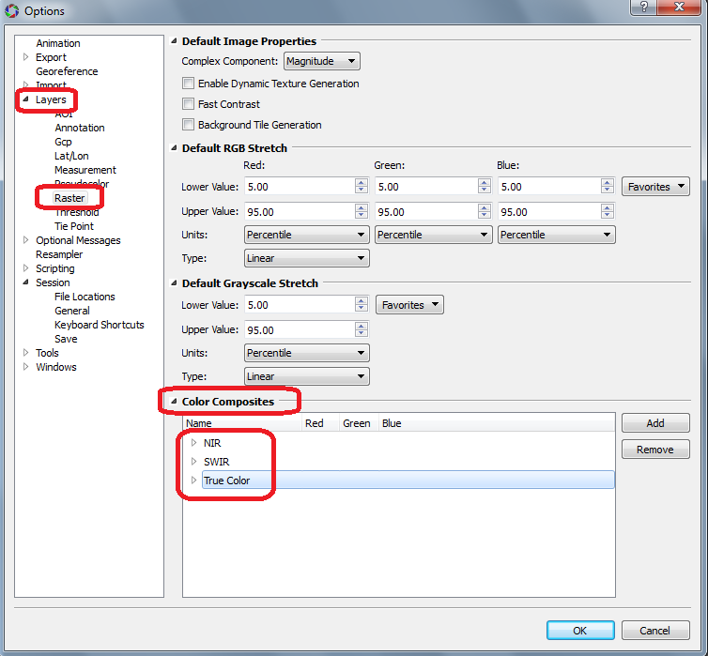

Slide 9
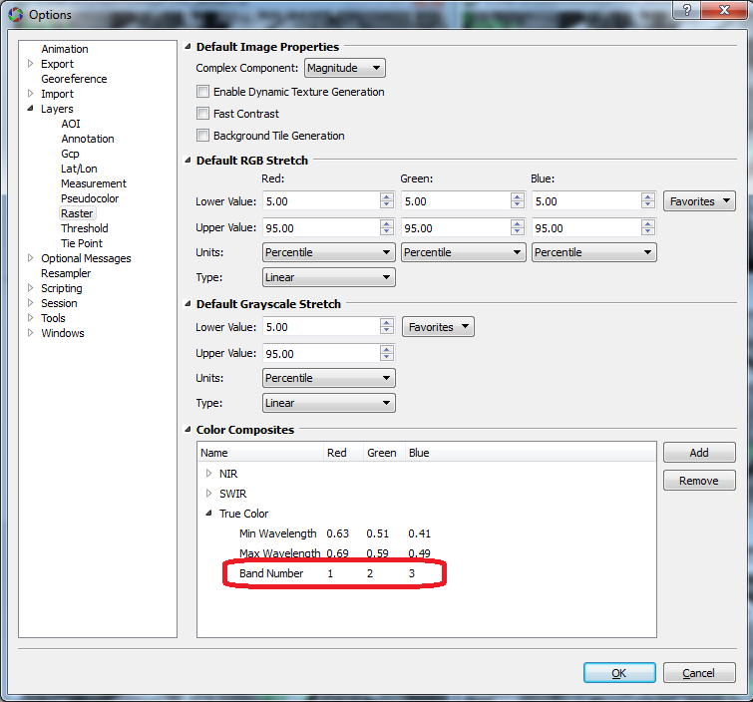

Slide 10
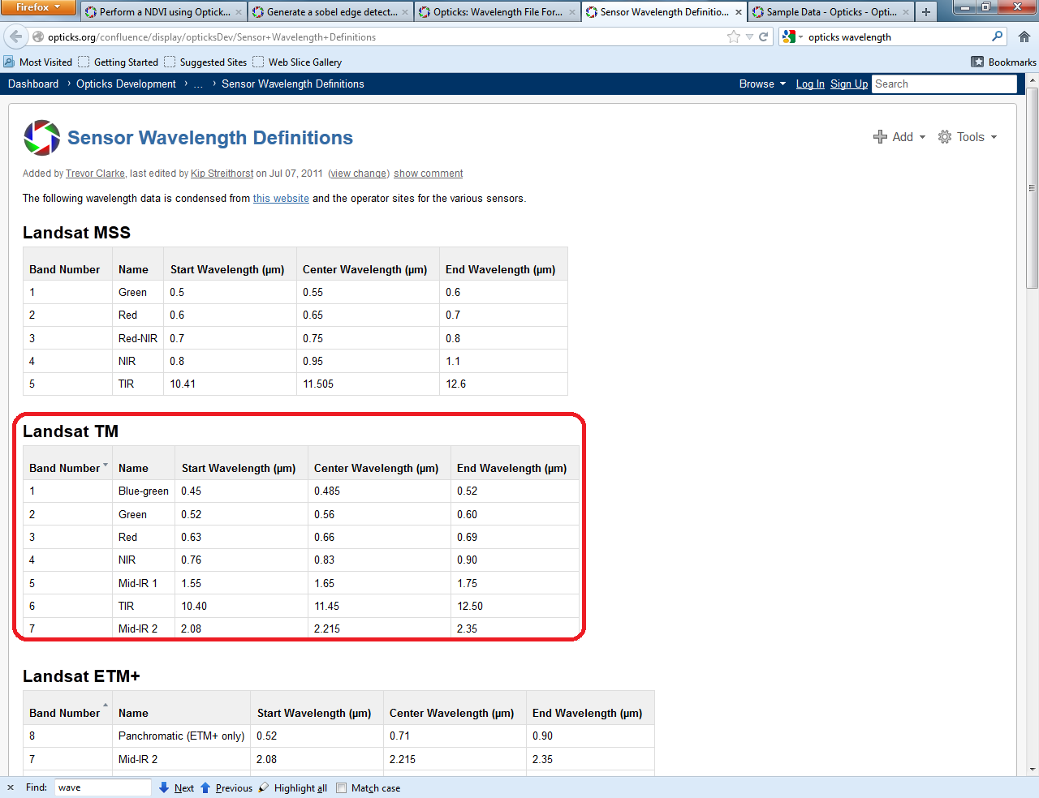
http://www.opticks.org/confluence/display/opticksDev/Sensor+Wavelength+Definitions

Slide 11
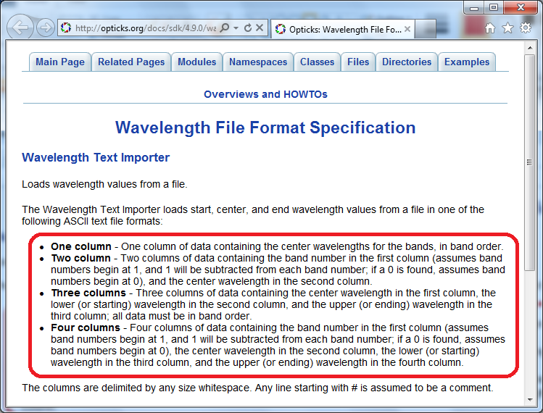
http://www.opticks.org/docs/sdk/4.9.0/wavelengthformat.html

Slide 12
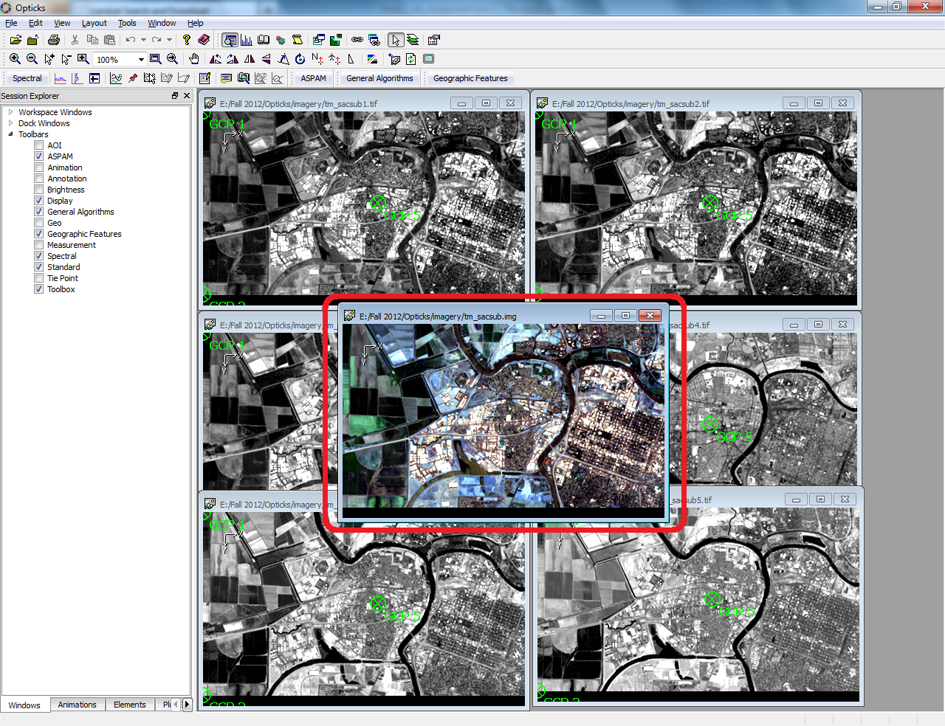

Slide 13
2. Image Properties

Slide 14
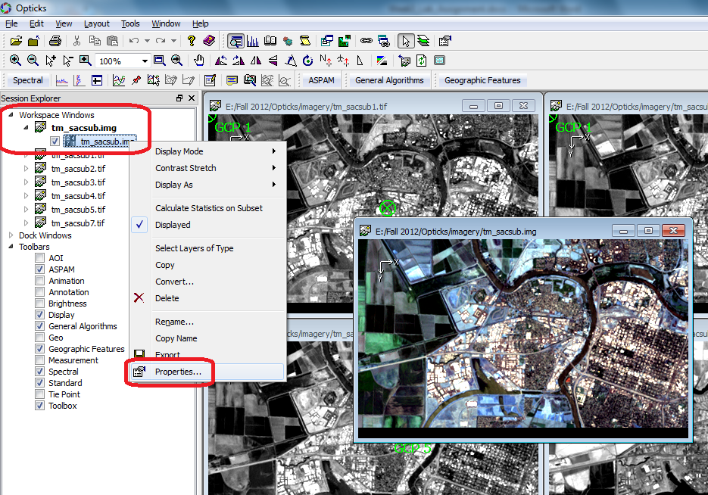

Slide 15
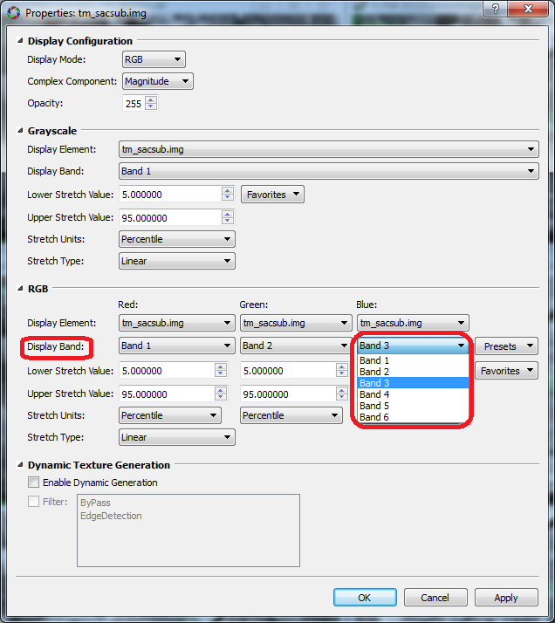

Slide 16
3. Image Clipping

Slide 17
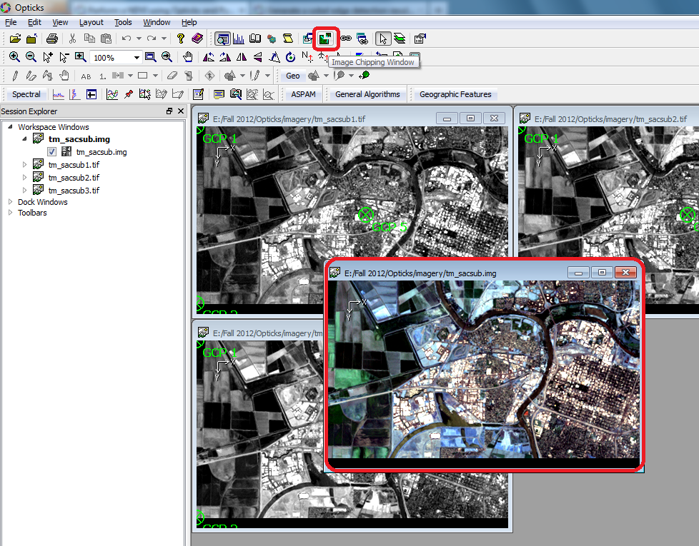

Slide 18
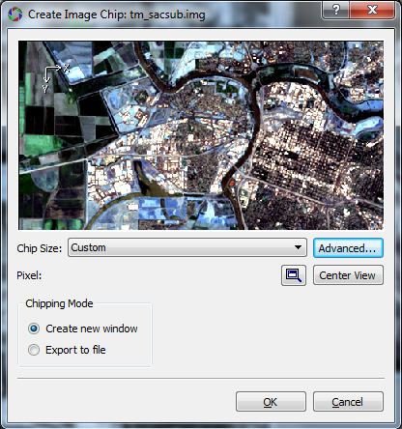

Slide 19
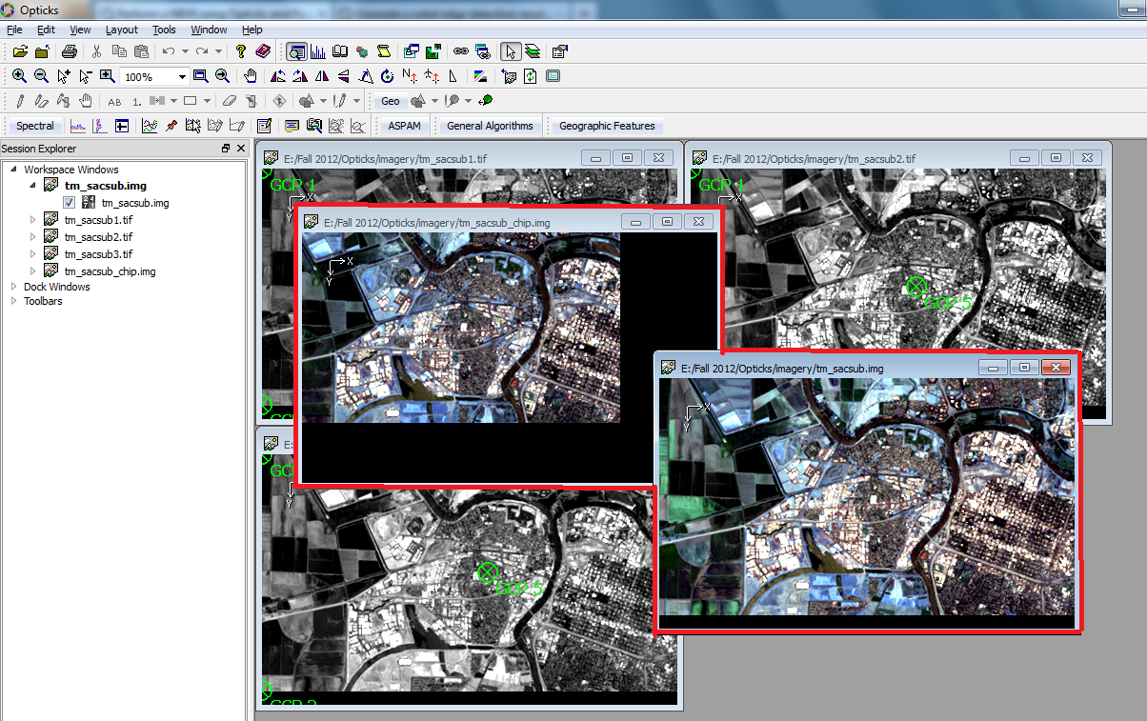

Slide 20
4. Image Composition

Slide 21
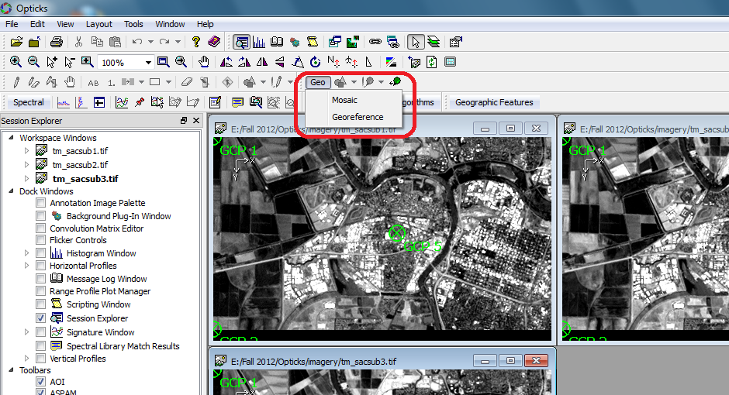

Slide 22
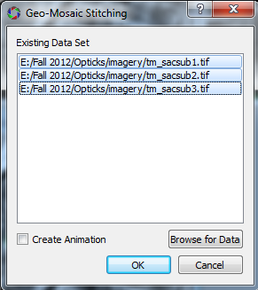

Slide 23
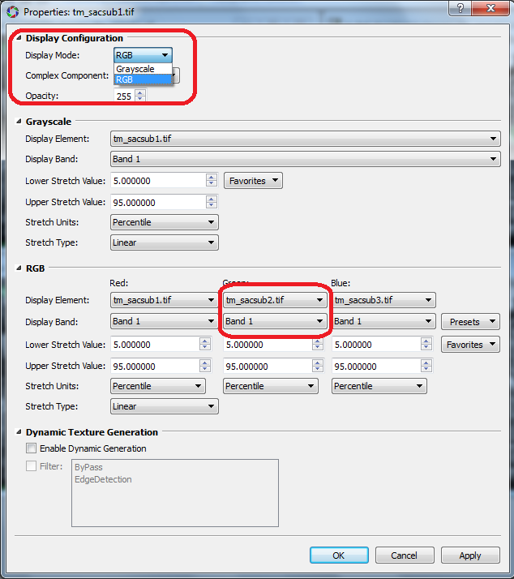

Slide 24
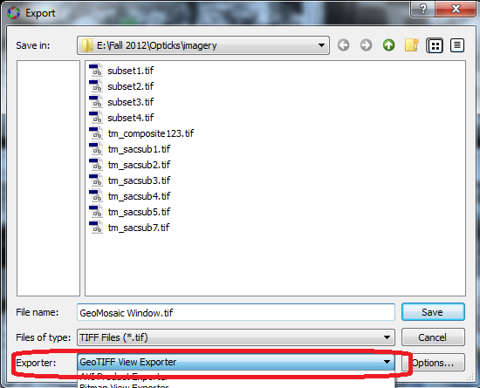

Slide 25
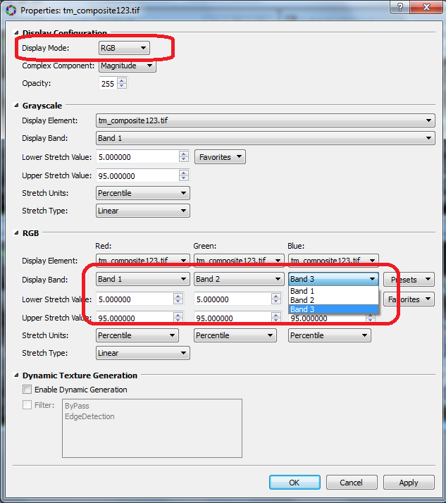

Slide 26
5. Histograms

Slide 27
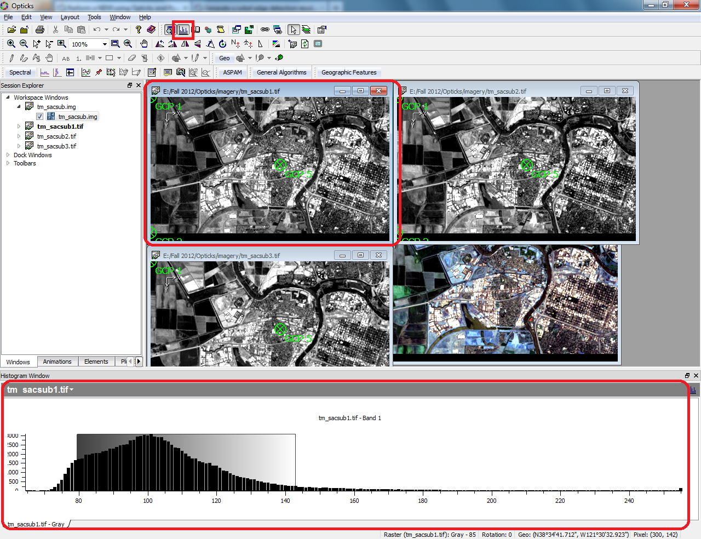

Slide 28
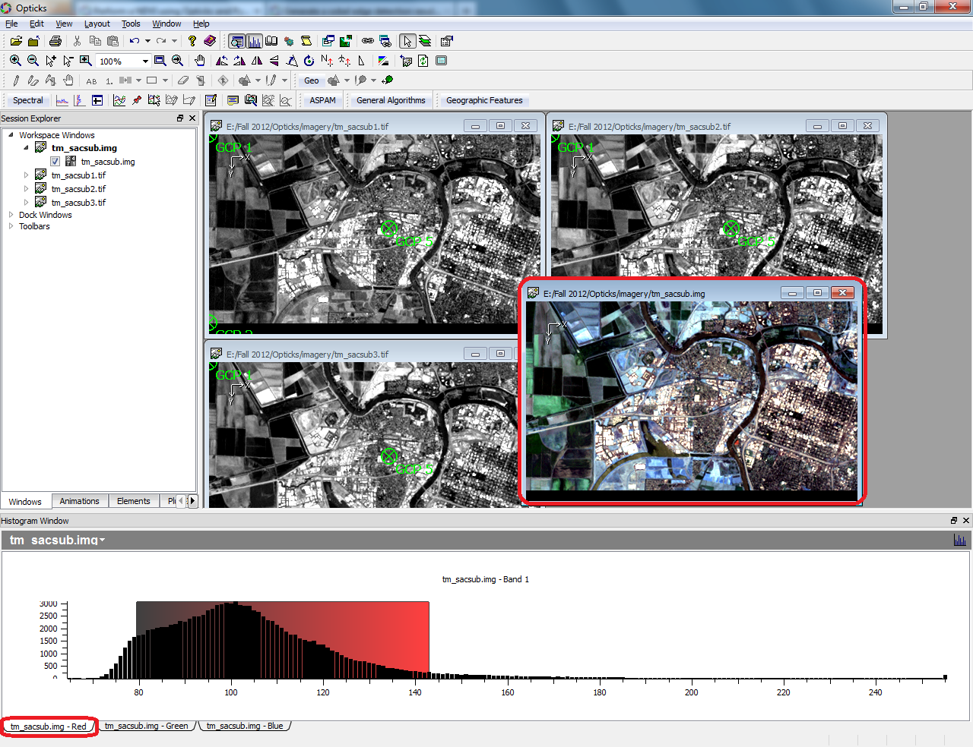

Slide 29
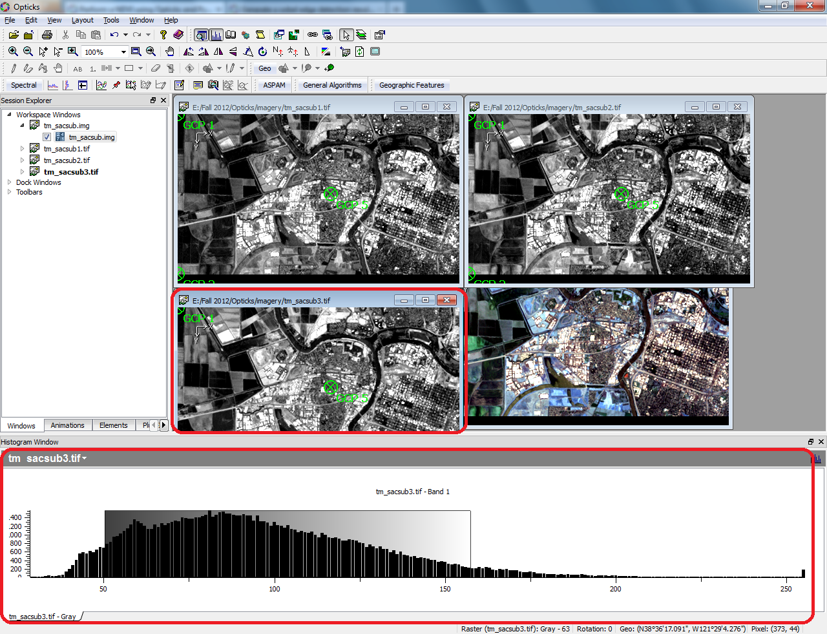

Slide 30
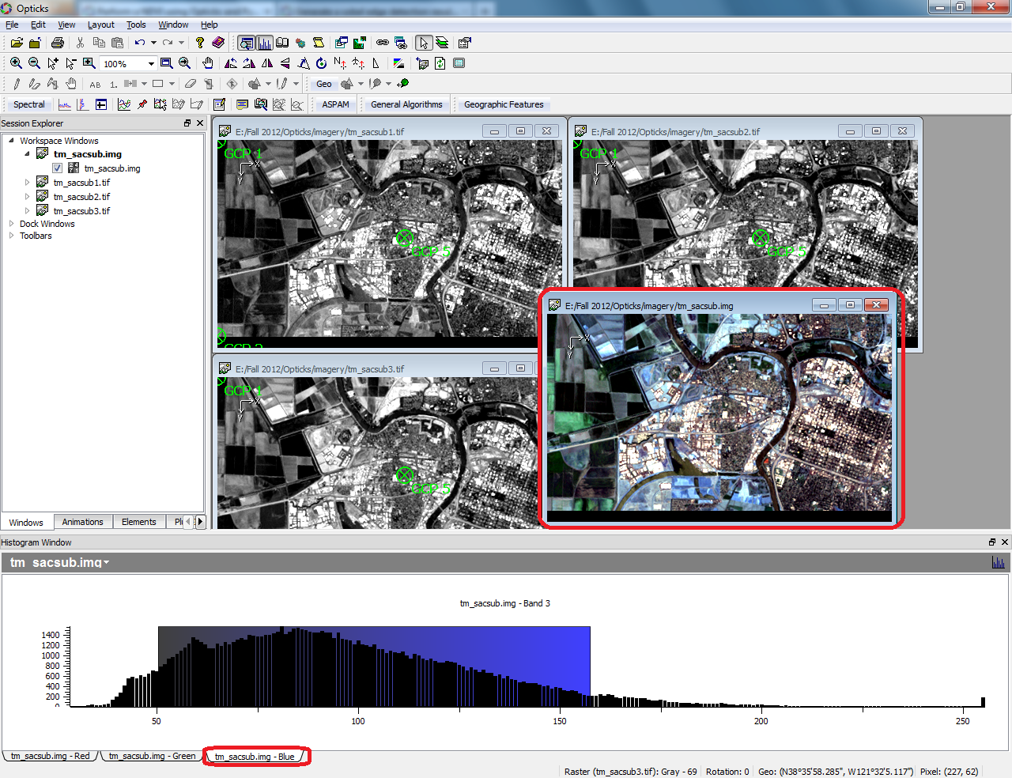

Slide 31
6. Band Math

Slide 32
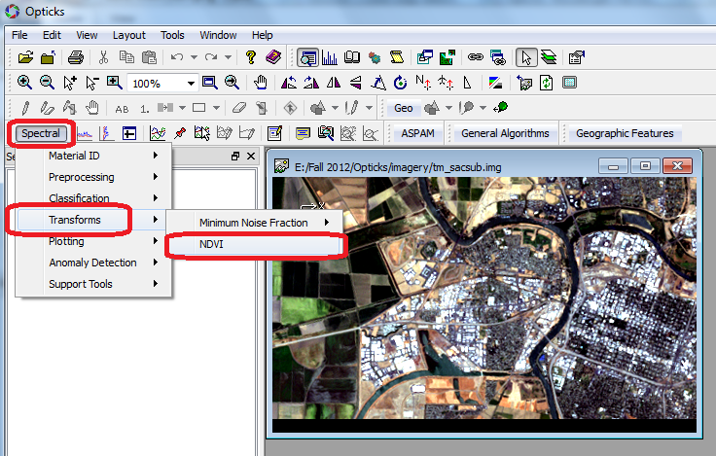

Slide 33
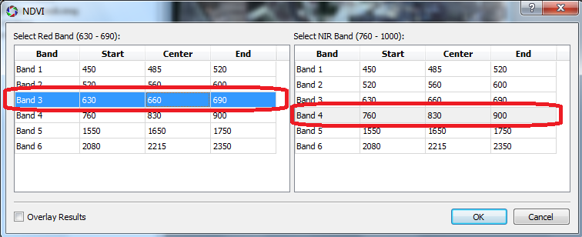

Slide 34
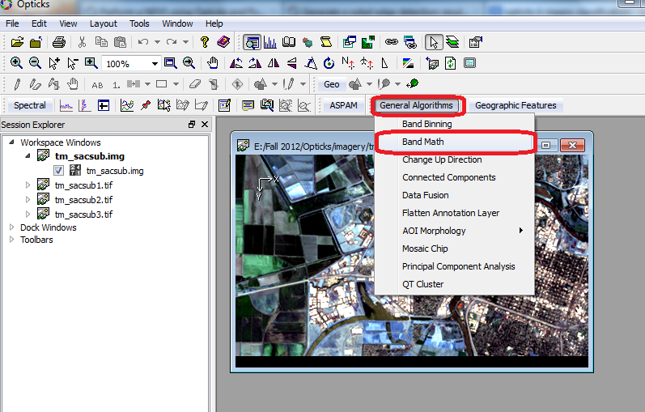

Slide 35
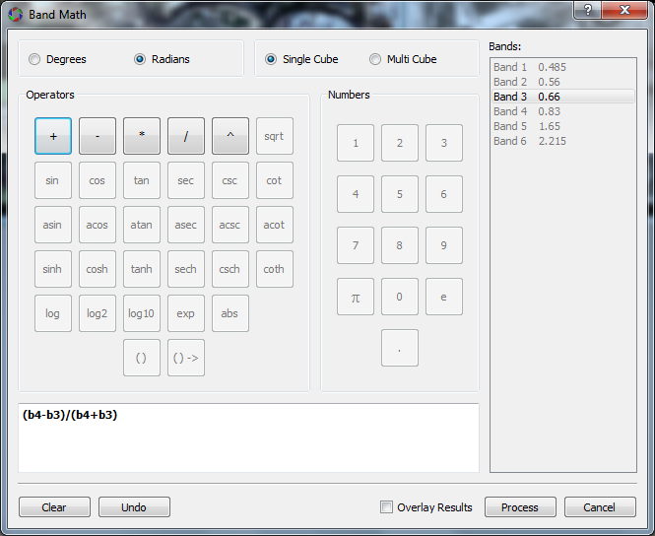
Can’t Type It! ☹

Slide 36
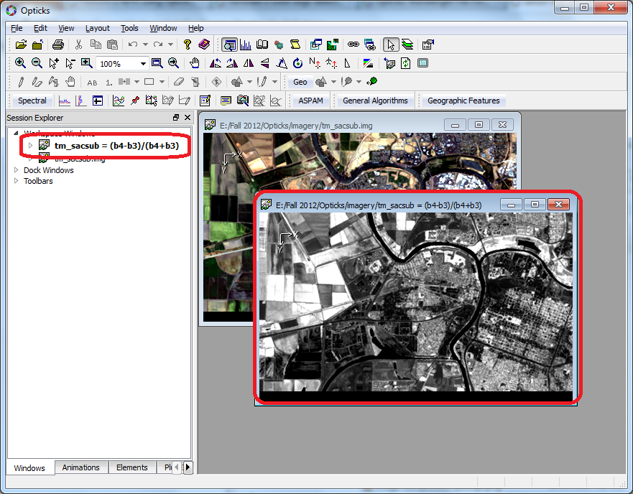

Slide 37
7. Image Classification

Slide 38
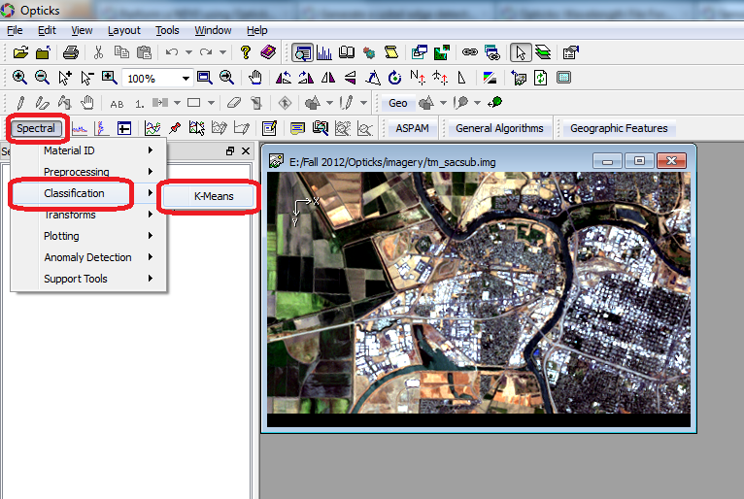

Slide 39
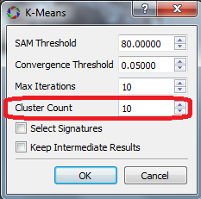

Slide 40
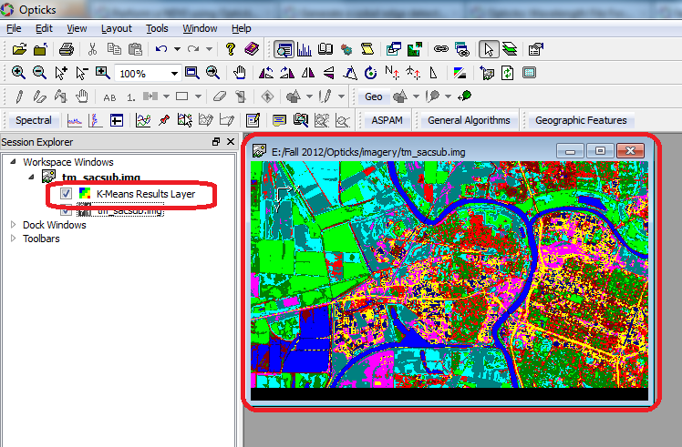

Slide 41
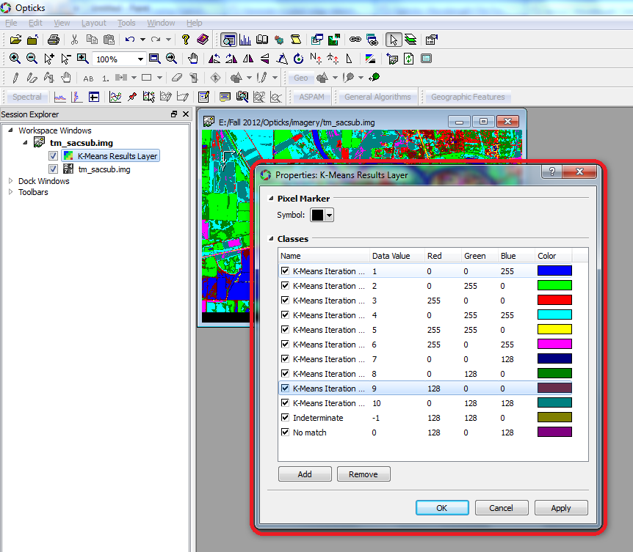

Slide 42
8. Opticks Wizards

Slide 43
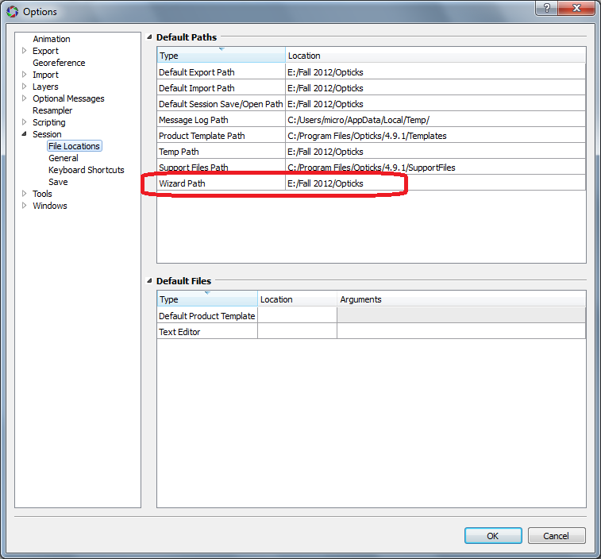

Slide 44
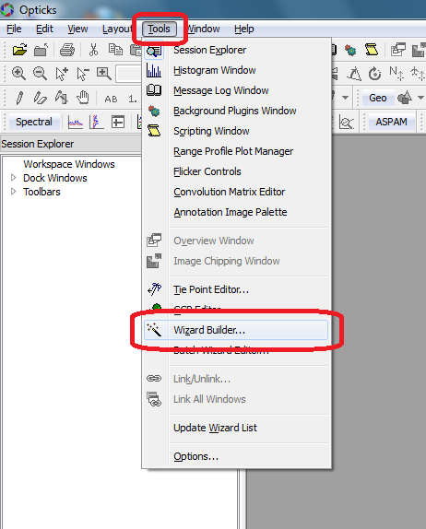

Slide 45
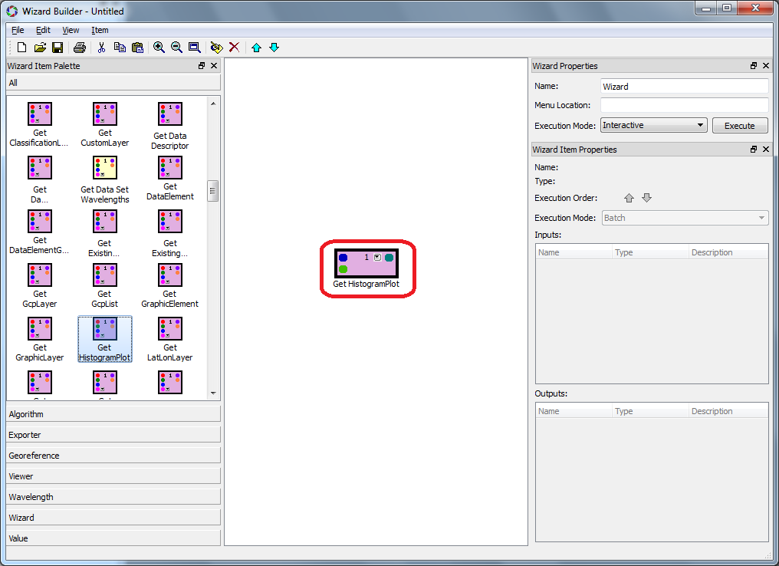
Tools

Slide 46
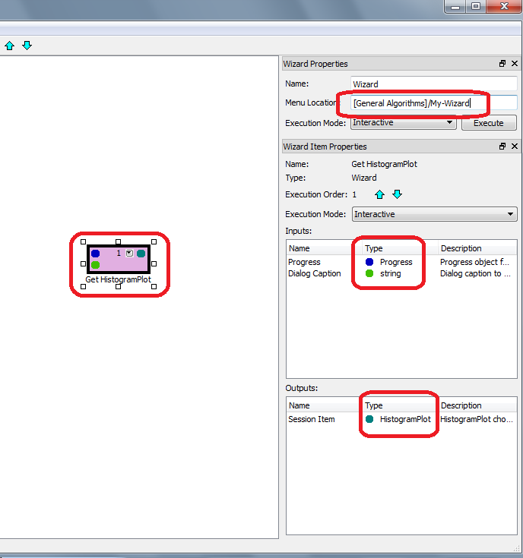
[MENU NAME]/WIZARD-NAME

Slide 47
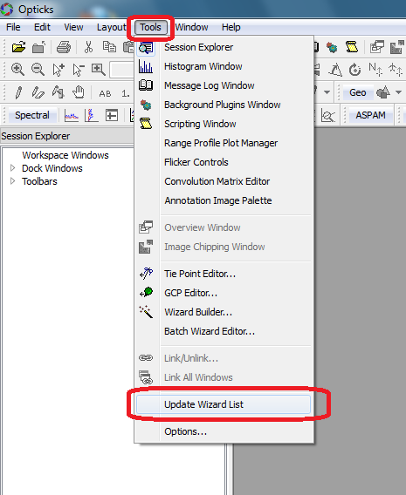

Slide 48
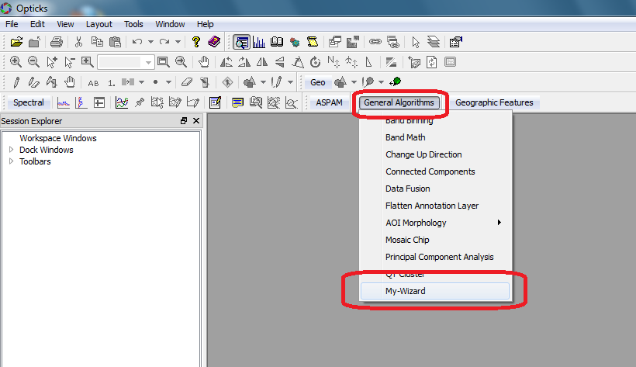

Slide 49
9. Python Scripting

Slide 50
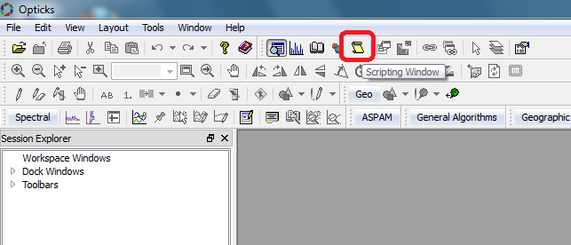

Slide 51
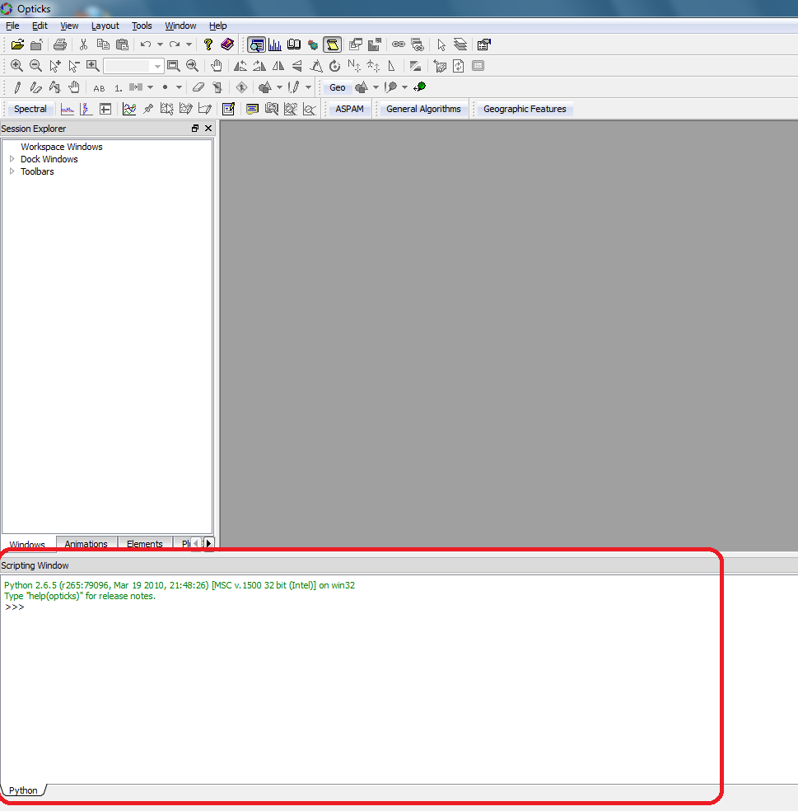

Slide 52
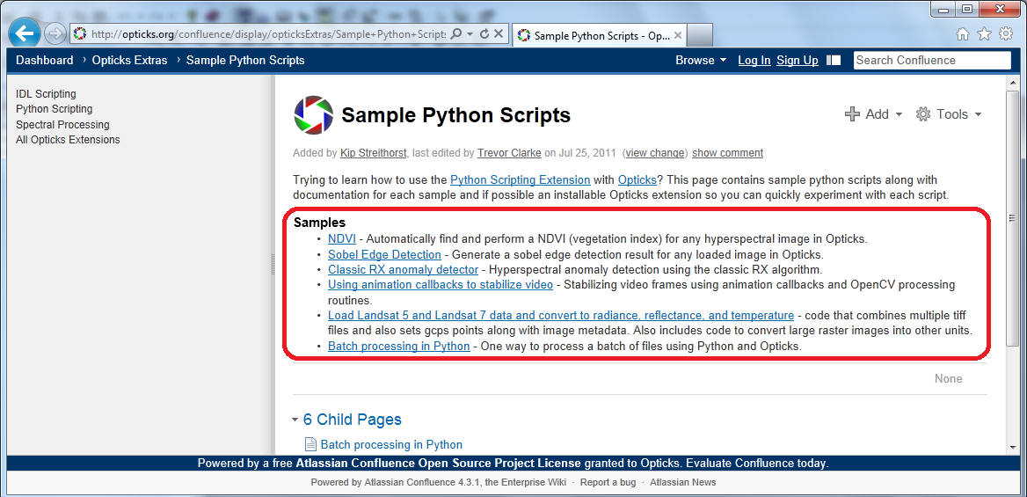

Slide 53
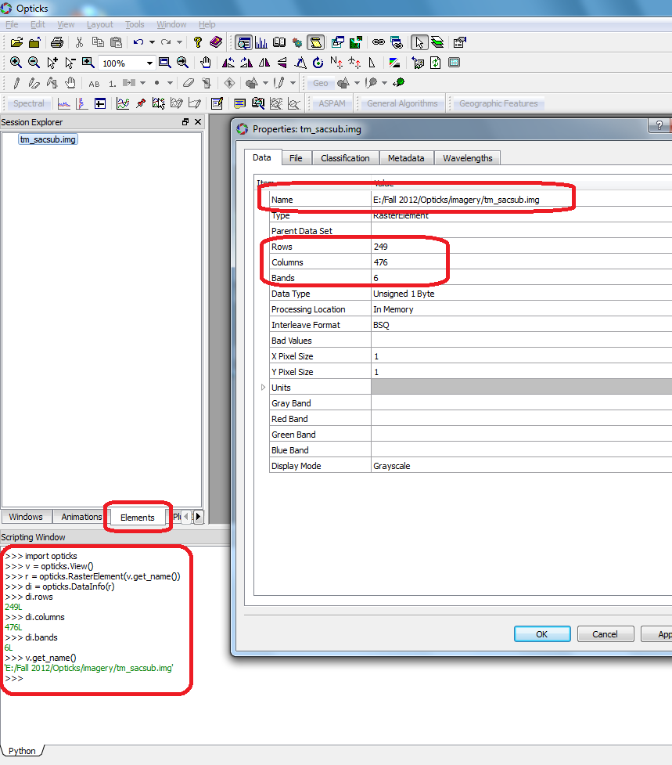
import opticks
v = opticks.View()
n = v.get_name()
r = opticks.RasterElement(n)
di = opticks.DataInfo(r)
di.rows
di.columns
di.bands
di.interleave

