Slide 1
Python Scripts for Public Works – City of Woodland
Geog 375
Miguel Garcia
May 16, 2012

Slide 2
Purpose
The slowed rate of connectivity in the field for the CCTV inspection crews while using the city’s WiFi has prompted the implementation for the feature classes to be copied locally to speed up ArcMap.
The CCTV operators must have the most current/correct information on gravity mains and upstream and downstream access points so that the selected mains, which are being selected in ArcMap, and then imported into ITPipes contains the current attributes and only updates/edits by the operators as they visually inspect the segments of sewer and storm gravity mains.
Python programs to be run on a daily basis from CCTV laptop used in the field to conduct CCTV Inspections of all City Sewer/Storm gravity mains and from the desktop to export the latest information for underground utilities.
The first script updates the specified Sewer and Storm feature classes from SDE to a file GDB on the network. Specific feature classes in SDE are copied to the file GDB on the network.
The second script which run from the laptop deletes the existing file GDB and then copies the file GDB on the network to locally on the laptop.

Slide 3
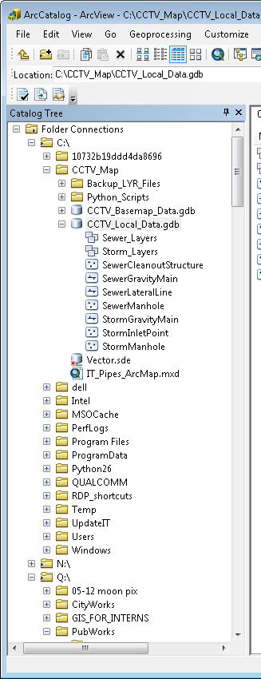
Feature Classes on Local GDB
Initially, the GDB had two
feature datasets (Sewer & Storm), and have since
been removed.
A separate “CCTV_Basemap _Data”
GDB which is not part of the script.
Established a local connection to our data on SDE.
“Vector.sde” which is incorporated into script for
The first part of script running on my desktop.

Slide 4
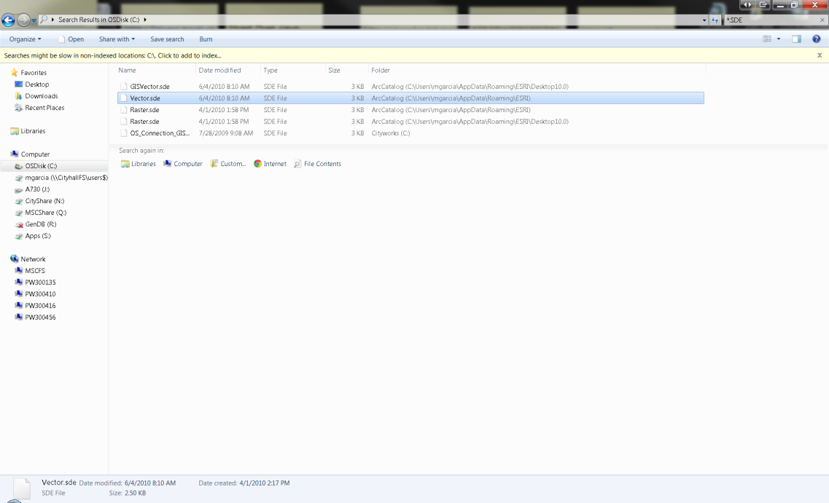
Establishing the variable for SDE
The search for the correct path to
Connect to SDE lead us to do a search
For the SDE connections to incorporate
it into the script.

Slide 5
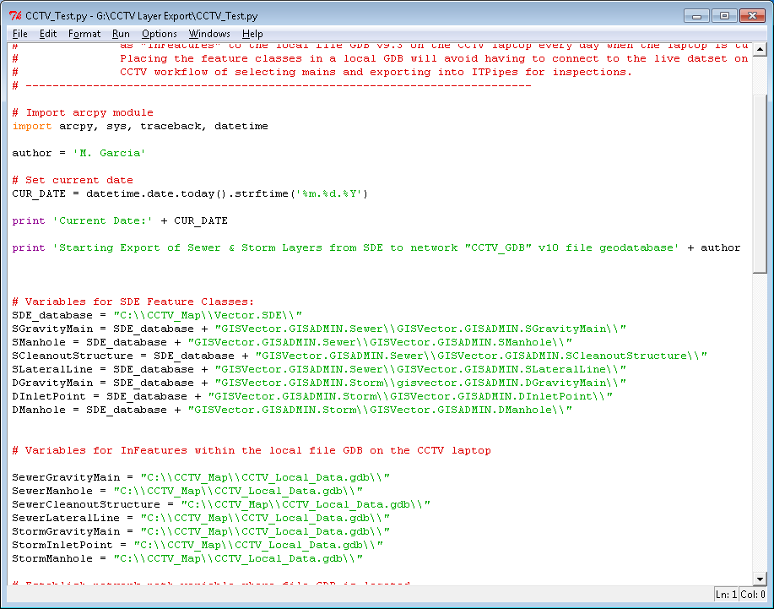
SDE Connection Variable Paths
The SDE connection from the laptop.
Since the script is now split into two parts, this connection is no
Longer needed since it only copies the GDB on the network.

Slide 6
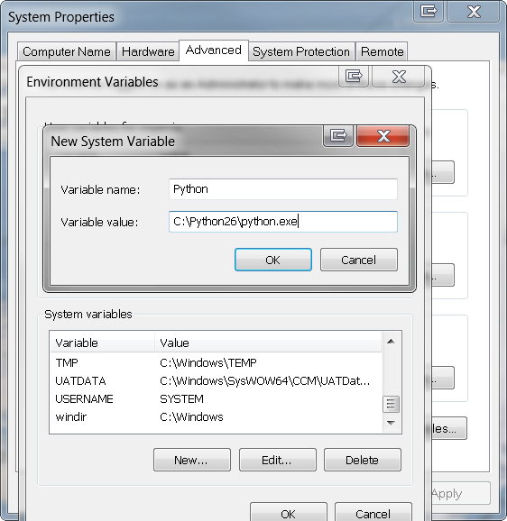
Establish Recognition of Python
The computer did not recognize
Python when attempting to run a
batch file using the Task Scheduler.
Established in the System Variables
The program name and path to the
Python.exe file for the laptop and my
desktop.
http://docs.python.org/faq/windows.html#how-do-i-run-a-python-program-under-windows

Slide 7
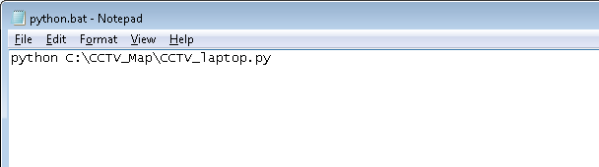
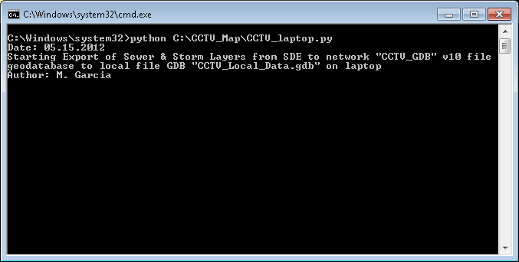
Batch File Program on Laptop
Batch file written in Note Pad
and renamed “.bat”
The batch file running on the
laptop. It takes about 2 minutes to
run and closes when completed.

Slide 8
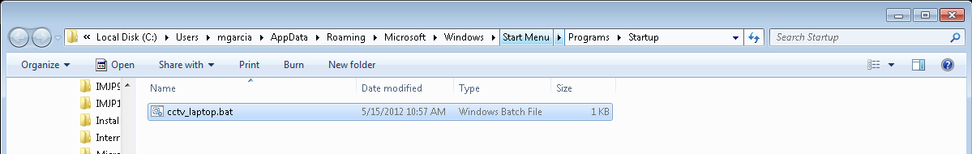
Batch File for Laptop Script
The batch file on the laptop and placed in the Start Up folder to have it run every time
the machine is booted up or logged into.

Slide 9
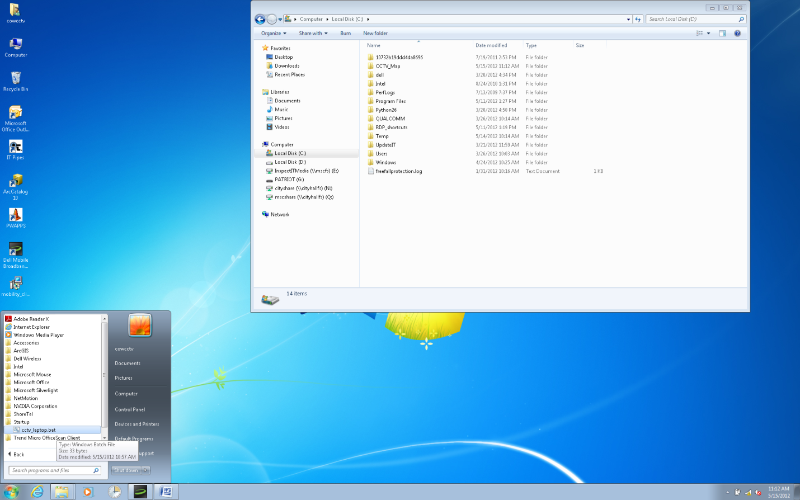
Batch File Location
Batch file is placed in the Start Up folder on the CCTV laptop

Slide 10
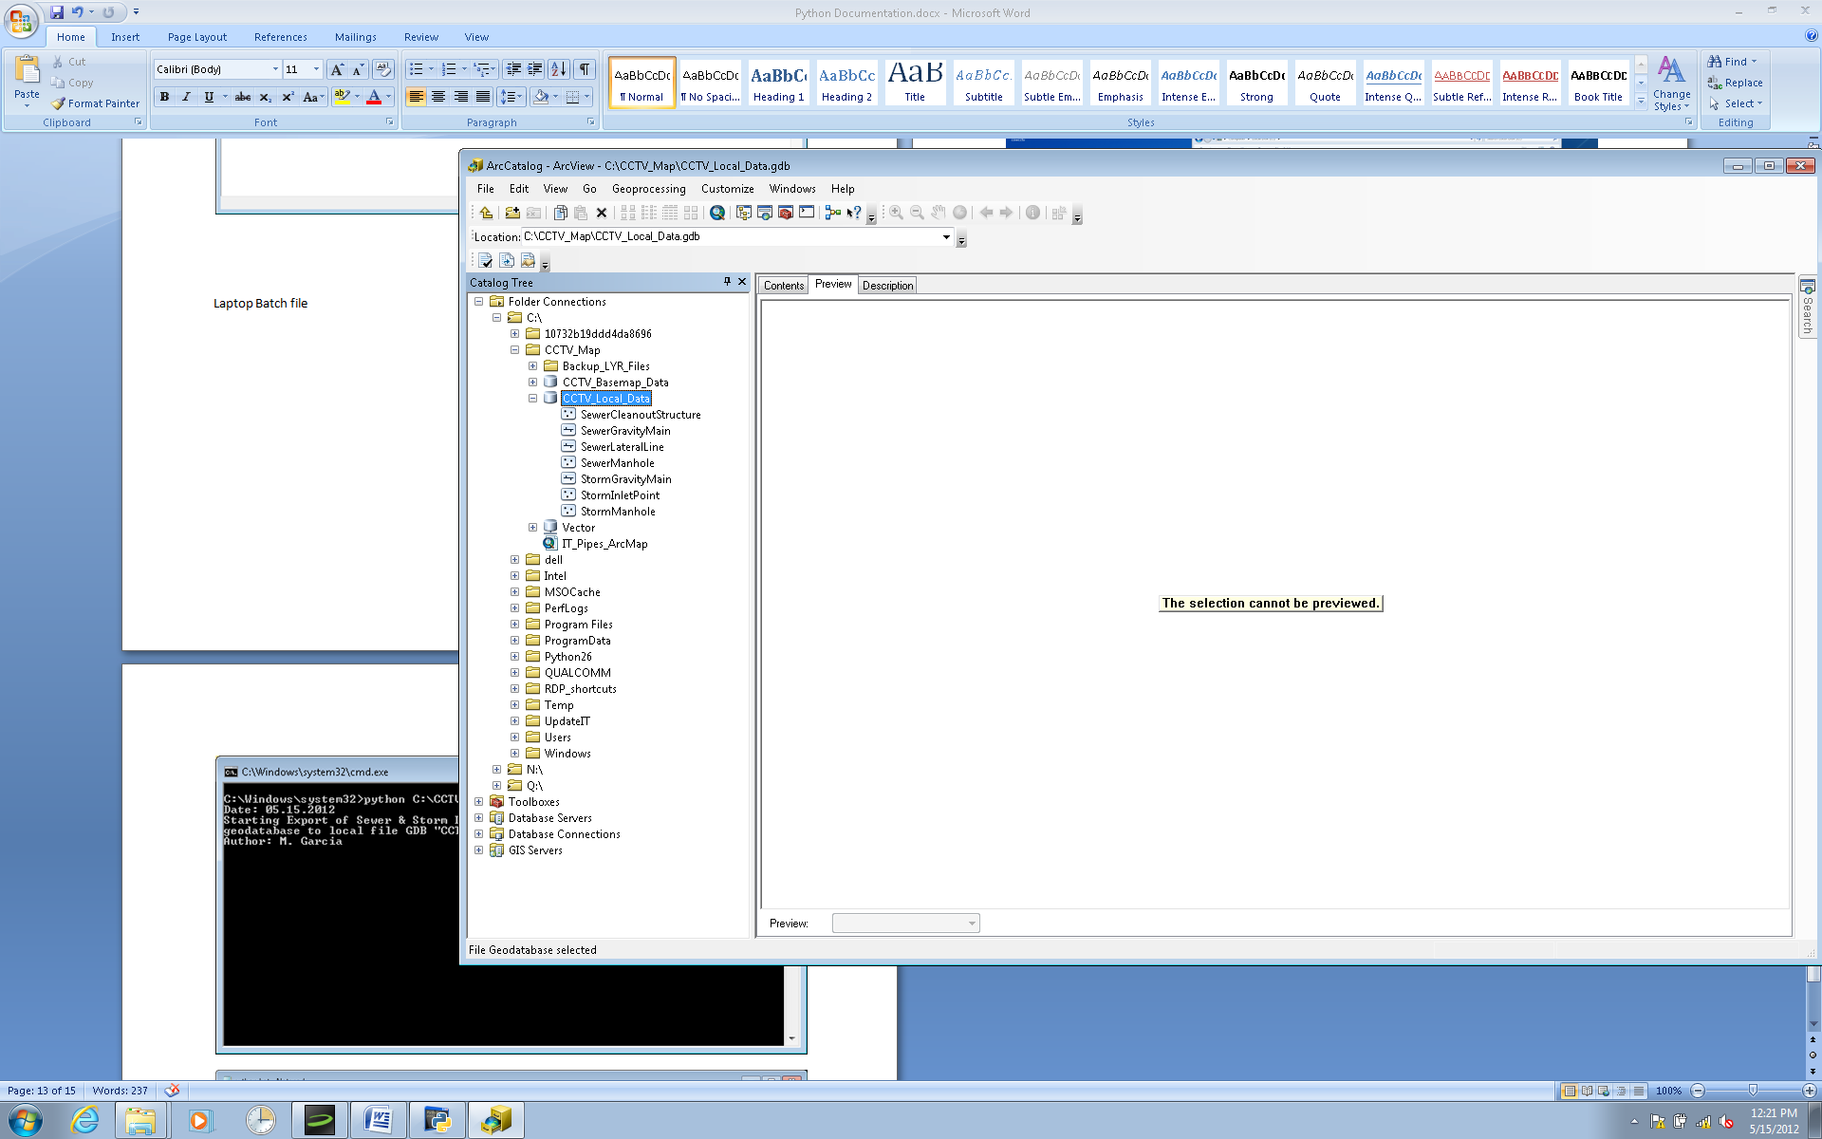
Local File GDB on Laptop
The GDB is copied over with the layers to the
CCTV laptop, with the same name to preserve
data link.

Slide 11
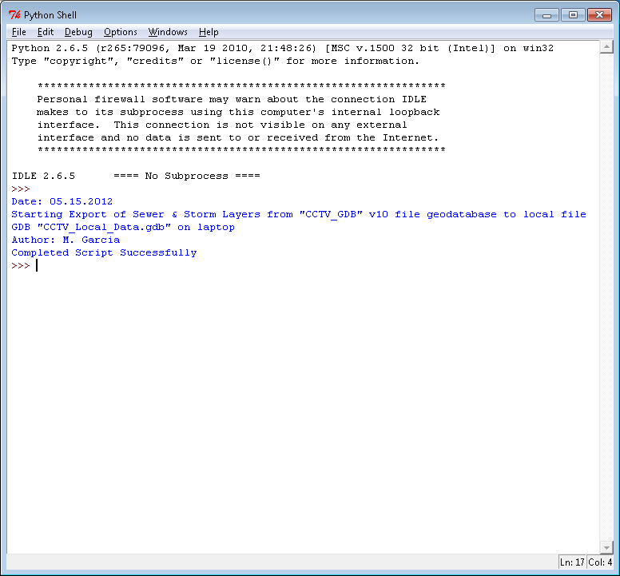
SDE Layers Export to Network GDB
The first part of the script copies
the specified sewer and storm layers
to a file GDB on the network.
A query is set to only export only ‘Active’ assets.

Slide 12
Python Script on Laptop
The Second part of the script copies the
file GDB on the network to the laptop.
No SDE connection needed
for this process to run.

