Slide 1
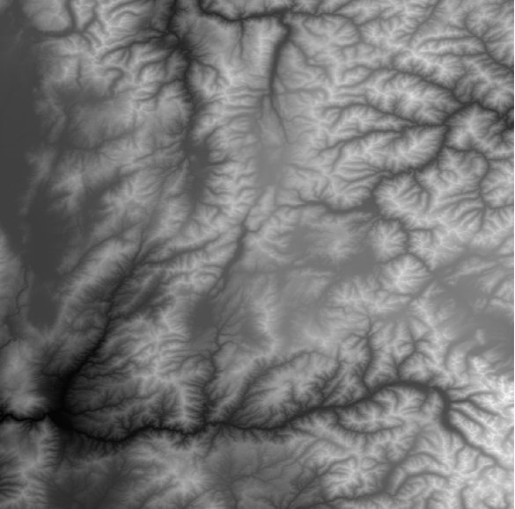
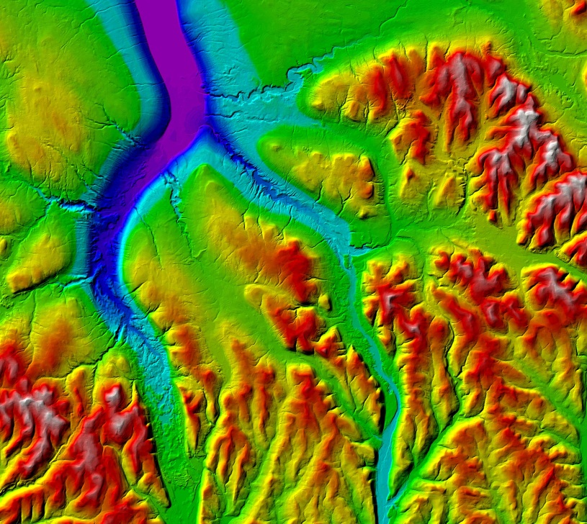
Using ArcGIS 10.0 to develop a raw LiDAR to Digital Elevation Model workflow for the
U.S. Army Corps of Engineers
Sacramento District Regulatory Division
Zachary Fancher
Last updated 12/15/2012

Slide 2
Background
Regulatory Division responsible for making jurisdictional determinations on “Waters of the U.S”, as part of the permitting process for impacts to these aquatic features.
Push over the last couple of years to make determinations remotely, due to limited budget, staff, and high workload.
Available data not always sufficient – there is always a need for more high resolution imagery.

Slide 3
Background
Regulatory recently acquired a vast LiDAR dataset through California Department of Water Resources. Data was collected as part of DWR’s Central Valley Floodplain Evaluation and Delineation Program, from 2007-2010.
High resolution dataset covering 9000 square miles of the Central Valley.
Perfect for assisting project managers with remote jurisdictional determinations – but no one knows how to process raw LiDAR!

Slide 4
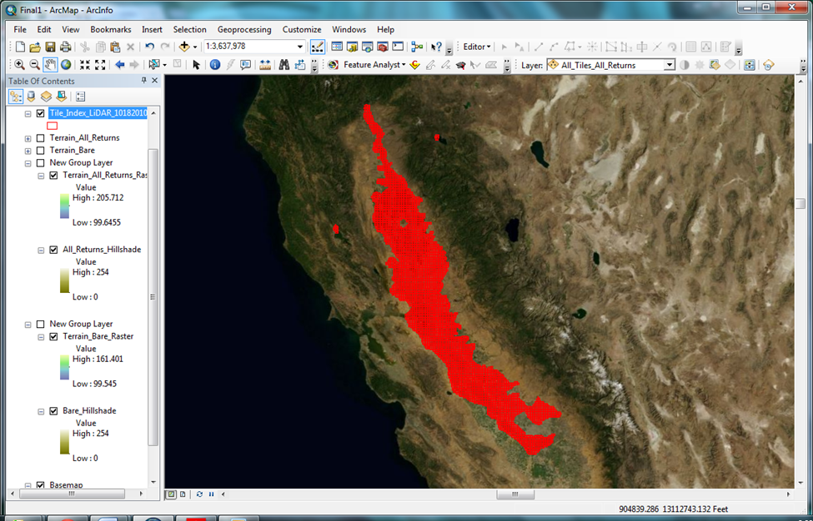
DWR CVFED LiDAR data coverage (CA Central Valley)

Slide 5
Project Goals:
Gain an understanding of LiDAR data in general, and how to access the various information stored in the .las format.
Develop a standardized workflow for producing DEMs that can be reproduced easily by Regulatory project managers.
Consolidate these production methods into a Standard Operating Procedure document.
Create a pilot demonstration to show project managers the practical value of using LiDAR.
Notes:
After 4. – Make clear that methodology put together with use of ArcGIS 10.0 in mind. 10.1 has new LiDAR tools that render much of this methodology obsolete. However, an upgrade to 10.1 is not going to happen in Regulatory anytime soon (again budgetary), so this methodology will still be useful for the foreseeable future.

Slide 6
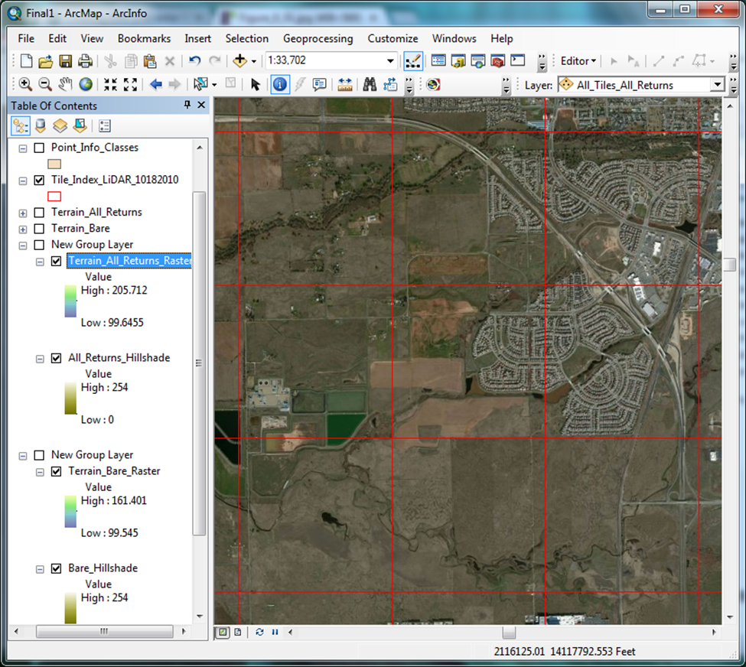
Area of Interest
SW of Lincoln, CA
9 Tiles
Approx 8 sq mi
Density of vernal pools, agricultural conversions, aquatic features

Slide 7
Possible Approaches:
Process, mosaic, and attempt to serve up the entire set of derivative raster data.
Run the DEM production process on a project-by-project basis, as needed.
Notes:
1. Don’t have ArcGIS Image Server extension, aren’t likely to be getting it. We are looking into the potential to serve the data through a browser via ArcGIS Online, as we will probably be getting a full license soon. But in the meantime, and considering processing overhead and storage requirements, we decided to go with option 2 – piecemeal.

Slide 8
Possible Approaches:
Process, mosaic, and attempt to serve up the entire set of derivative raster data.
Run the DEM production process on a project-by-project basis, as needed.
Notes:
1. Don’t have ArcGIS Image Server extension, aren’t likely to be getting it. We are looking into the potential to serve the data through a browser via ArcGIS Online, as we will probably be getting a full license soon. But in the meantime, and considering processing overhead and storage requirements, we decided to go with option 2 – piecemeal.

Slide 9
Some Important LiDAR Data Elements
Elevations
Classifications (maybe)
Returns
Intensities
Average point spacing
Notes:
Explain each. Note that LiDAR is convieniently already georeferenced as it is created.

Slide 10
DEM Production
Point File Information
LAS to Multipoint feature class
Create and Pyramid Terrain, Add Feature Class
Build Terrain
Raster from Terrain (DEM)
Symbolize
Hillshade from DEM

Slide 11
DEM Production
Point File Information (3D Analyst Tools>Conversion>From File)
- Class Numbers
- Average Point Spacing
- Additional Information (not used in this demo)
Learned that this data was classified only into (1) Unclassified, (2) Bare Earth, and (12) Overlap Points. Not ideal, but still usable.
Notes:
Using LAS 1.1 Specification

Slide 12
DEM Production
LAS to Multipoint (3D Analyst Tools>Conversion>From File)
- Requires Average Point Spacing
- Requires a coordinate system
- Allows selection of class code and return(s)
- Creates multipoint feature class
Bare earth multipoint created first: Class code = (2), Returns = ANY_RETURNS
Notes:
Using LAS 1.1 Specification

Slide 13
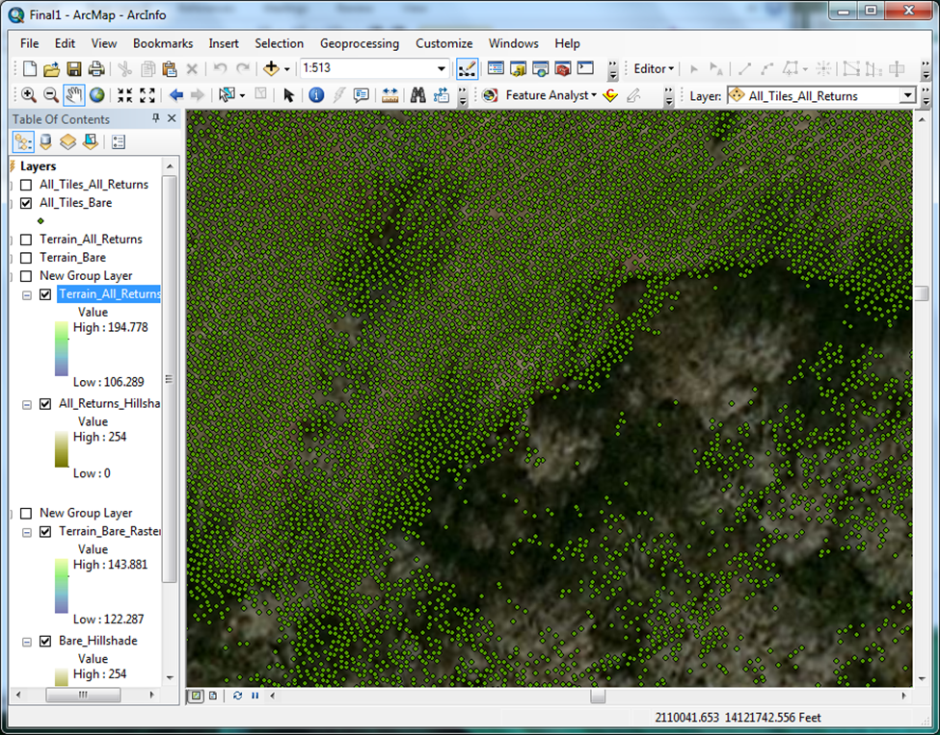
Bare earth multipoint feature class

Slide 14
DEM Production
Create Terrain (3D Analyst Tools>Terrain Management)
- Use Z-Tolerance for Pyramid Type
- Requires Average Point Spacing
Add Terrain Pyramid Level (3D Analyst Tools>Terrain Management)
- Use 2 24000 for Pyramid Levels Definition (window size and scale)
Add Feature Class to Terrain (3D Analyst Tools>Terrain Management)
  - Can add or subtract feature classes as needed

Slide 15
DEM Production
Build Terrain (3D Analyst Tools>Terrain Management)

Slide 16
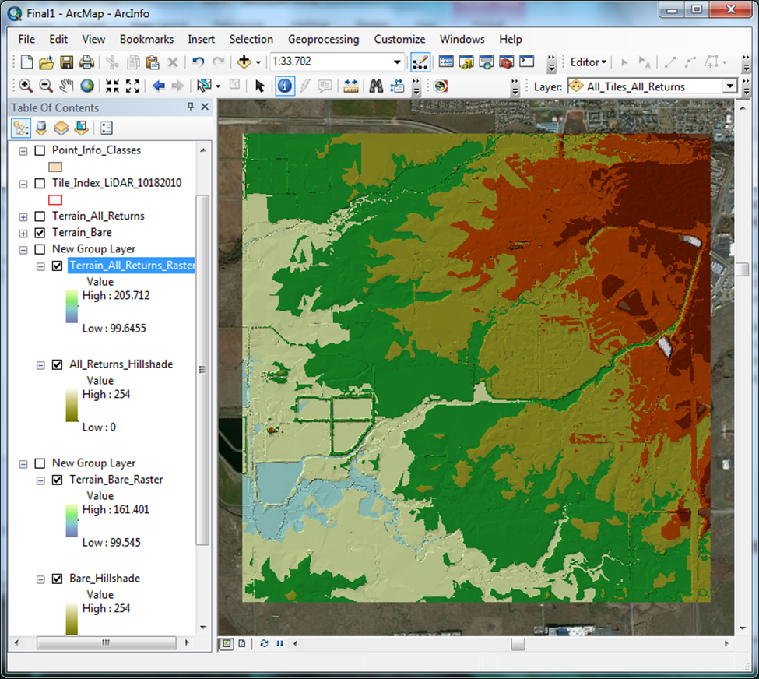
Bare earth pyramided and built terrain

Slide 17
DEM Production
Terrain to Raster (3D Analyst Tools>Conversion>From Terrain)
- Natural Neighbors
- FLOAT data type to retain vertical precision
- Sampling Distance = CELLSIZE “Average Point Spacing”
Research suggests using value of 4x average point spacing for direct point to raster operations. Because we are creating raster from terrain which already inherently contains a level of averaging from point to point, there is no reason to average further. Making cell size the same as the average point spacing will generate a raster with maximum resolution and accuracy confidence. Cell size is rounded to the nearest whole number for simplification of measurement and analysis.

Slide 18
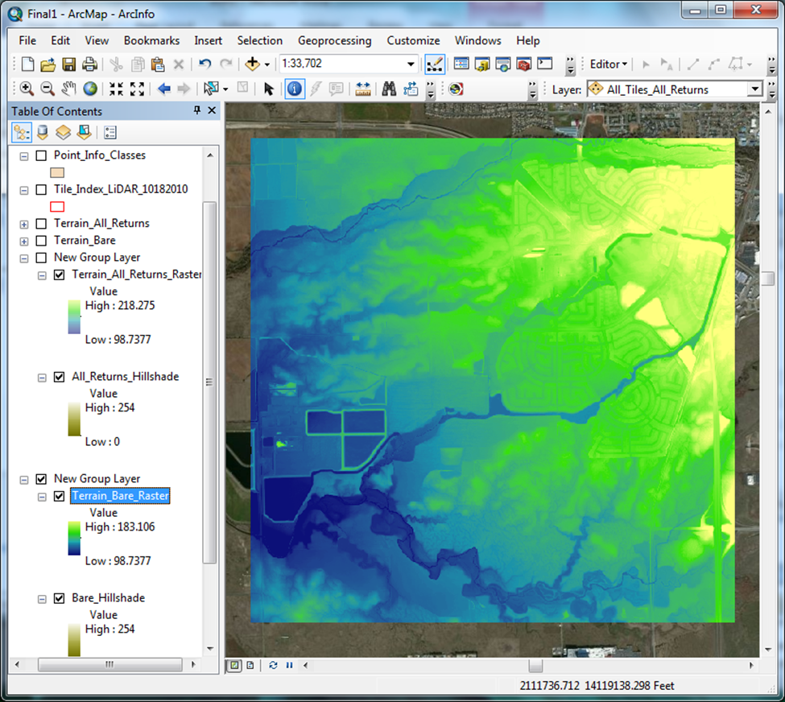
Bare Earth DEM
(Symbolized)

Slide 19
DEM Production
Hillshade from DEM

Slide 20
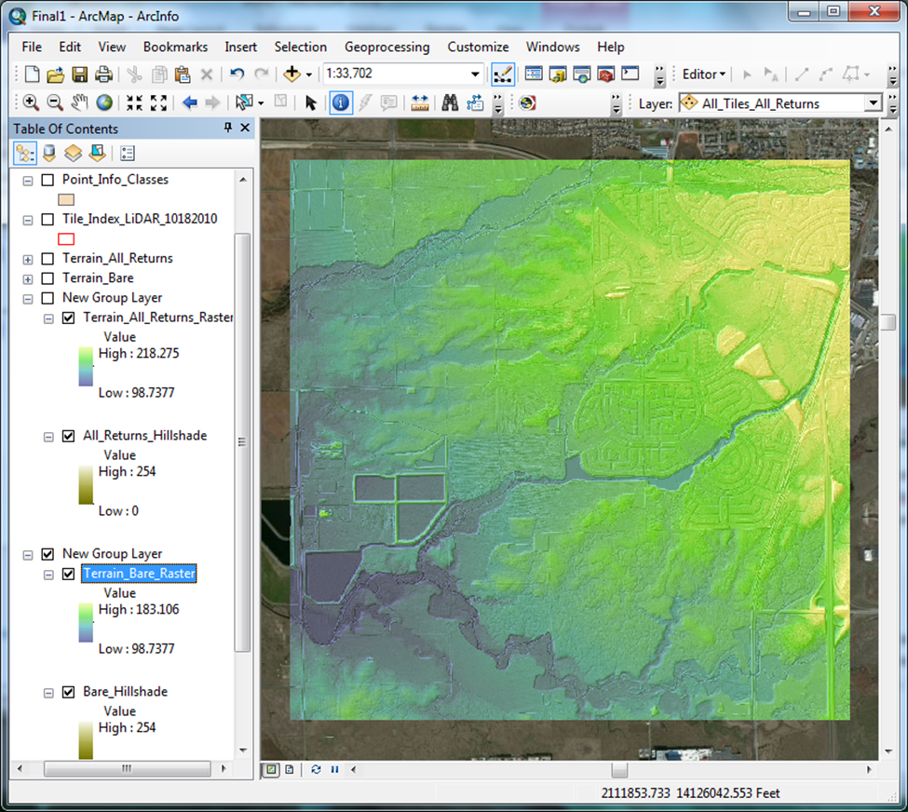
Bare Earth DEM and Hillshade
(Symbolized)

Slide 21
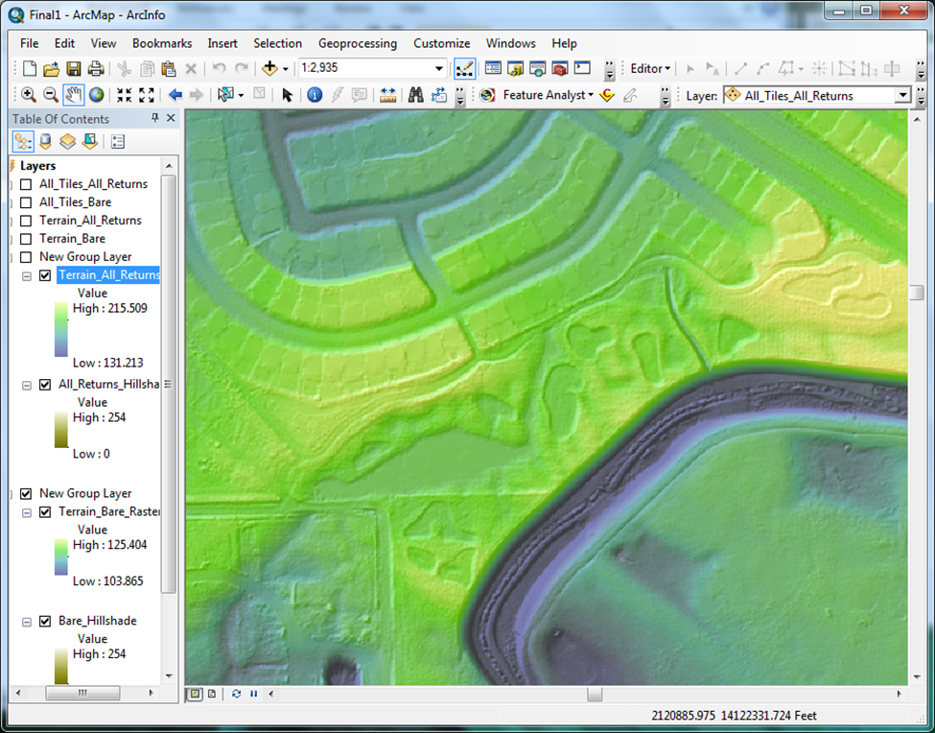
Bare Earth DEM and Hillshade
(Detail)

Slide 22
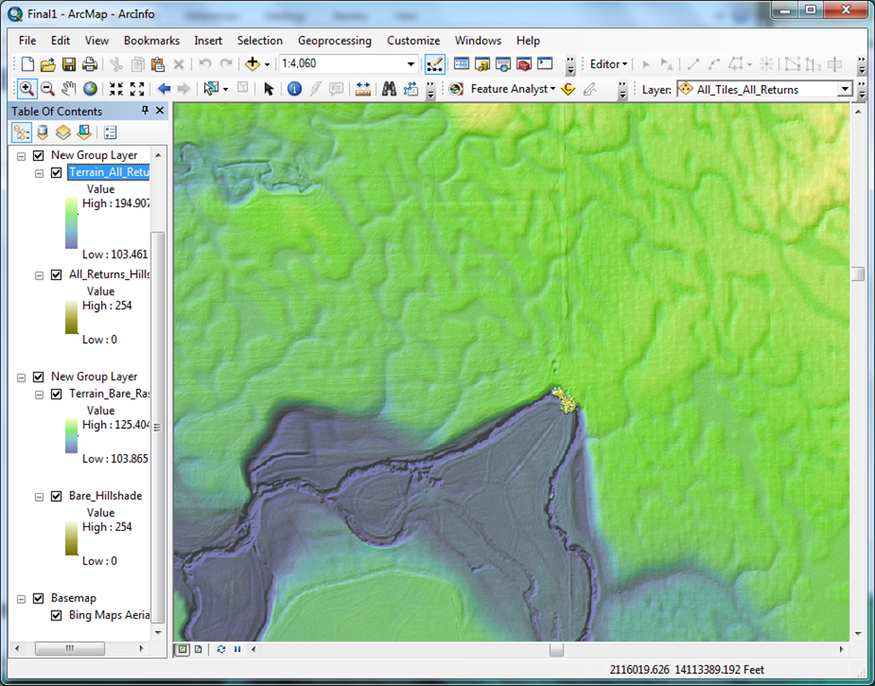
Bare Earth DEM and Hillshade
(Detail)

Slide 23
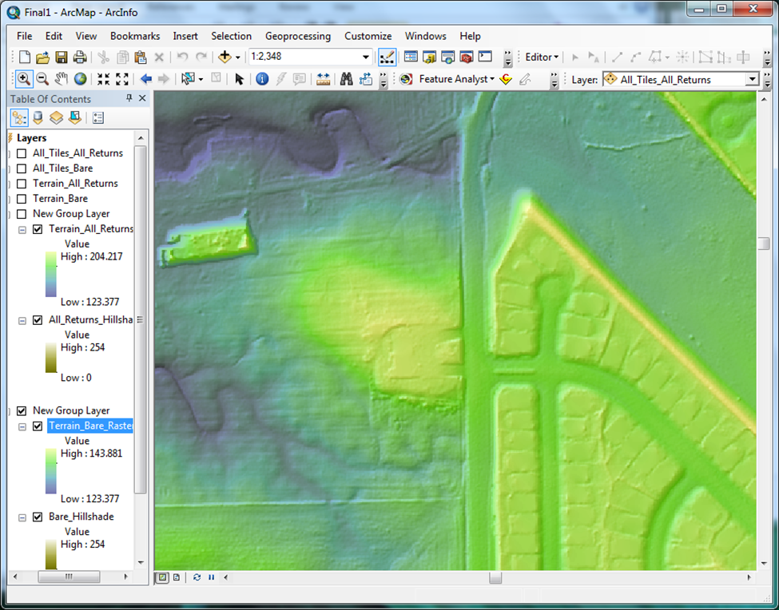
Bare Earth DEM and Hillshade
(Obscured Areas Detail)

Slide 24
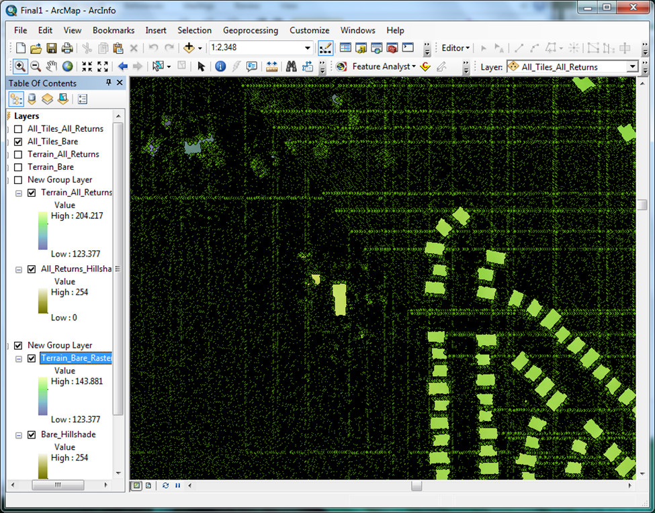
Bare Earth Multipoint
(Obscured Areas Detail)

Slide 25
DEM Production
Additional DEM needed to show which areas are obscured
- Needed for project managers to interpret bare earth with any degree of confidence
- If LiDAR data was better classified, a direct point to raster operation could be used to pull out only vegetation and buildings.
- NULL values in the rest of the raster could be transparently symbolized, and would look good turning layer visibility on and off.

Slide 26
DEM Production
Additional DEM needed to show which areas are obscured
- Because this data is not that well classified, another DEM composed of bare earth plus vegetation and structures is needed.
- Using all of the LiDAR is appropriate to generate a bare earth plus vegetation / canopy / structures DEM
- Process identical except at LAS to Multipoint step. Class code = None,
Returns = ANY_RETURNS

Slide 27
Bare Earth DEM and Hillshade
(Obscured Areas Detail)

Slide 28
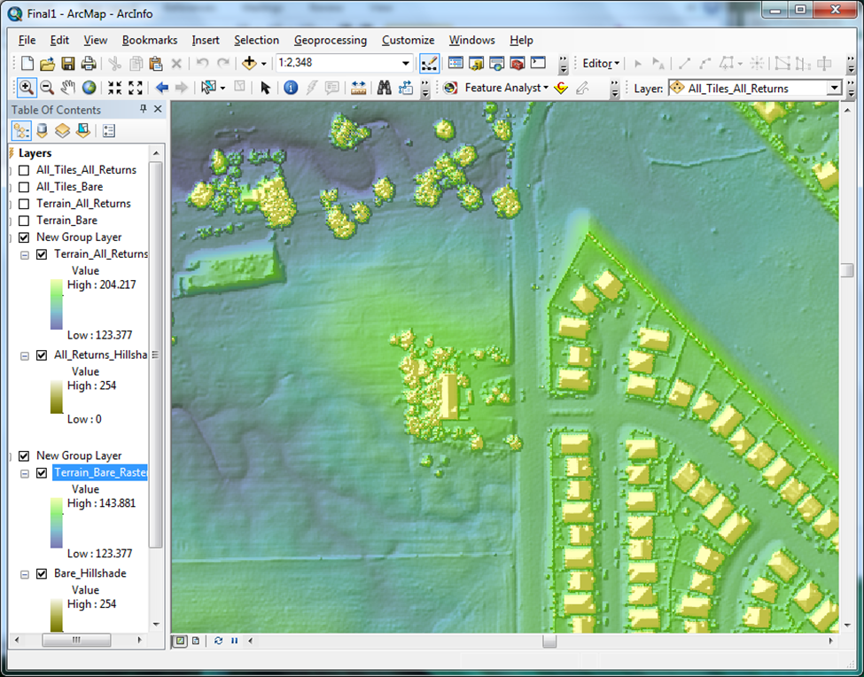
Canopy/Buildings
DEM and Hillshade
(Detail)

Slide 29
Analysis / Accuracy Assesment
Original data spec was within 0.6 ft vertical accuracy at a 95% confidence level. Horizontal, within 3.5 ft.
Pixel elevation in bare earth portions of canopy/buildings raster within 0 to 0.1 ft of their bare earth raster counterparts.
Pixels adjacent to canopy and buildings were on average 0.12 ft higher than bare earth counterparts.
Comparison with Google Earth elevations showed bare earth raster elevations to be within +/- 1 ft on average.

Slide 30
Analysis / Accuracy Assesment
Comparison with georeferenced digital orthophotos and basemaps showed excellent xy alignment.
Level of detail outstanding, will certainly be a useful tool for Regulatory project managers.

Slide 31
Next Steps
As mentioned, complete rasterizing of LiDAR data, mosaicking, hosting, and serving may be an option in the future. Will require more research.
In short term, a ModelBuilder tool or Python script will be the key to automating the workflow. Tool was built and runs successfully on a single machine, but because the tool would be by definition a shared tool, more research must be done to learn how to turn file paths into input variables, while keeping keystrokes minimal for the average project manager.

Slide 32
Using ArcGIS 10.0 to develop a raw LiDAR to Digital Elevation Model workflow for the
U.S. Army Corps of Engineers
Sacramento District Regulatory Division
Zachary Fancher
Last updated 12/15/2012

