Slide 1
SUPERVISED LAND USE CLASSIFICATION FOR HYDROLOGIC MODELING USING GIS
Geography 342
Jennifer Buchanan

Slide 2
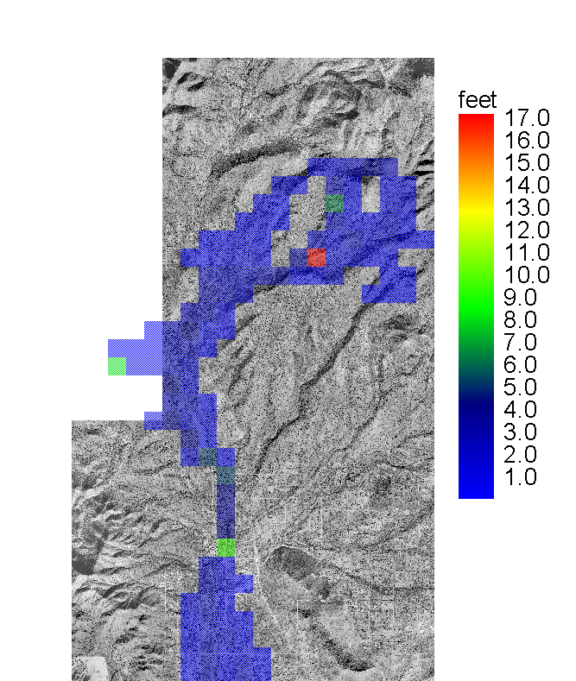
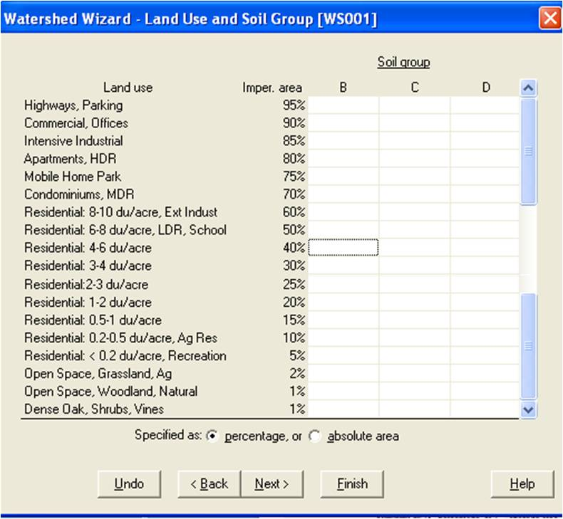
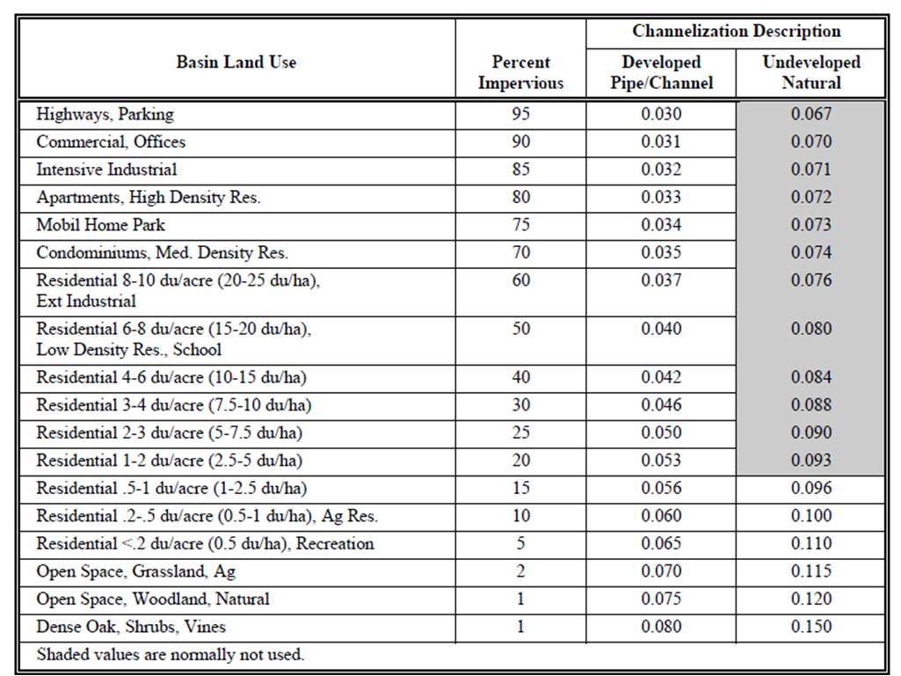
Hydrologic Models: SAC-CALC/FLO-2D
Land use data is essential.
Hydrology Standards Drainage Manual Recommendations

Slide 3
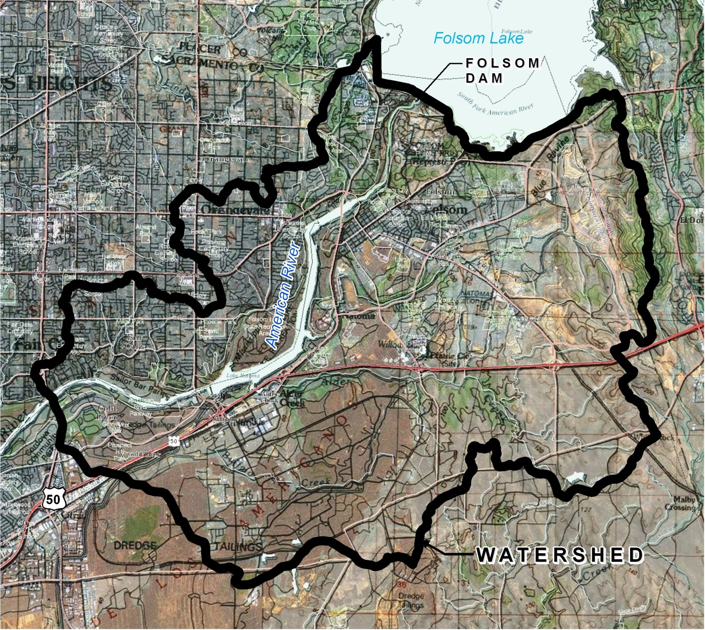
STUDY AREA
Watershed below Folsom Dam
Urban
Open Space
Trees/Vegetation
American River
Low Ag Use

Slide 4
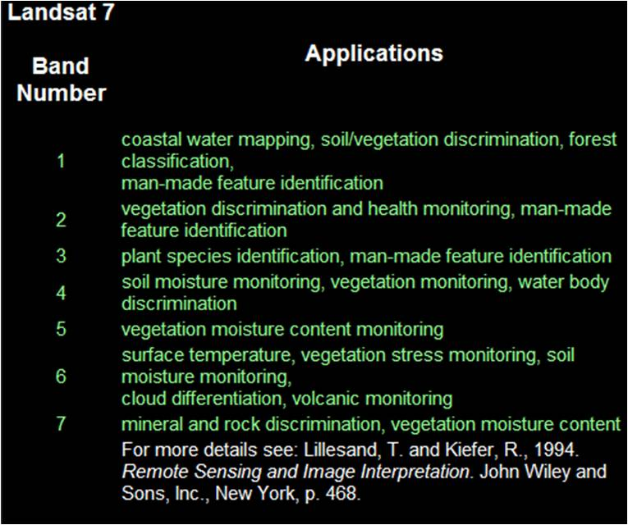
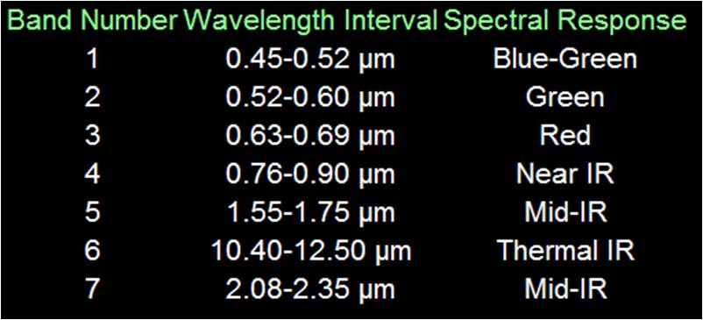
LANDSAT 7
Download for Study Area
Cal-Atlas (http://atlas.ca.gov)
USGS (http://landsat.usgs.gov)
1
30-M resolution
Satellite Mission - 1999
The Mediterranean Sea is one body of water that connects to the Atlantic Ocean through a narrow passage.
2
COMPOSITE
BANDS
Using ArcGIS
Exclude Band 6 (Thermal)
Set output extent in
Environmental Settings

Slide 5
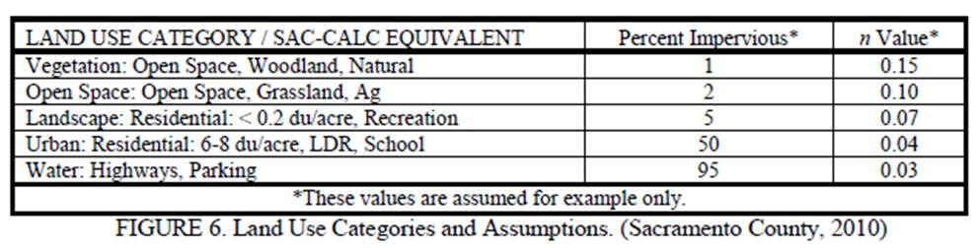
DETERMINE LAND USE CLASSES
3
WATER
OPEN SPACE
URBAN
VEGETATION
LANDSCAPE
Assign
Percent Impervious
n Value

Slide 6
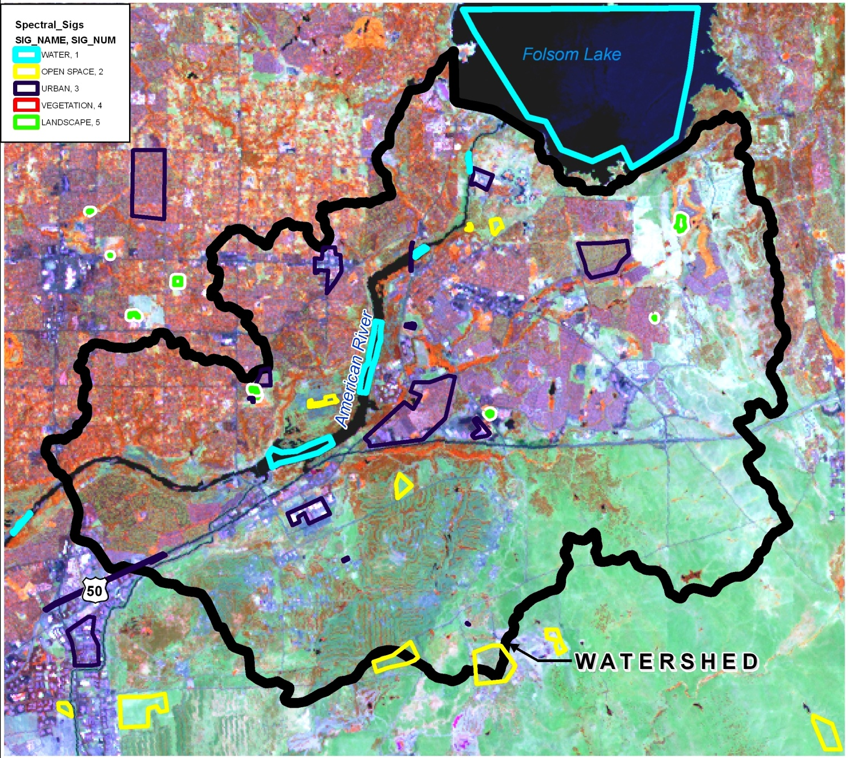
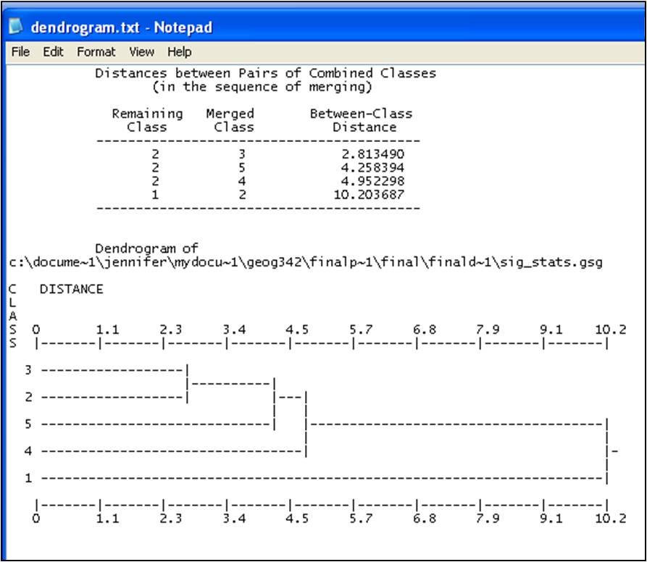
MULTISPECTRAL TOOLS
4
Reference Data Sources:
ArcGIS Online Service World Imagery
DWR Year 2000 Land Use Survey
Create Training Sites
Create Spectral Signatures
Review Dendrogram
Maximum Likelihood Classification
*Iterative Process

Slide 7
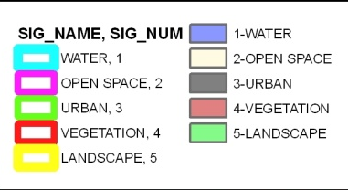
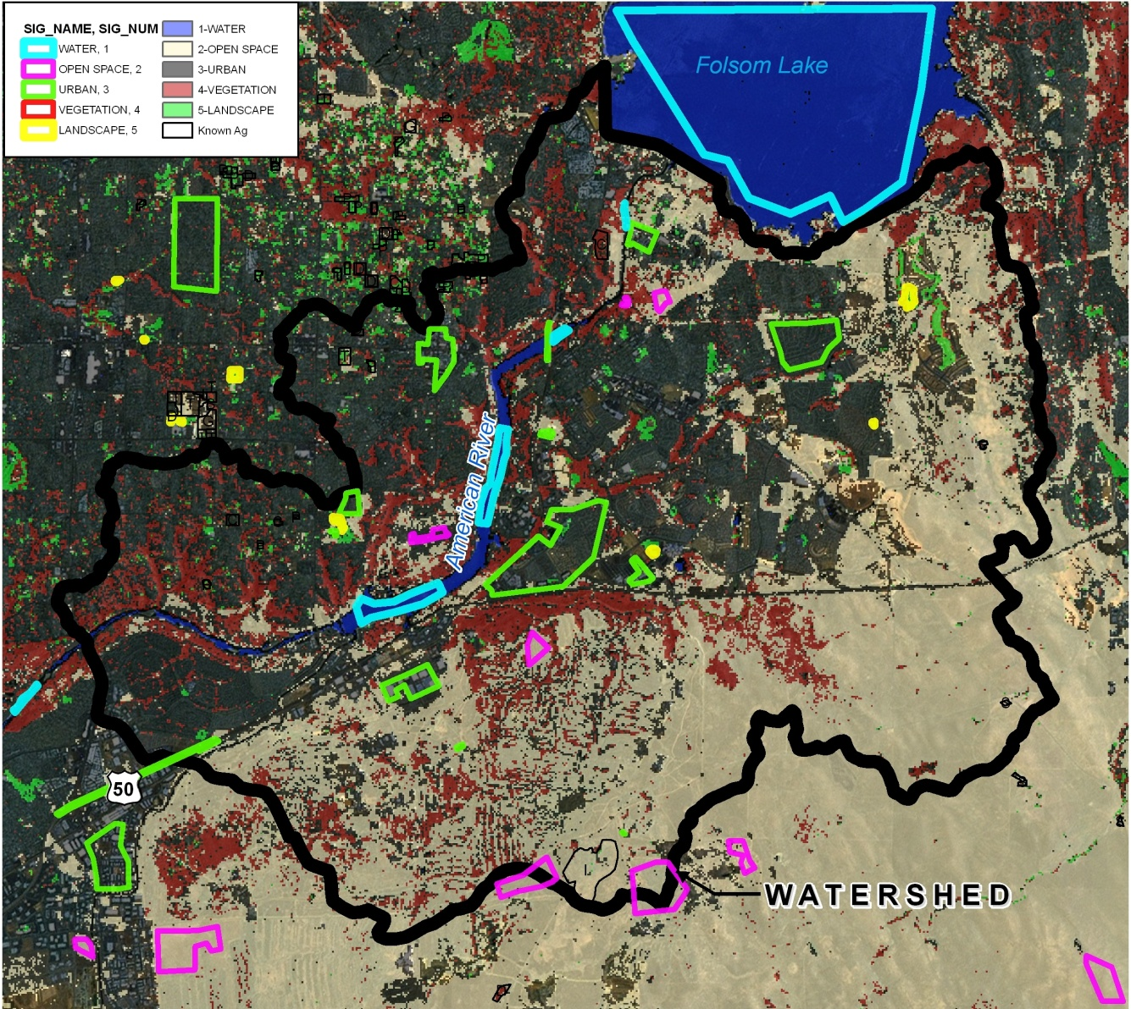
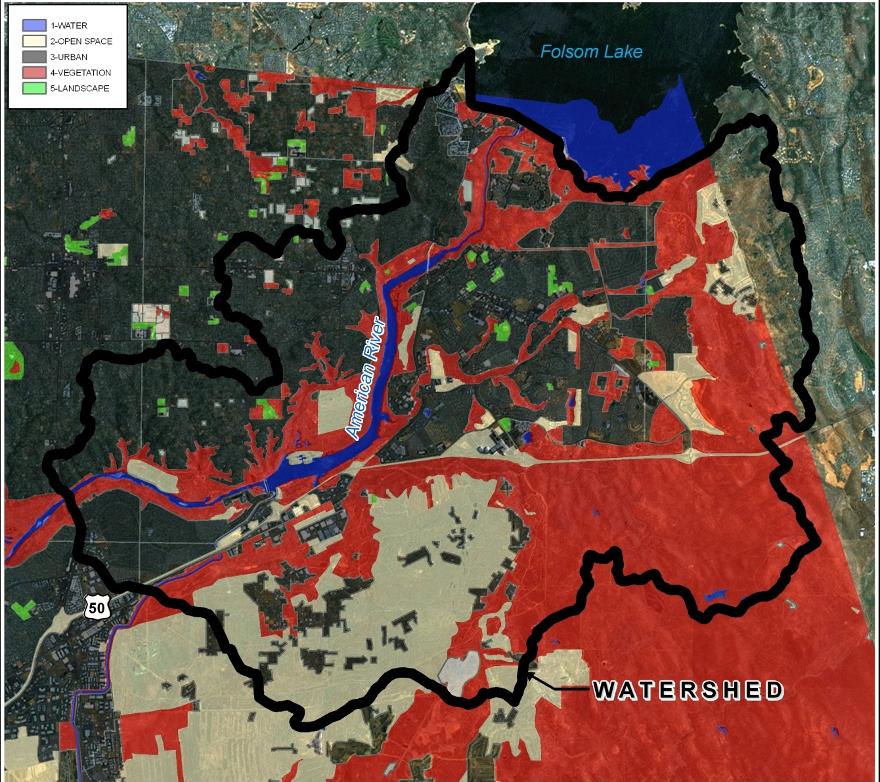
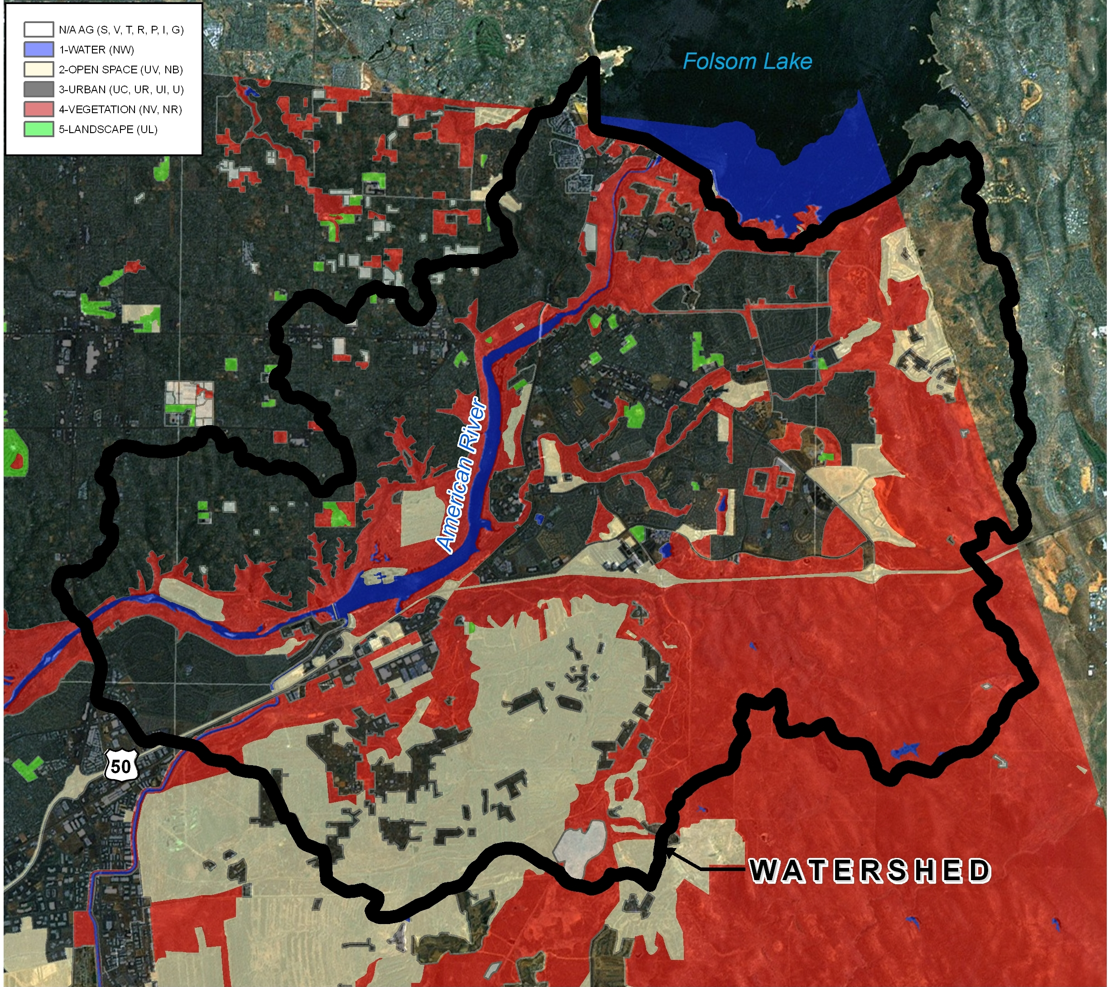
FINAL PRODUCT
COMPARISON
DWR Year 2000 Land Use

Slide 8
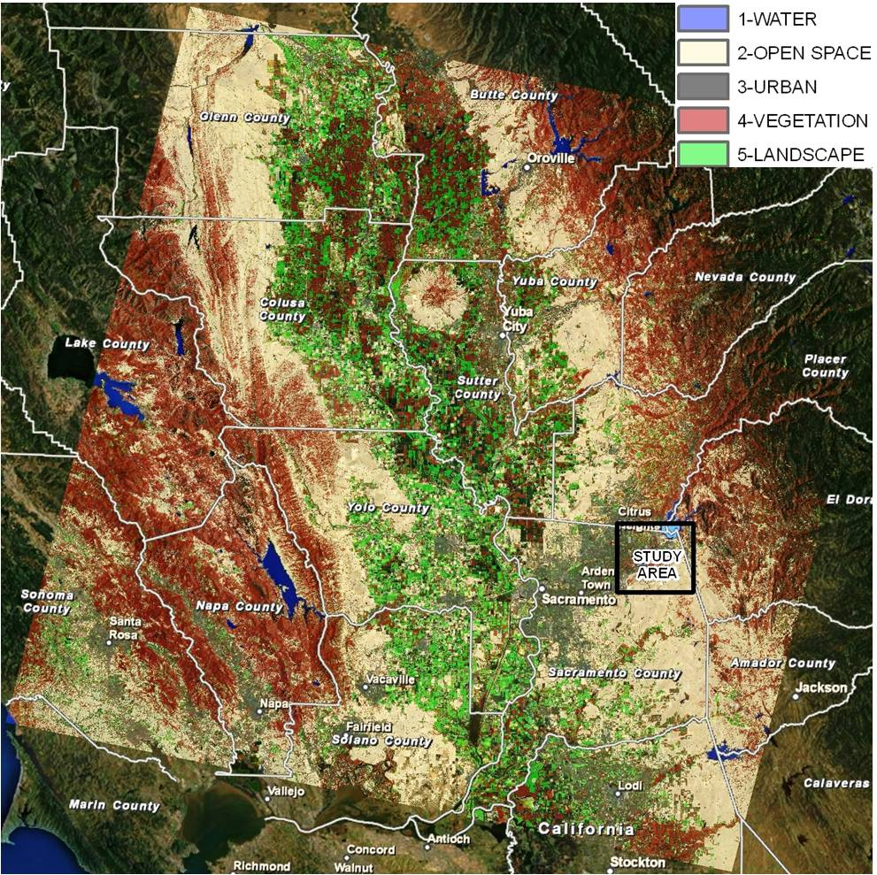
TRAINING APPLIED TO LARGE EXTENT

Slide 9
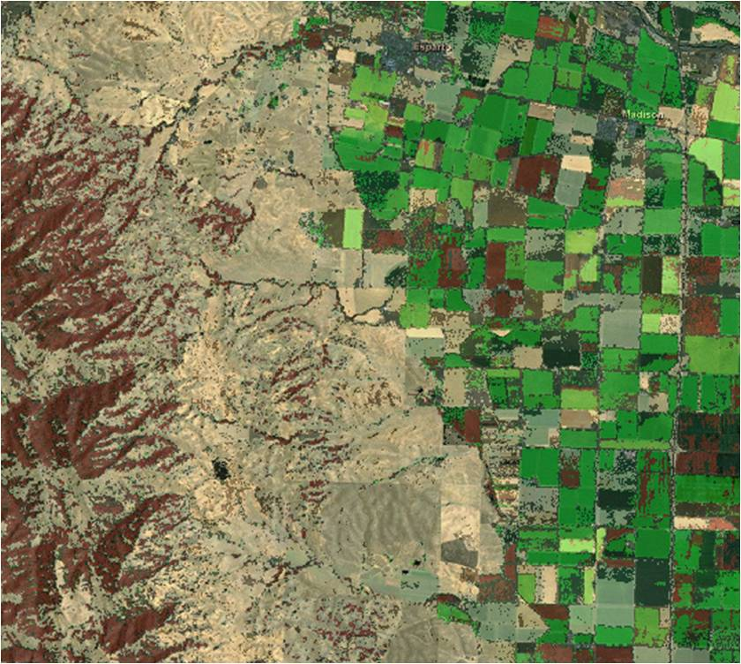
ISSUES: AGRICULTURAL AREAS
MIXED OUTPUT:
VEGETATION
OPEN SPACE
LANDSCAPE

Slide 10
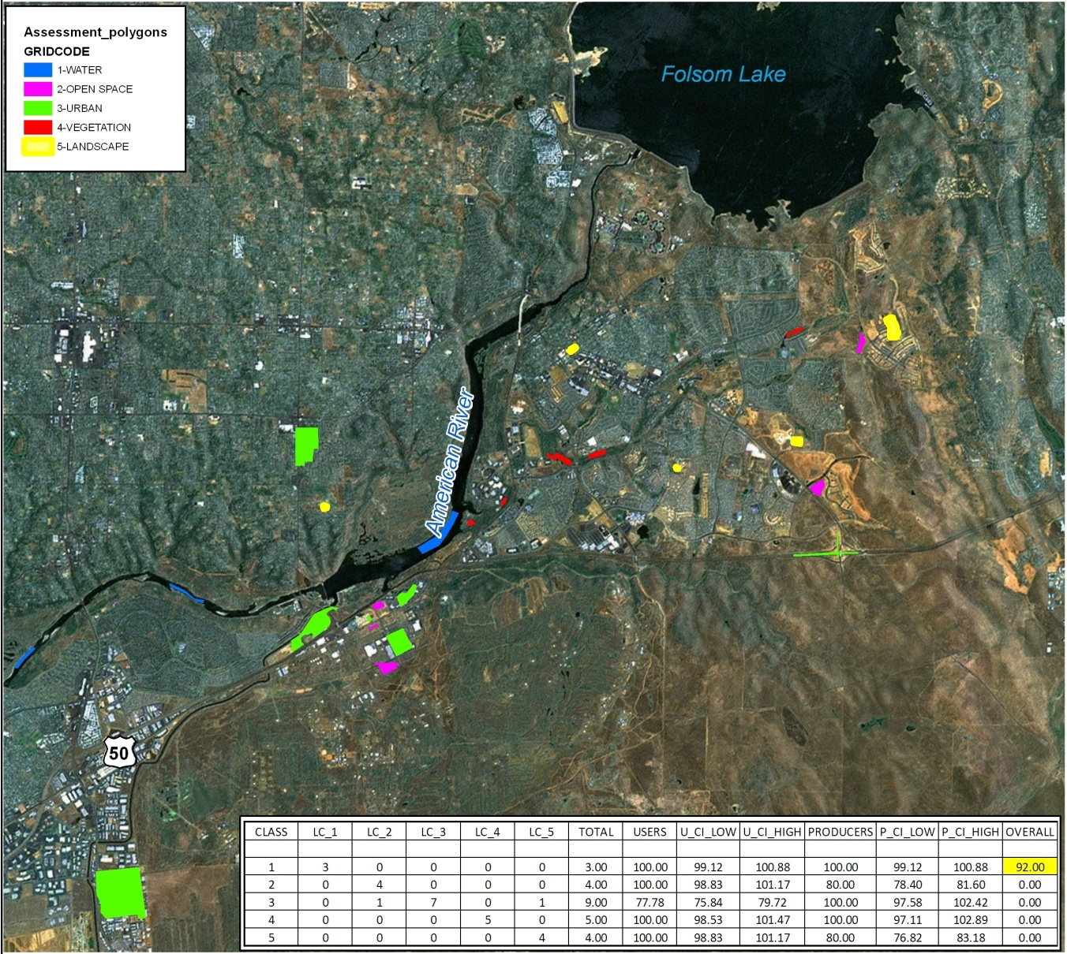

ACCURACY ASSESSMENT
ERROR MATRIX
92% SUCCESS!

Slide 11

CONCLUSION
I am satisfied with the results and I am confident that one can successfully use LANDSAT imagery and ArcGIS to classify basic land use types for hydrologic modeling purposes.
QUESTIONS/COMMENTS?

