Slide 1
Geography 385
Introduction to ArcGIS Web Application Design
Final GIS Web Application Project
by
Luisa Studen

Slide 2
Project Summary and Purpose
The Web application allows clients to create buffers on existing point features and select point features by location
The Web application consists of a map service and two geo-processing services
The map service serves as a base map to which the two geo-processing services are added
The first geo-processing service creates buffers on existing point features
The second geo-processing service selects point features by location

Slide 3
Create Map Document
Open ArcMap document and add the following data layers to it
California counties from CAL-ATLAS website
California elementary schools from CAL-ATLAS website
California earthquake epicenters from California Geological Survey website
Alameda county from CAL-ATLAS website

Slide 4
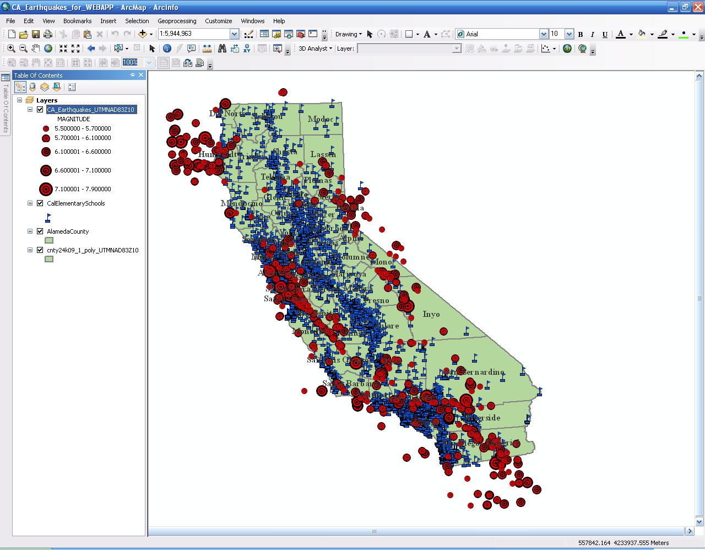
California earthquake epicenters since 1800, Elementary Schools, California Counties, and Alameda County

Slide 5
Prepare and Save Map
Symbolize features
Set layer visibility scale range for features and labels
Set relative pathnames to data sources on map document properties
Save map as CA_Earthquakes_for_WEBAPP

Slide 6
Publish Map as Map Service
Add Map Services Publisher Toolbar to ArcMap document
Click the Publish Map Service tool

Slide 7
Create First Geo-Processing Service (Buffer Points)
In ArcCatalog, create new folder and name it BuffPoints
Create new folder inside BuffPoints folder and name it ToolData
Within ToolData folder create new geodatabase and name it Schema
Create a new point feature class in Schema geodatabase and call it Points
Set coordinate system for point feature class as WGS 84 World Geographic Coordinate System
Repeat steps above to create a Scratch folder within the BuffPoints folder
Create new geodatabase in Scratch folder and name it Scratch
Create new toolbox within the BuffPoints folder and name it BufferService

Slide 8
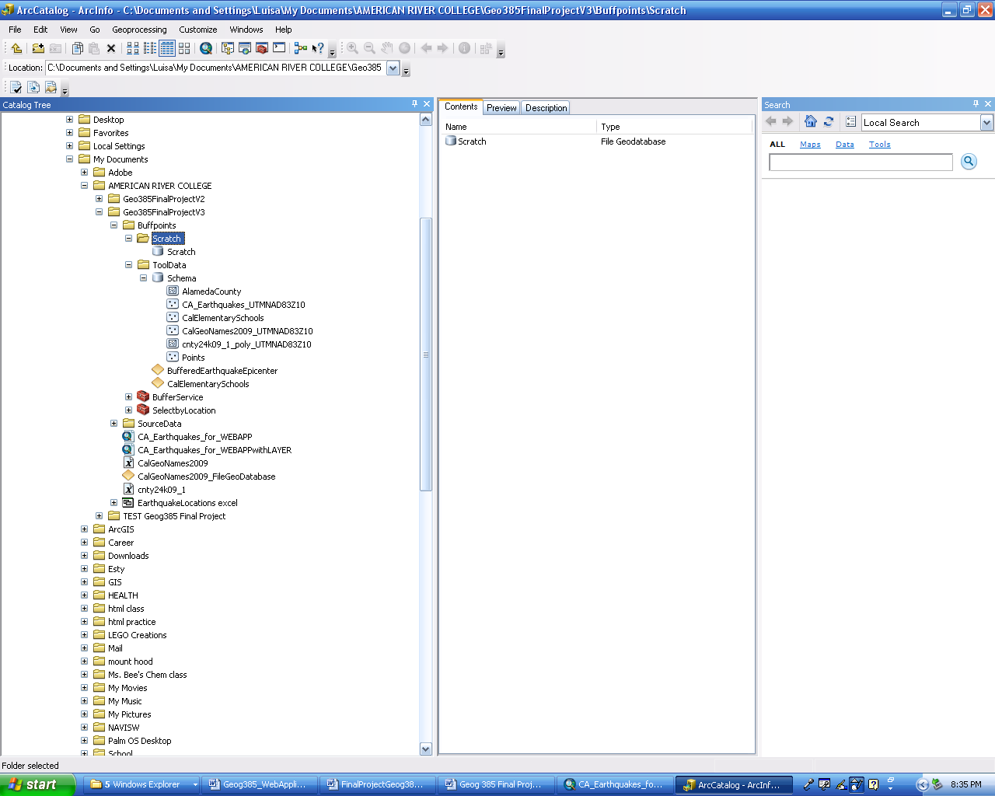
Data Folder Organization for First Geo-Processing Service

Slide 9
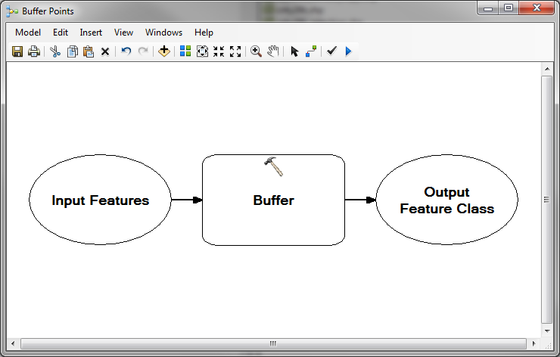
Create First Geo-Processing Service (Buffer Points)
Create a new model within the BufferService toolbox
Add the Buffer tool to the model
Right-click the Buffer tool, choose Make Variable from Parameter and select Input Features

Slide 10
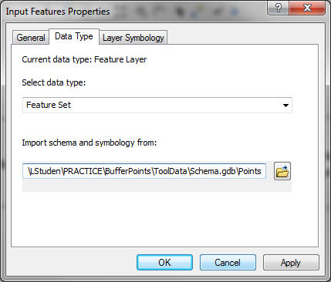
Create First Geo-Processing Service (Buffer Points)
Right-click Input Features and select properties
Click the Data Type tab and choose Feature Set from Select data type drop-down list
On Import schema and symbology from box, browse to the Points feature class within the Schema geodatabase

Slide 11
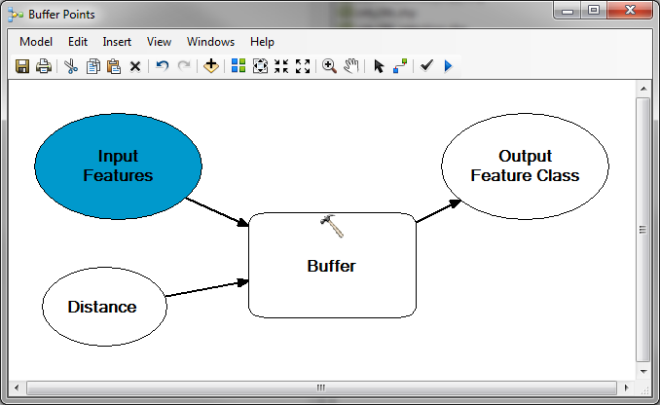
Create First Geo-Processing Service (Buffer Points)
Right-click the Buffer tool and choose Make Variable from Parameter
Click the Distance option from Make Variable from Parameter menu
Right-click the newly created variable and rename it Distance

Slide 12
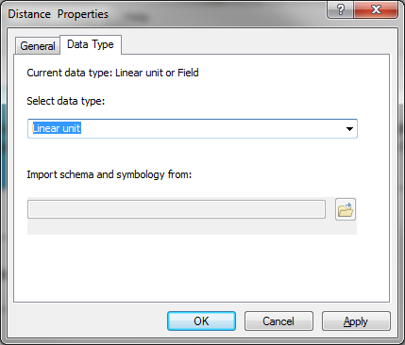
Create First Geo-Processing Service (Buffer Points)
Right-click the Distance variable and click Properties
Click the data type tab and set it to linear

Slide 13
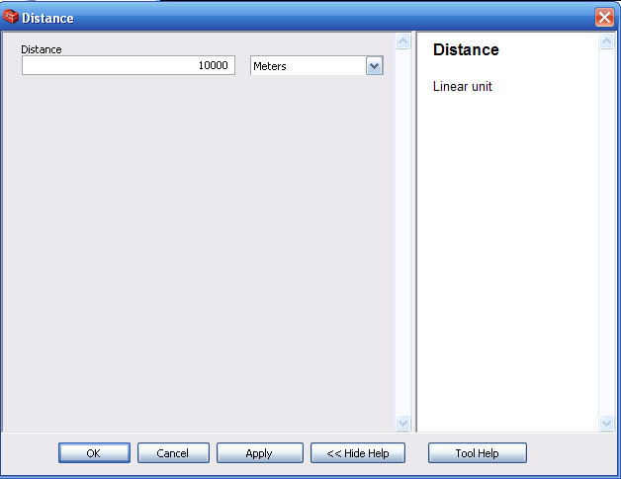
Create First Geo-Processing Service (Buffer Points)
Double-click the Distance variable and input desired distance (for this example, 10000 meters)

Slide 14
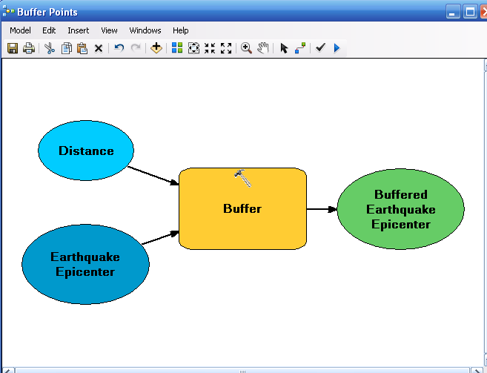
Create First Geo-Processing Service (Buffer Points)
Right-click the Input Features variable and rename it to Earthquake Epicenter
Right-click the Output Features variable and rename it to Buffered Earthquake Epicenters

Slide 15
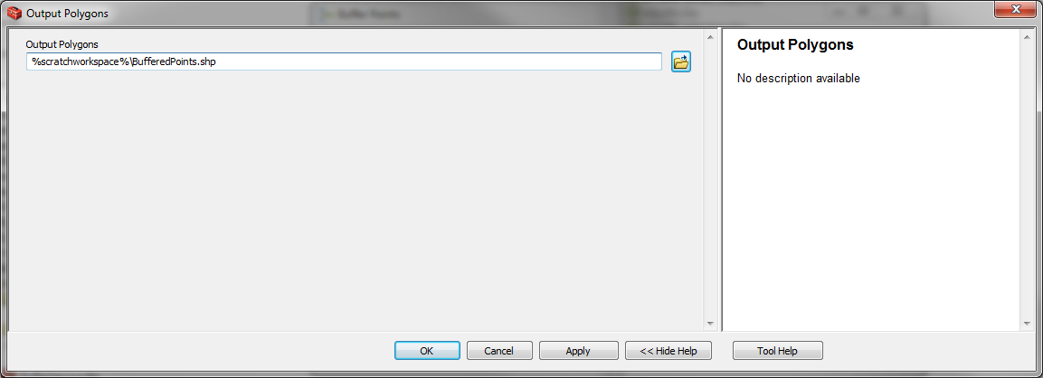
Create First Geo-Processing Service (Buffer Points)
Double-click the Buffered Earthquake Epicenters variable
Enter the “%scratchworkspace%\BufferedPoints.shp”string in the Output Polygon text box
This string names this model’s output polygon BufferedPoints.shp and stores it inside the Scratch geodatabase within the Scratch folder

Slide 16
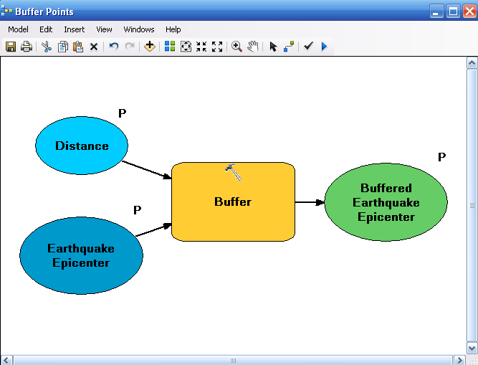
Create First Geo-Processing Service (Buffer Points)
Right-click the variables, Earthquake Epicenter, Distance, and Buffered Earthquake Epicenter individually and check the Model Parameter option to set the variables as Model Parameters

Slide 17
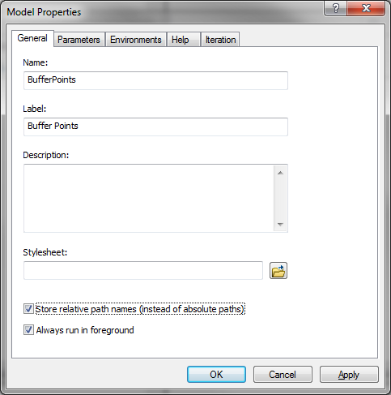
Create First Geo-Processing Service (Buffer Points)
In the ModelBuilder menu, click Model then Model Properties
Set the name of the model to BufferPoints, and the label to Buffer Points
Check the Store Relative Path Names option

Slide 18
Create First Geo-Processing Service (Buffer Points)
In the main ModelBuilder menu, click Model and click Save
Click Model again and click Close

Slide 19
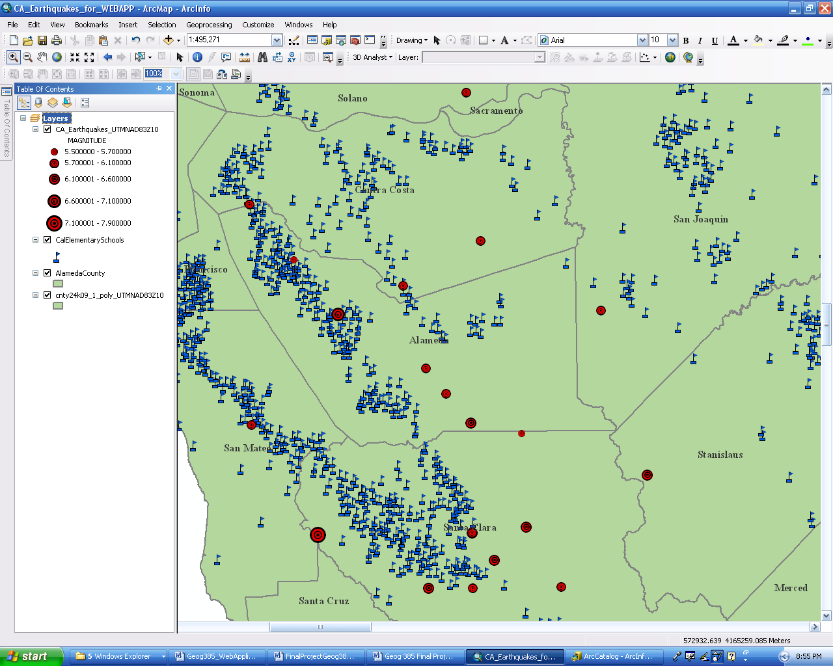
Test the First Geo-Processing Model in ArcMap
Open an existing map document

Slide 20
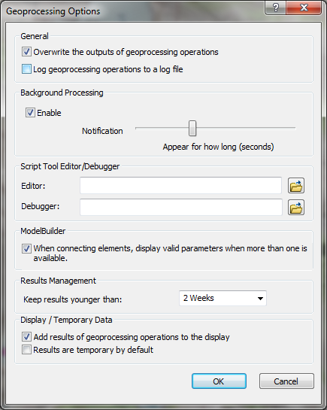
Test the First Geo-Processing Model in ArcMap
In ArcMap, click the Geoprocessing tab
Under Geoprocessing Options, check Overwrite the outputs of geoprocessing … , and check Add results of geoprocessing operations ….

Slide 21
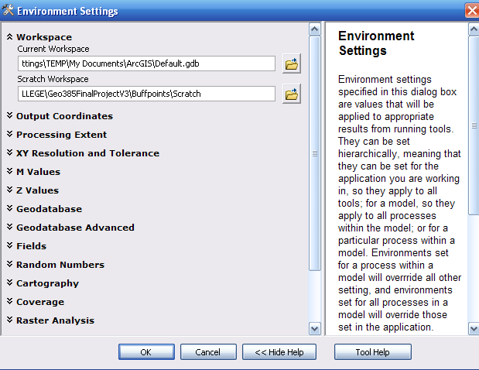
Test the First Geo-Processing Model in ArcMap
In ArcMap, click the Geoprocessing tab
Under Environment Settings, expand the Workspace category and set the scratch workspace to BufferPoints\Scratch

Slide 22

Test the First Geo-Processing Model in ArcMap
Add the Buffer Points tool to the ArcMap document (Use Add Data button)

Slide 23
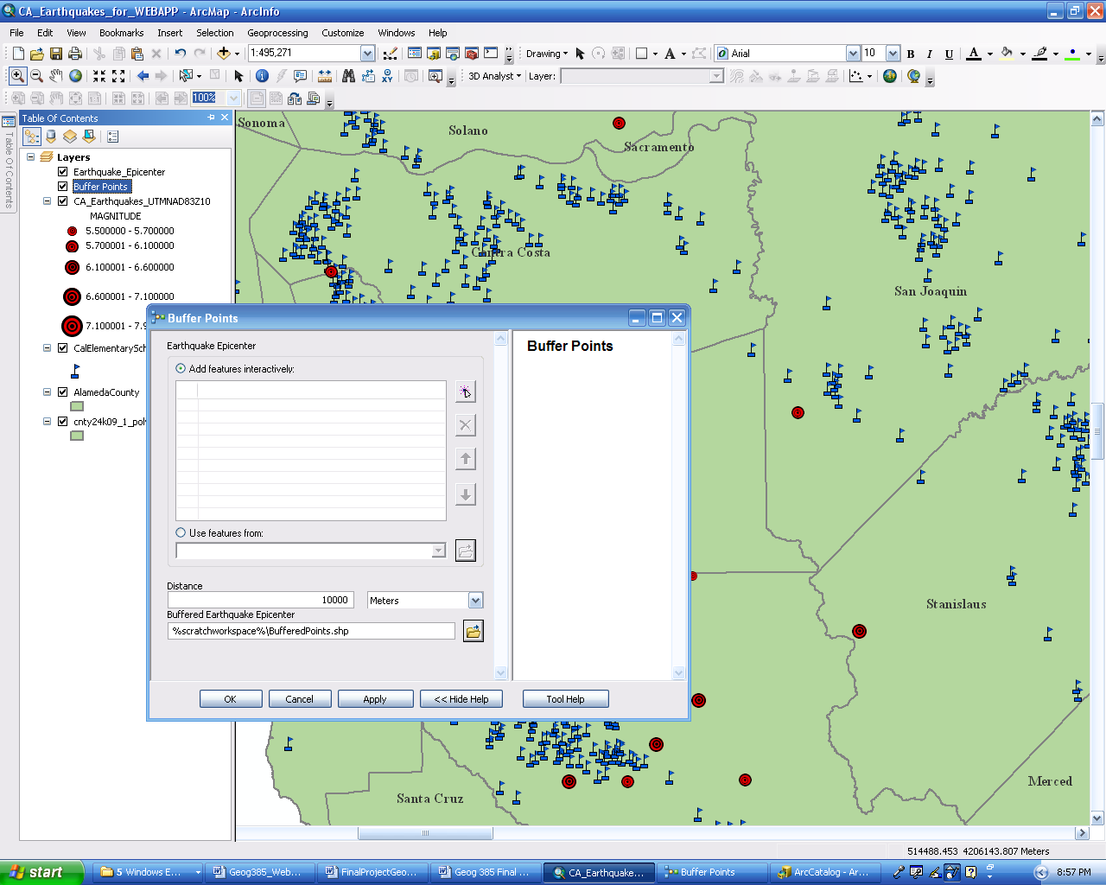
Test the First Geo-Processing Model in ArcMap
Right-click the Buffer Points tool layer in ArcMap and click open to open the tool’s dialog box and test the model

Slide 24
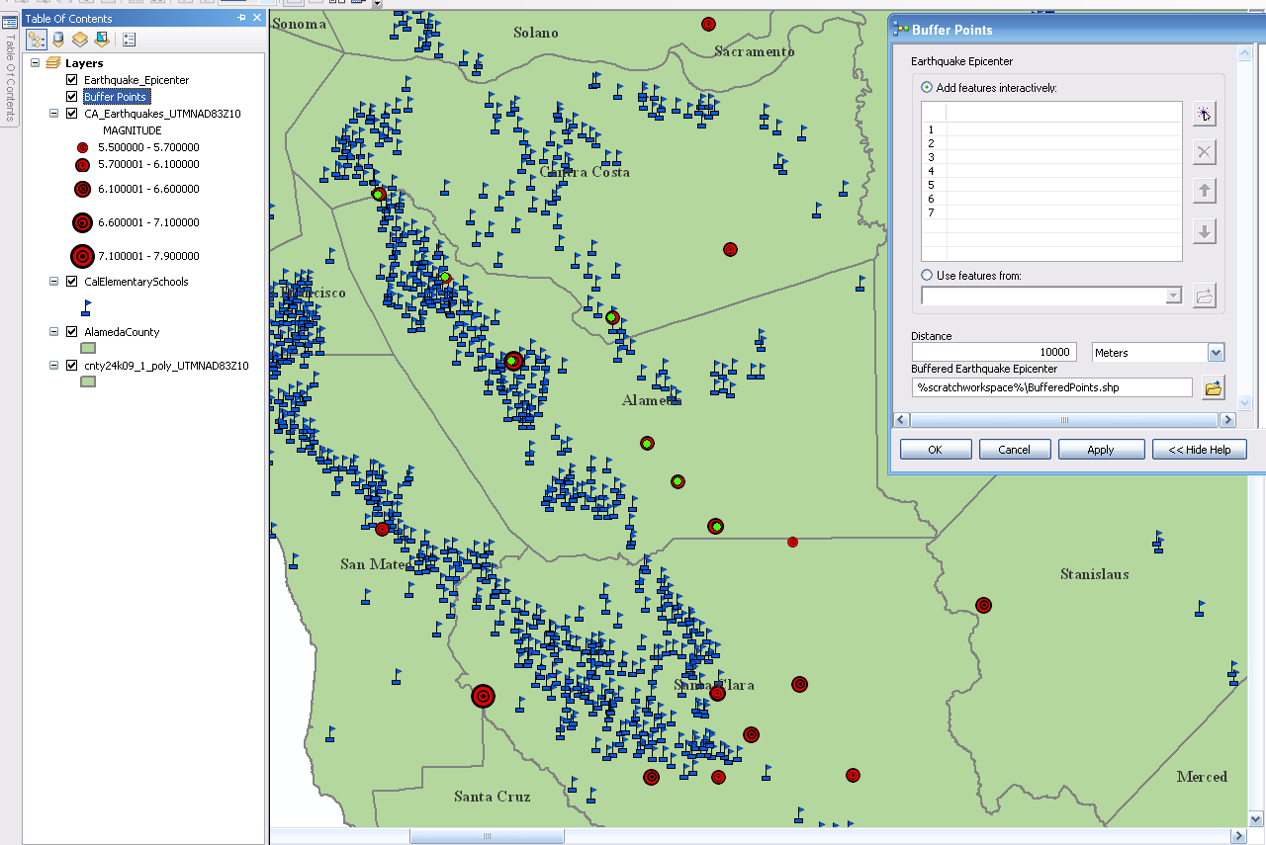
Test the First Geo-Processing Model in ArcMap
Click the Add Feature button in the tool’s dialog box and select several point features

Slide 25
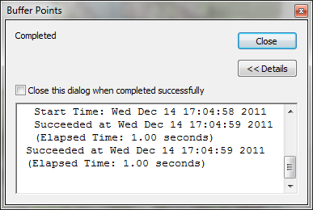
Test the First Geo-Processing Model in ArcMap
Click OK to run the geoprocessing model and see newly created buffered features

Slide 26
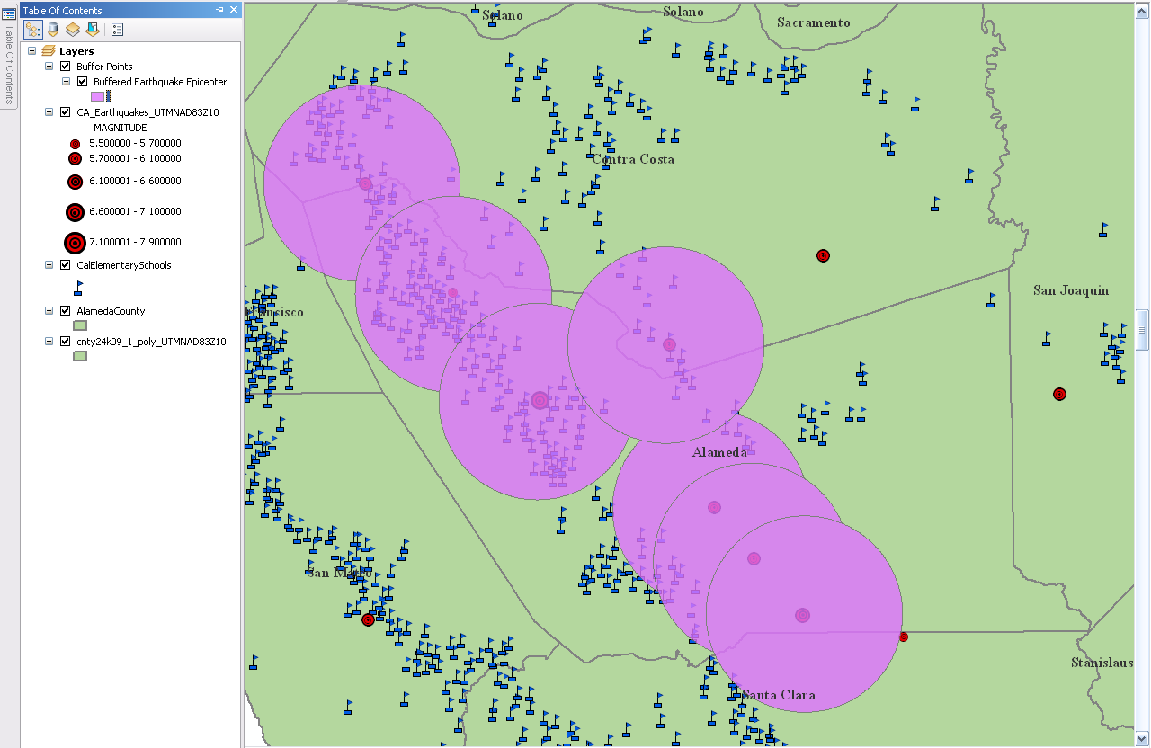
Test the First Geo-Processing Model in ArcMap
The model runs successfully and the BufferedPoints features are created

Slide 27
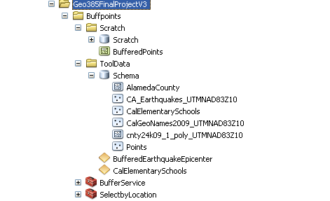
Test the First Geo-Processing Model in ArcMap
The newly created BufferedPoints feature class has been created and it resides in the Scratch geodatabase inside the Scratch folder

Slide 28
Publish the First Geo-Processing Service
Right-click the BufferService toolbox in ArcCatalog and click Publish to ArcGIS Server
On the Publish to ArcGIS Server dialog box, choose the server to publish to
Name the service BufferService
Click Next
Click Finish

Slide 29
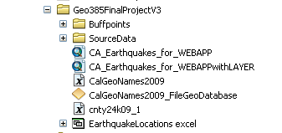
Create Second Geo-Processing Service (Select Features by Location)
Open the ArcMap document CA_Earthquakes_for_WEBAPP used to publish the map service
Save it as CA_Earthquakes_for_WEBAPPwithLAYER

Slide 30
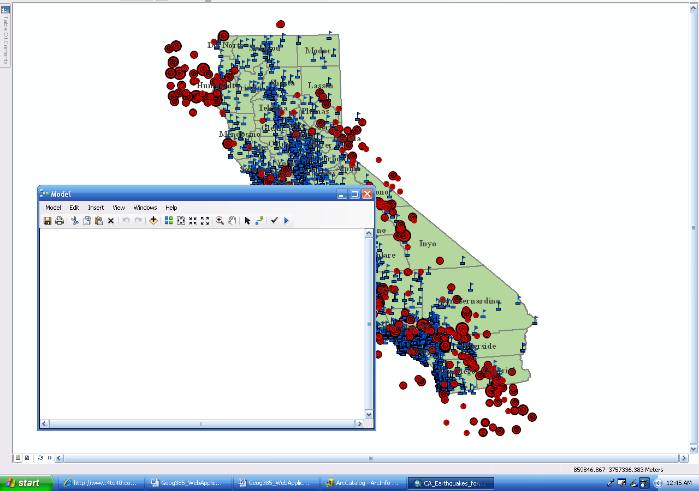
Create Second Geo-Processing Service (Select Features by Location)
Add a model from the Menu toolbar in ArcMap

Slide 31
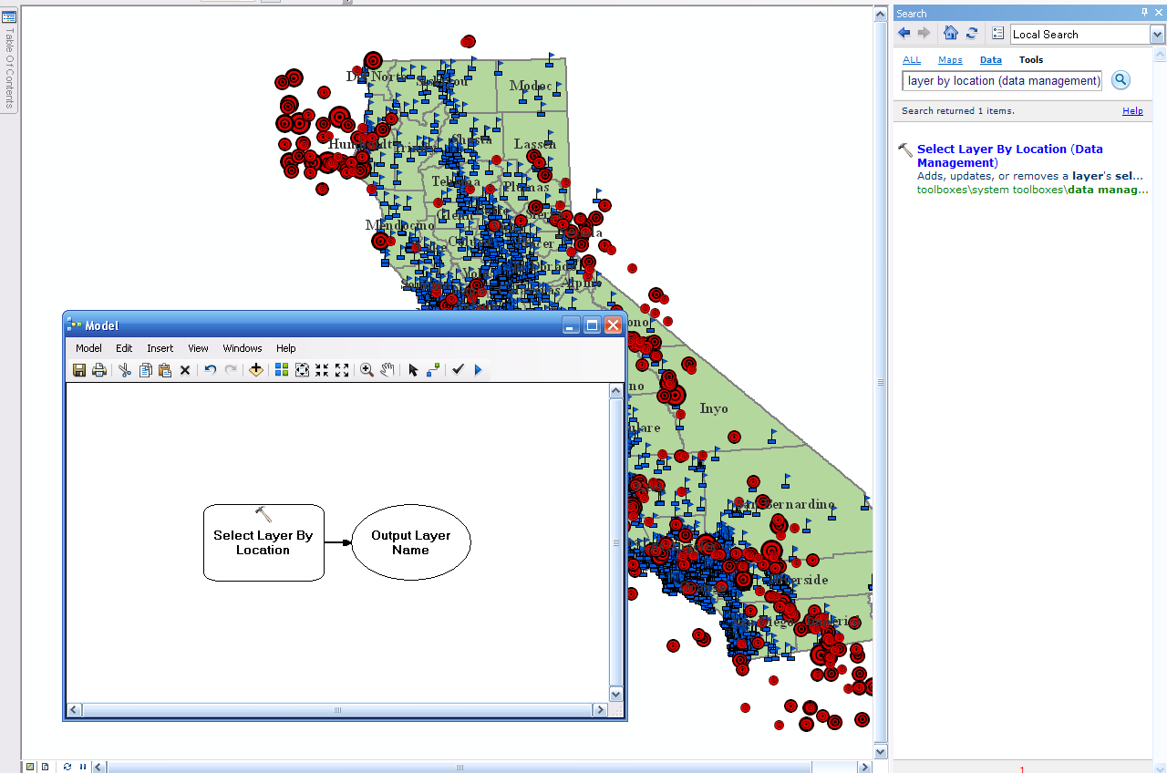
Create Second Geo-Processing Service (Select Features by Location)
Add the Select Layer by Location tool to the map document

Slide 32
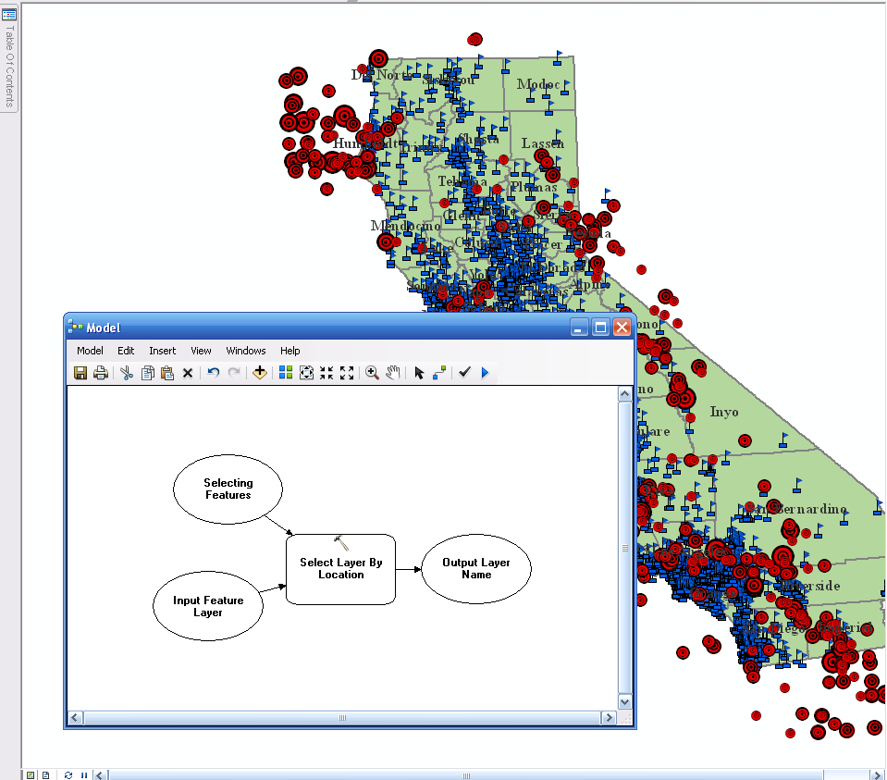
Create Second Geo-Processing Service (Select Features by Location)
Right-click the Select Layer by Location variable, go to Make Variable From Parameter, select Input Features. Repeat steps and select Selecting Features

Slide 33
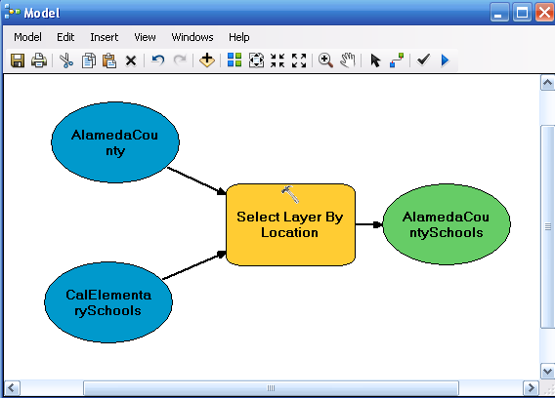
Create Second Geo-Processing Service (Select Features by Location)
Right-click the Selecting Features variable, click open, and select AlamedaCounty
Right-click the Input Features variable, click open, and select CalElementarySchools

Slide 34

Create Second Geo-Processing Service (Select Features by Location)
Right-click each of the variables, AlamedaCounty, CalElementarySchools, and AlamedaCountySchools, individually and check Model Parameter

Slide 35
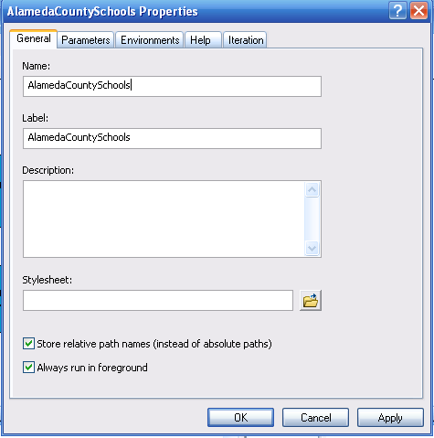
Create Second Geo-Processing Service (Select Features by Location)
Right-click AlamedaCountySchools and check Add to Display
In the main ModelBuilder menu, click Model, click Model Properties, set name to AlamedaCountySchools, set label to AlamedaCountySchools , and Description to Schools in Alameda County, and check Store relative path names. Click OK.

Slide 36
Create Second Geo-Processing Service (Select Features by Location)
In the main ModelBuilder menu, click Model and click Save
Browse to the SelectbyLocation toolbox
Click Model again and click Close

Slide 37
Test the Second Geo-Processing Service in ArcMap
Open the CA_Earthquakes_for_WEBAPPwithLAYER ArcMap document
Click the Add Data button to Navigate to the SelectbyLocation toolbox
Double-click the toolbox and add the AlamedaCountySchools tool to the map

Slide 38
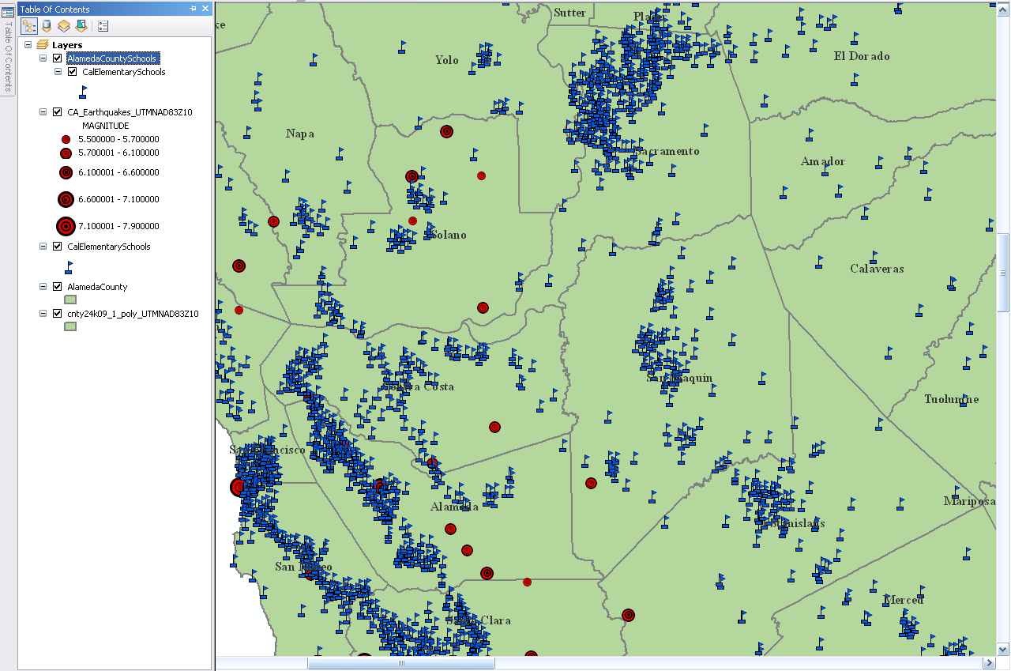
Test the Second Geo-Processing Service in ArcMap
The AlamedaCountySchools tool layer appears as the top layer in the table of contents of the map

Slide 39
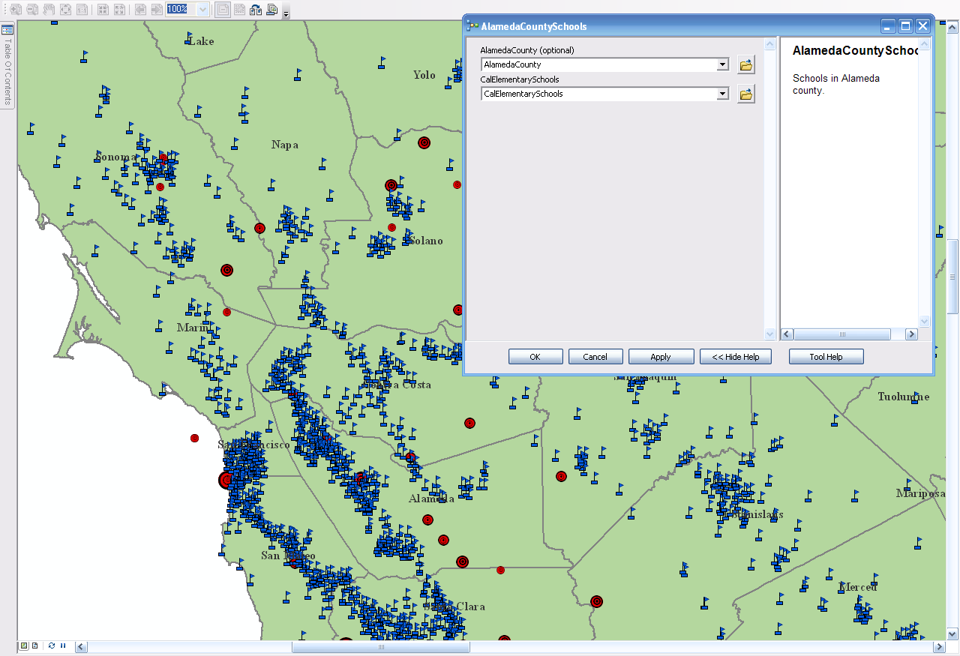
Test the Second Geo-Processing Service in ArcMap
Right-click the AlamedaCountySchools tool and click Open

Slide 40
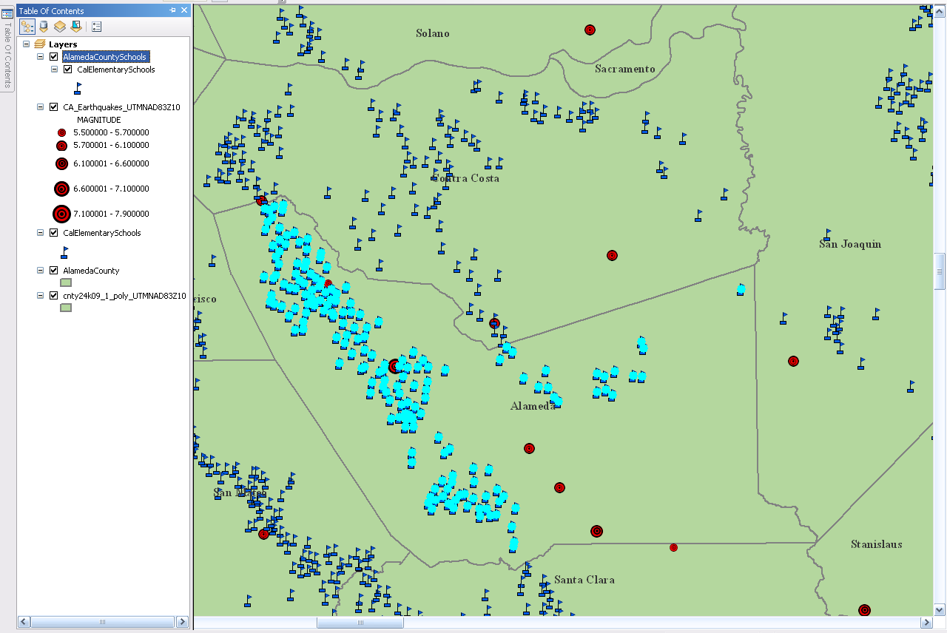
Test the Second Geo-Processing Service in ArcMap
Click OK on the AlamedaCountySchools tool’s dialog box
All the Elementary schools in Alameda county are selected

Slide 41
Test the Second Geo-Processing Service in ArcMap
Unselect all selected features
Save the map document with the AlamedaCountySchools, Select by Location tool layer embedded in the map
Name the map CA_Earthquakes_for_WEBAPPwithLAYER

Slide 42
Publish the Second Geo-Processing Service
In ArcCatalog, under the ArcGIS Server instance, right-click and choose Add New Service
Name the service SelectAlamedaSchools
Choose Geoprocessing Service as Type and click Next
Choose the Map option and browse for the MXD file from disk
Select the CA_Earthquakes_for_WEBAPPwithLAYER map document which contains the Select by Location, AlamedaCountySchools tool embedded in it

Slide 43
Create Web Application
First log in to ArcGIS Server Manager
Click Create a Web application
In the name text box, type SelectandBufferVersionTwo for the name of the Web Application
In the description text box, type Buffer Features Interactively and Select Features by Location
Click Next
Click Add Layers and select the ArcGIS Server that contains the map service and two geo-processing services created earlier
First, choose the map service CA_Earthquakes_for_WEBAPP and click Add
Click Close to return to the list of layers and click Next
Click Add New Task, Click on Supporting Services, select the Local connection showing the Web Server name, locate the BufferService geoprocessing toolbox and click on Buffer Points and click Apply

Slide 44
Create Web Application
Click Add New Task, Click on Supporting Services, select the Local connection showing the Web Server name, locate the SelectbyLocation geoprocessing toolbox and click on SelectAlamedaSchools and click Apply

Slide 45
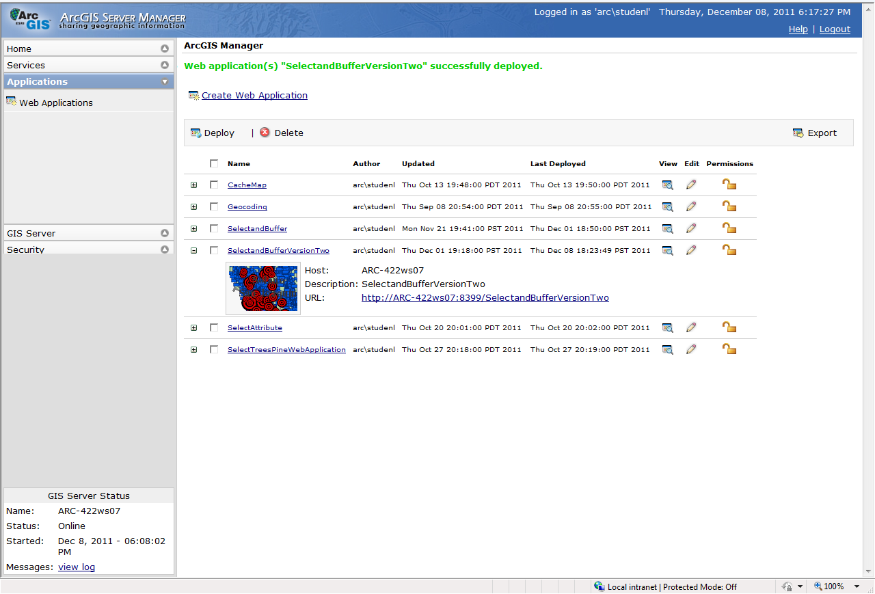
Deploy Web Application
Click on the URL to bring up the newly created Web Application, SelectandBufferVersionTwo

Slide 46
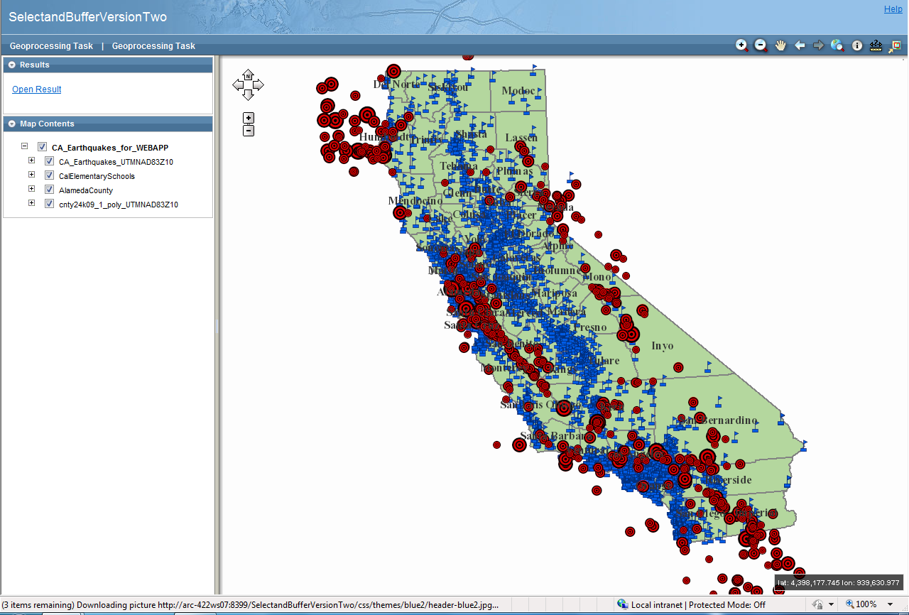
Deploy Web Application
The Web application opens successfully

Slide 47
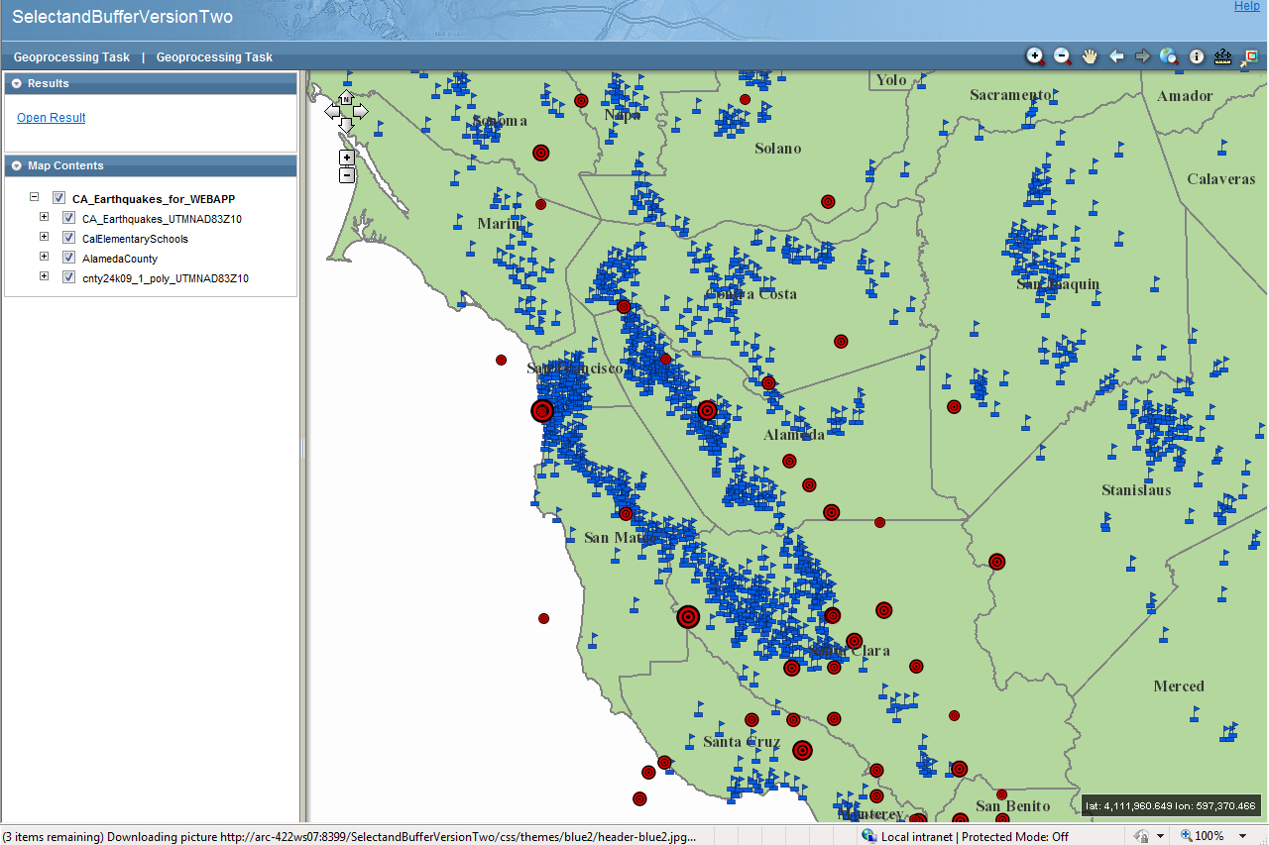
Test Web Application
Zoom in closer to Alameda county to see the geoprocessing capabilities

Slide 48
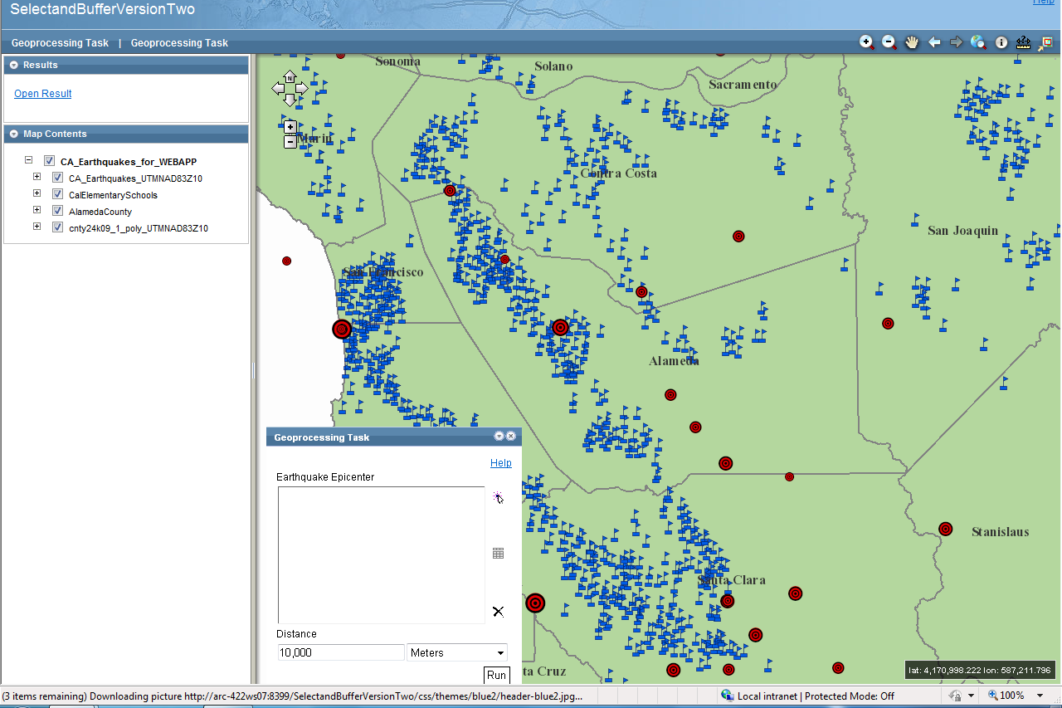
Test Web Application
Click on the first Geoprocessing Task, this is the Buffer Points geoprocessing task

Slide 49

Test Web Application
The user selects point features interactively

Slide 50
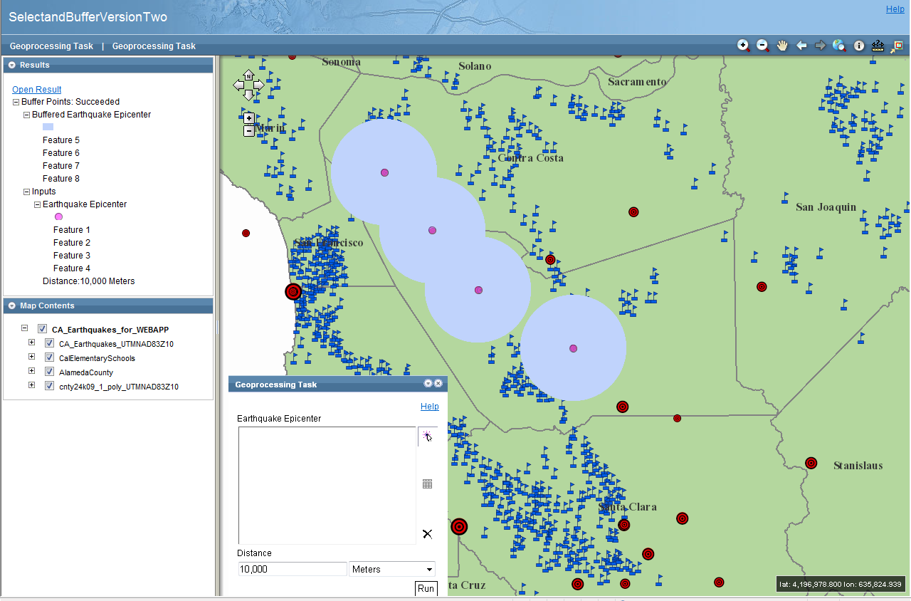
Test Web Application
The tool runs successfully displaying a buffer around each selected feature

Slide 51
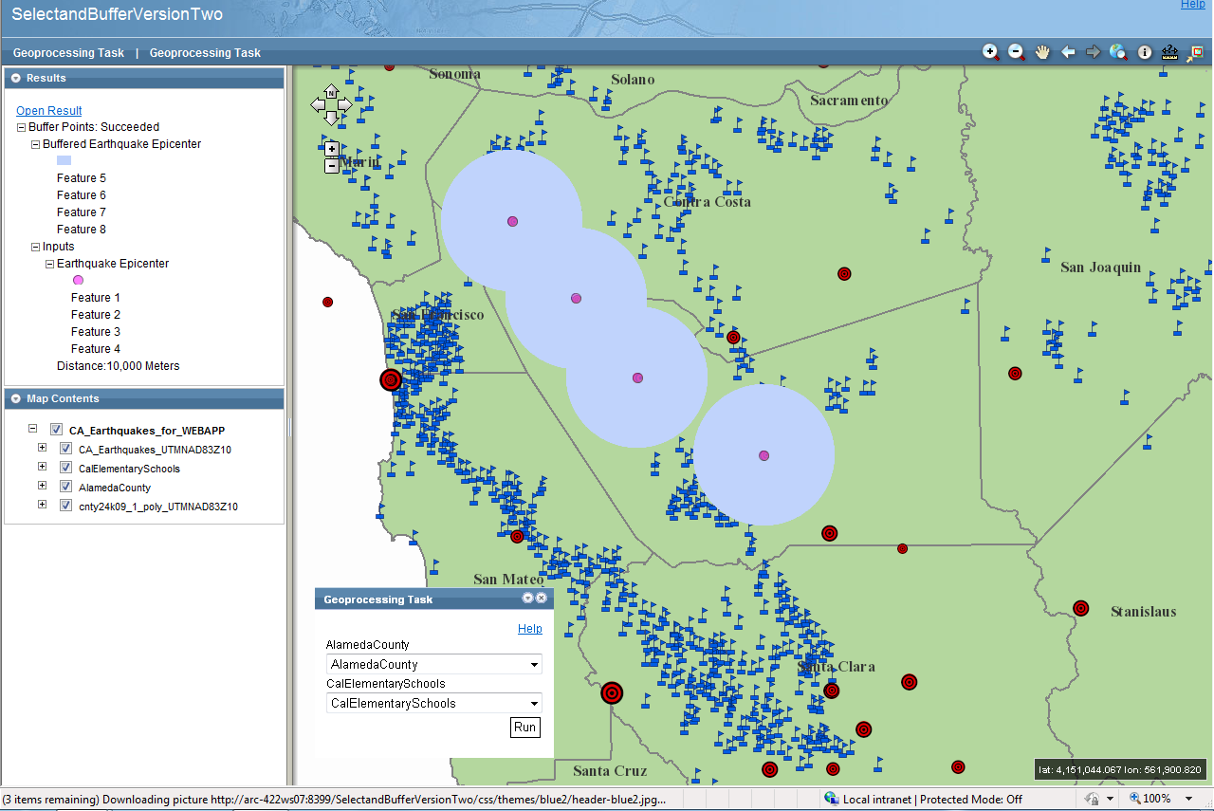
Test Web Application
The user clicks on the second Geoprocessing Task, the AlamedaCountySchools geoprocessing task

Slide 52
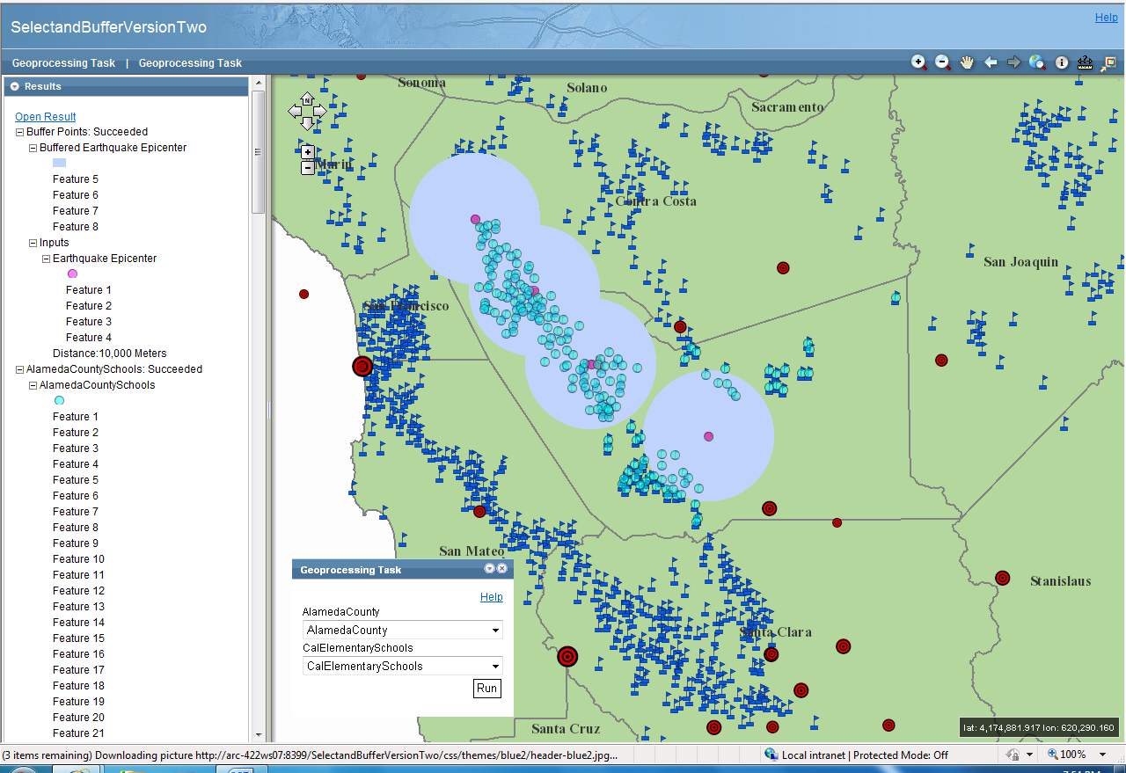
Test Web Application
The user clicks run and all the Elementary schools in Alameda county are selected

Slide 53
Test Web Application
The next screen shot provide a better visual representation of the resulting Select by Location, AlamedaCountySchools, geoprocessing routine.

Slide 54
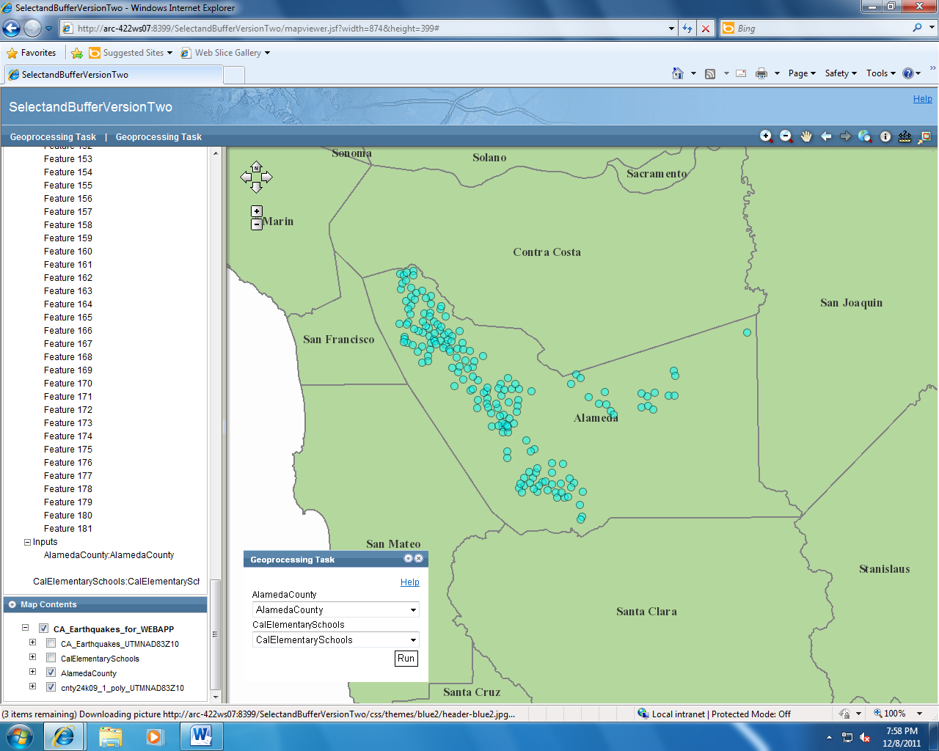
Test Web Application

