Slide 1
American River Driving Route
Morgan Neal
GEOG 385
Fall 2011
Objective
  Identify a driving route through locations within a user-specified distance of the lower American River using two methods
    Specify maximum distance from river
    Specify buffer around river

Slide 2
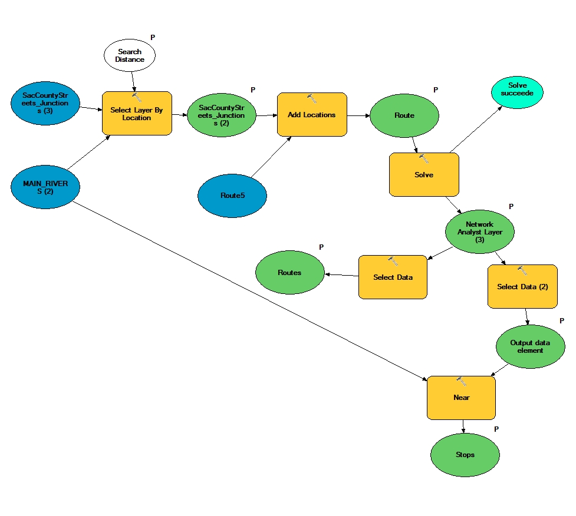
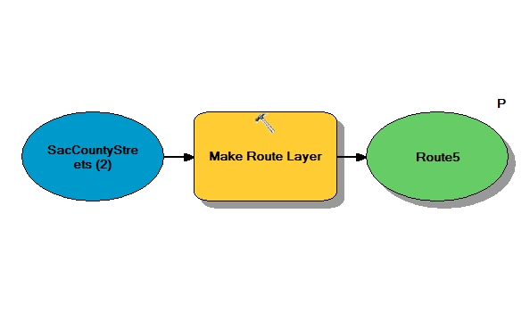
Select Distance Model
Need to run this model first (creates initial route for input to the model)

Slide 3
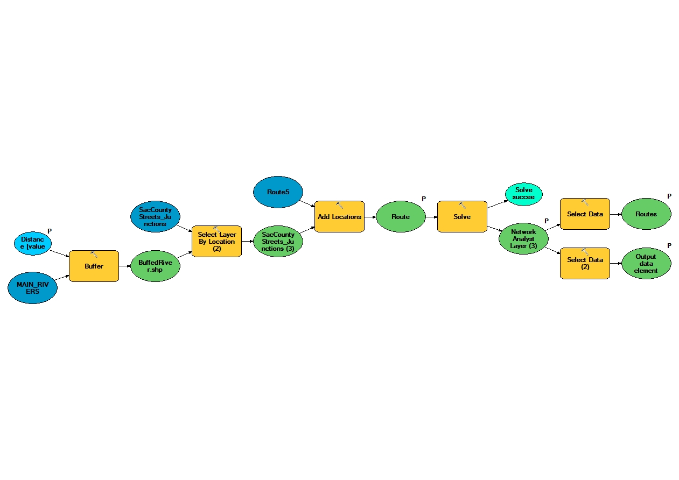
Buffer Model
This is essentially the same as the original model, except that the buffer tool is used to select intersections within the user-specified buffer.

Slide 4
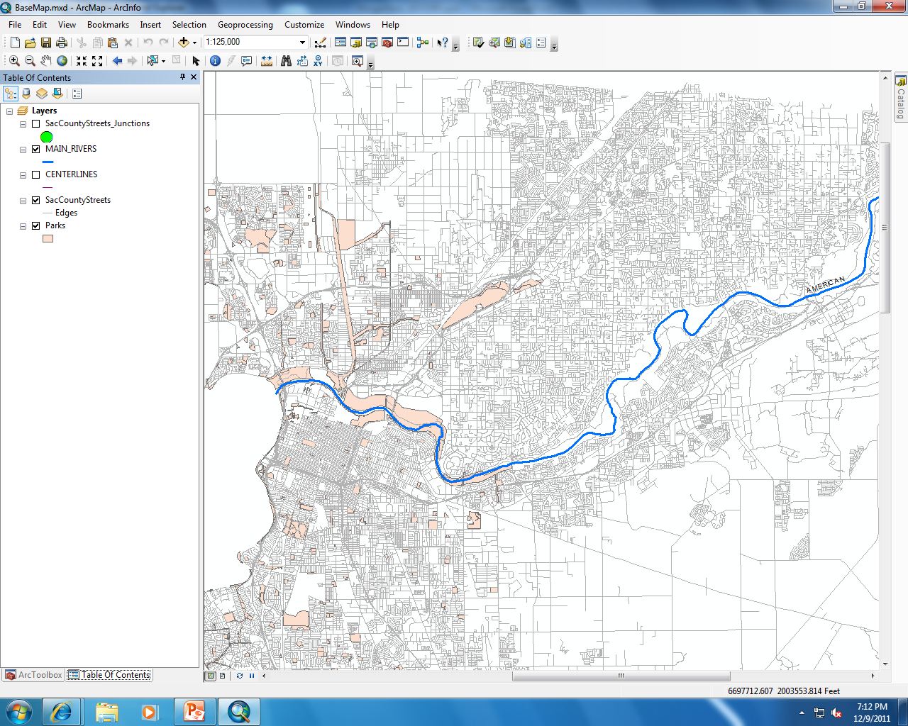
ArcMap: Basemap for Map Service
Displays the lower American River, Sacramento County streets, and public parks

Slide 5
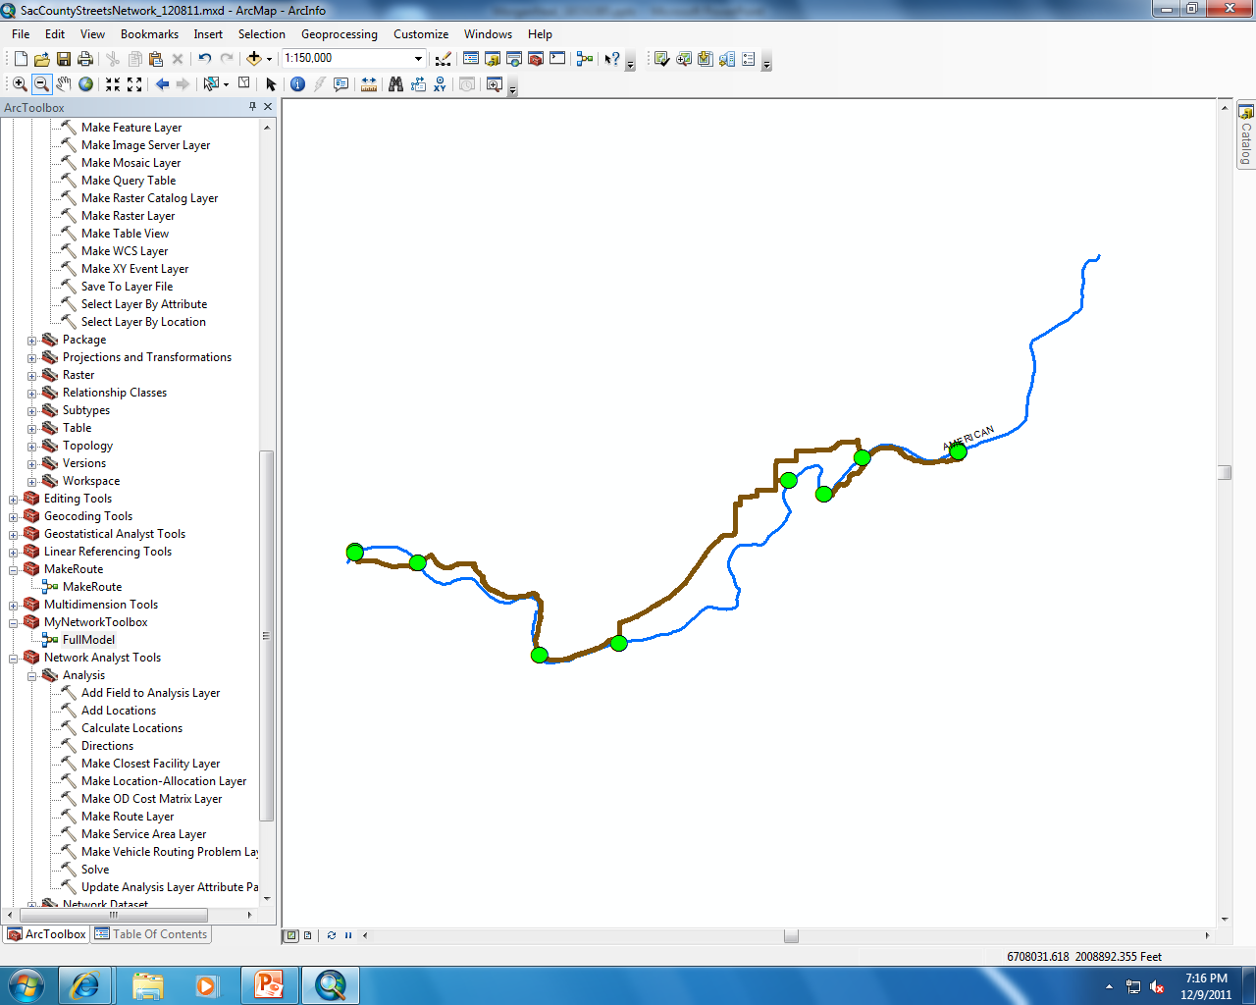
ArcMap: Geoprocessing Task 1 (Select Distance)

Slide 6
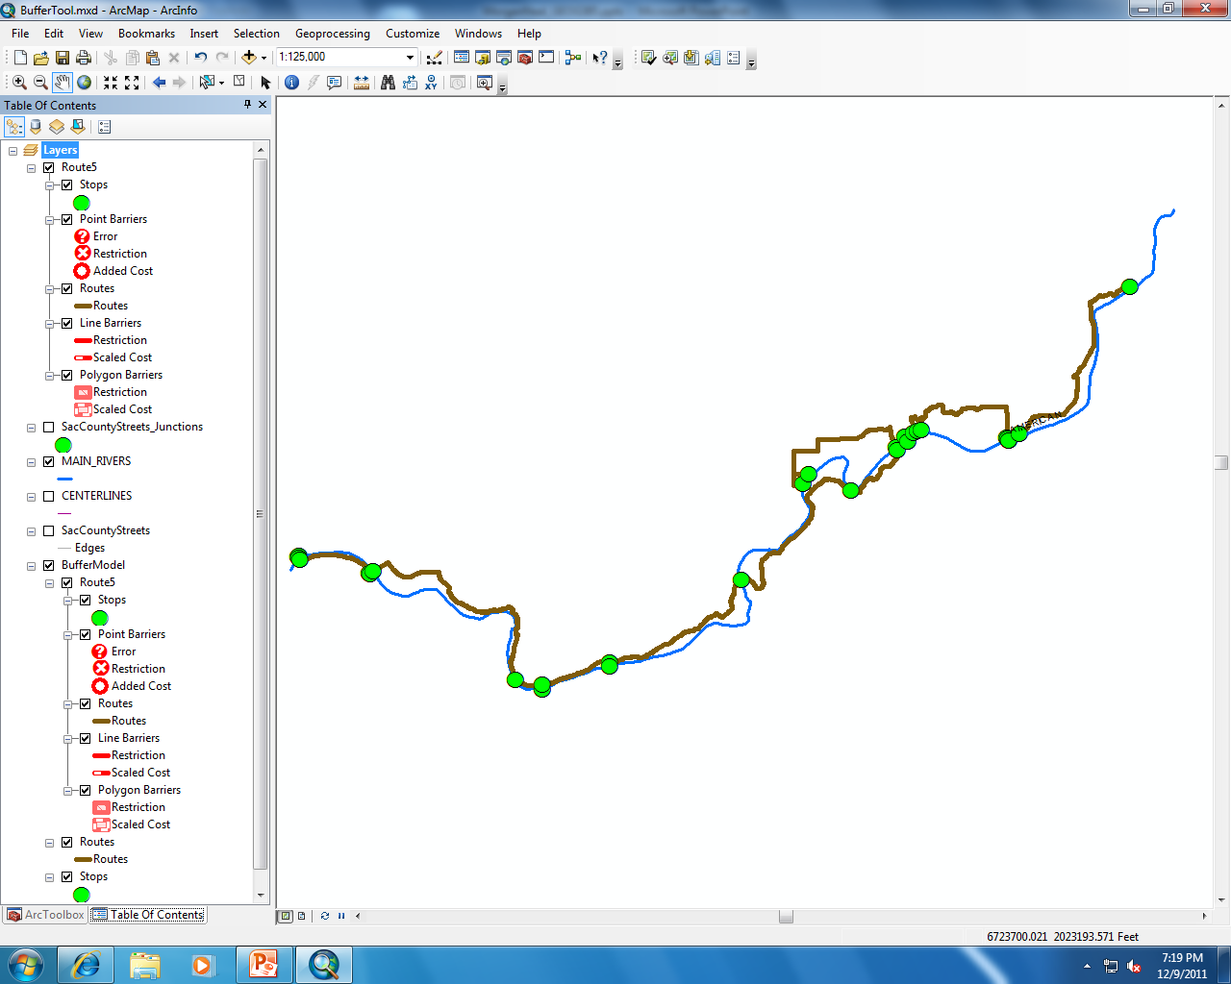
ArcMap: Geoprocessing Task 2 (Buffer)

Slide 7
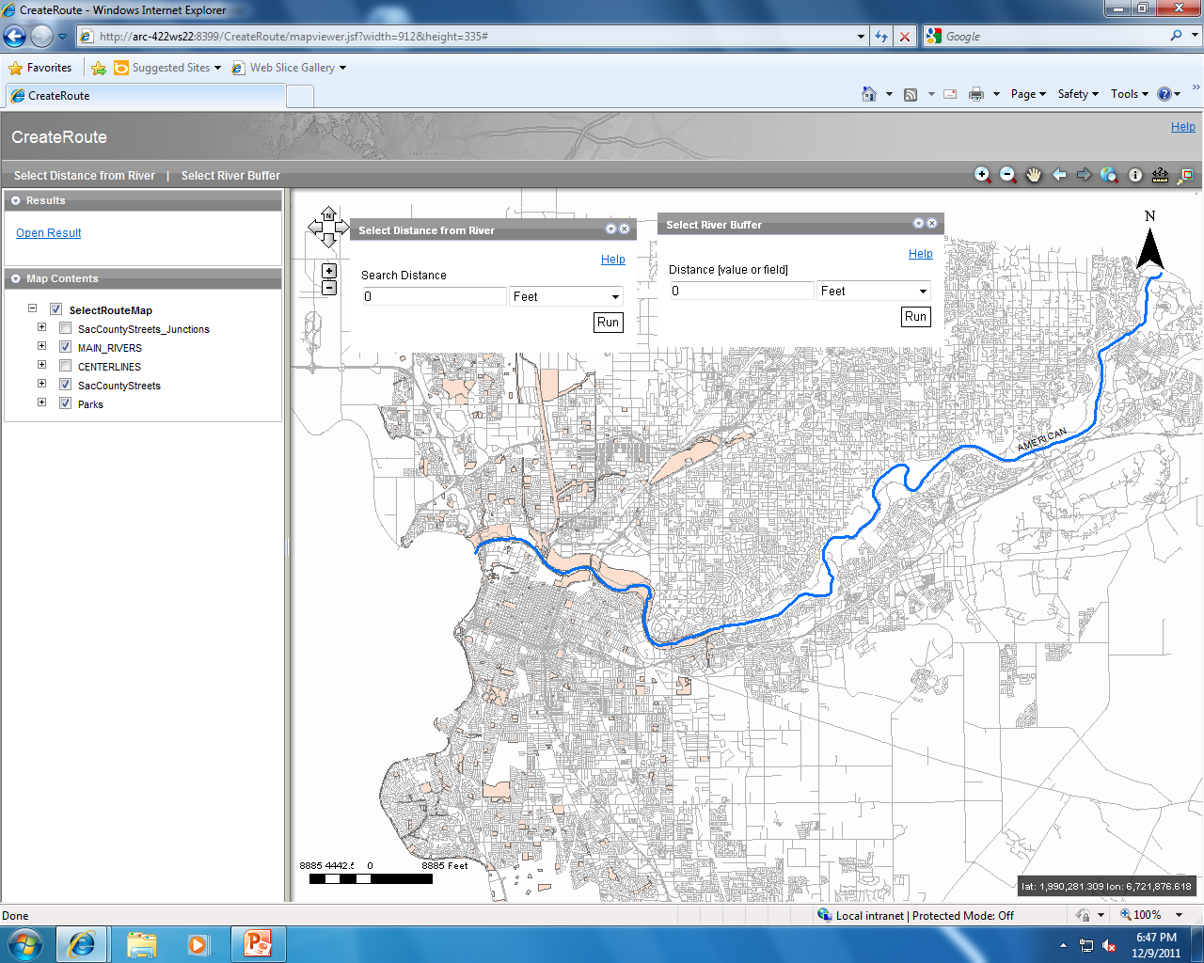
ArcGIS Server: Geoprocessing Dialog Boxes Prior to Execution

Slide 8
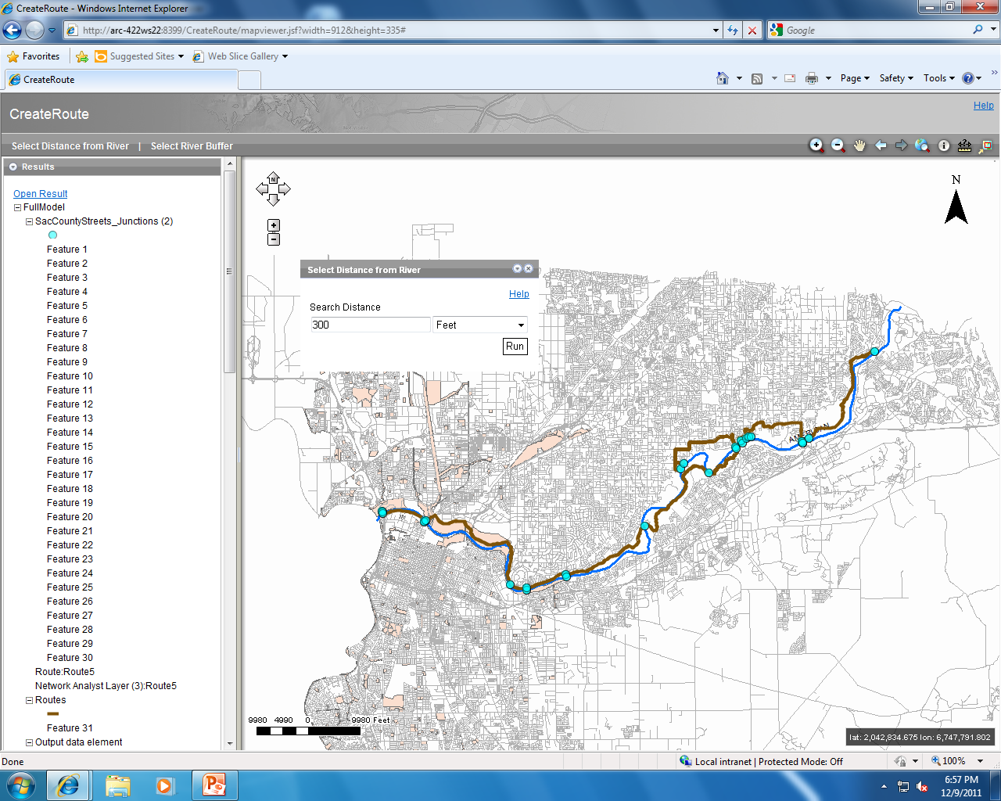
ArcGIS Server: Execution of Select Distance Task

Slide 9
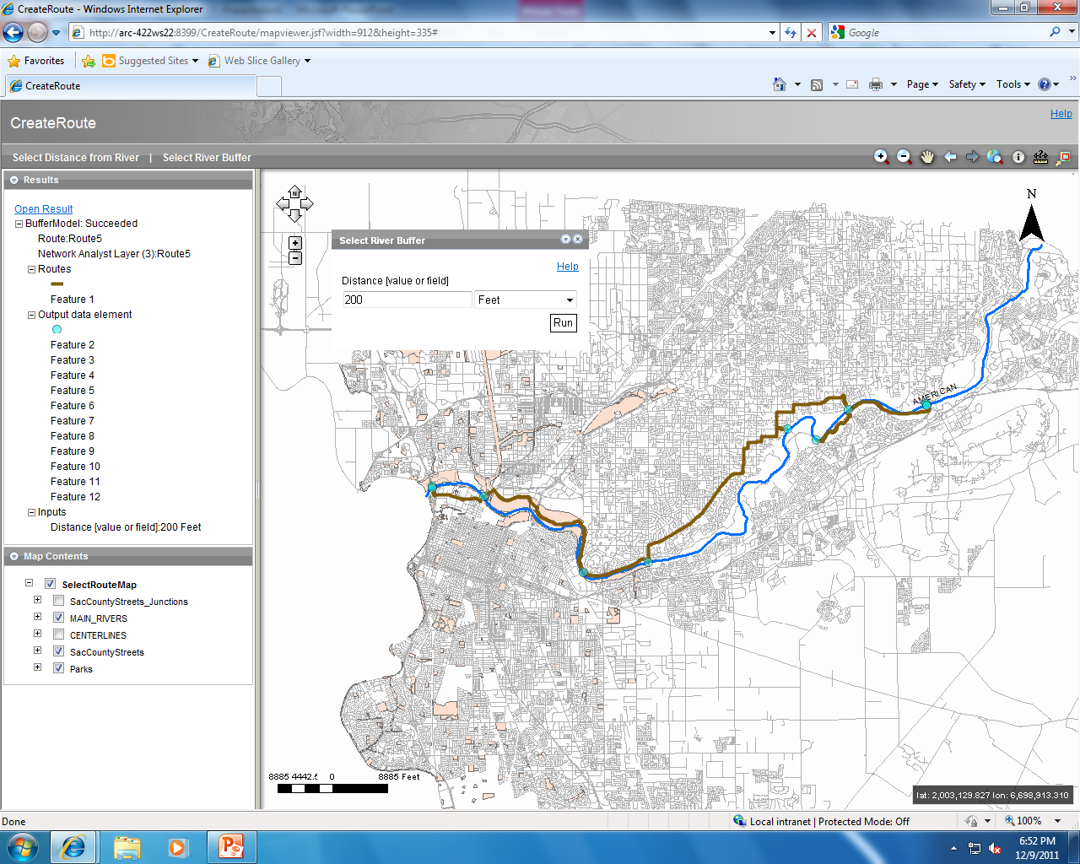
ArcGIS Server: Execution of Select River Buffer Task

