Slide 1
Final Presentation
GEOG 385 – Web Applications
Sean McCartney
Fall 2011

Slide 2
Workflow
Create ArcMap documents (.mxd).
Create one document for a map service, and one each for your geoprocessing services.
Publish the (.mxd) as a map service (.msd).
Test the map service in ArcMap.
Create an application for the map service (.msd).
Publish each individual map (.mxd), with a tool layer, as a geoprocessing service.
Create tasks for the application from your geoprocessing services.
Deploy the web application.
Test results and troubleshoot.
Many steps can be iterative until your objectives are met.

Slide 3
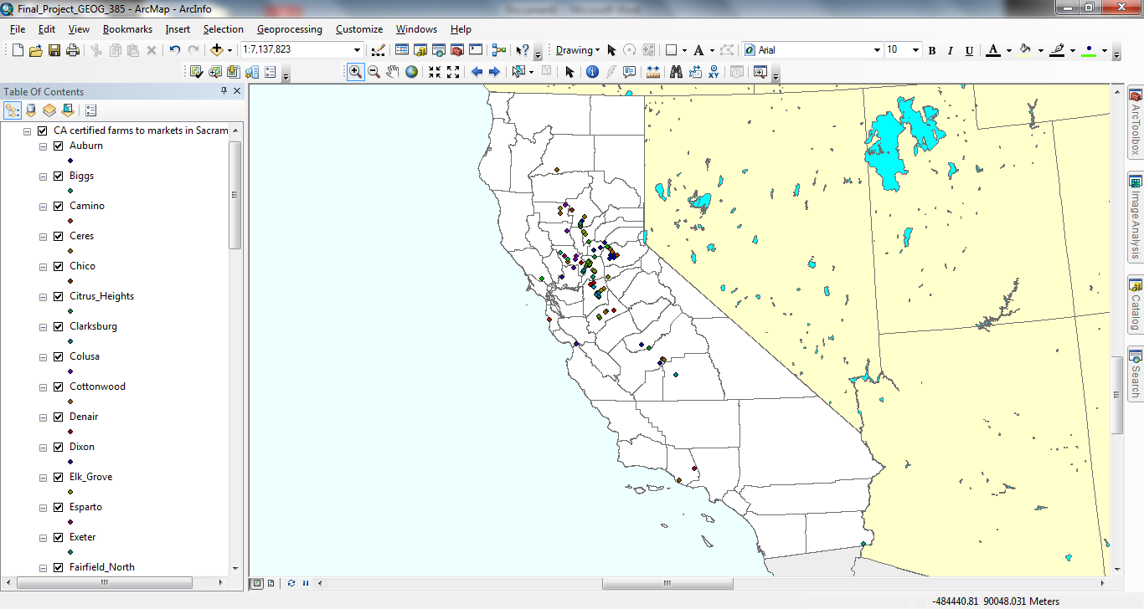
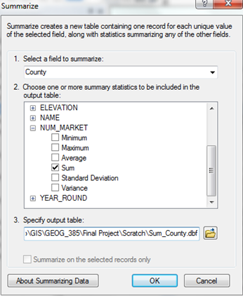
Preparing my datasets...

Slide 4
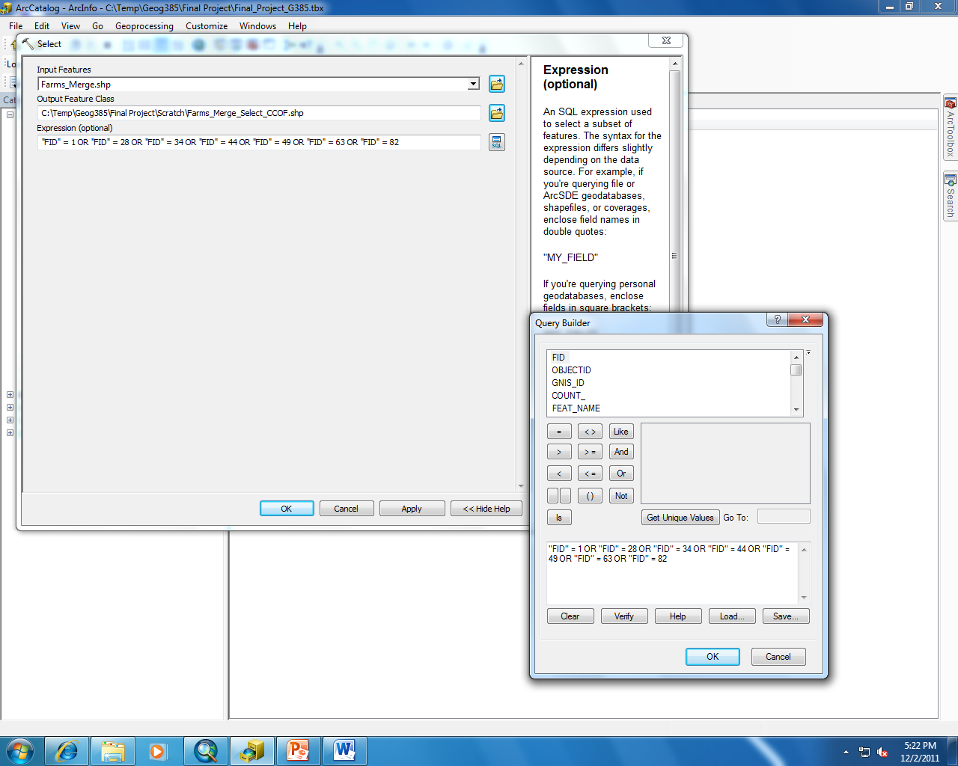
Preparing my geoprocessing tools…

Slide 5
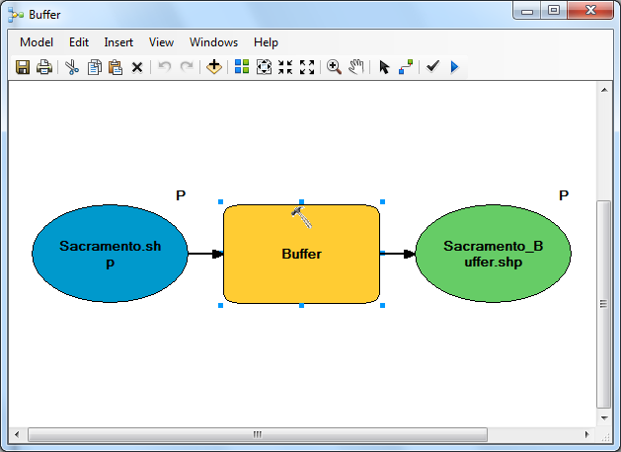
Building my tools through Model Builder.

Slide 6
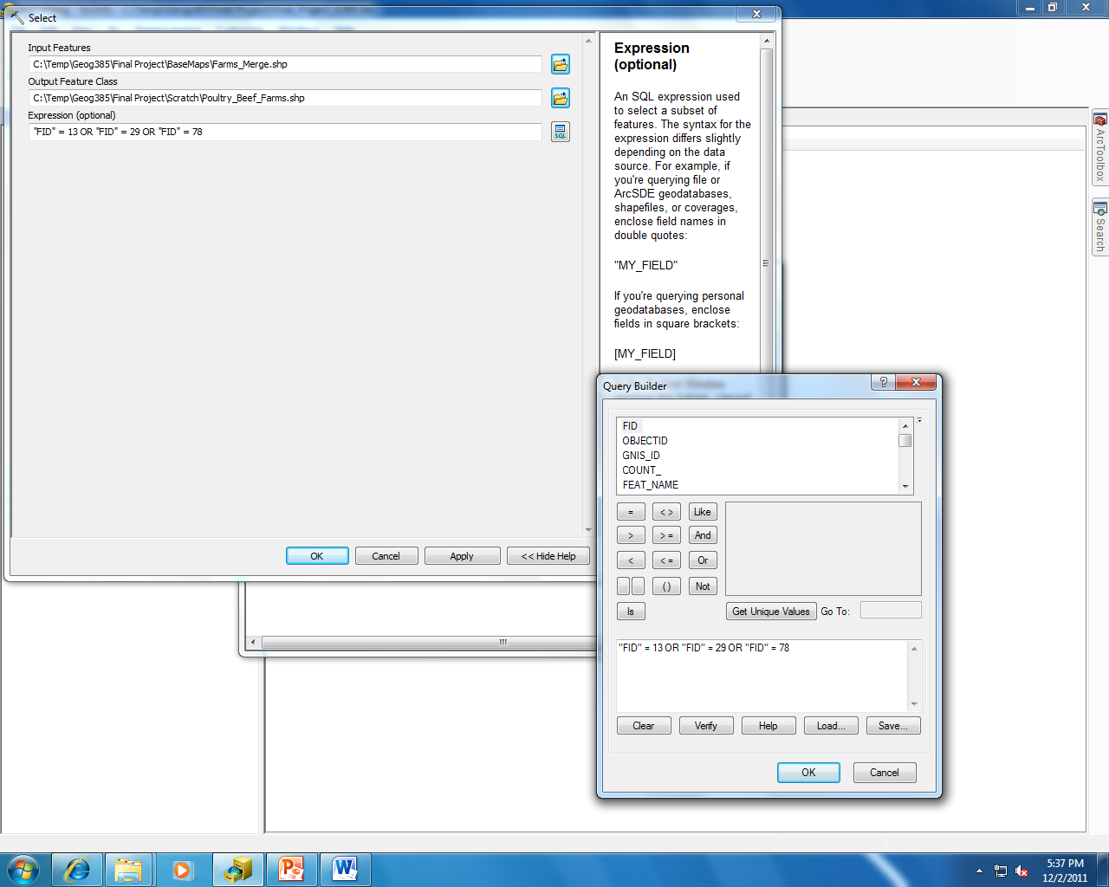
Continued…

Slide 7
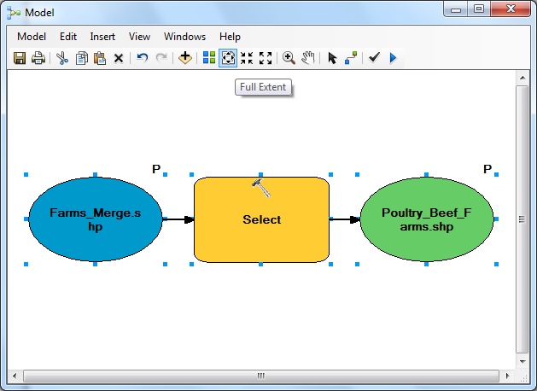
Continued…

Slide 8
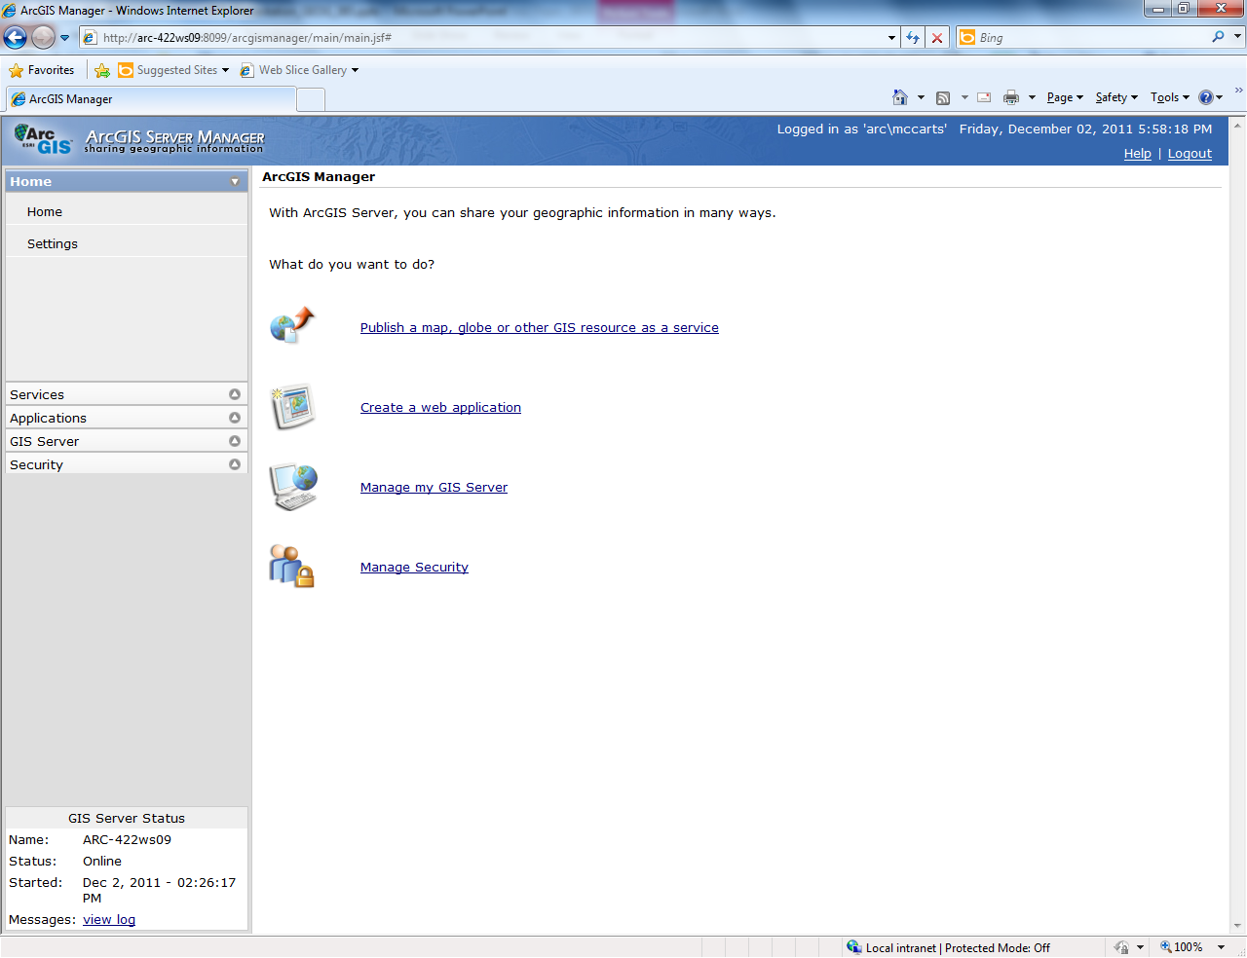
Publishing my map service.

Slide 9
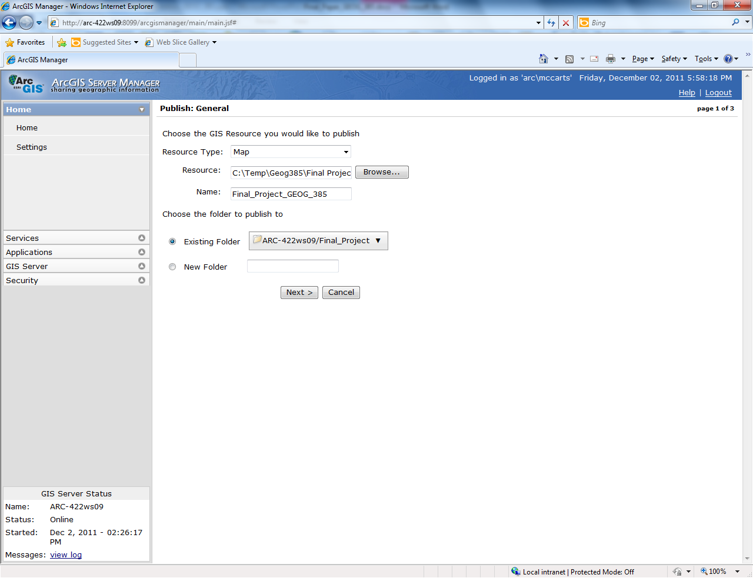

Slide 10
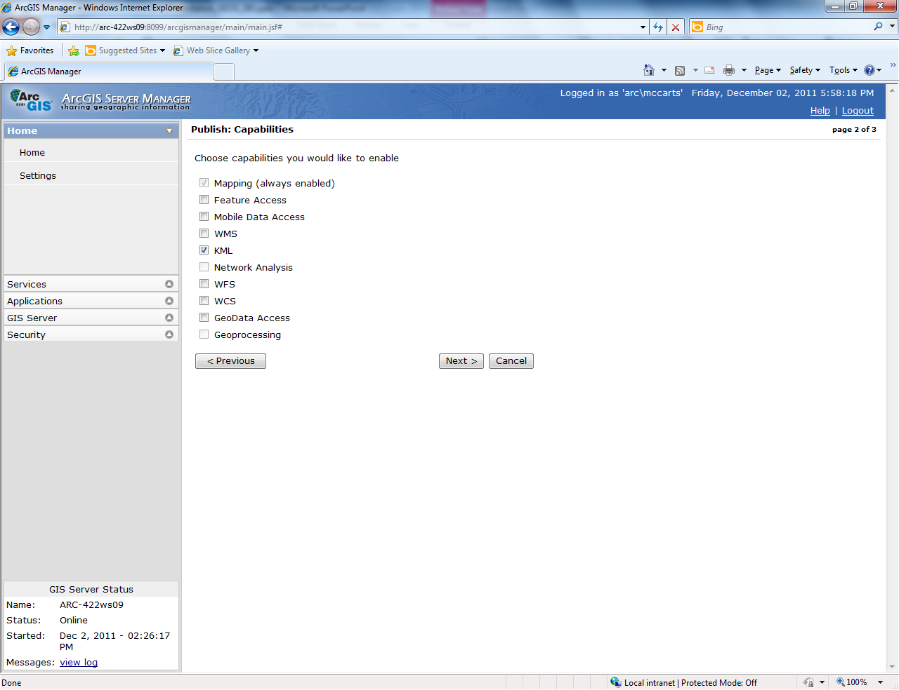

Slide 11
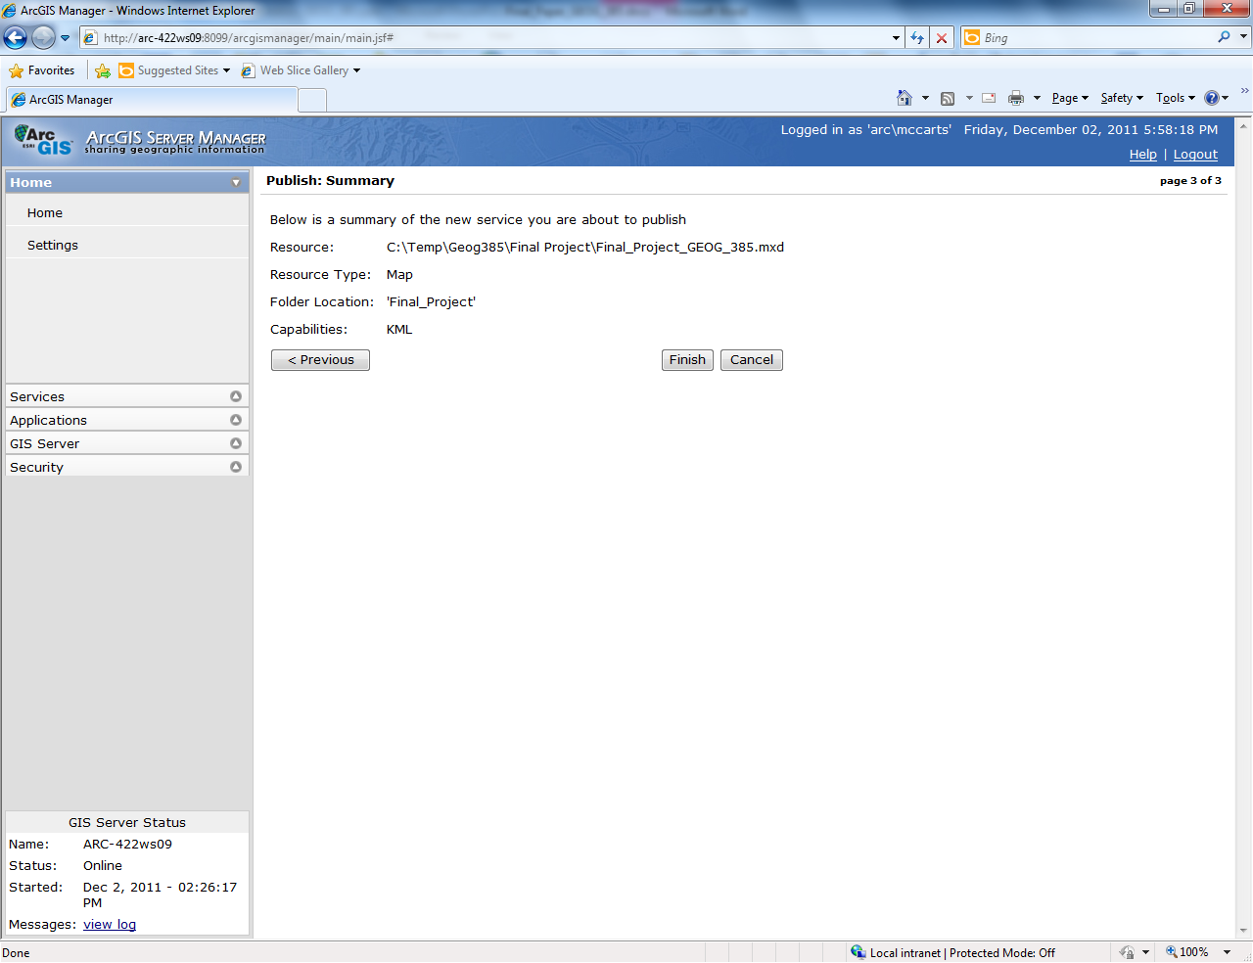

Slide 12
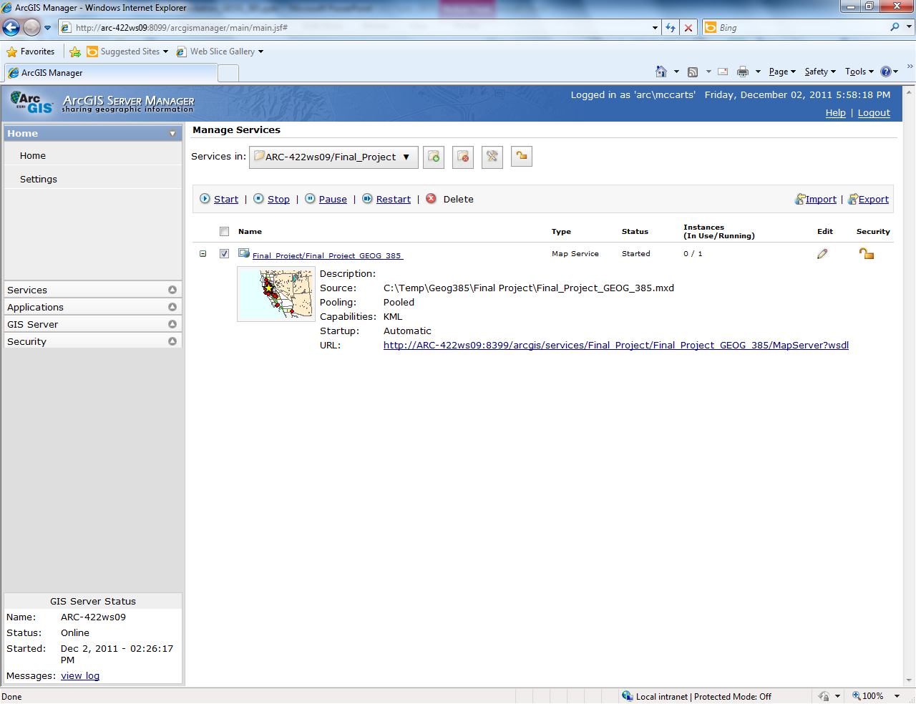

Slide 13
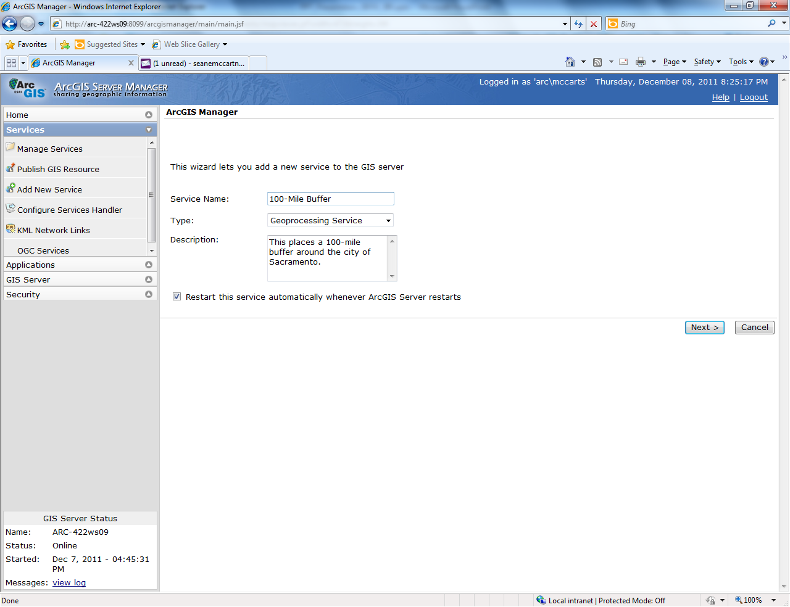
Publishing my geoprocessing services.

Slide 14
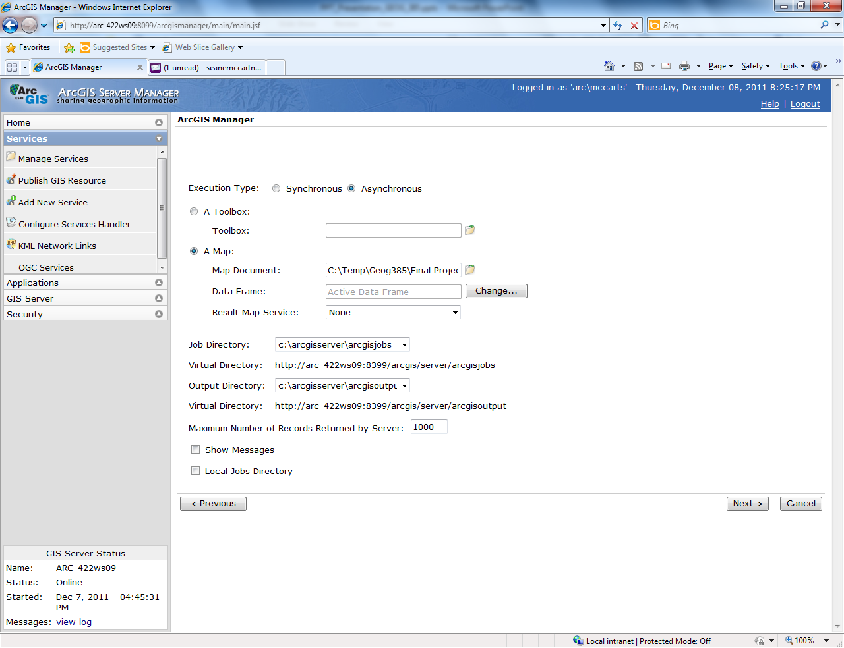

Slide 15
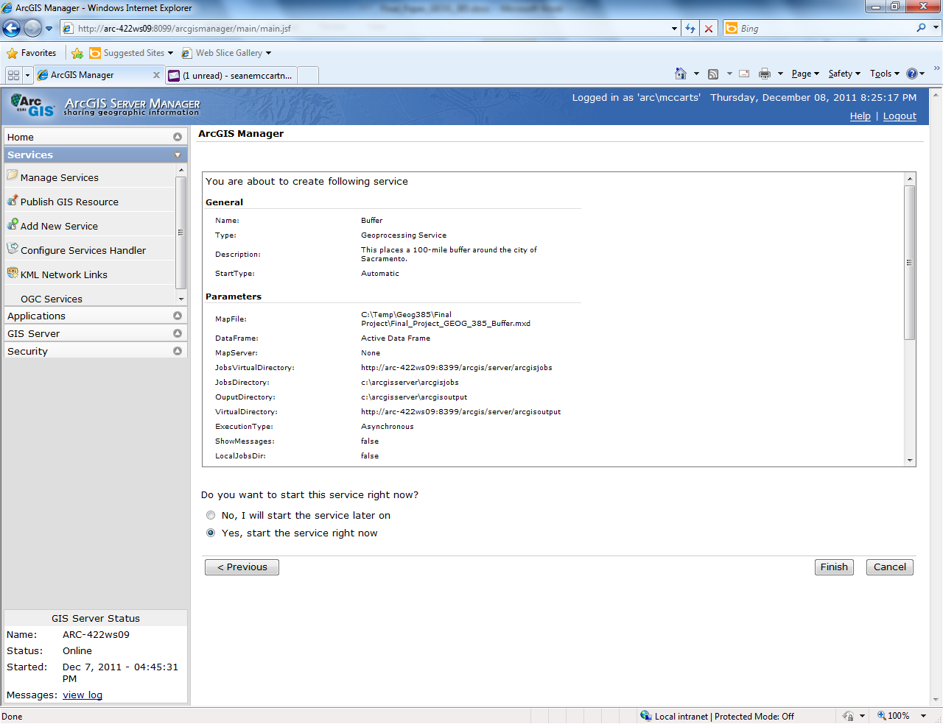

Slide 16
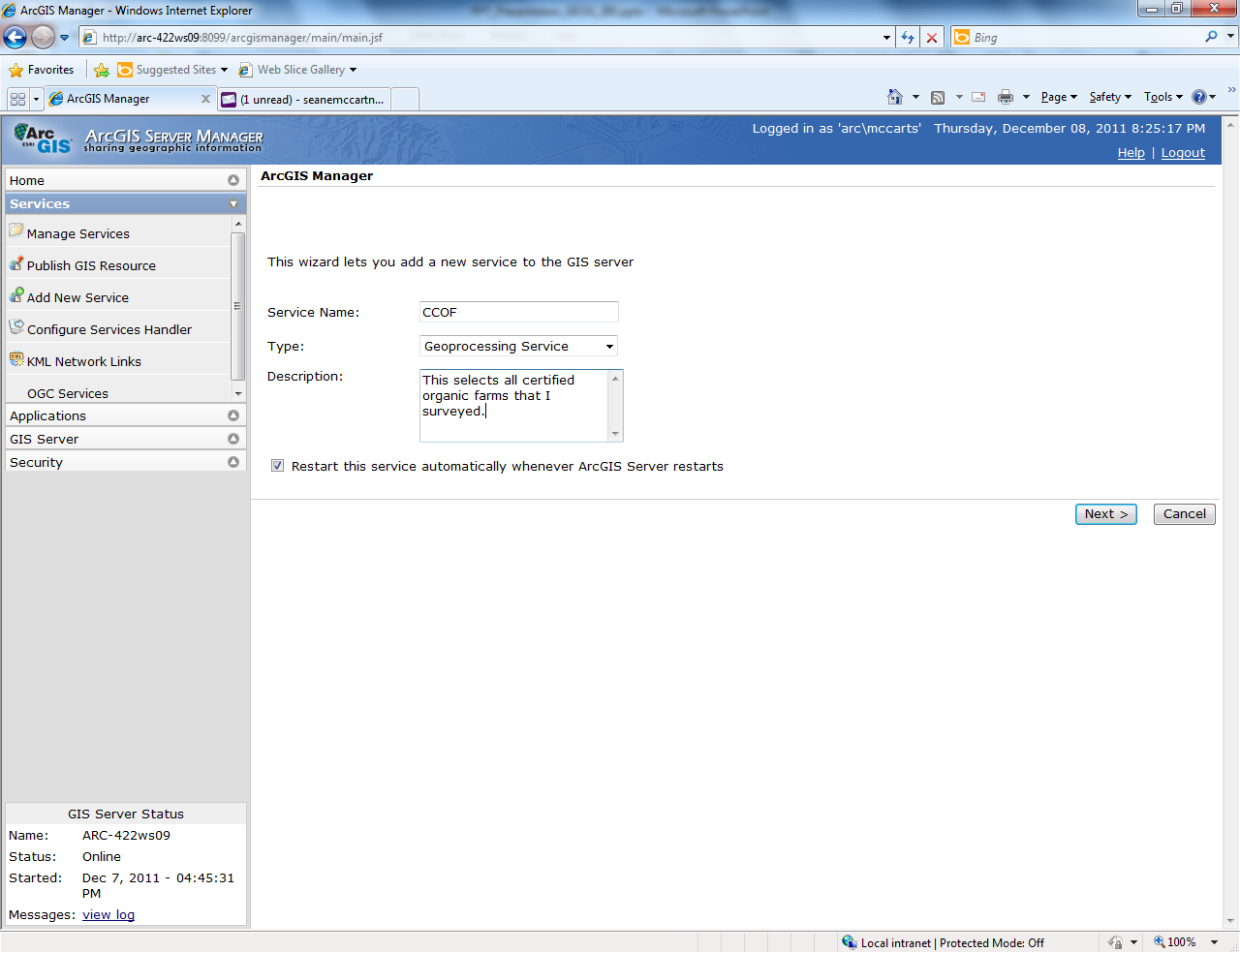

Slide 17


Slide 18
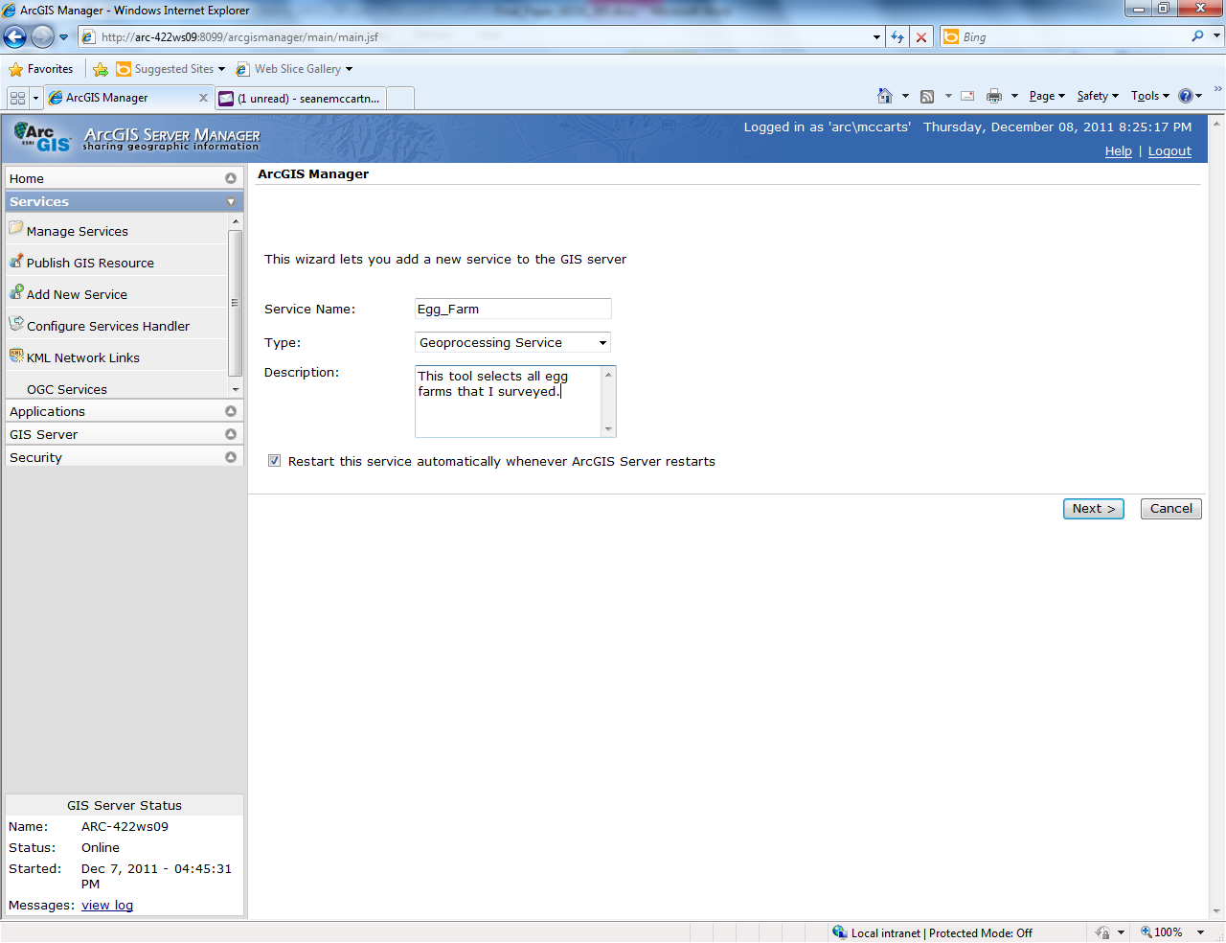

Slide 19
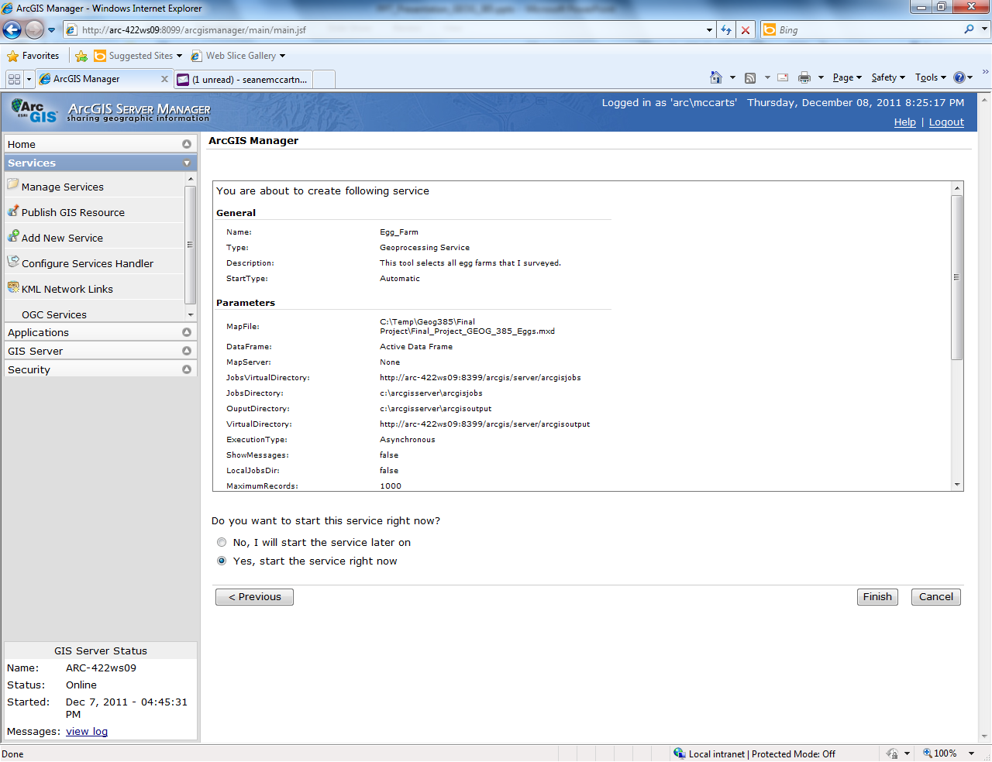

Slide 20
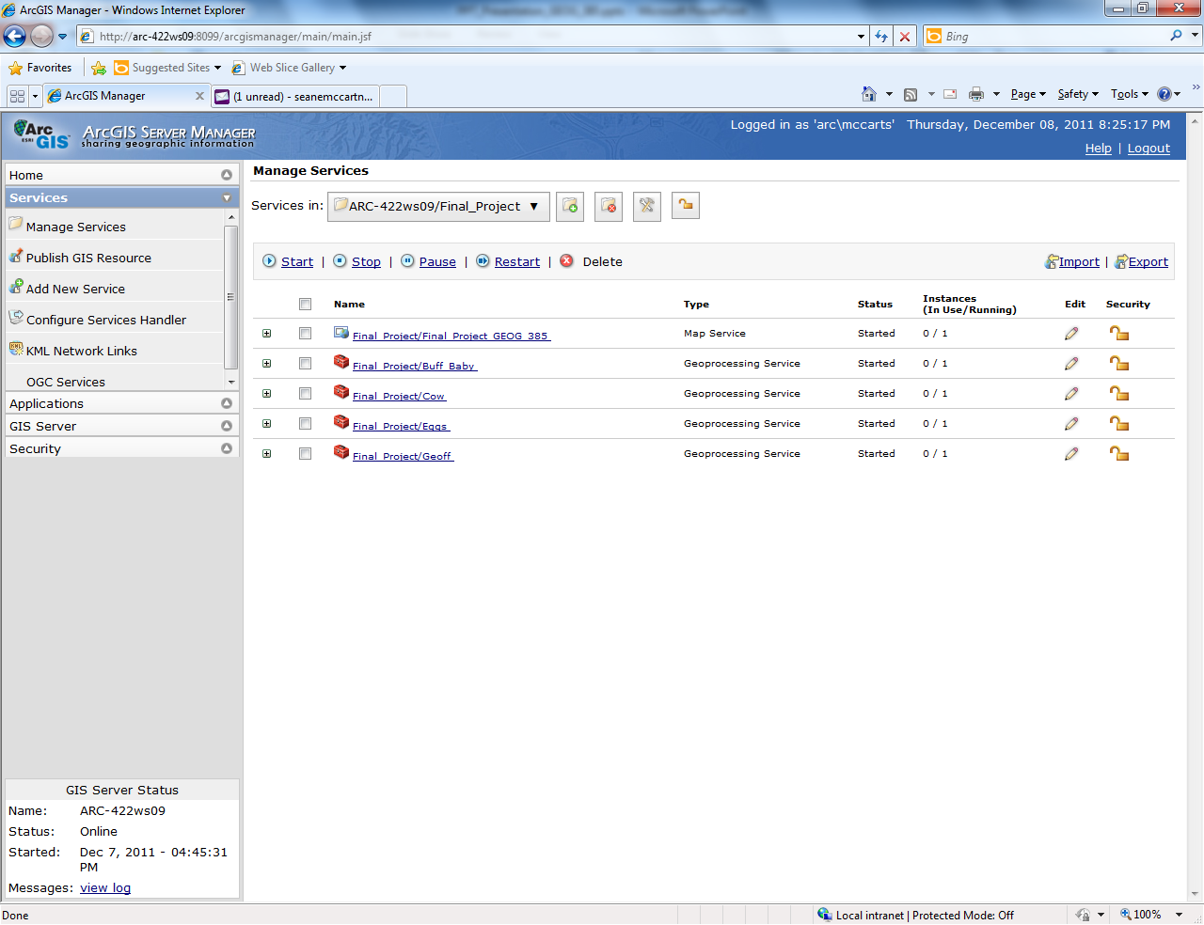
Map service published with geoprocessing services.

Slide 21
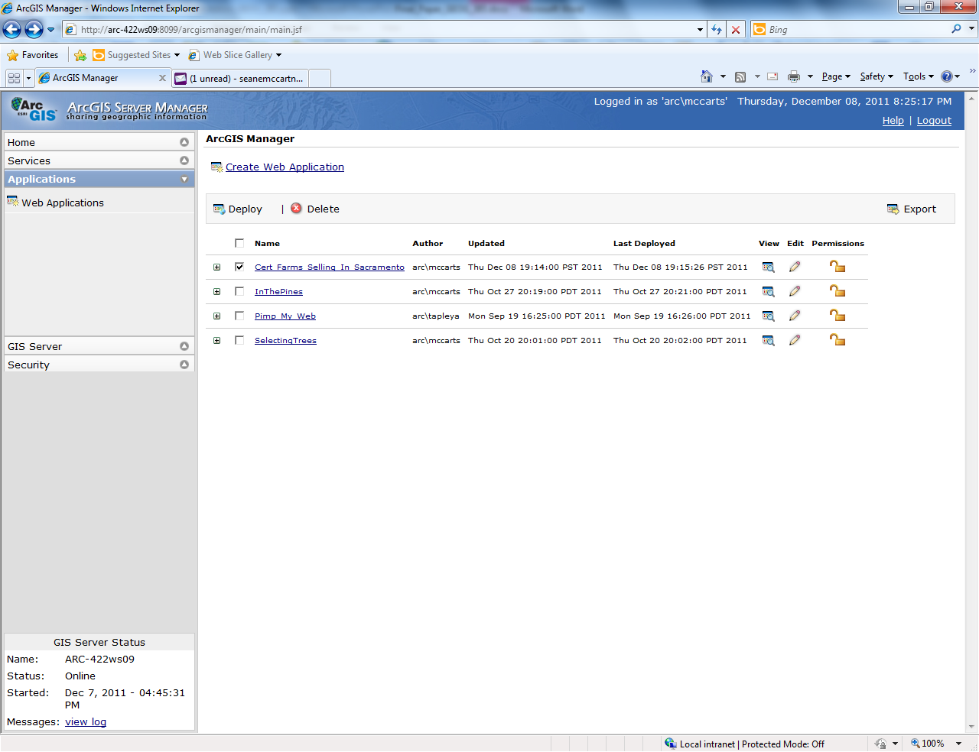
Adding tasks to the application.

Slide 22
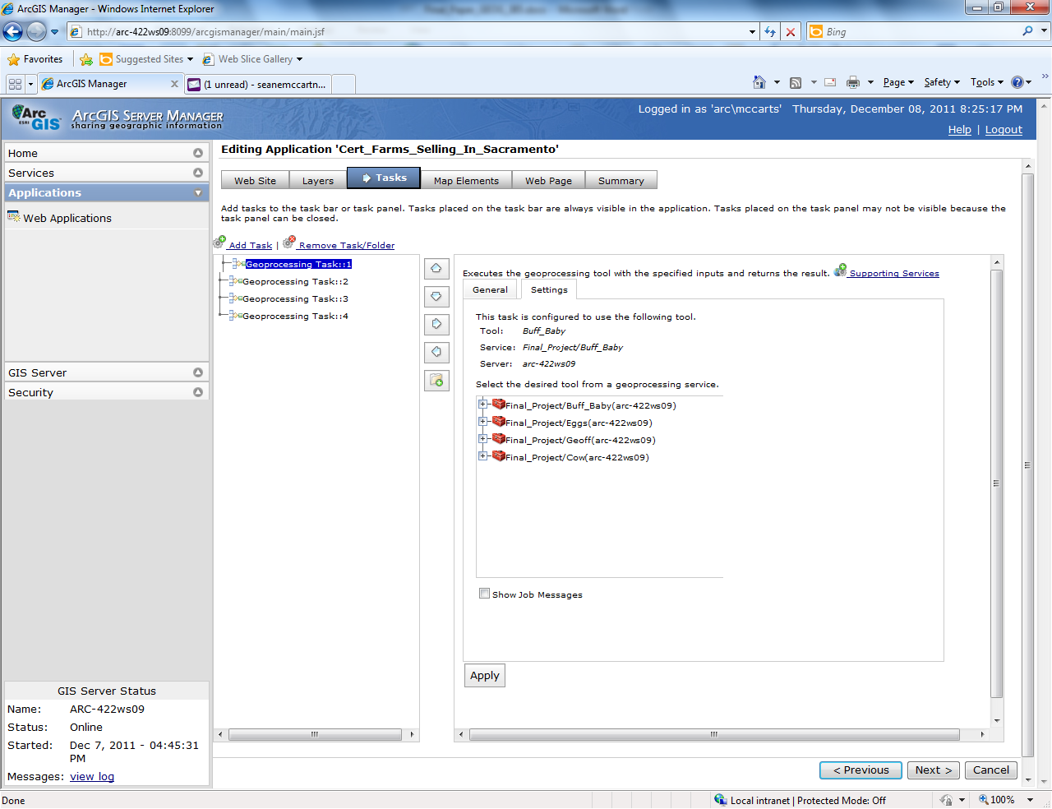
Continued…

Slide 23
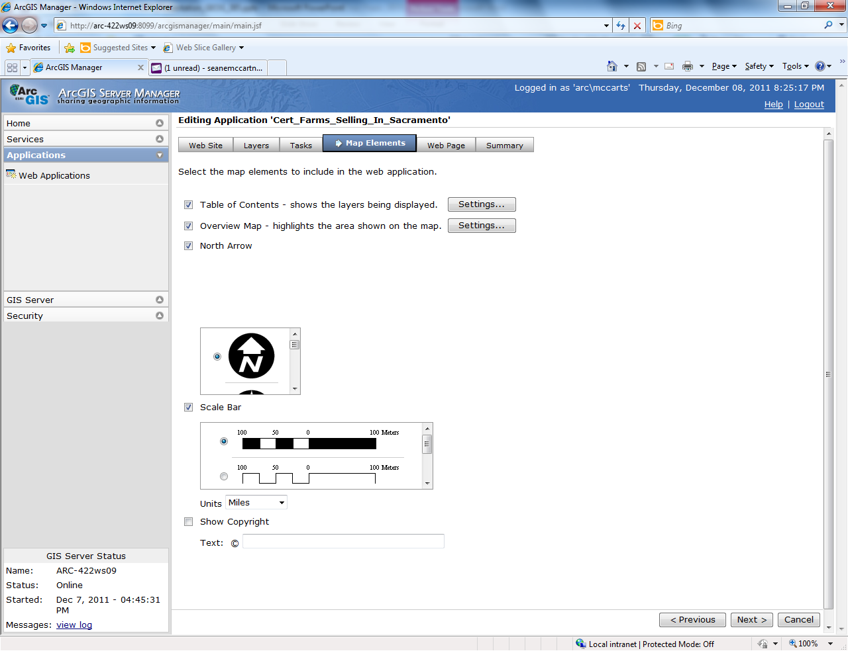
Putting the finishing touches on the application.

Slide 24
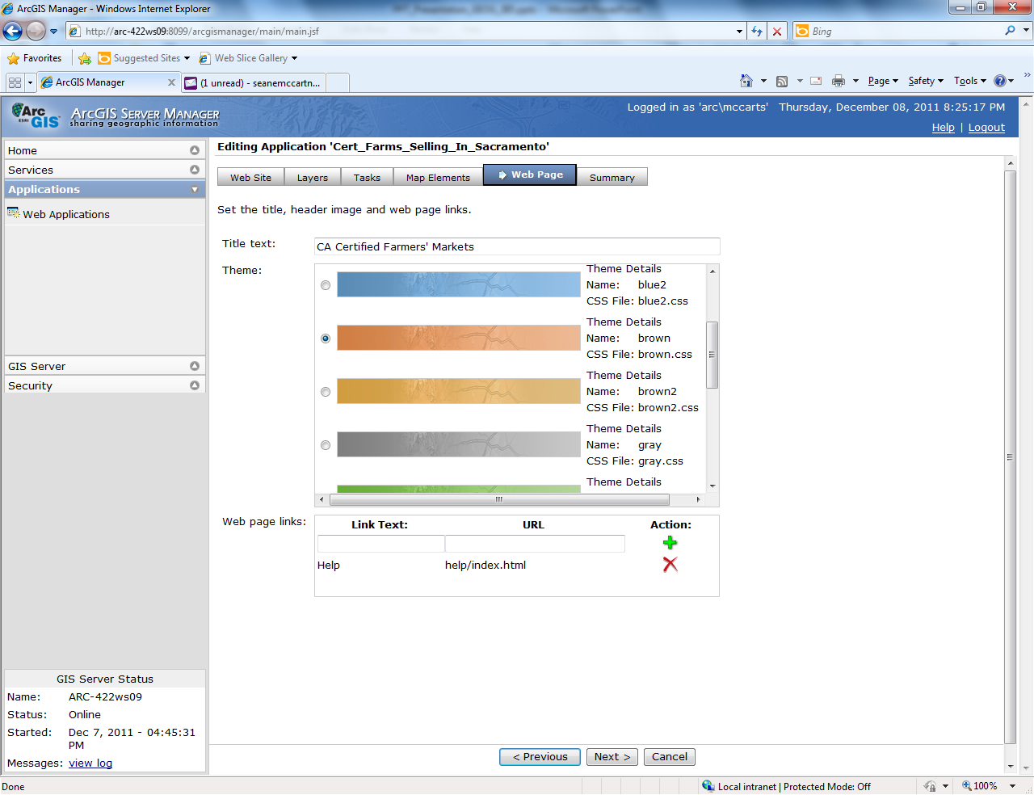
Continued…

Slide 25
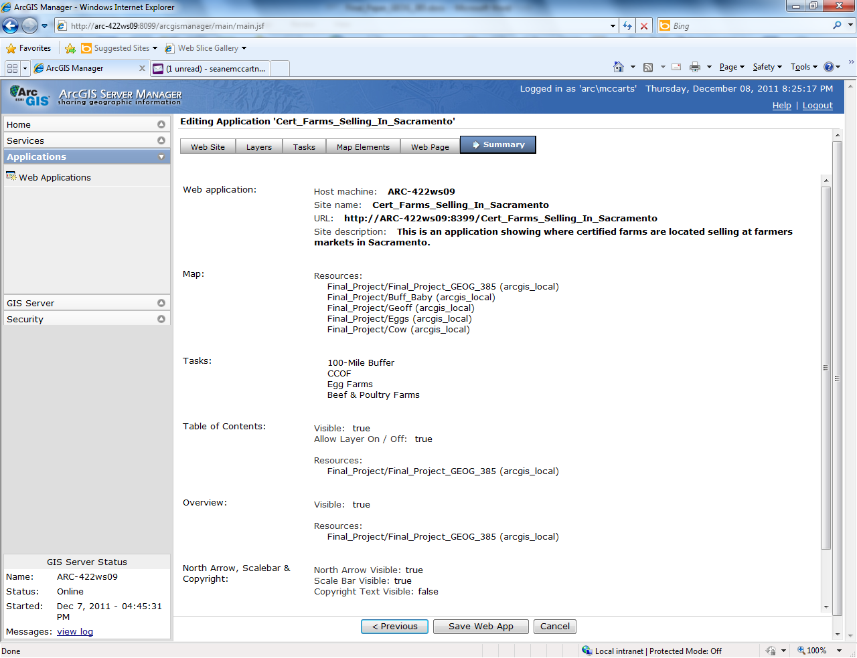
Summary of web application.

Slide 26
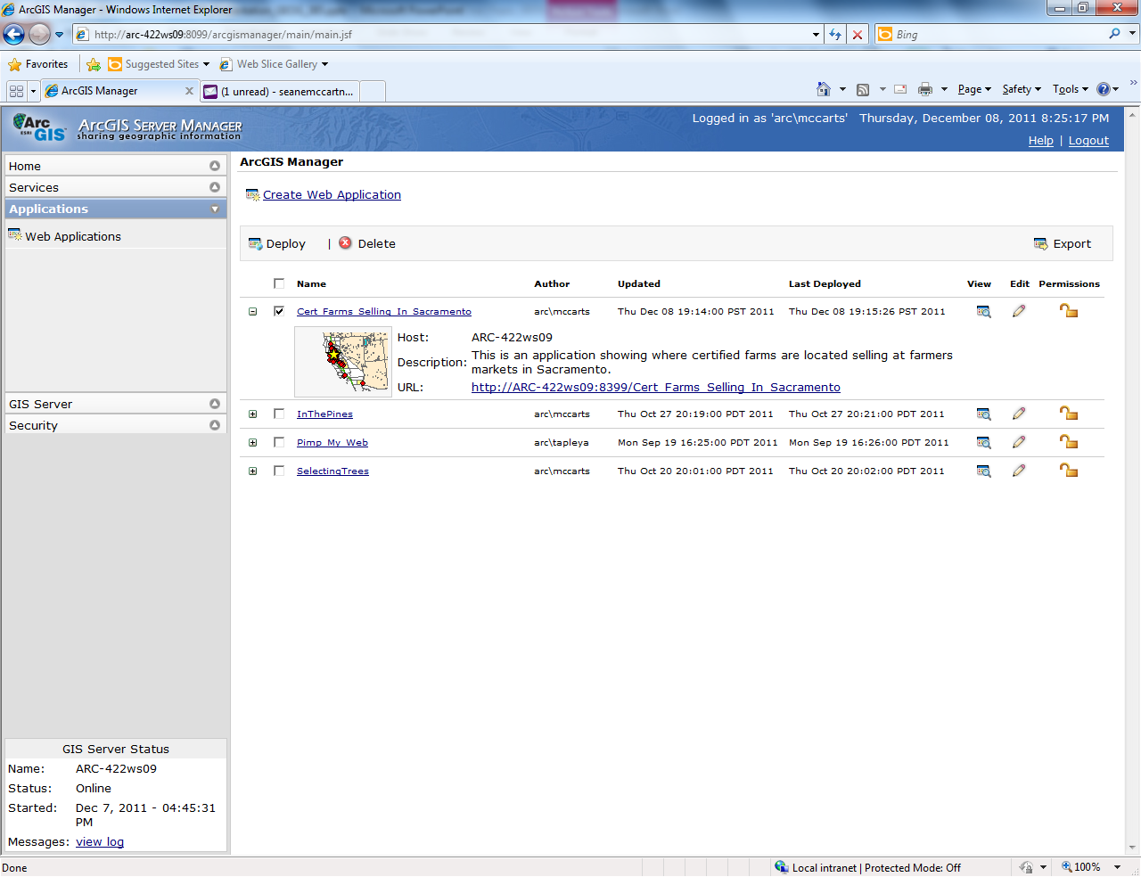
Ready to deploy the web application.

Slide 27
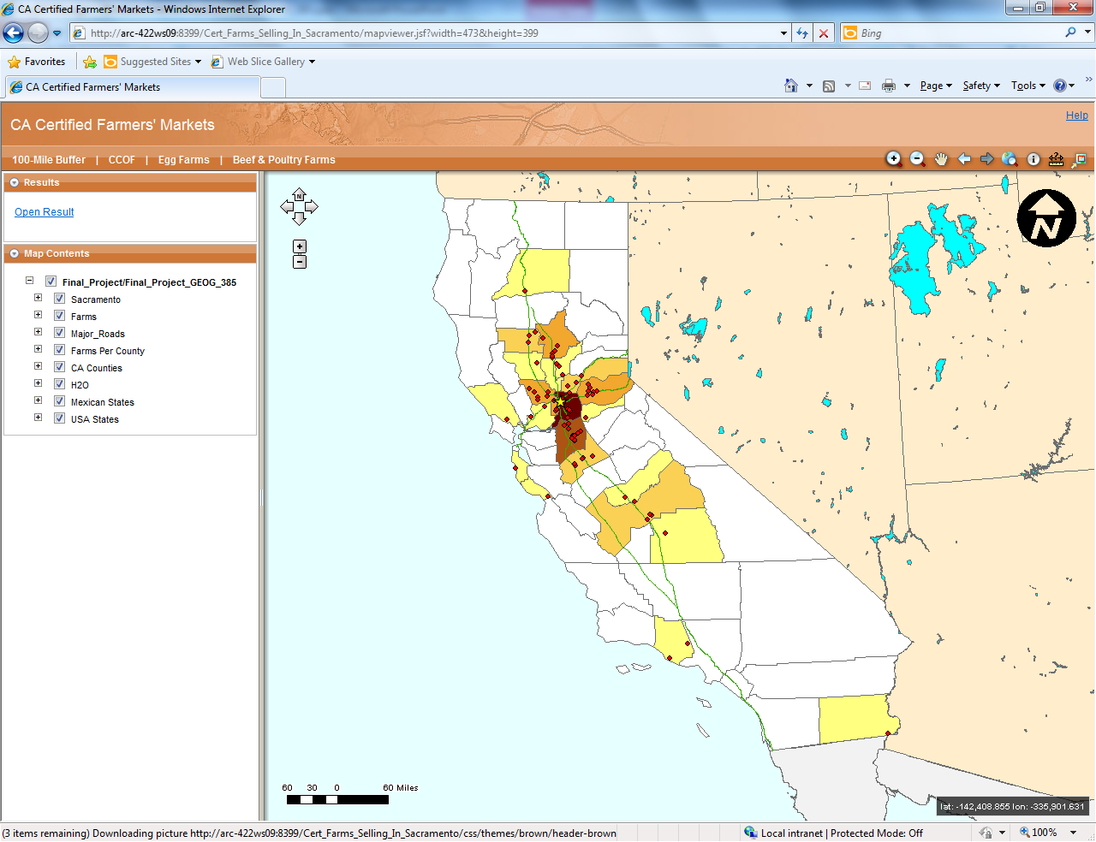
Success! A functional web application!

