Slide 1
The American River Parkway
Dawn Magnusson
Geography 385
Web-Based GIS Application Development

Slide 2
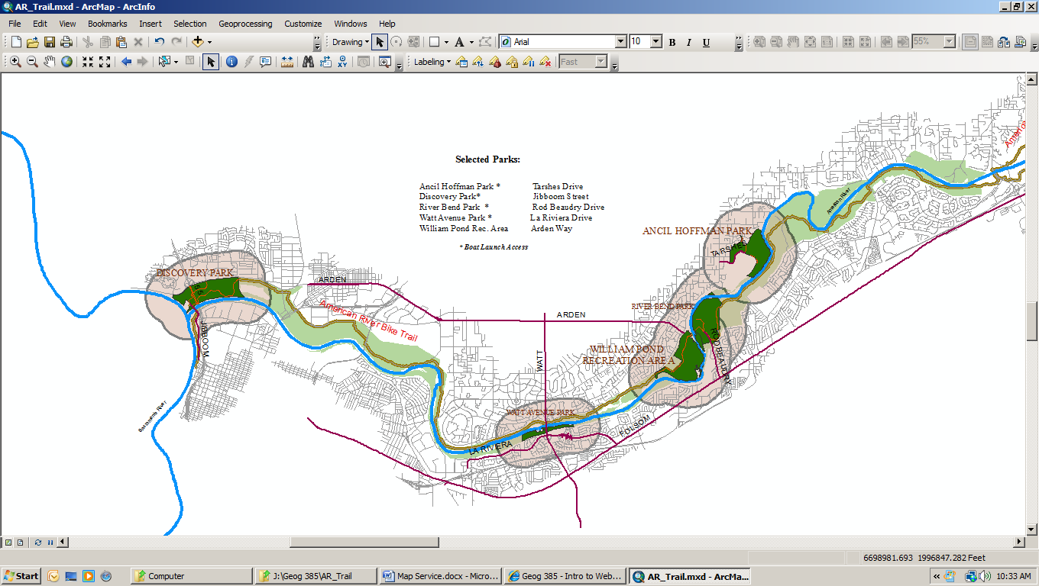
The purpose of this project was to create a site to illustrate some of the amenities of the American River Parkway, including the Bike Trail and boat launching access sites, as well as showing the location of those areas. I decided to use only 5 Selected Parks to save time, and chose parks that I am familiar with.

Slide 3
I used data from both the City and County of Sacramento. Some areas of the parks, streets and rivers I wanted to use were not included in City data. I had hoped that the American River Parkway Foundation would have their own data, but I found none. I used Select by Attribute to select the parks, the American and Sacramento Rivers, and the Parkway itself.
Then I used Select by Location to show the streets within a mile of the Parkway. I used Select by Attribute to select and highlight the streets where the parks were located.

Slide 4
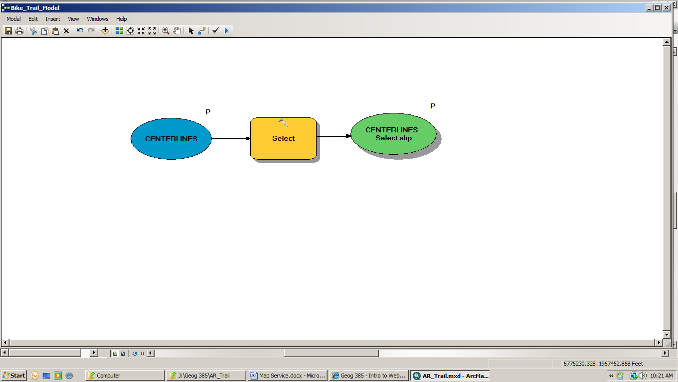
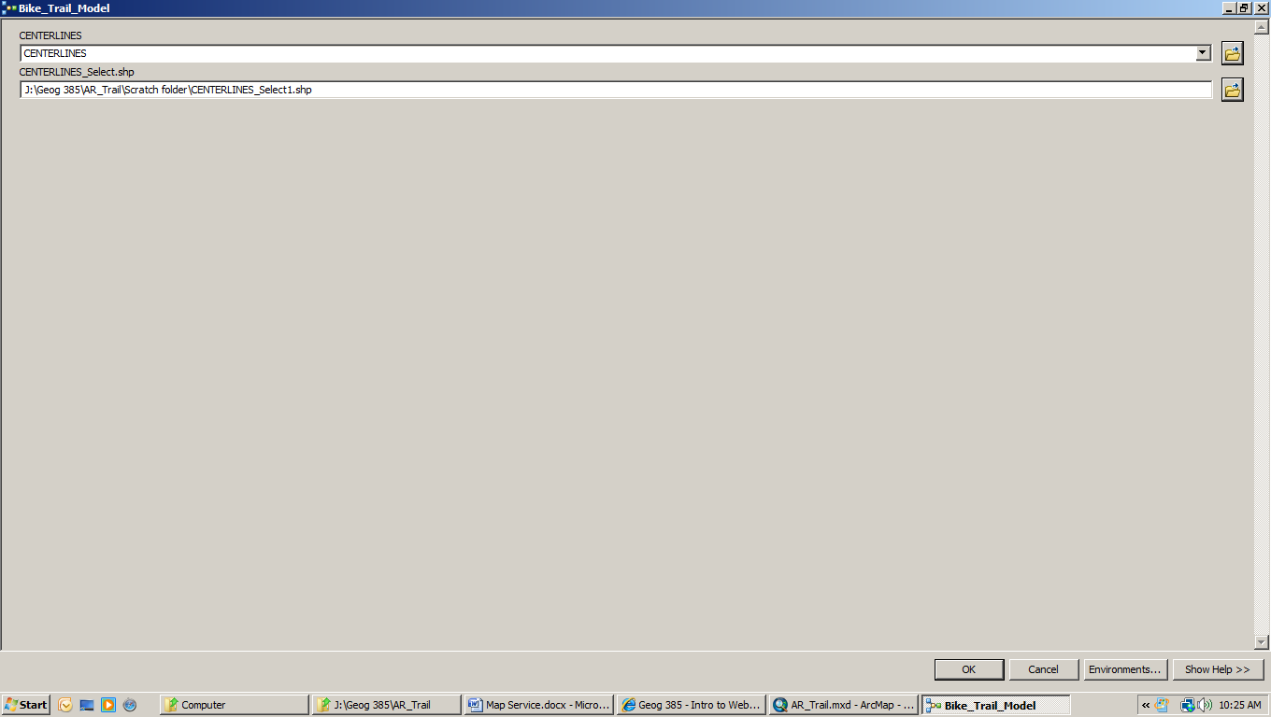
Bike Trail Model and Tool, with Parameters
I wanted to highlight the Bike Trail as one of the important amenities of the Parkway.

Slide 5
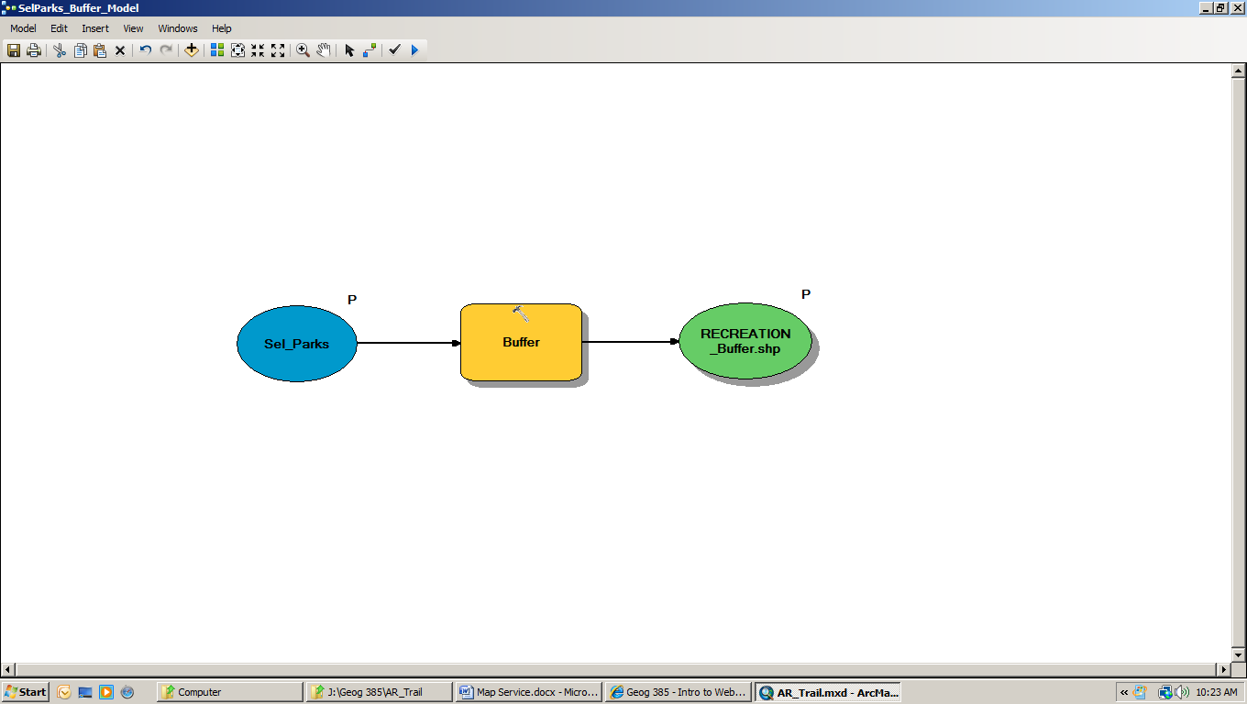
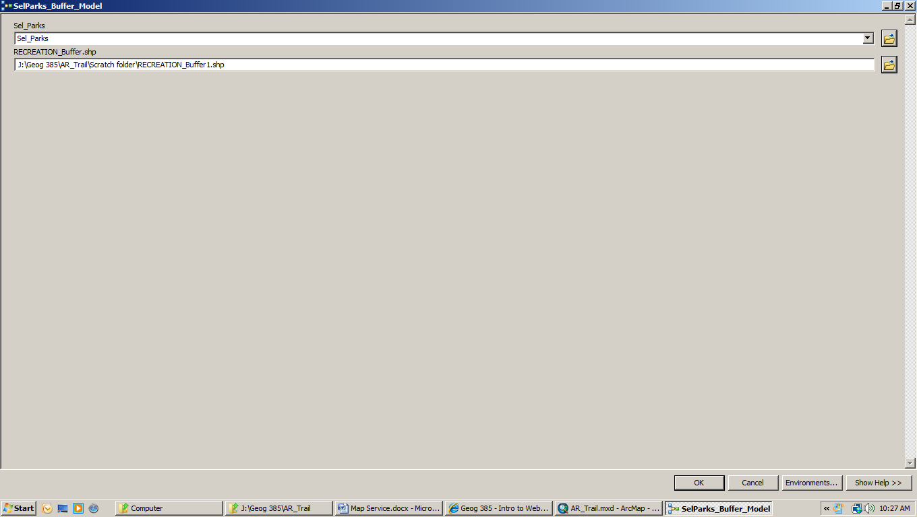
Parks Buffer
This model puts a 1000 foot buffer around the Selected Parks, to highlight the area around the parks.

Slide 6
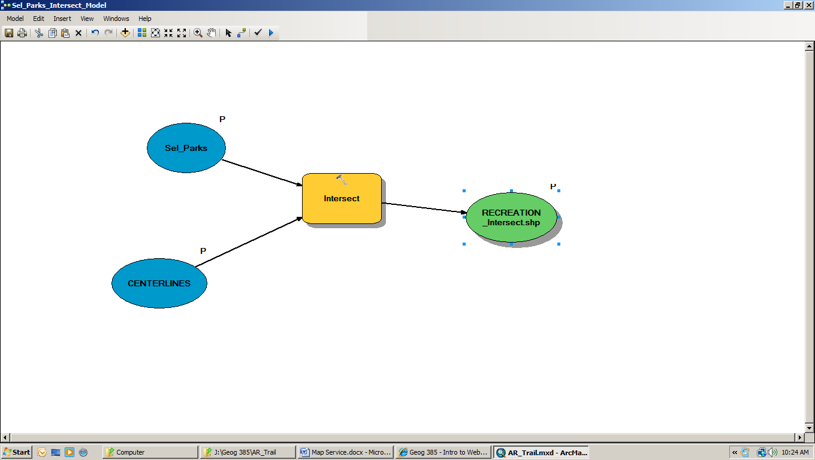
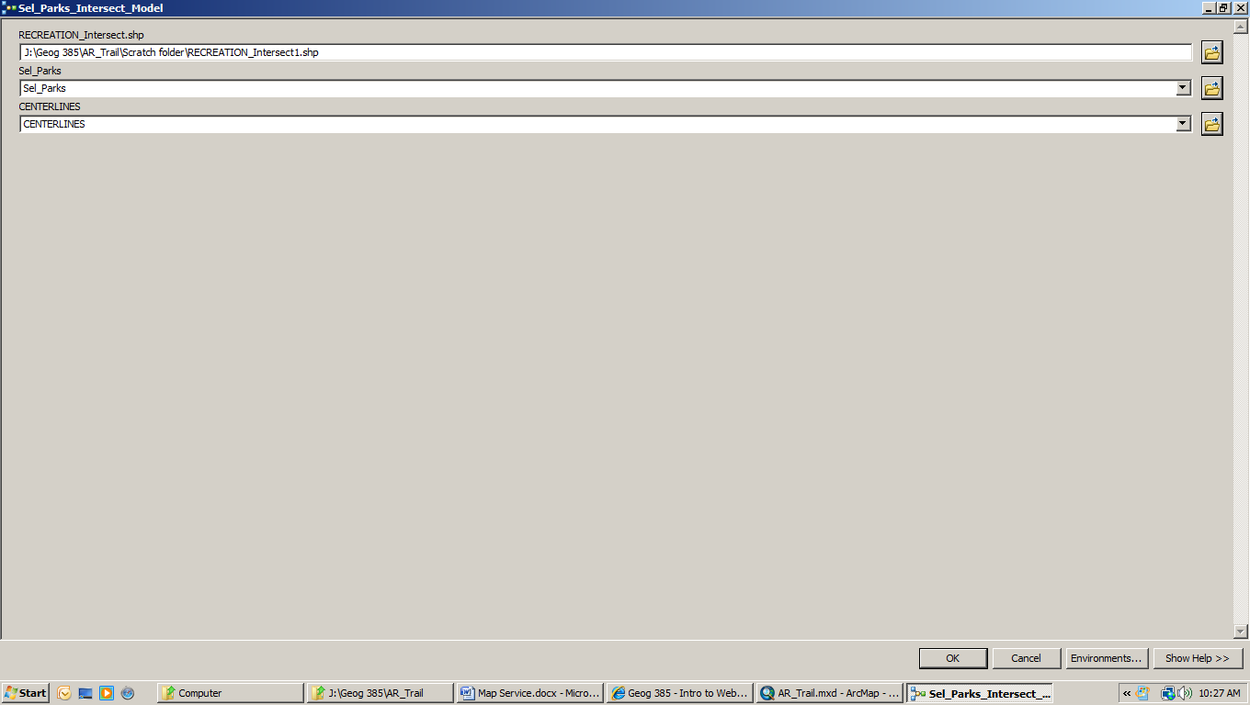
Centerline Intersects, showing streets crossing Selected Parks
This model shows streets crossing the parks, to highlight the location and access to the parks.

Slide 7
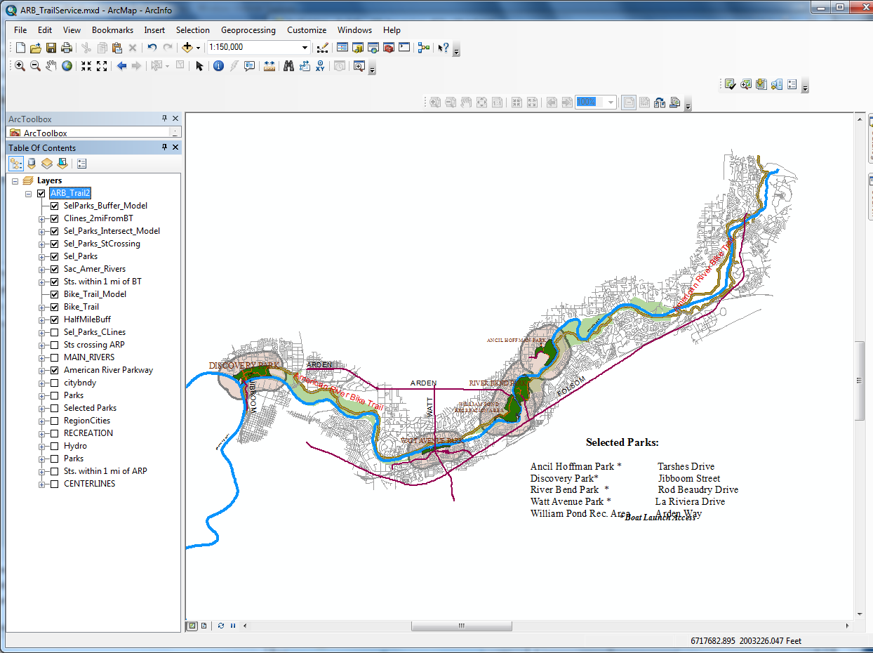
Map Service Document Resulting from the ArcMap Document, with the following Geoprocessing routines:
Bike Trail Model, (showing the Bike Trail in Brown), Parks Buffer, (showing a 1000 foot buffer around Selected Parks), and an Intersect routine, showing the streets crossing and/or leading to the Parks.

