Slide 1
Portland Breweries and Beer
Jesse King
Team Beer Sacramento
Geography 385
12/15/2011

Slide 2
Drinking beer and riding bikes are important pastimes in my life.
Being so I decided to create a map application that would allow me to map out the Breweries in the city of Portland.

Slide 3
I started out with the street and city data of the Portland area.
Went on to data mine for the breweries in the Portland area.
Created a nice map, and made a few models in model builder.

Slide 4
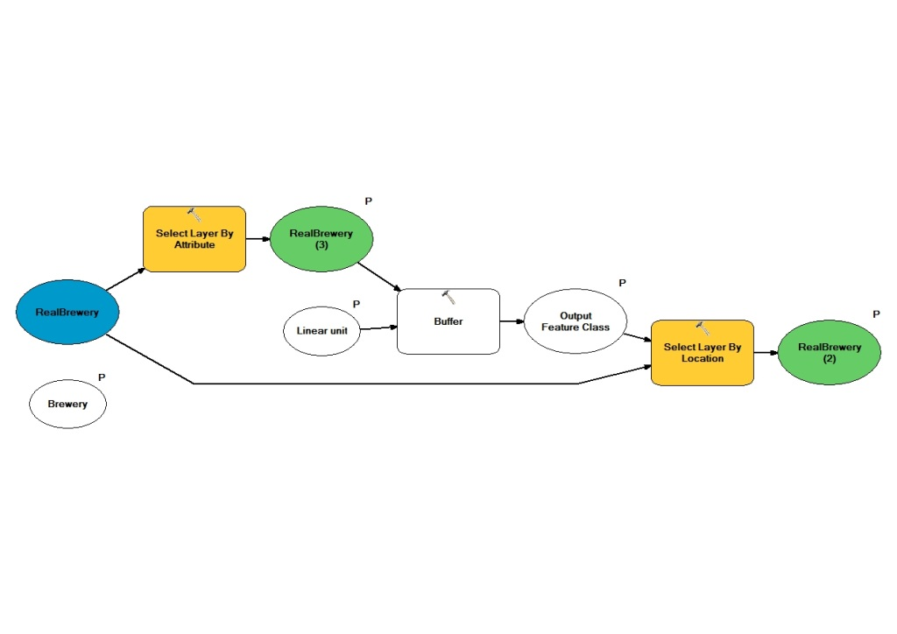
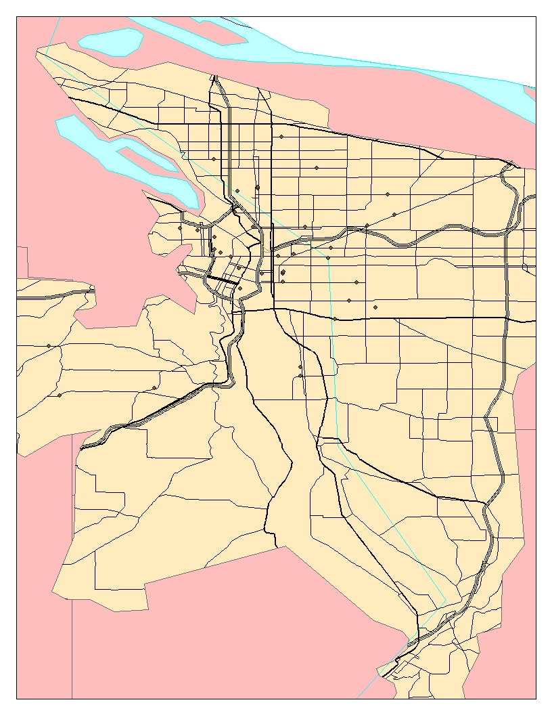
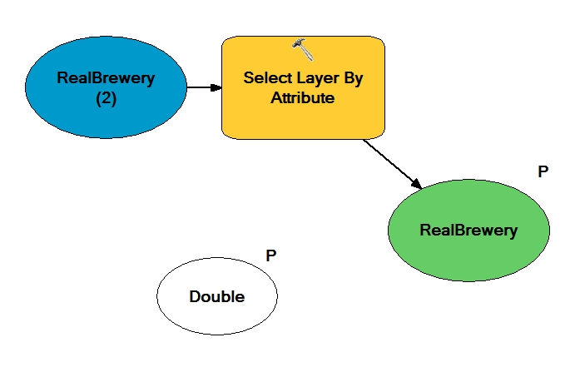

Slide 5
I then used the Arc Web Server Manager to publish both the base map as well as the tools.
Using the bare bone map as the base, I added onto it the different tools.
The select by number of beers
And the select by buffer ring.

Slide 6
Web Server Manager
Once you have the map and tools made you need to add them to the web server.
Create a map service from the bare bone map.
Use the map service to create a map Application
Once you have the web app, create geoproccessing tools with the imbedded toolboxes in the second and third map you created.

Slide 7
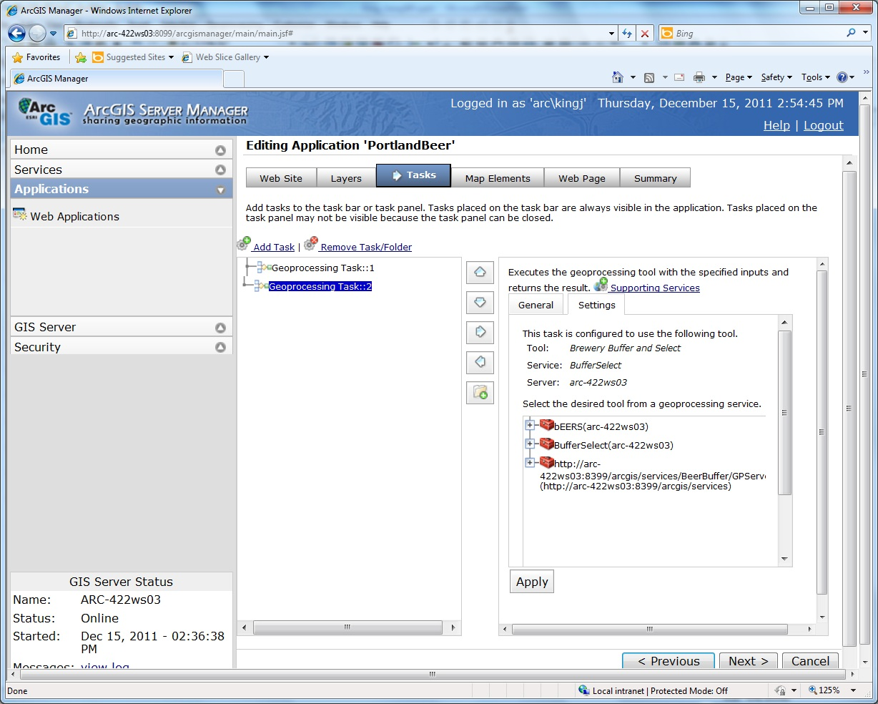
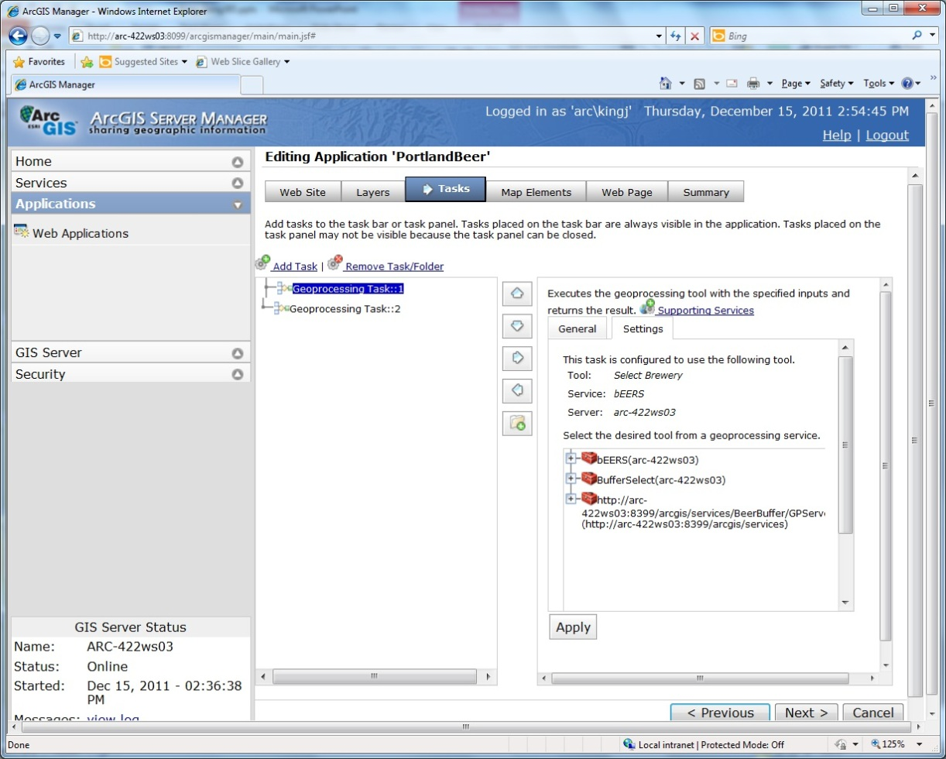

Slide 8
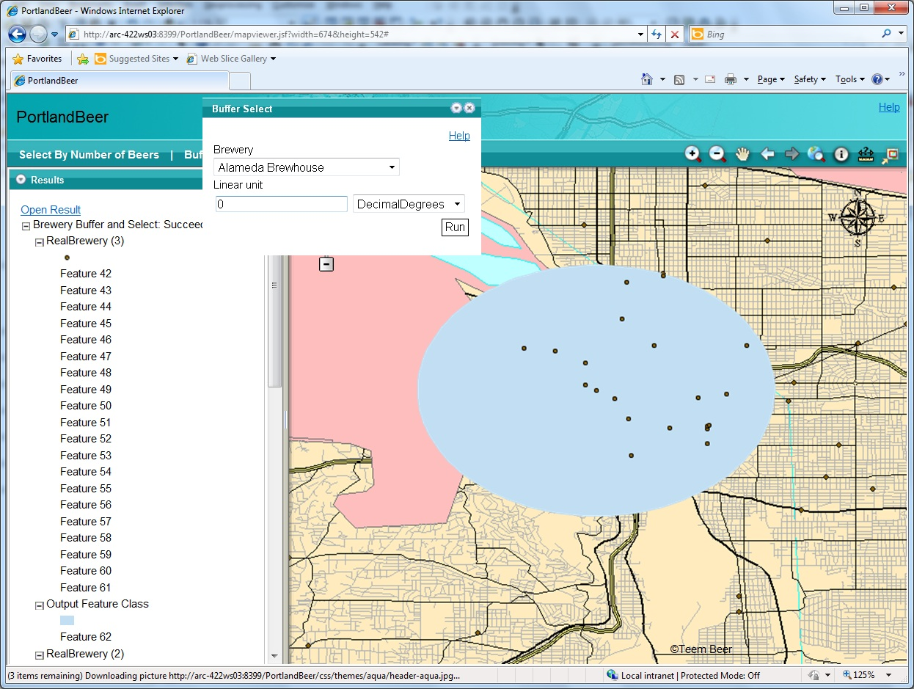
Final Outcome part 1

Slide 9
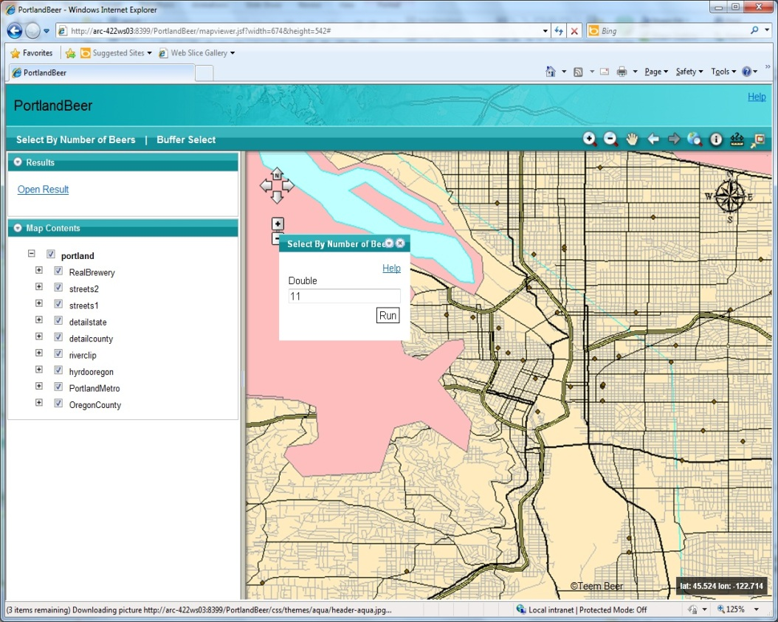
Final Outcome part 2

